Slide 1
Model-view-controller

Slide 2
Model-View-Controller
model
  represents state of the application and the rules that govern access to and updates of state
view
  presents the user with a sensory (visual, audio, haptic) representation of the model state
controller
  processes and responds to events (such as user actions) from the view and translates them to model method calls

Slide 3
Model—View—Controller
TV
- on : boolean
- channel : int
- volume : int
+ power(boolean) : void
+ channel(int) : void
+ volume(int) : void
Model
View
RemoteControl
+ togglePower() : void
+ channelUp() : void
+ volumeUp() : void
Controller

Slide 4
MVC (Notes version)
Model
controller invokes Model
methods to:
  get Model state
  modify Model state
Controller
controller invokes View
methods to:
  update the View based on
  changes in the Model
View sends events
to Controller
View

Slide 5
MVC
why adopt this design?
completely decouples the Model and the View

Slide 6
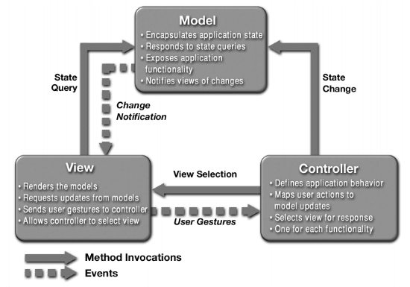
a different MVC structure than in the notes

Slide 7
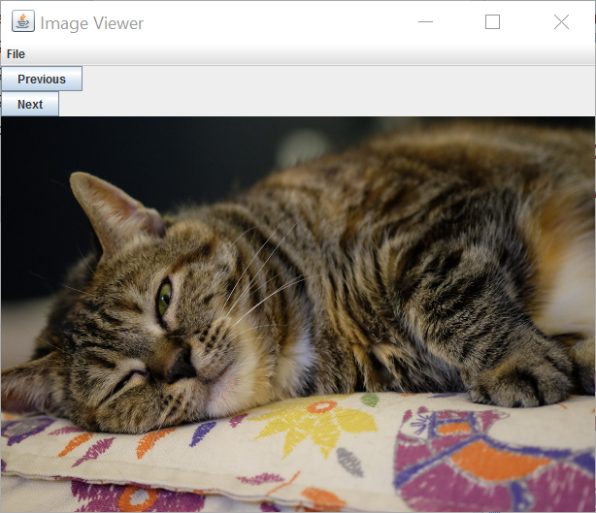
An Image Viewer using MVC
allows user to load multiple images and cycle through the images using buttons

Slide 8
Image Viewer: Model
model
  the data
  methods that get the data (accessors)
  methods that modify the data (mutators)
the data
  zero or more images
accessors
  get the current/next/previous image
mutators
  load images
  remove images

Slide 9
Image Viewer: Model
List<ImageIcon>
ViewerModel
+ getCurrentImage() : ImageIcon
+ getPreviousImage(): ImageIcon
+ getNextImage() : ImageIcon
+ clearImages()
+ openImages(File[])

Slide 10




Image Viewer: Model
this.images (list of images)
0
1
2
3
this.currentImage
(index into this.images)

Slide 11
public class ViewerModel {
private static final ImageIcon EMPTY_IMAGE = new ImageIcon();
private int currentImage;
private List<ImageIcon> images;
/**
* Creates a model having zero images.
*/
public ViewerModel() {
this.images = new ArrayList<ImageIcon>();
this.currentImage = -1;
}
index of the current image; intially set to -1
because there is no current image

Slide 12
/**
* Get the current image in the model. Returns an empty image if the model
* has no images.
*
* @return the current image if the model has one or more images, or an
* empty image otherwise
*/
public ImageIcon getCurrentImage() {
if (this.currentImage < 0) {
return EMPTY_IMAGE;
}
return this.images.get(this.currentImage);
}
worksheet problem 2(a)

Slide 13
/**
* Get the next image in the model and makes the next image the current
* image. Returns the current image if the current image is the last image
* in the model. Returns an empty image if the model has no images.
*
* @return the next image in the model
*/
public ImageIcon getNextImage() {
ImageIcon i = EMPTY_IMAGE;
if (this.currentImage >= 0) {
if (this.currentImage < this.images.size() - 1) {
this.currentImage++;
}
i = this.images.get(this.currentImage);
}
return i;
}
worksheet problem 2(b)

Slide 14
/**
* Get the previous image in the model and makes the previous image the
* current image. Returns the current image if the current image is the
* first image in the model. Returns an empty image if the model has no
* images.
*
* @return the previous image in the model
*/
public ImageIcon getPreviousImage() {
ImageIcon i = EMPTY_IMAGE;
if (this.currentImage > 0) {
this.currentImage--;
}
if (this.currentImage >= 0) {
i = this.images.get(this.currentImage);
}
return i;
}

Slide 15
/**
* Clear the images held by the model.
*/
public void clearImages() {
this.currentImage = -1;
this.images.clear();
}

Slide 16
/**
* Read an array of image files into the model. The images are added to the
* end of the sequence of images in the model. Image file formats supported
* include JPEG, PNG, and GIF.
*
* @param files
* an array of <code>File</code> references to open
*/
public void openImages(File[] files) {
List<ImageIcon> icons = new ArrayList<ImageIcon>();
for (File f : files) {
ImageIcon icon = new ImageIcon(f.getAbsolutePath());
if (icon.getImageLoadStatus() == MediaTracker.COMPLETE) {
icons.add(icon);
}
}
if (this.currentImage < 0 && icons.size() > 0) {
this.currentImage = 0;
}
this.images.addAll(icons);
}

Slide 17
Image Viewer: View
view
  a visual (or other) display of the model
  a user interface that allows a user to interact with the view
  methods that get information from the view (accessors)
  methods that modify the view (mutators)
a visual (or other) display of the model
  the current image
a user interface that allows a user to interact with the view
  next and previous buttons
  a menu to load and clear images

Slide 18

Image Viewer: View
2
JMenuItem
1
JMenuBar
1
JFrame
JMenuBar
1
2
JLabel
ViewerView
+ setImage(ImageIcon)
+ getFilesToOpen(): File[]
JButton
shows the image
allows the user to
move between images; emit an action event when pressed

Slide 19
public class ViewerView extends JFrame {
private static final long serialVersionUID =
5851493549391433289L;
private JLabel img;
private JButton next;
private JButton prev;
private JFileChooser fc;
does not implement ActionListener
(although it could) because the controller
will listen for events and respond
accordingly

Slide 20
public class ViewerView extends JFrame {
private JLabel img;
private JButton next;
private JButton prev;
private JFileChooser fc;
label displays the image
button for next image
button for previous image
a file chooser to allow the user to choose
the images to show

Slide 21
/**
* String for the action command for opening files.
*/
public static final String OPEN = "OPEN";
/**
* String for the action command for clearing all of the images.
*/
public static final String CLEAR = "CLEAR";
/**
* String for the action command for showing the previous image.
*/
public static final String PREVIOUS = "PREVIOUS";
/**
* String for the action command for showing the next image.
*/
public static final String NEXT = "NEXT";

Slide 22
public ViewerView(ActionListener listener) {
// 1. Create the frame
super("Image Viewer");
// 2. Choose what happens when the frame closes
this.setDefaultCloseOperation(JFrame.EXIT_ON_CLOSE);
// 3. Create components and put them in the frame
this.makeLabel();
this.makeFileChooser();
this.makeMenu(listener);
this.makeButtons(listener);
this.add(this.prev);
this.add(this.next);
this.add(this.img);
// 4. Size the frame
this.setMinimumSize(new Dimension(600, 400));
this.pack();
this.setLayout(new BoxLayout(this.getContentPane(), BoxLayout.Y_AXIS));
// 5. Show the view
// we'll let ViewerApp do this
}
the controller will be the
listener for events

Slide 23
private void makeMenu(ActionListener listener) {
JMenuBar menuBar = new JMenuBar();
JMenu fileMenu = new JMenu("File");
menuBar.add(fileMenu);
JMenuItem openMenuItem = new JMenuItem("Open...");
openMenuItem.setActionCommand(ViewerView.OPEN);
openMenuItem.addActionListener(listener);
fileMenu.add(openMenuItem);
JMenuItem clear = new JMenuItem("Clear");
clear.setActionCommand(ViewerView.CLEAR);
clear.addActionListener(listener);
fileMenu.add(clear);
this.setJMenuBar(menuBar);
}
the controller will be the
listener

Slide 24
private void makeButtons(ActionListener listener) {
this.prev = new JButton("Previous");
this.prev.setActionCommand(ViewerView.PREVIOUS);
this.prev.addActionListener(listener);
this.next = new JButton("Next");
this.next.setActionCommand(ViewerView.NEXT);
this.next.addActionListener(listener);
}
the controller will be the
listener

Slide 25
/**
* Sets the image shown by the view to the specified image.
*
* @param icon
* an image to show in the view
*/
public void setImage(ImageIcon icon) {
if (this.img.getIcon() != icon) {
this.img.setIcon(icon);
this.pack();
}
}
change the image only if the
image to show is a different
ImageIcon object than what
is currently in the label

Slide 26
Not a UML Diagram
"OPEN"
event object "OPEN"
"CLEAR"
"PREVIOUS"
ViewerController
"NEXT"
event object "NEXT"
implements
ActionListener
AbstractButton
ActionEvent

Slide 27
Controller
controller
  processes and responds to events (such as user actions) from the view and translates them to model method calls
needs to interact with both the view and the model but does not own the view or model
  aggregation
JFrame
View is a
subclass
of JFrame
1
1
View
Controller
Model
Controller has
1 View
Controller has
1 Model

Slide 28
Image Viewer Controller
recall that our application only uses events that are fired by buttons (Jbuttons and JMenuItems)
  a button fires an ActionEvent event whenever it is clicked
ViewerController listens for fired ActionEvents
  how? by implementing the ActionListener interface
  public interface ActionListener
  {
  void actionPerformed(ActionEvent e);
  }

Slide 29
ViewerController was registered to listen for ActionEvents fired by the various buttons in ViwerView
whenever a button fires an event, it passes an ActionEvent object to ViewerController via the actionPerformed method
  actionPerformed is responsible for dealing with the different actions (open, save, sum, etc)

Slide 30
User Presses Next Button
ViewerView
ViewerController
1
actionPerformed
Next
ViewerModel
2
getNextImage
setImage
3

Slide 31
public class ViewerController implements ActionListener {
private ViewerModel model;
private ViewerView view;
/**
* Creates a controller having no model and no view.
*/
public ViewerController() {
}

Slide 32
/**
* Sets the model for the controller.
*
* @param model
* the viewer model the controller should use
*/
public void setModel(ViewerModel model) {
this.model = model;
}
/**
* Sets the view for the controller.
*
* @param view
* the view the controller should use
*/
public void setView(ViewerView view) {
this.view = view;
}

Slide 33
/**
* The method that responds to events emitted by the view components.
*
* @param event
* an event emitted by the view
*
*/
@Override
public void actionPerformed(ActionEvent event) {
}

Slide 34
@Override
public void actionPerformed(ActionEvent event) {
String action = event.getActionCommand();
if (action.equals(ViewerView.OPEN)) {
File[] files = this.view.getFilesToOpen();
this.model.openImages(files);
ImageIcon icon = this.model.getCurrentImage();
this.view.setImage(icon);
} else if (action.equals(ViewerView.CLEAR)) {
this.model.clearImages();
ImageIcon icon = this.model.getCurrentImage();
this.view.setImage(icon);
} else if (action.equals(ViewerView.PREVIOUS)) {
ImageIcon icon = this.model.getPreviousImage();
this.view.setImage(icon);
} else if (action.equals(ViewerView.NEXT)) {
ImageIcon icon = this.model.getNextImage();
this.view.setImage(icon);
}
}

Slide 35
@Override
public void actionPerformed(ActionEvent event) {
String action = event.getActionCommand();
if (action.equals(ViewerView.OPEN)) {
File[] files = this.view.getFilesToOpen();
this.model.openImages(files);
ImageIcon icon = this.model.getCurrentImage();
this.view.setImage(icon);
} else if (action.equals(ViewerView.CLEAR)) {
this.model.clearImages();
ImageIcon icon = this.model.getCurrentImage();
this.view.setImage(icon);
} else if (action.equals(ViewerView.PREVIOUS)) {
ImageIcon icon = this.model.getPreviousImage();
this.view.setImage(icon);
} else if (action.equals(ViewerView.NEXT)) {
ImageIcon icon = this.model.getNextImage();
this.view.setImage(icon);
}
}

Slide 36
@Override
public void actionPerformed(ActionEvent event) {
String action = event.getActionCommand();
if (action.equals(ViewerView.OPEN)) {
File[] files = this.view.getFilesToOpen();
this.model.openImages(files);
ImageIcon icon = this.model.getCurrentImage();
this.view.setImage(icon);
} else if (action.equals(ViewerView.CLEAR)) {
this.model.clearImages();
ImageIcon icon = this.model.getCurrentImage();
this.view.setImage(icon);
} else if (action.equals(ViewerView.PREVIOUS)) {
ImageIcon icon = this.model.getPreviousImage();
this.view.setImage(icon);
} else if (action.equals(ViewerView.NEXT)) {
ImageIcon icon = this.model.getNextImage();
this.view.setImage(icon);
}
}

Slide 37
User Chooses Open Menu Item
ViewerView
ViewerController
1
actionPerformed
Open
getFilesToOpen
2
ViewerModel
3
openImages
4
getCurrentImage
setImage
5

Slide 38
@Override
public void actionPerformed(ActionEvent event) {
String action = event.getActionCommand();
if (action.equals(ViewerView.OPEN)) {
File[] files = this.view.getFilesToOpen();
this.model.openImages(files);
ImageIcon icon = this.model.getCurrentImage();
this.view.setImage(icon);
} else if (action.equals(ViewerView.CLEAR)) {
this.model.clearImages();
ImageIcon icon = this.model.getCurrentImage();
this.view.setImage(icon);
} else if (action.equals(ViewerView.PREVIOUS)) {
ImageIcon icon = this.model.getPreviousImage();
this.view.setImage(icon);
} else if (action.equals(ViewerView.NEXT)) {
ImageIcon icon = this.model.getNextImage();
this.view.setImage(icon);
}
}

Slide 39
User Chooses Clear Menu Item
ViewerView
ViewerController
1
actionPerformed
Clear
ViewerModel
2
clearImages
3
getCurrentImage
setImage
4

Slide 40
@Override
public void actionPerformed(ActionEvent event) {
String action = event.getActionCommand();
if (action.equals(ViewerView.OPEN)) {
File[] files = this.view.getFilesToOpen();
this.model.openImages(files);
ImageIcon icon = this.model.getCurrentImage();
this.view.setImage(icon);
} else if (action.equals(ViewerView.CLEAR)) {
this.model.clearImages();
ImageIcon icon = this.model.getCurrentImage();
this.view.setImage(icon);
} else if (action.equals(ViewerView.PREVIOUS)) {
ImageIcon icon = this.model.getPreviousImage();
this.view.setImage(icon);
} else if (action.equals(ViewerView.NEXT)) {
ImageIcon icon = this.model.getNextImage();
this.view.setImage(icon);
}
}

Slide 41
User Presses Previous Button
ViewerView
ViewerController
1
actionPerformed
Previous
ViewerModel
2
getPreviousImage
setImage
3

Slide 42
@Override
public void actionPerformed(ActionEvent event) {
String action = event.getActionCommand();
if (action.equals(ViewerView.OPEN)) {
File[] files = this.view.getFilesToOpen();
this.model.openImages(files);
ImageIcon icon = this.model.getCurrentImage();
this.view.setImage(icon);
} else if (action.equals(ViewerView.CLEAR)) {
this.model.clearImages();
ImageIcon icon = this.model.getCurrentImage();
this.view.setImage(icon);
} else if (action.equals(ViewerView.PREVIOUS)) {
ImageIcon icon = this.model.getPreviousImage();
this.view.setImage(icon);
} else if (action.equals(ViewerView.NEXT)) {
ImageIcon icon = this.model.getNextImage();
this.view.setImage(icon);
}
}

Slide 43
User Presses Next Button
ViewerView
ViewerController
1
actionPerformed
Next
ViewerModel
2
getNextImage
setImage
3

Slide 44
The Image Viewer Application
we need one more class that represents the image viewer application
  has a main method
  makes a ViewerModel
  makes a ViewerController
  makes a ViewerView
    passes the controller to the view constructor so that the view knows where to send events
  tells the controller about the model and the view
  makes the view visible

Slide 45
public class ViewerApp {
private ViewerApp() {
}
/**
* The entry point to the image viewer application. Creates the model,
* view, and controller, and makes the view visible.
*
* @param args not used
*/
public static void main(String[] args) {
ViewerModel model = new ViewerModel();
ViewerController controller = new ViewerController();
ViewerView view = new ViewerView(controller);
controller.setModel(model);
controller.setView(view);
view.setVisible(true);
}
}

Slide 46
actionPerformed
even with only 2 buttons and 2 menu items our actionPerformed method is unwieldy
  imagine what would happen if you tried to implement a Controller this way for a big application with hundreds of buttons and menu items

Slide 47
Processing an event
each part of the if statement in our current implementation of actionPerformed deals with processing of a different kind of event
  "open" event
  "clear" event
  "next" event
  "previous" event
rather than one big actionPerformed method we can encapsulate the processing of each event in a separate object

Slide 48
Processing an event
ProcessOpenEvent
ProcessClearEvent
«interface»
ProcessEvent
ProcessNextEvent
+ process(ViewerView,
ViewerModel): void
ProcessPreviousEvent

Slide 49
public interface ProcessEvent {
public void process(ViewerView view, ViewerModel model);
}
a method that encapsulates the processing of
an event; every class that implements this
interface must implement process

Slide 50
ProcessOpenEvent
import java.io.File;
import javax.swing.ImageIcon;
public class ProcessOpenEvent implements ProcessEvent {
@Override
public void process(ViewerView view, ViewerModel model) {
File[] files = view.getFilesToOpen();
model.openImages(files);
ImageIcon icon = model.getCurrentImage();
view.setImage(icon);
}
}
code that was in actionPerformed
now goes here

Slide 51
ProcessClearEvent
import javax.swing.ImageIcon;
public class ProcessClearEvent implements ProcessEvent {
@Override
public void process(ViewerView view, ViewerModel model) {
model.clearImages();
ImageIcon icon = model.getCurrentImage();
view.setImage(icon);
}
}
code that was in actionPerformed
now goes here

Slide 52
ProcessNextEvent
import javax.swing.ImageIcon;
public class ProcessNextEvent implements ProcessEvent {
@Override
public void process(ViewerView view, ViewerModel model) {
ImageIcon icon = model.getNextImage();
view.setImage(icon);
}
}
code that was in actionPerformed
now goes here

Slide 53
ProcessPreviousEvent
import javax.swing.ImageIcon;
public class ProcessPreviousEvent implements ProcessEvent {
@Override
public void process(ViewerView view, ViewerModel model) {
ImageIcon icon = model.getPreviousImage();
view.setImage(icon);
}
}
code that was in actionPerformed
now goes here

Slide 54
Viewer Controller
now that we've moved all of the event processing code out of actionPerformed and into separate classes, what does actionPerformed look like?

Slide 55
public class ViewerController2 implements ActionListener {
private ViewerModel model;
private ViewerView view;
// constructor, setView, and setModel all remain the same as ViewerController
@Override
public void actionPerformed(ActionEvent event) {
String action = event.getActionCommand();
ProcessEvent pe = // what goes here? how do we get the right ProcessEvent
// object?
pe.process();
}
}

Slide 56
Viewer Controller
the problem we have is that we need to get or create a ProcessEvent object that can handle the event whose action command string is given by action
a solution is to call a method that knows how to create the appropriate ProcessEvent object given an action command string

Slide 57
public class ProcessEventFactory {
public static ProcessEvent create(String action) {
switch (action) {
case ViewerView.OPEN:
return new ProcessOpenEvent();
case ViewerView.CLEAR:
return new ProcessClearEvent();
case ViewerView.NEXT:
return new ProcessNextEvent();
case ViewerView.PREVIOUS:
return new ProcessPreviousEvent();
default:
throw new IllegalArgumentException();
}
}
}
static factory method:
A static method that creates
and returns a new object; in
this case, the method returns
objects of different types
depending on the value of
the string action

Slide 58
public class ViewerController2 implements ActionListener {
private ViewerModel model;
private ViewerView view;
// constructor, setView, and setModel all remain the same as ViewerController
@Override
public void actionPerformed(ActionEvent event) {
String action = event.getActionCommand();
ProcessEvent pe = ProcessEventFactory.create(action);
pe.process(this.view, this.model);
}
}
calls the factory method
to get an object to handle
the event; notice that we
never see the actual type
of pe

Slide 59
What have we gained?
moved code that processes an event into separate classes
  easier to debug, maintain, and extend
  possible to handle new events by creating new subclasses of ProcessEvent
removed an if statement from actionPerformed
  but replaced it with a switch statement in the factory class
handling new events requires modifying the factory class

Slide 60
A better factory
we can build a better factory class
the key insight is to realize that the factory maps a String onto a ProcessEvent
  maybe we should use a Map<String, ProcessEvent> object to store ProcessEvent objects
  it is probably a bad idea to have multiple factories (and thus, multiple possibly different mappings of Strings to ProcessEvents)
    but we have a solution for that, too

Slide 61
import java.util.HashMap;
import java.util.Map;
public class ProcessEventFactory {
private Map<String, ProcessEvent> map;
public static final ProcessEventFactory instance = new ProcessEventFactory();
private ProcessEventFactory() {
this.map = new HashMap<String, ProcessEvent>();
this.map.put(ViewerView.OPEN, new ProcessOpenEvent());
this.map.put(ViewerView.CLEAR, new ProcessClearEvent());
this.map.put(ViewerView.NEXT, new ProcessNextEvent());
this.map.put(ViewerView.PREVIOUS, new ProcessPreviousEvent());
}
map Strings to ProcessEvents
singleton

Slide 62
public ProcessEvent getProcessEvent(String event) {
ProcessEvent pe = this.map.get(event);
if (pe == null) {
throw new IllegalArgumentException("cannot process " + event);
}
return pe;
}
a method that returns
an appropriate
ProcessEvent object
by retrieving it from the
map

Slide 63
public void register(String event, ProcessEvent p) {
this.map.put(event, p);
}
a method that allows a
client to add ProcessEvent
objects to handle new types
of events

Slide 64
public class ViewerController2 implements ActionListener {
private ViewerModel model;
private ViewerView view;
// constructor, setView, and setModel all remain the same as ViewerController
@Override
public void actionPerformed(ActionEvent event) {
String action = event.getActionCommand();
ProcessEvent pe = ProcessEventFactory.instance.getProcessEvent(action);
pe.process(this.view, this.model);
}
}
uses the singleton
to get an object to handle
the event; notice that we
never see the actual type
of pe

Slide 65
Recursion
notes Chapter 8

Slide 66
Printing n of Something
suppose you want to implement a method that prints out n copies of a string
public static void printIt(String s, int n) {
for(int i = 0; i < n; i++) {
System.out.print(s);
}
}

Slide 67
A Different Solution
alternatively we can use the following algorithm:
  if n == 0 done, otherwise
    print the string once
    print the string (n – 1) more times
public static void printItToo(String s, int n) {
if (n == 0) {
return;
}
else {
System.out.print(s);
printItToo(s, n - 1); // method invokes itself
}
}

Slide 68
Recursion
a method that calls itself is called a recursive method
a recursive method solves a problem by repeatedly reducing the problem so that a base case can be reached
printItToo("*", 5)
*printItToo ("*", 4)
**printItToo ("*", 3)
***printItToo ("*", 2)
****printItToo ("*", 1)
*****printItToo ("*", 0) base case
*****
Notice that the number of times
the string is printed decreases
after each recursive call to printIt
Notice that the base case is
eventually reached.

Slide 69
Base cases
a base case is a version of the problem that the method is trying to solve for which the answer is known
  because the answer is known no further recursion is required
for many recursive algorithms, there is one obvious base case which is the smallest version of the problem for which the answer is known

Slide 70
Infinite Recursion
if the base case(s) is missing, or never reached, a recursive method will run forever (or until the computer runs out of resources)
public static void printItForever(String s, int n) {
// missing base case; infinite recursion
System.out.print(s);
printItForever(s, n - 1);
}
printItForever("*", 1)
* printItForever("*", 0)
** printItForever("*", -1)
*** printItForever("*", -2) ...........

Slide 71
Climbing a Flight of n Stairs
not Java
/**
* method to climb n stairs
*/
climb(n) :
if n == 0
done
else
step up 1 stair
climb(n – 1);
end

Slide 72
Rabbits
Month 0: 1 pair
0 additional pairs
Month 1: first pair
makes another pair
1 additional pair
Month 2: each pair
makes another pair;
oldest pair dies
1 additional pair
2 additional pairs
Month 3: each pair
makes another pair;
oldest pair dies

Slide 73
Fibonacci Numbers
the sequence of additional pairs
  0, 1, 1, 2, 3, 5, 8, 13, ...
are called Fibonacci numbers
base cases
  F(0) = 0
  F(1) = 1
recursive definition
  F(n) = F(n – 1) + F(n – 2)

Slide 74
Recursive Methods & Return Values
a recursive method can return a value
example: compute the nth Fibonacci number
public static int fibonacci(int n) {
if (n == 0) {
return 0;
}
else if (n == 1) {
return 1;
}
else {
int f = fibonacci(n - 1) + fibonacci(n - 2);
return f;
}
}

Slide 75
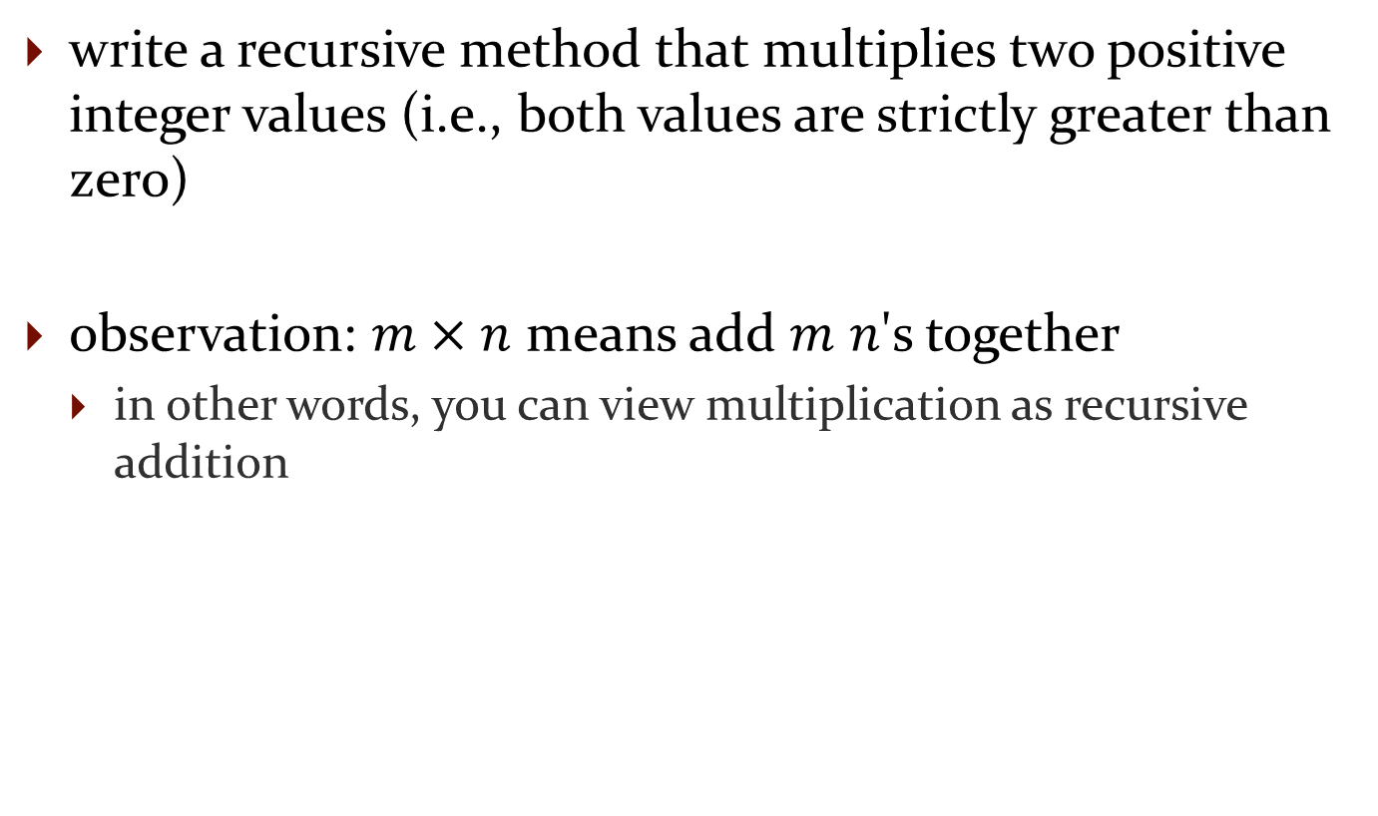
Recursive Methods & Return Values
write a recursive method that multiplies two positive integer values (i.e., both values are strictly greater than zero)
observation: $m×n$ means add $m$ $n$'s together
  in other words, you can view multiplication as recursive addition

Slide 76
Recursive Methods & Return Values
not Java:
/**
* Computes m * n
*/
multiply(m, n) :
if m == 1
return n
else
return n + multiply(m - 1, n)

Slide 77
public static int multiply(int m, int n) {
if (m == 1) {
return n;
}
return n + multiply(m - 1, n);
}

Slide 78
Recursive Methods & Return Values
example: write a recursive method countZeros that counts the number of zeros in an integer number n
  10305060700002L has 8 zeros
trick: examine the following sequence of numbers
  10305060700002
  1030506070000
  103050607000
  10305060700
  103050607
  1030506 ...

Slide 79
Recursive Methods & Return Values
not Java:
/**
* Counts the number of zeros in an integer n
*/
countZeros(n) :
if the last digit in n is a zero
return 1 + countZeros(n / 10)
else
return countZeros(n / 10)

Slide 80
don't forget to establish the base case(s)
  when should the recursion stop? when you reach a single digit (not zero digits; you never reach zero digits!)
    base case #1 : n == 0
      return 1
    base case #2 : n != 0 && n < 10
      return 0

Slide 81
public static int countZeros(long n) {
if(n == 0L) { // base case 1
return 1;
}
else if(n < 10L) { // base case 2
return 0;
}
boolean lastDigitIsZero = (n % 10L == 0);
final long m = n / 10L;
if(lastDigitIsZero) {
return 1 + countZeros(m);
}
else {
return countZeros(m);
}
}

Slide 82
countZeros Call Stack
callZeros( 800410L )
last in
first out
callZeros( 8L )
0
callZeros( 80L )
1 + 0
callZeros( 800L )
1 + 1 + 0
callZeros( 8004L )
0 + 1 + 1 + 0
callZeros( 80041L )
0 + 0 + 1 + 1 + 0
callZeros( 800410L )
1 + 0 + 0 + 1 + 1 + 0
= 3

Slide 83
Fibonacci Call Tree
F(5)
F(4)
F(3)
F(3)
F(2)
F(2)
F(1)
1
F(2)
F(1)
1
F(1)
1
F(0)
0
F(1)
1
F(0)
0
F(1)
1
F(0)
0

Slide 84
Compute Powers of 10
write a recursive method that computes 10^{n} for any integer value n
recall:
  10⁰ = 1
  10^{n} = 10 * 10^{n-1}
  10^{-n} = 1 / 10^{n}

Slide 85
public static double powerOf10(int n) {
if (n == 0) {
// base case
return 1.0;
}
else if (n > 0) {
// recursive call for positive n
return 10.0 * powerOf10(n - 1);
}
else {
// recursive call for negative n
return 1.0 / powerOf10(-n);
}
}

Slide 86
Fibonacci Numbers
the sequence of additional pairs
  0, 1, 1, 2, 3, 5, 8, 13, ...
are called Fibonacci numbers
base cases
  F(0) = 0
  F(1) = 1
recursive definition
  F(n) = F(n – 1) + F(n – 2)

Slide 87
Recursive Methods & Return Values
a recursive method can return a value
example: compute the nth Fibonacci number
public static int fibonacci(int n) {
if (n == 0) {
return 0;
}
else if (n == 1) {
return 1;
}
else {
int f = fibonacci(n - 1) + fibonacci(n - 2);
return f;
}
}

Slide 88
Fibonacci Call Tree
F(5)
F(4)
F(3)
F(3)
F(2)
F(2)
F(1)
1
F(2)
F(1)
1
F(1)
1
F(0)
0
F(1)
1
F(0)
0
F(1)
1
F(0)
0

Slide 89
A Better Recursive Fibonacci
public class Fibonacci {
private static Map<Integer, Long> values = new HashMap<Integer, Long>();
static {
Fibonacci.values.put(0, (long) 0);
Fibonacci.values.put(1, (long) 1);
}
public static long getValue(int n) {
Long value = Fibonacci.values.get(n);
if (value != null) {
return value;
}
value = Fibonacci.getValue(n - 1) + Fibonacci.getValue(n - 2);
Fibonacci.values.put(n, value);
return value;
}
}

Slide 90
Better Fibonacci Call Tree
F(5)
F(4)
F(3)
2
F(3)
F(2)
1
F(2)
F(1)
1
values in blue are already stored
in the map
F(1)
1
F(0)
0

Slide 91
A Better Recursive Fibonacci
because the map is static subsequent calls to Fibonacci.getValue(int) can use the values already computed and stored in the map

Slide 92
Better Fibonacci Call Tree
assuming the client has already invoked Fibonacci.getValue(5)
F(6)
F(5)
5
F(4)
3
values in blue are already stored
in the map

Slide 93
Compute Powers of 10
write a recursive method that computes 10^{n} for any integer value n
recall:
  10^{n} = 1 / 10^{-n} if n < 0
  10⁰ = 1
  10^{n} = 10 * 10^{n-1}

Slide 94
public static double powerOf10(int n) {
if (n < 0) {
return 1.0 / powerOf10(-n);
}
else if (n == 0) {
return 1.0;
}
return n * powerOf10(n - 1);
}

Slide 95
A Better Powers of 10
recall:
  10^{n} = 1 / 10^{-n} if n < 0
  10⁰ = 1
  10^{n} = 10 * 10^{n-1} if n is odd
  10^{n} = 10^{n/2} * 10^{n/2} if n is even

Slide 96
public static double powerOf10(int n) {
if (n < 0) {
return 1.0 / powerOf10(-n);
}
else if (n == 0) {
return 1.0;
}
else if (n % 2 == 1) {
return 10 * powerOf10(n - 1);
}
double value = powerOf10(n / 2);
return value * value;
}

