Slide 1
Documenting a method
Javadoc

Slide 2
Documenting
documenting code was not a new idea when Java was invented
however, Java was the first major language to embed documentation in the code and extract the documentation into readable electronic APIs
the tool that generates API documents from comments embedded in the code is called Javadoc

Slide 3
Documenting
Javadoc processes doc comments that immediately precede a class, attribute, constructor or method declaration
doc comments delimited by /** and */
doc comment written in HTML and made up of two parts
a description
first sentence of description gets copied to the summary section
only one description block; can use <p> to create separate paragraphs
block tags
begin with @ (@param, @return, @throws and many others)
@pre. is a non-standard (custom tag used in EECS1030) for documenting preconditions

Slide 4
Method documentation example
Eclipse will generate an empty Javadoc comment for you if you right-click on the method header and choose Source→Generate Element Comment
/**
* @param min
* @param max
* @param value
* @return
*/
public static boolean isBetween(int min, int max, int value) {
// implementation not shown
}

Slide 5
Method documentation example
The first sentence of the documentation should be short summary of the method; this sentence appears in the method summary section.
/**
* Returns true if value is strictly greater than min and strictly
* less than max, and false otherwise.
*
* @param min
* @param max
* @param value
* @return
*/
public static boolean isBetween(int min, int max, int value) {
// implementation not shown
}

Slide 6
Method documentation example
You should provide a brief description of each parameter.
/**
* Returns true if value is strictly greater than min and strictly
* less than max, and false otherwise.
*
* @param min a minimum value
* @param max a maximum value
* @param value a value to check
* @return
*/
public static boolean isBetween(int min, int max, int value) {
// implementation not shown
}

Slide 7
Method documentation example
Provide a brief description of the return value if the return type is not void. This description often describes a postcondition of the method.
/**
* Returns true if value is strictly greater than min and strictly
* less than max, and false otherwise.
*
* @param min a minimum value
* @param max a maximum value
* @param value a value to check
* @return true if value is strictly greater than min and strictly
* less than max, and false otherwise
*/
public static boolean isBetween(int min, int max, int value) {
// implementation not shown
}

Slide 8
Method documentation example
if a method has one or more preconditions, you should use the EECS2030 specific @pre. tag to document them

Slide 9
Method documentation example
Describe any preconditions using the EECS2030 specific @pre. tag. You have to manually do this.
/**
* Returns true if value is strictly greater than min and strictly
* less than max, and false otherwise.
*
* @param min a minimum value
* @param max a maximum value
* @param value a value to check
* @return true if value is strictly greater than min and strictly
* less than max, and false otherwise
* @pre min is less than or equal to max
*/
public static boolean isBetween(int min, int max, int value) {
// implementation not shown
}

Slide 10
Method documentation example
if a method throws an exception then you should use the @throws tag to document the exception

Slide 11
/**
* Given a list containing exactly 2 integers, returns the smaller of the
* two integers. The list <code>t</code> is not modified by this method.
* For example:
*
* <pre>
* t Test2F.min2(t)
* ---------------------------
* [-5, 9] -5
* [3, 3] 3
* [12, 6] 6
* </pre>
*
* @pre t is not null
* @param t a list containing exactly 2 integers
* @return the minimum of the two values in t
* @throws IllegalArgumentException if the list does not contain exactly 2
* integers
*/
public static int min2(List<Integer> t) {
}
HTML markup is also allowed

Slide 12
Utility classes

Slide 13
Review: Java Class
a class is a model of a thing or concept
in Java, a class is usually a blueprint for creating objects
fields (or attributes)
the structure of an object; its components and the information (data) contained by the object
methods
the behaviour of an object; what an object can do

Slide 14
Utility classes
sometimes, it is useful to create a class called a utility class that is not used to create objects
such classes have no constructors for a client to use to create objects
in a utility class, all features are marked as being static
you use the class name to access these features
examples of utility classes:
java.lang.Math
java.util.Arrays
java.util.Collections

Slide 15
Utility classes
the purpose of a utility class is to group together related fields and methods where creating an object is not necessary
java.lang.Math
groups mathematical constants and functions
do not need a Math object to compute the cosine of a number
java.util.Collections
groups methods that operate on Java collections
do not need a Collections object to sort an existing List

Slide 16
Class versus utility class
a class is used to create instances of objects where each instance has its own state
for example:
the class java.awt.Point is used to create instances that represent a location (x, y) where x and y are integers
each instance occupies a separate location in memory which we can illustrate in a memory diagram
public static void main(String[] args) {
Point p = new Point(0, 0); // point (0, 0) Point q = new Point(17, 100); // point (17, 100) Point r = new Point(-1, -5); // point (-1, -5)
}

Slide 17
Name | Address
 | 100 | Point class
x
y
 | 200 | Point instance
x |  | 0
y |  | 0
 | 300 | Point instance
x |  | 17
y |  | 100
 | 400 | Point instance
x |  | -1
y |  | -5
Point class is loaded
into memory
Point instance with
state (0, 0)
Point instance with
state (17, 100)
Point instance with
state (-1, -5)
continued on next slide

Slide 18
Name | Address
 | 500 | main method
p |  | 200a
q |  | 300a
r |  | 400a
the main method
the variables
created in the
main method
the object at address 200
the object at address 300
the object at address 400
these are addresses
because p, q, and r
are reference variables
(refer to objects)

Slide 19
Class versus utility class
a utility class is never used to create objects
when you use a utility class only the class itself occupies any memory
public static void main(String[] args) {
double x = Math.cos(Math.PI / 3.0);
double y = Math.sin(Math.PI / 3.0);
// notice that we never created a Math object
}

Slide 20
Name | Address
 | 100 | Math class
PI |  | 3.1415....
E |  | 2.7182....
 | 200 | main method
x |  | 0.8660....
y |  | 0.5
Math class is loaded
into memory but there
are no Math instances
the value cos(π/3)
the value sin(π/3)
these are values (not
addresses) because
x and y are primitive
variables (double)

Slide 21
A simple utility class
implement a utility class that helps you calculate Einstein's famous mass-energy equivalence equation E = mc² where
m is mass (in kilograms)
c is the speed of light (in metres per second)
E is energy (in joules)

Slide 22
Start by creating a package, giving the class a name, and creating the class body block.
package ca.yorku.eecs.eecs2030;
public class Relativity {
public static final double C = 299792458;
public static double massEnergy(double mass) {
return mass * Relativity.C * Relativity.C;
}
}

Slide 23
Add a field that represents the speed of light.
package ca.yorku.eecs.eecs2030;
public class Relativity {
public static final double C = 299792458;
public static double massEnergy(double mass) {
return mass * Relativity.C * Relativity.C;
}
}

Slide 24
Add a method to compute $E=mc^{2}$.
package ca.yorku.eecs.eecs2030;
public class Relativity {
public static final double C = 299792458;
public static double massEnergy(double mass) {
double energy = mass * Relativity.C * Relativity.C;
return energy;
}
}

Slide 25
Add a method to compute $E=mc^{2}$.
package ca.yorku.eecs.eecs2030;
public class Relativity {
public static final double C = 299792458;
public static double massEnergy(double mass) {
double energy = mass * Relativity.C * Relativity.C;
return energy;
}
}

Slide 26
Here's a program that uses (a client) the Relativity utility class.
package ca.yorku.eecs.eecs2030;
public class OneGram {
public static void main(String[] args) {
double mass = 0.001;
double energy = Relativity.massEnergy(mass);
System.out.println("1 gram = " + energy + " Joules");
}
}

Slide 27
Fields
a field is a member that holds data
a constant field is usually declared by specifying
modifiers
access modifier public
static modifier static
final modifier final
type double
name C
value 299792458
public static final double C = 299792458;

Slide 28
Fields
field names must be unique in a class
the scope of a field is the entire class
[notes] use the term “field” only for public fields

Slide 29
public Fields
a public field is visible to all clients
// client of Relativity
int speedOfLight = Relativity.C;

Slide 30
static Fields
a field that is static is a per-class member
only one copy of the field, and the field is associated with the class
every object created from a class declaring a static field shares the same copy of the field
textbook uses the term static variable
also commonly called class variable

Slide 31
static Fields
 | 64 | client invocation
y
Relativity y = new Relativity();
Relativity z = new Relativity();
1000a
z
1100a
 | 500 | Relativity class
C |  | 299792458
belongs to class
 | 1000 | Relativity object
???
no copy of
C
 | 1100 | Relativity object
???

Slide 32
static Field Client Access
a client should access a public static field without using an object reference
use the class name followed by a period followed by the attribute name
public static void main(String[] args) {
double sunDistance = 149.6 * 1e9;
double seconds = sunDistance / Relativity.C;
System.out.println(
"time for light to travel from sun to earth " +
seconds + " seconds");
}
time for light to travel from sun to earth 499.01188641643546 seconds

Slide 33
static Attribute Client Access
it is legal, but considered bad form, to access a public static attribute using an object
public static void main(String[] args) {
double sunDistance = 149.6 * 1e9;
Relativity y = new Relativity();
double seconds = sunDistance / y.C;
System.out.println(
"time for light to travel from sun to earth " +
seconds + " seconds");
}
time for light to travel from sun to earth 499.01188641643546 seconds

Slide 34
final Fields
a field that is final can only be assigned to once
public static final fields are typically assigned when they are declared
public static final double C = 299792458;
public static final fields are intended to be constant values that are a meaningful part of the abstraction provided by the class

Slide 35
final Fields of Primitive Types
final fields of primitive types are constant
public class Relativity {
public static final double C = 299792458;
}
// client of Relativity
public static void main(String[] args) {
Relativity.C = 100; // will not compile;
// field C
// is final and
// previously assigned
}

Slide 36
final Fields of Immutable Types
final fields of immutable types are constant
String is immutable
it has no methods to change its contents
public class NothingToHide {
public static final String X = "peek-a-boo";
}
// client of NothingToHide
public static void main(String[] args) {
NothingToHide.X = "i-see-you";
// will not compile;
// field X is final and
// previously assigned
}

Slide 37
final Fields of Mutable Types
final fields of mutable types are not logically constant; their state can be changed
public class ReallyNothingToHide {
public static final Fraction HALF =
new Fraction(1, 2);
}
// client of ReallyNothingToHide
public static void main(String[] args) {
ReallyNothingToHide.HALF.setDenominator(3);
// works!! // HALF is now 1/3
}

Slide 38
final Fields of Mutable Types
 |  |  | ReallyNothingToHide class
final | HALF | 192 | 700a
 |  |  | :
 |  | 700 | Fraction obj
 |  |  | :
not final! | numer |  | 1
not final! | denom |  | 2
3
ReallyNothingToHide.HALF.setDenominator(3);

Slide 39
final fields
avoid using mutable types as public constants
they are not logically constant

Slide 40
new Relativity objects
our Relativity class does not expose a constructor
but
Relativity y = new Relativity();
is legal
if you do not define any constructors, Java will generate a default no-argument constructor for you
e.g., we get the public constructor public Relativity() { } even though we did not implement it

Slide 41
Preventing instantiation
in a utility class you can prevent a client from making new instances of your class by declaring a private constructor
a private field, constructor, or method can only be used inside the class that it is declared in

Slide 42
package ca.yorku.eecs.eecs2030;
public class Relativity {
public static final double C = 299792458;
private Relativity() {
// private and empty by design
}
public static double massEnergy(double mass) {
double energy = mass * Relativity.C * Relativity.C;
return energy;
}
}

Slide 43
Introduction to Testing

Slide 44
Testing
testing code is a vital part of the development process
the goal of testing is to find defects in your code
Program testing can be a very effective way to show the presence of bugs, but it is hopelessly inadequate for showing their absence. —Edsger W. Dijkstra

Slide 45
Testing with a main method
before Lab 1, if I had asked you to test your worksheet 1 methods you probably would have written a main method

Slide 46
public static void main(String[] args) {
// avg
int a = 1;
int b = 1;
int c = 1;
System.out.println(
String.format("average of %d, %d, and %d : ", a, b, c) +
Test2E.avg(a, b, c));
// swap2
List<Integer> t = new ArrayList<Integer>();
t.add(3);
t.add(5);
String s = t.toString();
Test2E.swap2(t);
System.out.println(
String.format("swap2(%s) : %s", s, t.toString()));

Slide 47
// allGreaterThan
t.clear();
t.add(4);
t.add(5);
t.add(6);
t.add(7);
t.add(8);
System.out.println(
String.format("allGreaterThan(%s, %s) : %s",
t.toString(), 5, Test2E.allGreaterThan(t, 5)));
// toInt
t.clear();
t.add(1);
t.add(2);
t.add(3);
System.out.println(
String.format("toInt(%s) : %d",
t.toString(), Test2E.toInt(t)));
}

Slide 48
Testing with a main method
running the main method results in the following output:
average of 1, 1, and 1 : 1.0
swap2([3, 5]) : [5, 3]
allGreaterThan([4, 5, 6, 7, 8], 5) : [6, 7, 8]
toInt([1, 2, 3]) : 123

Slide 49
Testing with a main method
testing using a single main method has some disadvantages:
someone has to examine the output to determine if the tests have passed or failed
all of the tests are in one method
we can’t run tests independently from one another
there is no easy way to pick which tests we want to run

Slide 50
JUnit
JUnit is a unit test framework
“A framework is a semi-complete application. A framework provides a reusable, common structure to share among applications.”
from the book JUnit in Action

Slide 51
JUnit
“A unit test examines the behavior of a distinct unit of work. Within a Java application, the “distinct unit of work” is often (but not always) a single method. … A unit of work is a task that isn't directly dependent on the completion of any other task.”
from the book JUnit in Action

Slide 52
A JUnit test example
let’s write a test for the worksheet 1 method avg
we need a class to write the test in
we need to import the JUnit library
we need to write a method that implements the test
happily, eclipse helps you do all of this
in the Package Explorer, right click on the class that you want to test and select New > JUnit Test Case

Slide 53
package eecs2030.test2;
import static org.junit.Assert.*;
import org.junit.Test;
public class Test2ETest {
@Test
public void test_avg() {
int a = -99;
int b = 100;
int c = -11;
double expected = -10.0 / 3;
double actual = Test2E.avg(a, b, c);
double delta = 1e-9;
assertEquals(expected, actual, delta);
}
static import: allows you to use
static methods from the class
org.junit.Assert without specifying
the class name
Avoid the widespread use of static
imports. Although it is convenient
being able to not include the class
name in front of the method name,
it makes it difficult to tell which
class the method comes from*.
*https://docs.oracle.com/javase/8/docs/technotes/guides/language/static-import.html

Slide 54
package eecs2030.test2;
import static org.junit.Assert.*;
import org.junit.Test;
public class Test2ETest {
@Test
public void test_avg() {
int a = -99;
int b = 100;
int c = -11;
double expected = -10.0 / 3;
double actual = Test2E.avg(a, b, c);
double delta = 1e-9;
assertEquals(expected, actual, delta);
}
An annotation; JUnit uses the @Test
annotation to determine which
methods are unit tests.

Slide 55
package eecs2030.test2;
import static org.junit.Assert.*;
import org.junit.Test;
public class Test2ETest {
@Test
public void test_avg() {
int a = -99;
int b = 100;
int c = -11;
double expected = -10.0 / 3;
double actual = Test2E.avg(a, b, c);
double delta = 1e-9;
assertEquals(expected, actual, delta);
}
A JUnit method that throws an exception if expected and actual differ
by more than delta. JUnit handles the exception and reports the test
failure to the user.

Slide 56
A JUnit test example
consider testing swap2 (a method which does not return a value)

Slide 57
@Test
public void test_swap2() {
List<Integer> actual = new ArrayList<Integer>();
actual.add(-99);
actual.add(88);
List<Integer> expected = new ArrayList<Integer>();
expected.add(88);
expected.add(-99);
Test2E.swap2(actual);
assertEquals(expected, actual);
}
A JUnit method that throws an exception if expected and actual are
not equal. JUnit handles the exception and reports the test
failure to the user.

Slide 58
Creating tests
based on the previous example, when you write a test in you need to determine:
what arguments to pass to the method
what the expected return value is when you call the method with your chosen arguments
if the method does not return a value then you need to determine what the expected results are of calling the method with your chosen arguments

Slide 59
Creating tests
for now, we will define a test case to be:
a specific set of arguments to pass to the method
the expected return value (if any) and the expected results when the method is called with the specified arguments

Slide 60
Creating tests
to write a test for a static method in a utility class you need to consider:
the preconditions of the method
the postconditions of the method
what exceptions the method might throw

Slide 61
Creating tests: Preconditions
recall that method preconditions often place restrictions on the values that a client can use for arguments to the method

Slide 62
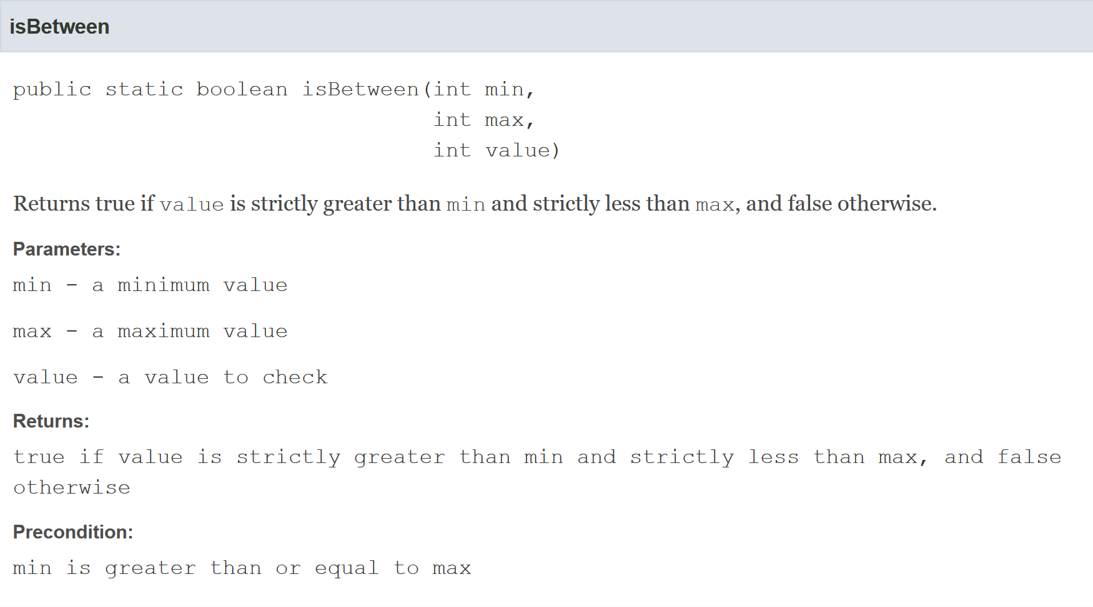
less
precondition

Slide 63
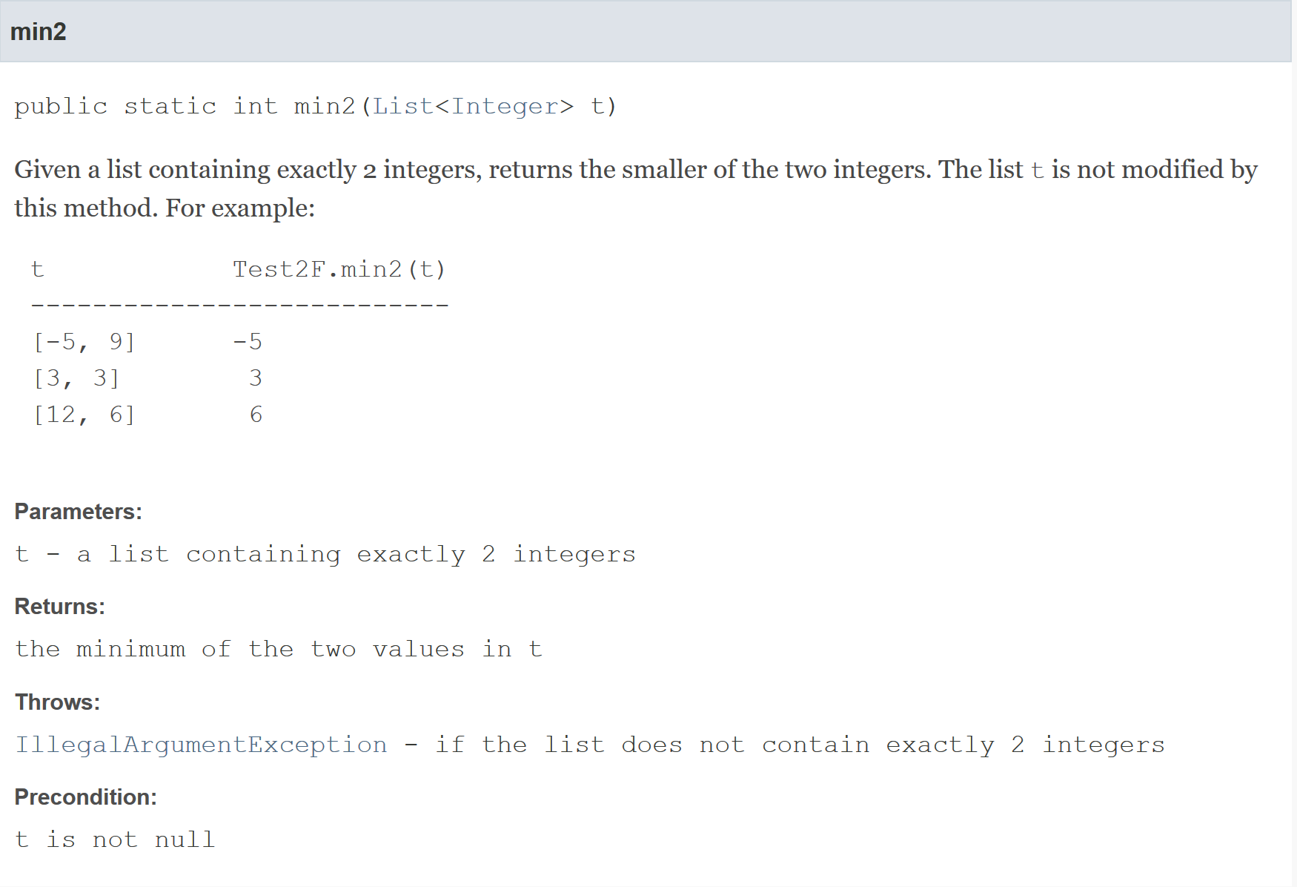
precondition
precondition

Slide 64
Creating tests: Preconditions
the arguments you choose for the test should satisfy the preconditions of the method
but see the slides on testing exceptions!
it doesn’t make sense to use arguments that violate the preconditions because the postconditions are not guaranteed if you violate the preconditions

Slide 65
Creating tests: Postconditions
recall that a postcondition is what the method promises will be true after the method completes running
a test should confirm that the postconditions are true
many postconditions require more than one test to verify

Slide 66
postcondition
less
requires one test to verify a return value of true and a second test to verify a return value for false

Slide 67
postcondition
postcondition

Slide 68
Creating tests: Exceptions
some methods having preconditions throw an exception if a precondition is violated
if the API for the method states that an exception is thrown under certain circumstances then you should test those circumstances
even if writing such a test requires violating a precondition

Slide 69
@Test(expected = IllegalArgumentException.class)
public void test_swap2_throws() {
List<Integer> t = new ArrayList<Integer>();
Test2E.swap2(t);
}
@Test(expected = IllegalArgumentException.class)
public void test_swap2_throws2() {
List<Integer> t = new ArrayList<Integer>();
t.add(10000);
Test2E.swap2(t);
}
A JUnit test that is expected to result
in an IllegalArgumentException
being thrown. The test fails if an
IllegalArgumentException
is not thrown.

Slide 70
@Test(expected = IllegalArgumentException.class)
public void test_swap2_throws() {
List<Integer> t = new ArrayList<Integer>();
Test2E.swap2(t);
}
@Test(expected = IllegalArgumentException.class)
public void test_swap2_throws2() {
List<Integer> t = new ArrayList<Integer>();
t.add(10000);
Test2E.swap2(t);
}
swap2 should throw an exception
because t is empty.

Slide 71
@Test(expected = IllegalArgumentException.class)
public void test_swap2_throws() {
List<Integer> t = new ArrayList<Integer>();
Test2E.swap2(t);
}
@Test(expected = IllegalArgumentException.class)
public void test_swap2_throws2() {
List<Integer> t = new ArrayList<Integer>();
t.add(10000);
Test2E.swap2(t);
}
swap2 should throw an exception
because t has only one element.

Slide 72
Choosing test cases
typically, you use several test cases to test a method
the course notes uses the term test vector to refer to a collection of test cases
it is usually impossible or impractical to test all possible sets of arguments
how many possible arguments does the worksheet 1 method avg have?

Slide 73
Choosing test cases
when choosing tests cases, you should consider using
arguments that have typical (not unusual) values, and
arguments that test boundary cases
argument value around the minimum or maximum value allowed by the preconditions
argument value around a value where the behavior of the method changes

Slide 74
Example of a boundary case
consider testing the worksheet 1 method avg
the method has no preconditions
the boundary values of the arguments a, b, and c are Integer.MAX_VALUE and Integer.MIN_VALUE

Slide 75
@Test
public void test_avg_boundary() {
int a = Integer.MAX_VALUE;
int b = Integer.MAX_VALUE;
int c = Integer.MAX_VALUE;
double expected = Integer.MAX_VALUE;
double actual = Test2E.avg(a, b, c);
double delta = 1e-9;
assertEquals(expected, actual, delta);
}

Slide 76
Example of a boundary case
consider testing the method isBetween
the method has a precondition that min <= max
less

Slide 77
Example of a boundary case
boundary cases:
value == min + 1
expected return value: true
value == min
expected return value: false
value == max
expected return value: false
value == max - 1
expected return value: true
min == max
expected result: no exception thrown
min == max - 1
expected result: IllegalArgumentException thrown

