Slide 1
Advanced Object Oriented Programming
EECS2030Z
Notes:
login 5065

Slide 2
Academic Support Programs: Bethune
having trouble with your FSC and LSE courses?
consider using the Academic Support Programs at Bethune College
PASS
free, informal, structured, facilitated study groups: http://bethune.yorku.ca/pass/
peer tutoring
free, one-on-one, drop-in tutoring: http://bethune.yorku.ca/tutoring/

Slide 3
Academic Support Programs: Bethune
your PASS leader is Glib Sitiugin

Slide 4
Who Am I?
Dr. Burton Ma
office
Lassonde 2046
hours : to be updated on the syllabus page
email
burton@cse.yorku.ca

Slide 5
Course Format
everything you need to know is on Moodle
http://learn.lassonde.yorku.ca/

Slide 6
Labs
in Prism computing labs (LAS1006 and LAS1004)
Lab Zero starts in Week 1
self-guided, can be done anytime before the start of Week 2
using the Prism lab environment
using eclipse
Labs 1-9 consist of a different set of programming problems for each lab
each of these labs counts towards 2% of your final grade
it is expected that you know how to use the lab computing environment

Slide 7
Labs
group lab work is allowed and strongly encouraged for Labs 1-9 (not Lab 0)
groups of up to size 3
see Academic Honesty section of syllabus
TLDR Do not submit work that is not wholly your own

Slide 8
Labs
tips for effective group work
alternate who is doing the typing (the driver) every few minutes
don’t allow the stronger programmer to do everything
if you are the stronger programmer then try explaining your thought processes to your group partners
if you aren’t typing then you are a navigator
you should be:
watching what the driver is doing to catch mistakes
planning what the group should do next
developing test cases to test the code that is being written

Slide 9
Labs
LAS1004 does not have desktop computers
if you want to attend the regularly scheduled lab and you want to work on your own laptop then you should use LAS1004
if LAS1006 is full and you don’t have a laptop you can borrow a laptop computer from the lab monitor in LAS1006 (requires a student card)

Slide 10
Tests
all testing occurs during your regularly scheduled lab using the EECS labtest environment
miss a test for an acceptable reason?
see Evaluation: Missed tests section of syllabus
Test | Weight
Test 1 | 2%
Test 2 | 25%
Test 3 | 25%
Exam | 30%

Slide 11
Textbook
a set of freely available electronic notes is available from the Moodle site
if you want a textbook the recommended text is Absolute Java, 5th Edition or newer by Savitch
if you want a very concise reference to the language consider Java 8 Pocket Guide by Liguori and Liguori

Slide 12
Organization of a Java Program
Packages, classes, fields, and methods

Slide 13
Organization of a Typical Java Program
one or more files

Slide 14
Organization of a Typical Java Program
one or more files
zero or one package name

Slide 15
Organization of a Typical Java Program
one or more files
zero or one package name
zero or more import statements

Slide 16
Organization of a Typical Java Program
one or more files
zero or one package name
zero or more import statements
one class

Slide 17
Organization of a Typical Java Program
one or more files
zero or one package name
zero or more import statements
one class
one or more fields (class variables)

Slide 18
Organization of a Typical Java Program
one or more files
zero or one package name
zero or more import statements
one class
zero or more fields (class variables)
zero or more more constructors

Slide 19
Organization of a Typical Java Program
one or more files
zero or one package name
zero or more import statements
one class
zero or more fields (class variables)
zero or more more constructors
zero or more methods

Slide 20
Worksheet
Question 1

Slide 21
Organization of a Typical Java Program
it's actually more complicated than this
static initialization blocks
non-static initialization blocks
classes inside of classes (inside of classes ...)
classes inside of methods
anonymous classes
lambda expressions (in Java 8)
see http://docs.oracle.com/javase/tutorial/java/javaOO/index.html

Slide 22
Methods
Basics

Slide 23
Methods
a method performs some sort of computation
a method is reusable
anyone who has access to the method can use the method without copying the contents of the method
anyone who has access to the method can use the method without knowing the contents of the method
methods are described by their API (application program interface)

Slide 24
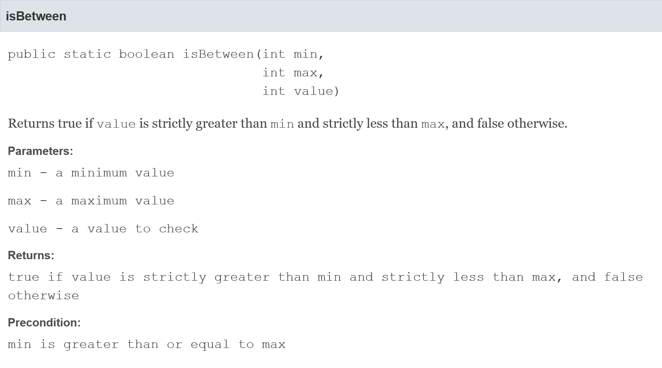
Example API method entry

Slide 25
Method header
the first line of a method declaration is sometimes called the method header
public static boolean isBetween(int min, int max, int value)
modifiers
return type
name
parameter list

Slide 26
Method parameter list
the parameter list is the list of types and names that appear inside of the parentheses
public static boolean isBetween(int min, int max, int value)
the names in the parameter list must be unique
i.e., duplicate parameter names are not allowed
parameter list

Slide 27
Method signature
every method has a signature
the signature consists of the method name and the types in the parameter list
public static boolean isBetween(int min, int max, int value)
has the following signature
isBetween(int, int, int)
name
number and types of parameters
signature

Slide 28
Method signature
other examples from java.lang.String
headers
String toUpperCase()
char charAt(int index)
int indexOf(String str, int fromIndex)
void getChars(int srcBegin, int srcEnd, char[] dst, int dstBegin)
signatures
toUpperCase()
charAt(int)
indexOf(String, int)
getChars(int, int, char[], int)

Slide 29
Method signature
method signatures in a class must be unique
we can introduce a second method in the same class:
public static boolean
isBetween(double min, double max, double value)
but not this one:
public static boolean
isBetween(int value, int lo, int hi)

Slide 30
Method return types
all Java methods return nothing (void) or a single type of value
our method
public static boolean
isBetween(double min, double max, double value)
has the return type boolean

Slide 31
Worksheet
Question 2

Slide 32
Methods
Preconditions and postconditions

Slide 33
Preconditions and postconditions
recall the meaning of method pre- and postconditions
precondition
a condition that the client must ensure is true immediately before a method is invoked
postcondition
a condition that the method must ensure is true immediately after the method is invoked

Slide 34
Preconditions
recall that a method precondition is a condition that the client must ensure is true immediately before invoking a method
if the precondition is not true, then the client has no guarantees of what the method will do
for static methods, preconditions are conditions on the values of the arguments passed to the method
you need to carefully read the API to discover the preconditions

Slide 35
precondition

Slide 36
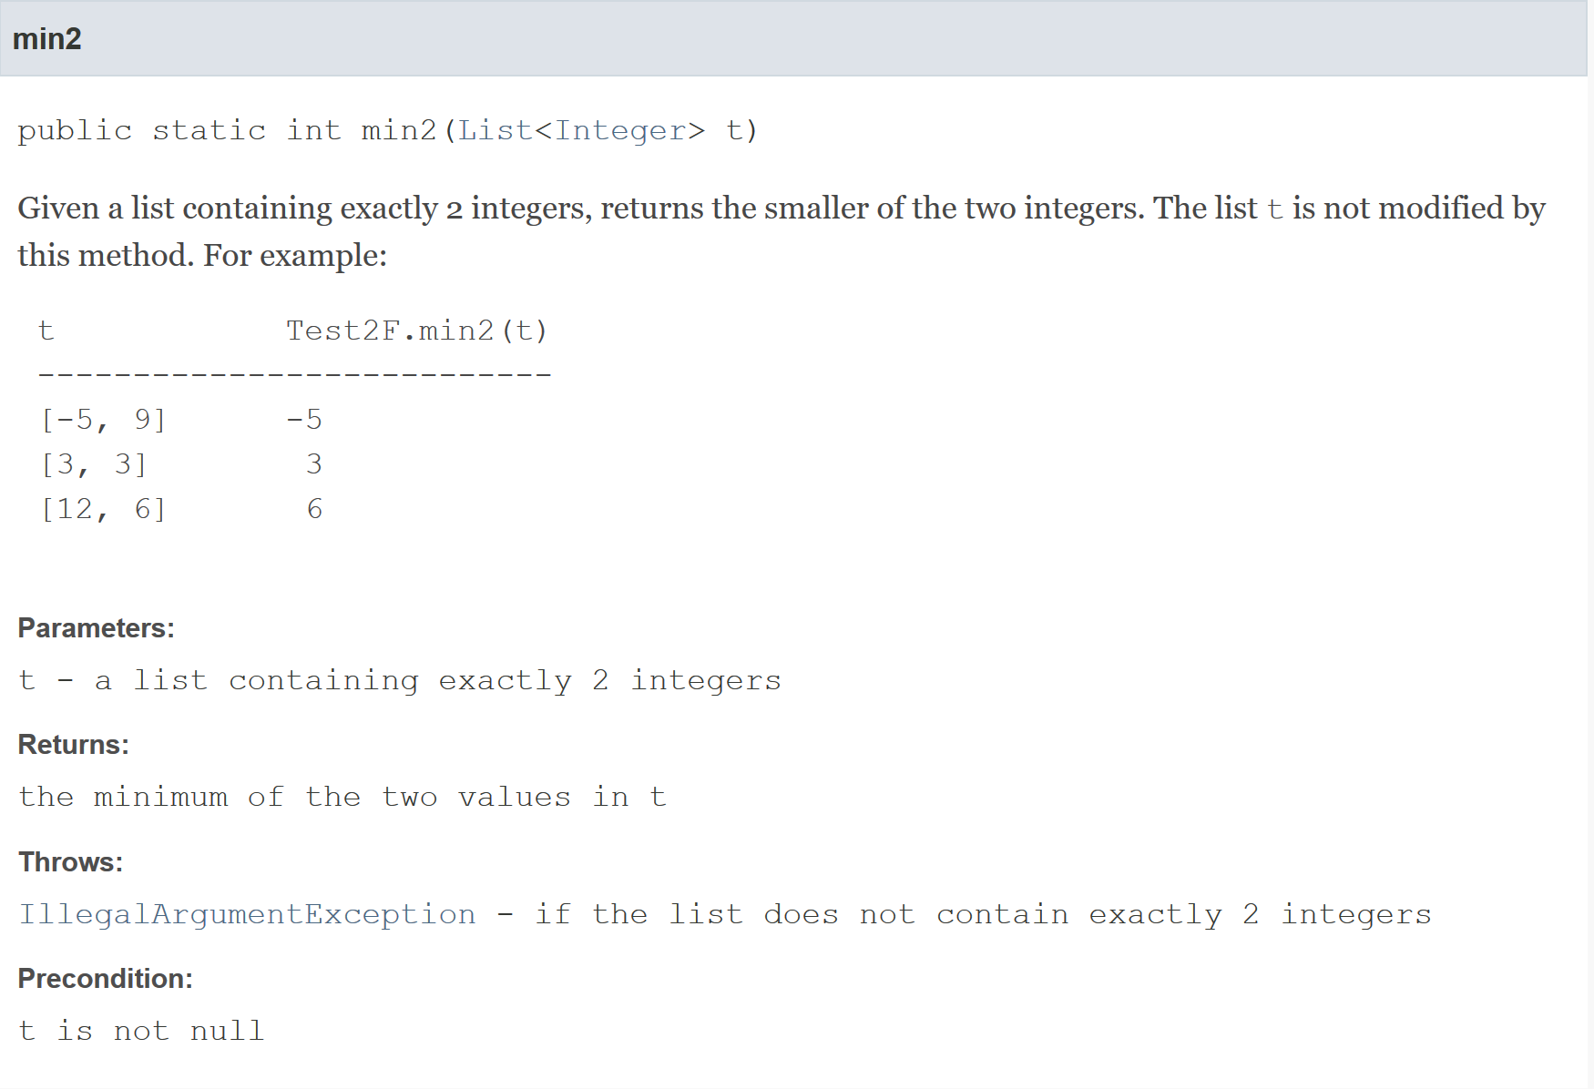
precondition
precondition

Slide 37
Preconditions
if a method has a parameter that has reference type then it is almost always assumed that a precondition for that parameter is that it is not equal to null
reminders:
reference type means “not primitive type”
null means “refers to no object”
primitive types are never equal to null

Slide 38
Postconditions
recall that a method postcondition is a condition that the method must ensure is true immediately after the method is invoked
if the postcondition is not true, then there is something wrong with the implementation of the method
for static methods, postconditions are:
conditions on the arguments after the method finishes
conditions on the return value

Slide 39
postcondition

Slide 40
postcondition
postcondition

Slide 41
Worksheet
Question 3

Slide 42
Methods
Implementation

Slide 44
Methods and classes
in Java every method must be defined inside of a class
we will try to implement our method so that it matches its API:
the method is inside the class named Test2F
the class Test2F is inside the package eecs2030.test2
eclipse demonstration here

Slide 45
package eecs2030.test2;
public class Test2F {
}

Slide 46
Method body
a method implementation consists of:
the method header
a method body
the body is a sequence of Java statements inside of a pair of braces { }

Slide 47
package eecs2030.test2;
public class Test2F {
public static boolean isBetween(int min, int max, int value) {
}
}

Slide 48
Methods with parameters
if a method has parameters, then you can use the parameter names as variables inside your method
you cannot create new variables inside the method that have the same name as a parameter
you cannot use the parameters outside of the method
we say that the scope of the parameters is the method body
you may create additional variables inside your method if you wish
we will create a variable to store the return value of the method

Slide 49
package eecs2030.test2;
public class Test2F {
public static boolean isBetween(int min, int max, int value) {
boolean result = true;
}
}

Slide 50
package eecs2030.test2;
public class Test2F {
public static boolean isBetween(int min, int max, int value) {
boolean result = true;
if (value <= min) {
result = false;
}
if (value >= max) {
result = false;
}
}
}

Slide 51
Methods with return values
if the method header says that a type is returned, then the method must return a value having the advertised type back to the client
you use the keyword return to return the value back to the client

Slide 52
package eecs2030.test2;
public class Test2F {
public static boolean isBetween(int min, int max, int value) {
boolean result = true;
if (value <= min) {
result = false;
}
if (value >= max) {
result = false;
}
return result;
}
}

Slide 53
Method return values
a method stops running immediately if a return statement is run
this means that you are not allowed to have additional code if a return statement is reached
however, you can have multiple return statements

Slide 54
package eecs2030.test2;
public class Test2F {
public static boolean isBetween(int min, int max, int value) {
if (value <= min) {
return false;
// code not allowed here
}
if (value >= max) {
return false;
// code not allowed here
}
return true;
// code not allowed here
}
}

Slide 55
Alternative implementations
there are many ways to implement this particular method

Slide 56
package eecs2030.test2;
public class Test2F {
public static boolean isBetween(int min, int max, int value) {
if (value <= min || value >= max) {
return false;
}
return true;
}
}

Slide 57
package eecs2030.test2;
public class Test2F {
public static boolean isBetween(int min, int max, int value) {
if (value > min && value < max) {
return true;
}
return false;
}
}

Slide 58
package eecs2030.test2;
public class Test2F {
public static boolean isBetween(int min, int max, int value) {
boolean result = value > min && value < max;
return result;
}
}

Slide 59
package eecs2030.test2;
public class Test2F {
public static boolean isBetween(int min, int max, int value) {
return value > min && value < max;
}
}

Slide 61
package eecs2030.test2;
import java.util.List;
public class Test2F {
// implementation of isBetween not shown
public static int min2(List<Integer> t) {
}
}

Slide 62
package eecs2030.test2;
import java.util.List;
public class Test2F {
// implementation not shown
public static int min2(List<Integer> t) {
if (t.size() != 2) {
throw new IllegalArgumentException("list size != 2");
}
int first = t.get(0);
int second = t.get(1);
}
}

Slide 63
package eecs2030.test2;
import java.util.List;
public class Test2F {
// implementation not shown
public static int min2(List<Integer> t) {
if (t.size() != 2) {
throw new IllegalArgumentException("list size != 2");
}
int first = t.get(0);
int second = t.get(1);
if (first < second) {
return first;
}
return second;
}
}

Slide 64
Worksheet
Question 4

Slide 65
Invoking methods
Pass-by-value

Slide 66
static Methods
a method that is static is a per-class member
client does not need an object reference to invoke the method
client uses the class name to access the method
boolean isBetween = Test2F.isBetween(0, 5, 2);
static methods are also called class methods
[notes 1.2.4]

Slide 67
Invoking methods
a client invokes a method by passing arguments to the method
the types of the arguments must be compatible with the types of parameters in the method signature
the values of the arguments must satisfy the preconditions of the method contract
List<Integer> t = new ArrayList<Integer>();
t.add(100);
t.add(-99);
int min = Test2F.min2(t);
argument

Slide 68
Pass-by-value
Java uses pass-by-value to:
transfer the value of the arguments to the method
transfer the return value back to the client
consider the following utility class and its client…

Slide 69
import type.lib.Fraction;
public class Doubler {
private Doubler() {
}
// tries to double x
public static void twice(int x) {
x = 2 * x;
}
// tries to double f
public static void twice(Fraction f) {
long numerator = f.getNumerator();
f.setNumerator( 2 * numerator );
}
}

Slide 70
import type.lib.Fraction;
public class TestDoubler {
public static void main(String[] args) {
int a = 1;
Doubler.twice(a);
Fraction b = new Fraction(1, 2);
Doubler.twice(b);
System.out.println(a);
System.out.println(b);
}
}

Slide 71
Pass-by-value
what is the output of the client program?
try it and see
an invoked method runs in its own area of memory that contains storage for its parameters
each parameter is initialized with the value of its corresponding argument

Slide 72
Pass-by-value with reference types
Fraction b =
new Fraction(1, 2);
 | 64 | client
b
500a
the object at address 500
this is an address
because b is a
reference variable
(refer to objects)
 | 500 | Fraction object
numer |  | 1
denom |  | 2

Slide 73
Pass-by-value with reference types
Fraction b =
new Fraction(1, 2);
 | 64 | client
b
value of b is not the
Fraction 1/2
500a
value of b is a reference to the new
Fraction object
 | 500 | Fraction object
numer |  | 1
denom |  | 2

Slide 74
Pass-by-value with reference types
Fraction b =
new Fraction(1, 2);
Doubler.twice(b);
 | 64 | client
b
the value of b
is passed to the
method Doubler.twice
500a
 | 500 | Fraction object
numer |  | 1
denom |  | 2
 | 600 | Doubler.twice
f
parameter f
is an independent copy of the value
of argument b
(a reference)
500a

Slide 75
Pass-by-value with reference types
Fraction b =
new Fraction(1, 2);
Doubler.twice(b);
 | 64 | client
b
500a
 | 500 | Fraction object
numer |  | 1 2
denom |  | 2
Doubler.twice
multiplies the
numerator of the Fraction object by 2
 | 600 | Doubler.twice
f
500a

Slide 76
Pass-by-value with primitive types
int a = 1;
 | 64 | client
a
1
value of a is the
integer value that we stored
this is the numeric
value because a is
a primitive variable

Slide 77
Pass-by-value with primitive types
int a = 1;
Doubler.twice(a);
 | 64 | client
a
the value of a
is passed to the
method Doubler.twice
1
this is a different Doubler.twice method than the previous example (now resides at address 800)
 | 800 | Doubler.twice
x |  | 1
parameter x
is an independent copy of the value
of argument a
(a primitive)

Slide 78
Pass-by-value with primitive types
int a = 1;
Doubler.twice(a);
 | 64 | client
a
1
 | 800 | Doubler.twice
x
Doubler.twice
multiplies the value of x by 2;
that's it, nothing else happens
1 2

Slide 79
Pass-by-value
Java uses pass-by-value for all types (primitive and reference)
an argument of primitive type cannot be changed by a method
an argument of reference type can have its state changed by a method
pass-by-value is used to return a value from a method back to the client

Slide 80
Worksheet
Question 5

Slide 81
Documenting a method
Javadoc

Slide 82
Documenting
documenting code was not a new idea when Java was invented
however, Java was the first major language to embed documentation in the code and extract the documentation into readable electronic APIs
the tool that generates API documents from comments embedded in the code is called Javadoc

Slide 83
Documenting
Javadoc processes doc comments that immediately precede a class, attribute, constructor or method declaration
doc comments delimited by /** and */
doc comment written in HTML and made up of two parts
a description
first sentence of description gets copied to the summary section
only one description block; can use <p> to create separate paragraphs
block tags
begin with @ (@param, @return, @throws and many others)
@pre. is a non-standard (custom tag used in EECS1030) for documenting preconditions

Slide 84
Method documentation example
Eclipse will generate an empty Javadoc comment for you if you right-click on the method header and choose Source→Generate Element Comment
/**
* @param min
* @param max
* @param value
* @return
*/
public static boolean isBetween(int min, int max, int value) {
// implementation not shown
}

Slide 85
Method documentation example
The first sentence of the documentation should be short summary of the method; this sentence appears in the method summary section.
/**
* Returns true if value is strictly greater than min and strictly
* less than max, and false otherwise.
*
* @param min
* @param max
* @param value
* @return
*/
public static boolean isBetween(int min, int max, int value) {
// implementation not shown
}

Slide 86
Method documentation example
You should provide a brief description of each parameter.
/**
* Returns true if value is strictly greater than min and strictly
* less than max, and false otherwise.
*
* @param min a minimum value
* @param max a maximum value
* @param value a value to check
* @return
*/
public static boolean isBetween(int min, int max, int value) {
// implementation not shown
}

Slide 87
Method documentation example
Provide a brief description of the return value if the return type is not void. This description often describes a postcondition of the method.
/**
* Returns true if value is strictly greater than min and strictly
* less than max, and false otherwise.
*
* @param min a minimum value
* @param max a maximum value
* @param value a value to check
* @return true if value is strictly greater than min and strictly
* less than max, and false otherwise
*/
public static boolean isBetween(int min, int max, int value) {
// implementation not shown
}

Slide 88
Method documentation example
if a method has one or more preconditions, you should use the EECS2030 specific @pre. tag to document them

Slide 89
Method documentation example
Describe any preconditions using the EECS2030 specific @pre. tag. You have to manually do this.
/**
* Returns true if value is strictly greater than min and strictly
* less than max, and false otherwise.
*
* @param min a minimum value
* @param max a maximum value
* @param value a value to check
* @return true if value is strictly greater than min and strictly
* less than max, and false otherwise
* @pre min is greater than or equal to max
*/
public static boolean isBetween(int min, int max, int value) {
// implementation not shown
}

Slide 90
Method documentation example
if a method throws an exception then you should use the @throws tag to document the exception

Slide 91
/**
* Given a list containing exactly 2 integers, returns the smaller of the
* two integers. The list <code>t</code> is not modified by this method.
* For example:
*
* <pre>
* t Test2F.min2(t)
* ---------------------------
* [-5, 9] -5
* [3, 3] 3
* [12, 6] 6
* </pre>
*
* @pre t is not null
* @param t a list containing exactly 2 integers
* @return the minimum of the two values in t
* @throws IllegalArgumentException if the list does not contain exactly 2
* integers
*/
public static int min2(List<Integer> t) {
}
HTML markup is also allowed

Slide 92
Worksheet
Question 6

Slide 93
Utility classes

Slide 94
Review: Java Class
a class is a model of a thing or concept
in Java, a class is usually a blueprint for creating objects
fields (or attributes)
the structure of an object; its components and the information (data) contained by the object
methods
the behaviour of an object; what an object can do

Slide 95
Utility classes
sometimes, it is useful to create a class called a utility class that is not used to create objects
such classes have no constructors for a client to use to create objects
in a utility class, all features are marked as being static
you use the class name to access these features
examples of utility classes:
java.lang.Math
java.util.Arrays
java.util.Collections

Slide 96
Utility classes
the purpose of a utility class is to group together related fields and methods where creating an object is not necessary
java.lang.Math
groups mathematical constants and functions
do not need a Math object to compute the cosine of a number
java.util.Collections
groups methods that operate on Java collections
do not need a Collections object to sort an existing List

Slide 97
Class versus utility class
a class is used to create instances of objects where each instance has its own state
for example:
the class java.awt.Point is used to create instances that represent a location (x, y) where x and y are integers
each instance occupies a separate location in memory which we can illustrate in a memory diagram
public static void main(String[] args) {
Point p = new Point(0, 0); // point (0, 0) Point q = new Point(17, 100); // point (17, 100) Point r = new Point(-1, -5); // point (-1, -5)
}

Slide 98
Name | Address
 | 100 | Point class
x
y
 | 200 | Point instance
x |  | 0
y |  | 0
 | 300 | Point instance
x |  | 17
y |  | 100
 | 400 | Point instance
x |  | -1
y |  | -5
Point class is loaded
into memory
Point instance with
state (0, 0)
Point instance with
state (17, 100)
Point instance with
state (-1, -5)
continued on next slide

Slide 99
Name | Address
 | 500 | main method
p |  | 200a
q |  | 300a
r |  | 400a
the main method
the variables
created in the
main method
the object at address 200
the object at address 300
the object at address 400
these are addresses
because p, q, and r
are reference variables
(refer to objects)

Slide 100
Class versus utility class
a utility class is never used to create objects
when you use a utility class only the class itself occupies any memory
public static void main(String[] args) {
double x = Math.cos(Math.PI / 3.0);
double y = Math.sin(Math.PI / 3.0);
// notice that we never created a Math object
}

Slide 101
Name | Address
 | 100 | Math class
PI |  | 3.1415....
E |  | 2.7182....
 | 200 | main method
x |  | 0.8660....
y |  | 0.5
Math class is loaded
into memory but there
are no Math instances
the value cos(π/3)
the value sin(π/3)
these are values (not
addresses) because
x and y are primitive
variables (double)

Slide 102
A simple utility class
implement a utility class that helps you calculate Einstein's famous mass-energy equivalence equation E = mc² where
m is mass (in kilograms)
c is the speed of light (in metres per second)
E is energy (in joules)

Slide 103
Start by creating a package, giving the class a name, and creating the class body block.
package ca.yorku.eecs.eecs2030;
public class Relativity {
public static final double C = 299792458;
public static double massEnergy(double mass) {
return mass * Relativity.C * Relativity.C;
}
}

Slide 104
Add a field that represents the speed of light.
package ca.yorku.eecs.eecs2030;
public class Relativity {
public static final double C = 299792458;
public static double massEnergy(double mass) {
return mass * Relativity.C * Relativity.C;
}
}

Slide 105
Add a method to compute $E=mc^{2}$.
package ca.yorku.eecs.eecs2030;
public class Relativity {
public static final double C = 299792458;
public static double massEnergy(double mass) {
double energy = mass * Relativity.C * Relativity.C;
return energy;
}
}

Slide 106
Add a method to compute $E=mc^{2}$.
package ca.yorku.eecs.eecs2030;
public class Relativity {
public static final double C = 299792458;
public static double massEnergy(double mass) {
double energy = mass * Relativity.C * Relativity.C;
return energy;
}
}

Slide 107
Here's a program that uses (a client) the Relativity utility class.
package ca.yorku.eecs.eecs2030;
public class OneGram {
public static void main(String[] args) {
double mass = 0.001;
double energy = Relativity.massEnergy(mass);
System.out.println("1 gram = " + energy + " Joules");
}
}

Slide 108
Worksheet
Question 7

Slide 109
Fields
a field is a member that holds data
a constant field is usually declared by specifying
modifiers
access modifier public
static modifier static
final modifier final
type double
name C
value 299792458
public static final double C = 299792458;

Slide 110
Fields
field names must be unique in a class
the scope of a field is the entire class
[notes] use the term “field” only for public fields

Slide 111
public Fields
a public field is visible to all clients
// client of Relativity
int speedOfLight = Relativity.C;

Slide 112
static Fields
a field that is static is a per-class member
only one copy of the field, and the field is associated with the class
every object created from a class declaring a static field shares the same copy of the field
textbook uses the term static variable
also commonly called class variable

Slide 113
static Fields
 | 64 | client invocation
y
Relativity y = new Relativity();
Relativity z = new Relativity();
1000a
z
1100a
 | 500 | Relativity class
C |  | 299792458
belongs to class
 | 1000 | Relativity object
???
no copy of
C
 | 1100 | Relativity object
???

Slide 114
static Field Client Access
a client should access a public static field without using an object reference
use the class name followed by a period followed by the attribute name
public static void main(String[] args) {
double sunDistance = 149.6 * 1e9;
double seconds = sunDistance / Relativity.C;
System.out.println(
"time for light to travel from sun to earth " +
seconds + " seconds");
}
time for light to travel from sun to earth 499.01188641643546 seconds

Slide 115
static Attribute Client Access
it is legal, but considered bad form, to access a public static attribute using an object
public static void main(String[] args) {
double sunDistance = 149.6 * 1e9;
Relativity y = new Relativity();
double seconds = sunDistance / y.C;
System.out.println(
"time for light to travel from sun to earth " +
seconds + " seconds");
}
time for light to travel from sun to earth 499.01188641643546 seconds

Slide 116
final Fields
a field that is final can only be assigned to once
public static final fields are typically assigned when they are declared
public static final double C = 299792458;
public static final fields are intended to be constant values that are a meaningful part of the abstraction provided by the class

Slide 117
final Fields of Primitive Types
final fields of primitive types are constant
public class Relativity {
public static final double C = 299792458;
}
// client of Relativity
public static void main(String[] args) {
Relativity.C = 100; // will not compile;
// field C
// is final and
// previously assigned
}

Slide 118
final Fields of Immutable Types
final fields of immutable types are constant
String is immutable
it has no methods to change its contents
public class NothingToHide {
public static final String X = "peek-a-boo";
}
// client of NothingToHide
public static void main(String[] args) {
NothingToHide.X = "i-see-you";
// will not compile;
// field X is final and
// previously assigned
}

Slide 119
final Fields of Mutable Types
final fields of mutable types are not logically constant; their state can be changed
public class ReallyNothingToHide {
public static final Fraction HALF =
new Fraction(1, 2);
}
// client of ReallyNothingToHide
public static void main(String[] args) {
ReallyNothingToHide.HALF.setDenominator(3);
// works!! // HALF is now 1/3
}

Slide 120
final Fields of Mutable Types
 |  |  | ReallyNothingToHide class
final | HALF | 192 | 700a
 |  |  | :
 |  | 700 | Fraction obj
 |  |  | :
not final! | numer |  | 1
not final! | denom |  | 2
3
ReallyNothingToHide.HALF.setDenominator(3);

Slide 121
final fields
avoid using mutable types as public constants
they are not logically constant

Slide 122
new Relativity objects
our Relativity class does not expose a constructor
but
Relativity y = new Relativity();
is legal
if you do not define any constructors, Java will generate a default no-argument constructor for you
e.g., we get the public constructor public Relativity() { } even though we did not implement it

Slide 123
Preventing instantiation
in a utility class you can prevent a client from making new instances of your class by declaring a private constructor
a private field, constructor, or method can only be used inside the class that it is declared in

Slide 124
package ca.yorku.eecs.eecs2030;
public class Relativity {
public static final double C = 299792458;
private Relativity() {
// private and empty by design
}
public static double massEnergy(double mass) {
double energy = mass * Relativity.C * Relativity.C;
return energy;
}
}

