Slide 1
Recursion and Data Structures in Computer Graphics
Ray Tracing

Slide 2
Forward Ray Tracing
imagine that you take a picture of a room using a camera
exactly what is the camera sensing?
  light reflected from the surfaces of objects into the camera lens

Slide 3
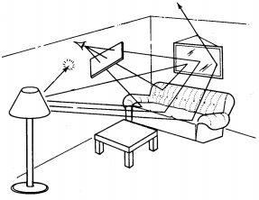
Forward Ray Tracing
camera or
"eye"
light source

Slide 4
Forward Ray Tracing
forward ray tracing traces the paths of light from the light source to the camera to produce an image
computationally infeasible because almost all of the possible paths of light miss the camera

Slide 5
Backward Ray Tracing
backward ray tracing traces the paths of light from the camera out into the environment to produce an image
computationally feasible because the process starts with a single* ray per screen pixel

Slide 6
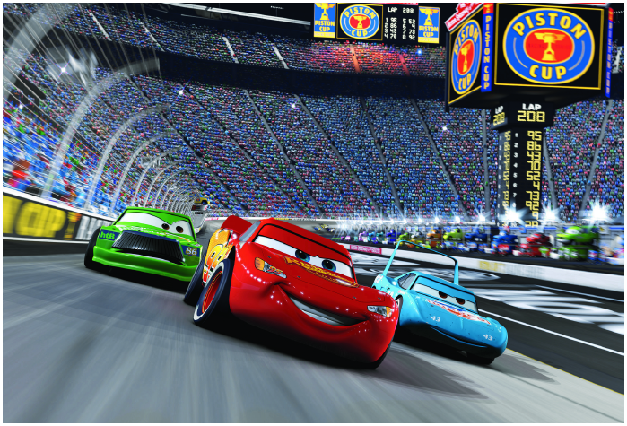
Why Ray Tracing: Shadows
shadows with ~1000 light sources
Ray Tracing for the Movie 'Cars', P. Christensen et al

Slide 7
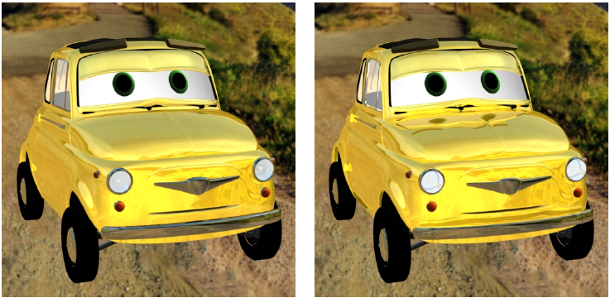
Ray Tracing: Reflections
Ray Tracing for the Movie 'Cars', P. Christensen et al

Slide 8
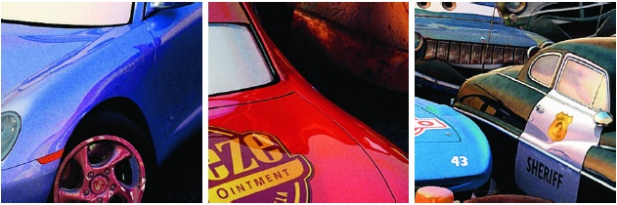
Ray Tracing: Reflections
Ray Tracing for the Movie 'Cars', P. Christensen et al

Slide 9
Comment on Previous Images
most of the rendering in the previous images was not done using ray tracing
ray tracing was only used on those parts of the image that would produce a noticeable difference

Slide 10
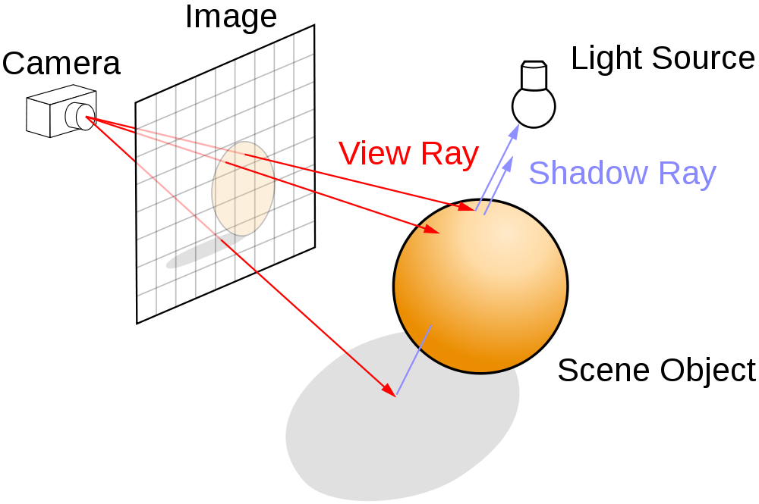
Backward Ray Tracing
http://en.wikipedia.org/wiki/File:Ray_trace_diagram.svg

Slide 11
Pseudocode for recursive raytracing (missing base cases)
Color raytrace(ray) {
if ray hits an object {
color0 = object_color
if object is shiny {
color1 = raytrace(reflected_ray)
}
if object is transparent {
color2 = raytrace(transmitted_ray)
}
return color0 + color1 + color2;
}
return background_color
}

Slide 12
Shadows
we can determine if a point is in shadow by tracing rays from the point to each light source
  called shadow rays
if a shadow ray hits an object before it reaches the light source then the point is in shadow

Slide 13
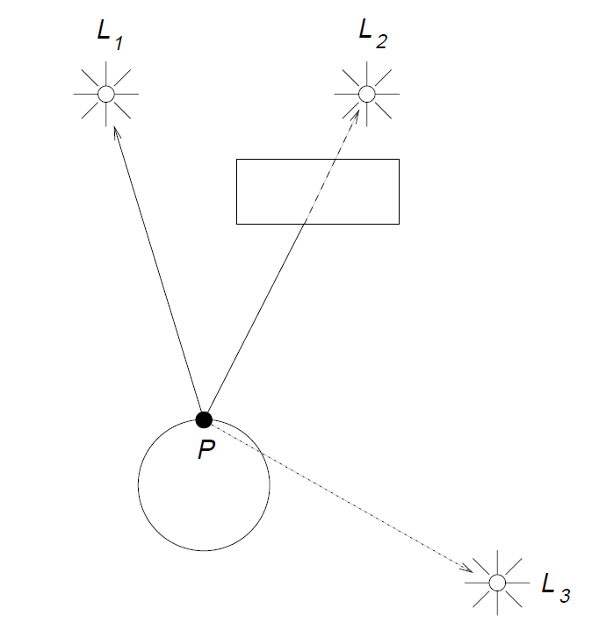
Shadows
not shadowed from L1
shadowed from L2
shadowed from L3

Slide 14
Reflections
if the ray hits a shiny object then we would like to know what reflection is seen at the hit point
we can cast a new ray in the mirror reflection direction to determine the reflection

Slide 15
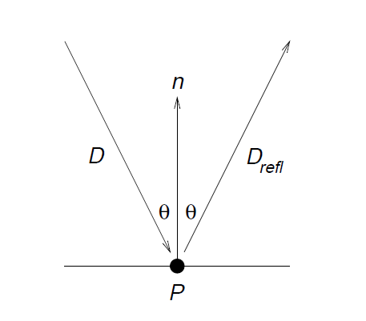
Reflections
incoming ray
reflection ray

Slide 16
Transparent Objects
if the ray hits a transparent object then we would like to know what can be seen through the object
we can cast a new ray in the refraction direction to determine what can be seen through the object

Slide 17
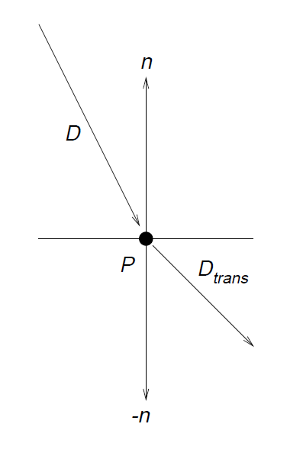
Transparent Objects
incoming ray
refraction ray

Slide 18
Recursion
each reflected and refracted ray can be treated as a new view ray emanating from a hit point
  i.e., we recursively trace the reflected and refracted rays

Slide 19
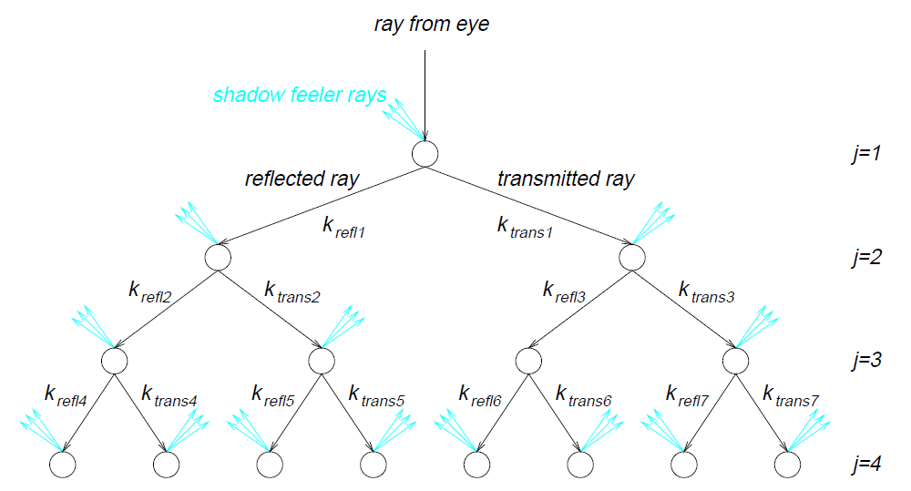
Ray Tracing as a Binary Tree
shadow rays

Slide 20
Stopping the Recursion
what are the base cases?
  ray misses all objects
  level of recursion exceeds a fixed value
  other cases outside the scope of EECS1030

Slide 21
How Fast is Ray Tracing
approaching real time for non-cinematic quality, e.g.,
  Brigade 2 game engine
  NVIDA OptiX
    demos here if you have a high-end NVIDIA graphics card
cinematic quality is much slower

Slide 22
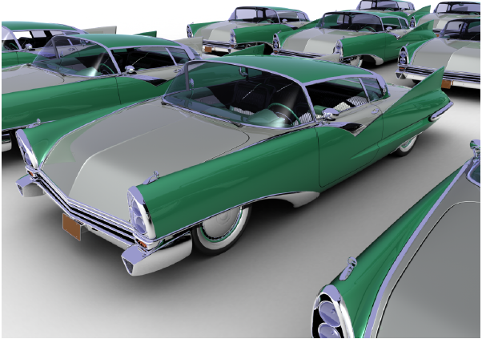
How Fast is Ray Tracing
678 million triangles
rays
  111 million diffuse
  37 million specular
  26 million shadow
1.2 billion ray-triangle
intersections
106 minutes on
2006 hardware

Slide 23
Bounding Volumes
it is easy to compute the intersection of a ray with certain shapes, e.g.,
  spheres and cubes
it is hard or expensive to compute the intersection of a ray with arbitrary shapes
idea
  put complex shapes inside simple ones

Slide 24
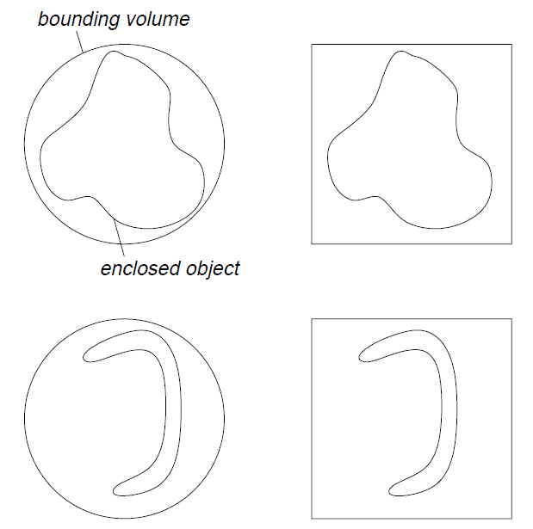
Bounding Volumes

Slide 25
Hierarchy of Bounding Volumes
why stop at putting complex shapes into bounding volumes?
why not put bounding volumes inside bounding volumes?

Slide 26
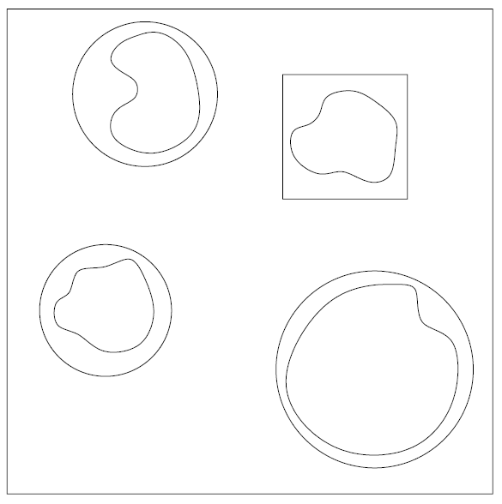
Hierarchy of Bounding Volumes

Slide 27
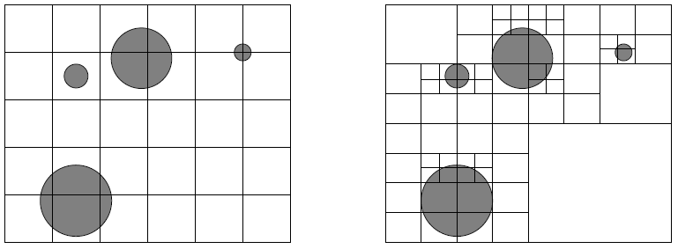
Spatial Subdivision
instead of putting objects inside volumes we can subdivide space

Slide 28
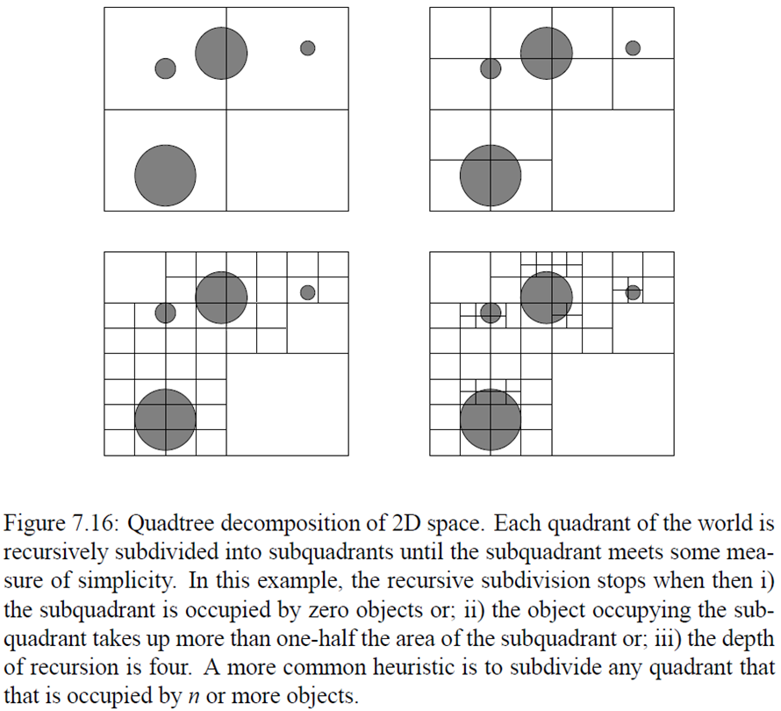
Quadtree Decomposition

Slide 29
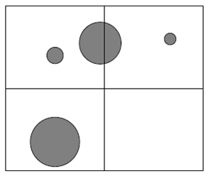
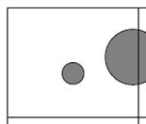
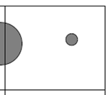
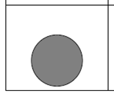













and so on ...

Slide 30
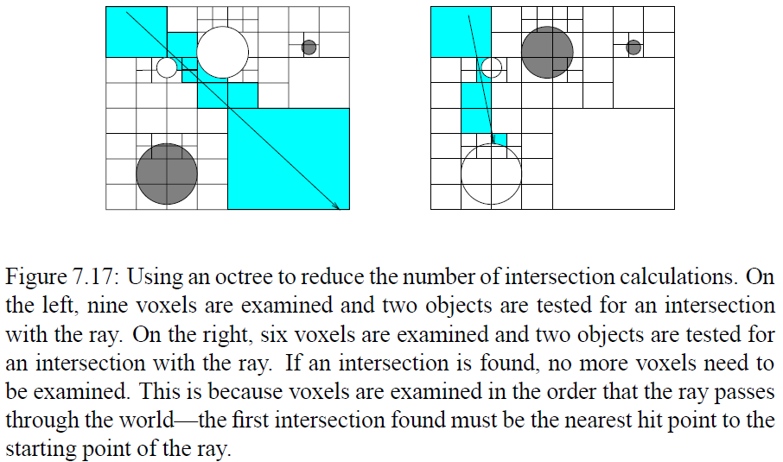
Using a Quadtree in Ray Tracing

Slide 31
Open Source Ray Tracers
Art of Illusion
POV-Ray
YafaRay
Manta
several others

