Slide 1
Informal Analysis of Merge Sort
suppose the running time (the number of operations) of merge sort is a function of the number of elements to sort
  let the function be T(n)
merge sort works by splitting the list into two sub-lists (each about half the size of the original list) and sorting the sub-lists
  this takes 2T(n/2) running time
then the sub-lists are merged
  this takes O(n) running time
total running time T(n) = 2T(n/2) + O(n)

Slide 2
Solving the Recurrence Relation
T(n) → 2T(n/2) + O(n) T(n) approaches...
≈ 2T(n/2) + n
= 2[ 2T(n/4) + n/2 ] + n
= 4T(n/4) + 2n
= 4[ 2T(n/8) + n/4 ] + 2n
= 8T(n/8) + 3n
= 8[ 2T(n/16) + n/8 ] + 3n
= 16T(n/16) + 4n
= 2^{k}T(n/2^{k}) + kn

Slide 3
Solving the Recurrence Relation
T(n) = 2^{k}T(n/2^{k}) + kn
for a list of length 1 we know T(1) = 1
  if we can substitute T(1) into the right-hand side of T(n) we might be able to solve the recurrence
  we have T(n/2^{k}) on the right-hand side, so we need to find some value of k such that
  n/2^{k} = 1 ⇒ 2^{k} = n ⇒ k = log₂(n)

Slide 4
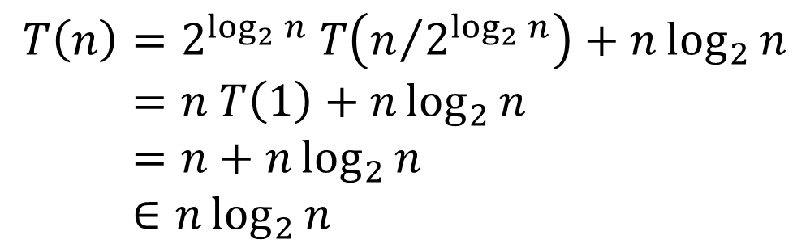
Solving the Recurrence Relation
$$T\left(n\right)=2^{\log_{2}{n}} T\left(n/{2^{\log_{2}{n}}}\right)+n\log_{2}{n} \\ =n T\left(1\right)+n\log_{2}{n} \\ =n+n\log_{2}{n} \\ ∈n\log_{2}{n}$$

Slide 5
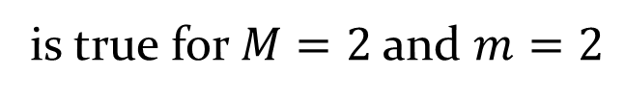

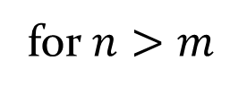
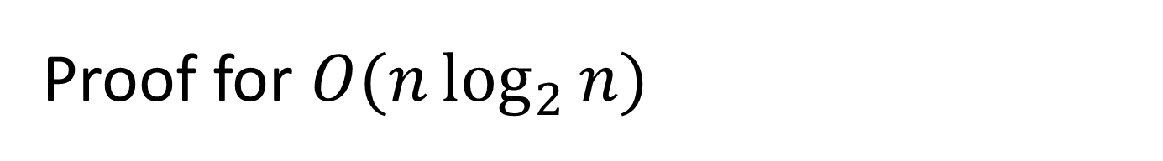

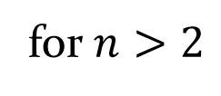


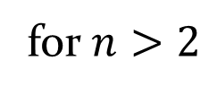
Proof for $O(n\log_{2}{n)}$
$$n<n\log_{2}{n}$$
for $n>2$
$$∴ n+n\log_{2}{n}<2n\log_{2}{n}$$
for $n>2$
$$∴ n+n\log_{2}{n}<Mn\log_{2}{n}$$
for $n>m$
is true for $M=2$ and $m=2$
$$∴ n+n\log_{2}{n} ∈ O\left(n\log_{2}{n}\right)$$

Slide 6
Recursion
notes Chapter 8

Slide 7
Is Merge Sort Efficient?
consider a simpler (non-recursive) sorting algorithm called insertion sort
// to sort an array a[0]..a[n-1] not Java
for i = 0 to (n-1) {
k = index of smallest element in sub-array a[i]..a[n-1]
swap a[i] and a[k]
}
for i = 0 to (n-1) { not Java
for j = (i+1) to (n-1) {
if (a[j] < a[i]) {
k = j;
}
}
tmp = a[i]; a[i] = a[k]; a[k] = tmp;
}
find smallest
element
1 comparison +
1 assignment
3 assignments

Slide 8

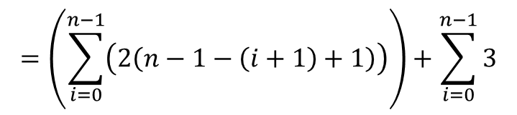

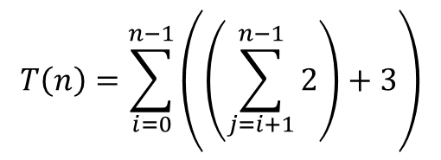
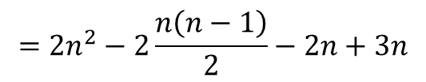
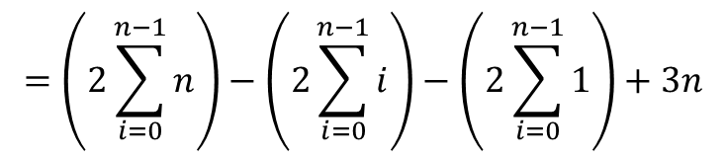
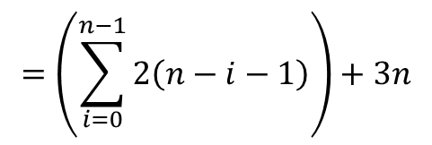

$$T\left(n\right)=\sum_{i=0}^{n−1}{\left(\left(\sum_{j=i+1}^{n−1}{2}\right)+3\right)}$$
$$=\left(\sum_{i=0}^{n−1}{\left(2\left(n−1−\left(i+1\right)+1\right)\right)}\right)+\sum_{i=0}^{n−1}{3}$$
$$=\left(\sum_{i=0}^{n−1}{2\left(n−i−1\right)}\right)+3n$$
$$=\left(2\sum_{i=0}^{n−1}{n}\right)−\left(2\sum_{i=0}^{n−1}{i}\right)−\left(2\sum_{i=0}^{n−1}{1}\right)+3n$$
$$=2n^{2}−2\frac{n\left(n−1\right)}{2}−2n+3n$$
$$=2n^{2}−n^{2}+n−2n+3n$$
$$=n^{2}+2n$$
$$∈O\left(n^{2}\right)$$

Slide 9
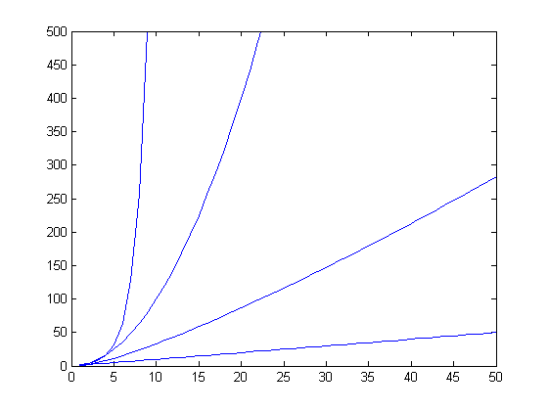
Comparing Rates of Growth
O(2^{n})
O(n²)
O(n logn)
O(n)
n

Slide 10
Comments
big O complexity tells you something about the running time of an algorithm as the size of the input, n, approaches infinity
  we say that it describes the limiting, or asymptotic, running time of an algorithm
for small values of n it is often the case that a less efficient algorithm (in terms of big O) will run faster than a more efficient one
  insertion sort is typically faster than merge sort for short lists of numbers

Slide 11
Revisiting the Fibonacci Numbers
the recursive implementation based on the definition of the Fibonacci numbers is inefficient
public static int fibonacci(int n) {
if (n == 0) {
return 0;
}
else if (n == 1) {
return 1;
}
int f = fibonacci(n - 1) + fibonacci(n - 2);
return f;
}

Slide 12
how inefficient is it?
let T(n) be the running time to compute the nth Fibonacci number
  T(0) = T(1) = 1
  T(n) is a recurrence relation

Slide 13
T(n)

Slide 14
Solving the Recurrence Relation
T(n) > 2^{k}T(n - 2k)
we know T(1) = 1
  if we can substitute T(1) into the right-hand side of T(n) we might be able to solve the recurrence
  we have T(n - 2k) so we need to find a value for k such that:
  n - 2k = 1 ⇒ 1 + 2k = n ⇒ k = (n – 1)/2

Slide 15
Towers of Hanoi
a problem easily solved using recursion
  move the stack of n disks from A to C
    can move one disk at a time from the top of one stack onto another stack
    cannot move a larger disk onto a smaller disk
A
B
C

Slide 16
Towers of Hanoi
legend says that the world will end when a 64 disk version of the puzzle is solved
several appearances in pop culture
  Doctor Who
  Rise of the Planet of the Apes
  Survior: South Pacific

Slide 17
Towers of Hanoi
n = 1
move disk from A to C
A
B
C

Slide 18
Towers of Hanoi
n = 1
A
B
C

Slide 19
Towers of Hanoi
n = 2
move disk from A to B
A
B
C

Slide 20
Towers of Hanoi
n = 2
move disk from A to C
A
B
C

Slide 21
Towers of Hanoi
n = 2
move disk from B to C
A
B
C

Slide 22
Towers of Hanoi
n = 2
A
B
C

Slide 23
Towers of Hanoi
n = 3
move disk from A to C
A
B
C

Slide 24
Towers of Hanoi
n = 3
move disk from A to B
A
B
C

Slide 25
Towers of Hanoi
n = 3
move disk from C to B
A
B
C

Slide 26
Towers of Hanoi
n = 3
move disk from A to C
A
B
C

Slide 27
Towers of Hanoi
n = 3
move disk from B to A
A
B
C

Slide 28
Towers of Hanoi
n = 3
move disk from B to C
A
B
C

Slide 29
Towers of Hanoi
n = 3
move disk from A to C
A
B
C

Slide 30
Towers of Hanoi
n = 3
A
B
C

Slide 31
Towers of Hanoi
n = 4
move (n – 1) disks from A to B using C
A
B
C

Slide 32
Towers of Hanoi
n = 4
move disk from A to C
A
B
C

Slide 33
Towers of Hanoi
n = 4
move (n – 1) disks from B to C using A
A
B
C

Slide 34
Towers of Hanoi
n = 4
A
B
C

Slide 35
base case n = 1
  move disk from A to C
recursive case
  move (n – 1) disks from A to B
  move 1 disk from A to C
  move (n – 1) disks from B to C

Slide 36
Towers of Hanoi
public static void move(int n,
String from,
String to,
String using) {
if(n == 1) {
System.out.println("move disk from " + from + " to " + to);
}
else {
move(n - 1, from, using, to);
move(1, from, to, using);
move(n - 1, using, to, from);
}
}

