Slide 1
Recursion
notes Chapter 8

Slide 2
What Happens During Recursion?
a simplified model of what happens during a recursive method invocation is the following:
whenever a method is invoked that method runs in a new block of memory
when a method recursively invokes itself, a new block of memory is allocated for the newly invoked method to run in
consider a slightly modified version of the powerOf10 method

Slide 3
public static double powerOf10(int n) {
double result;
if (n < 0) {
result = 1.0 / powerOf10(-n);
}
else if (n == 0) {
result = 1.0;
}
else {
result = 10 * powerOf10(n - 1);
}
return result;
}

Slide 4
double x = Recursion.powerOf10(3);
 | 100 | main method
x |  | powerOf10(3)

Slide 5
double x = Recursion.powerOf10(3);
 | 600 | powerOf10 method
n |  | 3
result
 | 100 | main method
x |  | powerOf10(3)

Slide 6
double x = Recursion.powerOf10(3);
 | 600 | powerOf10 method
n |  | 3
result |  | 10 * powerOf10(2)
 | 100 | main method
x |  | powerOf10(3)

Slide 7
double x = Recursion.powerOf10(3);
 | 600 | powerOf10 method
n |  | 3
result |  | 10 * powerOf10(2)
 | 100 | main method
x |  | powerOf10(3)
 | 750 | powerOf10 method
n |  | 2
result

Slide 8
double x = Recursion.powerOf10(3);
 | 600 | powerOf10 method
n |  | 3
result |  | 10 * powerOf10(2)
 | 100 | main method
x |  | powerOf10(3)
 | 750 | powerOf10 method
n |  | 2
result |  | 10 * powerOf10(1)

Slide 9
double x = Recursion.powerOf10(3);
 | 600 | powerOf10 method
n |  | 3
result |  | 10 * powerOf10(2)
 | 100 | main method
x |  | powerOf10(3)
 | 750 | powerOf10 method
n |  | 2
result |  | 10 * powerOf10(1)
 | 800 | powerOf10 method
n |  | 1
result |  | 10 * powerOf10(0)

Slide 10
double x = Recursion.powerOf10(3);
 | 600 | powerOf10 method
n |  | 3
result |  | 10 * powerOf10(2)
 | 100 | main method
x |  | powerOf10(3)
 | 750 | powerOf10 method
n |  | 2
result |  | 10 * powerOf10(1)
 | 800 | powerOf10 method
n |  | 1
result |  | 10 * powerOf10(0)
 | 950 | powerOf10 method
n |  | 0
result

Slide 11
double x = Recursion.powerOf10(3);
 | 600 | powerOf10 method
n |  | 3
result |  | 10 * powerOf10(2)
 | 100 | main method
x |  | powerOf10(3)
 | 750 | powerOf10 method
n |  | 2
result |  | 10 * powerOf10(1)
 | 800 | powerOf10 method
n |  | 1
result |  | 10 * powerOf10(0)
 | 950 | powerOf10 method
n |  | 0
result |  | 1

Slide 12
double x = Recursion.powerOf10(3);
 | 600 | powerOf10 method
n |  | 3
result |  | 10 * powerOf10(2)
 | 100 | main method
x |  | powerOf10(3)
 | 750 | powerOf10 method
n |  | 2
result |  | 10 * powerOf10(1)
 | 800 | powerOf10 method
n |  | 1
result |  | 10 * 1
 | 950 | powerOf10 method
n |  | 0
result |  | 1

Slide 13
double x = Recursion.powerOf10(3);
 | 600 | powerOf10 method
n |  | 3
result |  | 10 * powerOf10(2)
 | 100 | main method
x |  | powerOf10(3)
 | 750 | powerOf10 method
n |  | 2
result |  | 10 * powerOf10(1)
 | 800 | powerOf10 method
n |  | 1
result |  | 10

Slide 14
double x = Recursion.powerOf10(3);
 | 600 | powerOf10 method
n |  | 3
result |  | 10 * powerOf10(2)
 | 100 | main method
x |  | powerOf10(3)
 | 750 | powerOf10 method
n |  | 2
result |  | 10 * 10
 | 800 | powerOf10 method
n |  | 1
result |  | 10

Slide 15
double x = Recursion.powerOf10(3);
 | 600 | powerOf10 method
n |  | 3
result |  | 10 * powerOf10(2)
 | 100 | main method
x |  | powerOf10(3)
 | 750 | powerOf10 method
n |  | 2
result |  | 100

Slide 16
double x = Recursion.powerOf10(3);
 | 600 | powerOf10 method
n |  | 3
result |  | 10 * 100
 | 100 | main method
x |  | powerOf10(3)
 | 750 | powerOf10 method
n |  | 2
result |  | 100

Slide 17
double x = Recursion.powerOf10(3);
 | 600 | powerOf10 method
n |  | 3
result |  | 1000
 | 100 | main method
x |  | powerOf10(3)

Slide 18
double x = Recursion.powerOf10(3);
 | 600 | powerOf10 method
n |  | 3
result |  | 1000
 | 100 | main method
x |  | 1000

Slide 19
double x = Recursion.powerOf10(3);
 | 100 | main method
x |  | 1000

Slide 20
Recursion and Collections
consider the problem of searching for an element in a list
searching a list for a particular element can be performed by recursively examining the first element of the list
if the first element is the element we are searching for then we can return true
otherwise, we recursively search the sub-list starting at the next element
example: search for "X" in the list ["Z", "Q", "B", "X", "J"]

Slide 21
Recursively Search a List
contains("X", ["Z", "Q", "B", "X", "J"])
→ "X".equals("Z") == false
→ contains("X", ["Q", "B", "X", "J"]) recursive call
→ "X".equals("Q") == false
→ contains("X", ["B", "X", "J"]) recursive call
→ "X".equals("B") == false
→ contains("X", ["X", "J"]) recursive call
→ "X".equals("X") == true done!

Slide 22
Recursively Search a List
base case(s)?

Slide 23
public class Day25 {
public static <T> boolean contains(T element, List<T> t) {
boolean result;
if (t.size() == 0) { // base case
result = false;
}
else if (t.get(0).equals(element)) { // base case
result = true;
}
else { // recursive call
result = Day25.contains(element, t.subList(1, t.size()));
}
return result;
}
}

Slide 24
Recursively Search a List
recursive call?

Slide 25
public class Day25 {
public static <T> boolean contains(T element, List<T> t) {
boolean result;
if (t.size() == 0) { // base case
result = false;
}
else if (t.get(0).equals(element)) { // base case
result = true;
}
else { // recursive call
result = Day25.contains(element, t.subList(1, t.size()));
}
return result;
}
}

Slide 26
Recursion and Collections
consider the problem of moving the smallest element in a list of integers to the front of the list

Slide 27
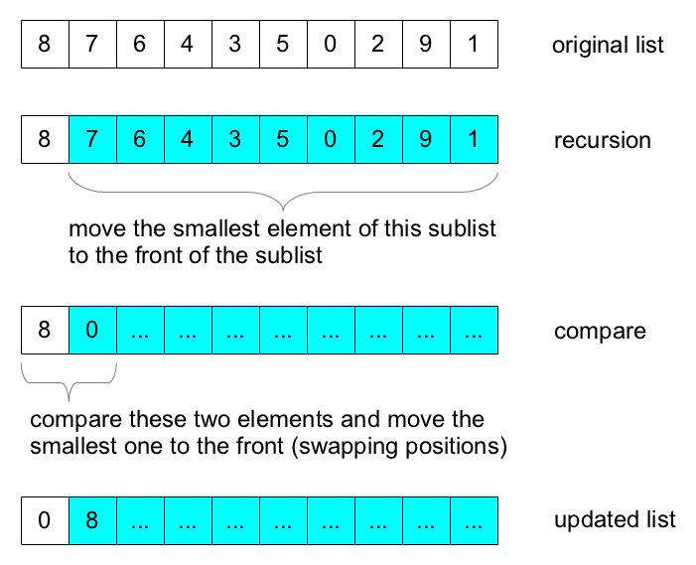
Recursively Move Smallest to Front

Slide 28
Recursively Move Smallest to Front
base case?

Slide 29
Recursively Move Smallest to Front
public class Day25 {
public static void minToFront(List<Integer> t) {
if (t.size() < 2) {
return;
}
Day25.minToFront(t.subList(1, t.size()));
int first = t.get(0);
int second = t.get(1);
if (second < first) {
t.set(0, second);
t.set(1, first);
}
}
}

Slide 30
Recursively Move Smallest to Front
recursive call?

Slide 31
Recursively Move Smallest to Front
public class Day25 {
public static void minToFront(List<Integer> t) {
if (t.size() < 2) {
return;
}
Day25.minToFront(t.subList(1, t.size()));
int first = t.get(0);
int second = t.get(1);
if (second < first) {
t.set(0, second);
t.set(1, first);
}
}
}
http://docs.oracle.com/javase/7/docs/api/java/util/List.html#subList%28int,%20int%29

Slide 32
Recursively Move Smallest to Front
compare and update?

Slide 33
Recursively Move Smallest to Front
public class Day25 {
public static void minToFront(List<Integer> t) {
if (t.size() < 2) {
return;
}
Day25.minToFront(t.subList(1, t.size()));
int first = t.get(0);
int second = t.get(1);
if (second < first) {
t.set(0, second);
t.set(1, first);
}
}
}

