Slide 1
Inheritance (Part 4)
Abstract Classes

Slide 2
Abstract Classes
sometimes you will find that you want the API for a base class to have a method that the base class cannot define
  e.g. you might want to know what a Dog's bark sounds like but the sound of the bark depends on the breed of the dog
    you want to add the method bark to Dog but only the subclasses of Dog can implement bark

Slide 3
Abstract Classes
sometimes you will find that you want the API for a base class to have a method that the base class cannot define
  e.g. you might want to know the breed of a Dog but only the subclasses have information about the breed
    you want to add the method getBreed to Dog but only the subclasses of Dog can implement getBreed

Slide 4
if the base class has methods that only subclasses can define and the base class has fields common to all subclasses then the base class should be abstract
  if you have a base class that just has methods that it cannot implement then you probably want an interface
abstract :
    (dictionary definition) existing only in the mind
in Java an abstract class is a class that you cannot make instances of
  e.g. http://docs.oracle.com/javase/7/docs/api/java/util/AbstractList.html

Slide 5
an abstract class provides a partial definition of a class
  the "partial definition" contains everything that is common to all of the subclasses
  the subclasses complete the definition
an abstract class can define fields and methods
  subclasses inherit these
an abstract class can define constructors
  subclasses must call these
an abstract class can declare abstract methods
  subclasses must define these (unless the subclass is also abstract)

Slide 6
Abstract Methods
an abstract base class can declare, but not define, zero or more abstract methods
the base class is saying "all Dogs can provide a String describing the breed, but only the subclasses know enough to implement the method"
public abstract class Dog
{
// fields, ctors, regular methods
public abstract String getBreed();
}

Slide 7
Abstract Methods
the non-abstract subclasses must provide definitions for all abstract methods
  consider getBreed in Mix

Slide 8
public class Mix extends Dog
{ // stuff from before...
@Override
public String getBreed() {
if(this.breeds.isEmpty()) {
return "mix of unknown breeds";
}
StringBuffer b = new StringBuffer();
b.append("mix of");
for(String breed : this.breeds) {
b.append(" " + breed);
}
return b.toString();
}

Slide 9
PureBreed
a purebreed dog is a dog with a single breed
  one String field to store the breed
note that the breed is determined by the subclasses
  the class PureBreed cannot give the breed field a value
  but it can implement the method getBreed
the class PureBreed defines an field common to all subclasses and it needs the subclass to inform it of the actual breed
  PureBreed is also an abstract class

Slide 10
public abstract class PureBreed extends Dog
{
private String breed;
public PureBreed(String breed) {
super();
this.breed = breed;
}
public PureBreed(String breed, int size, int energy) {
super(size, energy);
this.breed = breed;
}

Slide 11
@Override public String getBreed()
{
return this.breed;
}
}

Slide 12
Subclasses of PureBreed
the subclasses of PureBreed are responsible for setting the breed
  consider Komondor

Slide 13
Komondor
public class Komondor extends PureBreed
{
private final String BREED = "komondor";
public Komondor() {
super(BREED);
}
public Komondor(int size, int energy) {
super(BREED, size, energy);
}
// other Komondor methods...
}

Slide 14
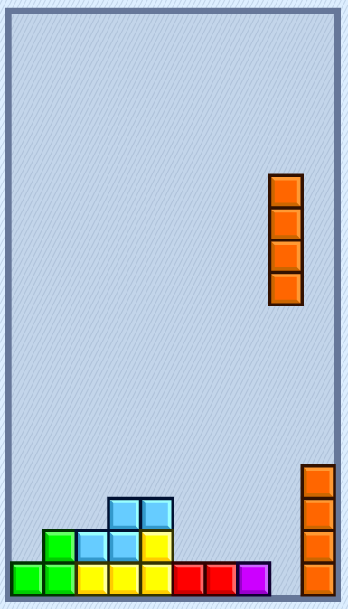
Another example: Tetris
played with 7 standard blocks called tetriminoes
blocks drop from the top
player can move blocks left, right, and down
player can spin blocks left and right

Slide 15
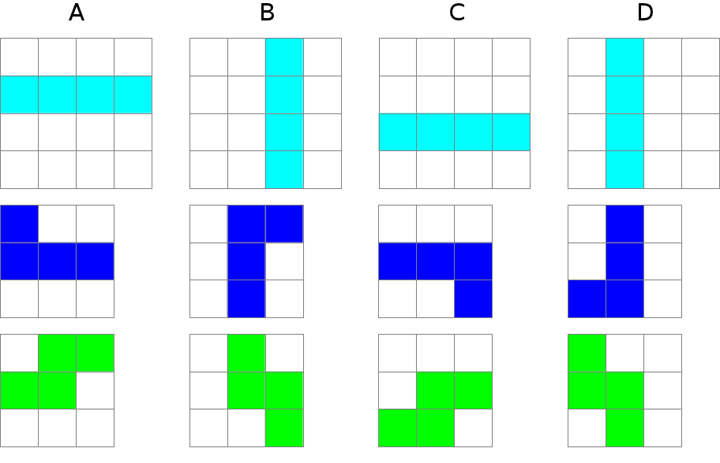
Tetriminoes
spinning the I, J, and S blocks

Slide 16
Tetriminoes
features common to all tetriminoes
  has-a color
  has-a shape
  has-a position
  draw
  move left, right, and down
features unique to each kind of tetrimino
  the actual shape
  spin left and right

Slide 17
class name in italics for abstract classes
an immutable 2D point
a grid object that stores the shape
Block
- color : Color
- position : IPoint2D
- grid : BlockGrid
+ draw()
+ moveDown()
+ moveLeft()
+ moveRight()
...
IBlock
+ IBlock(IPoint2D, Color)
+ spinLeft()
+ spinRight()
constructor defines the shape
methods modify the shape to produce the rotated version of the block
http://www.eecs.yorku.ca/course_archive/2013-14/F/1030/labs/06/lab6.html

Slide 18
Inheritance (Part 5)
Static Features; Interfaces

Slide 19
Static Fields and Inheritance
static fields behave the same as non-static fields in inheritance
  public and protected static fields are inherited by subclasses, and subclasses can access them directly by name
  private static fields are not inherited and cannot be accessed directly by name
    but they can be accessed/modified using public and protected methods

Slide 20
Static Fields and Inheritance
the important thing to remember about static fields and inheritance
  there is only one copy of the static field shared among the declaring class and all subclasses
consider trying to count the number of Dog objects created by using a static counter

Slide 21
// the wrong way to count the number of Dogs created
public abstract class Dog {
// other fields...
static protected int numCreated = 0;
Dog() {
// ...
Dog.numCreated++;
}
public static int getNumberCreated() {
return Dog.numCreated;
}
// other contructors, methods...
}
protected, not private, so that subclasses can modify it directly

Slide 22
// the wrong way to count the number of Dogs created
public class Mix extends Dog
{
// fields...
Mix()
{
super();
Mix.numCreated++;
}
// other contructors, methods...
}

Slide 23
// too many dogs!
public class TooManyDogs
{
public static void main(String[] args)
{
Mix mutt = new Mix();
System.out.println( Mix.getNumberCreated() );
}
}
prints 2

Slide 24
What Went Wrong?
there is only one copy of the static field shared among the declaring class and all subclasses
  Dog declared the static field
  Dog increments the counter everytime its constructor is called
  Mix inherits and shares the single copy of the field
  Mix constructor correctly calls the superclass constructor
    which causes numCreated to be incremented by Dog
  Mix constructor then incorrectly increments the counter

Slide 25
Counting Dogs and Mixes
suppose you want to count the number of Dog instances and the number of Mix instances
  Mix must also declare a static field to hold the count
    somewhat confusingly, Mix can give the counter the same name as the counter declared by Dog

Slide 26
public class Mix extends Dog
{
// other fields...
private static int numCreated = 0; // bad style
public Mix()
{
super(); // will increment Dog.numCreated
// other Mix stuff...
numCreated++; // will increment Mix.numCreated
}
// ...

Slide 27
Hiding Fields
note that the Mix field numCreated has the same name as an field declared in a superclass
  whenever numCreated is used in Mix, it is the Mix version of the field that is used
if a subclass declares an field with the same name as a superclass field, we say that the subclass field hides the superclass field
  considered bad style because it can make code hard to read and understand
    should change numCreated to numMixCreated in Mix

Slide 28
Static Methods and Inheritance
there is a significant difference between calling a static method and calling a non-static method when dealing with inheritance
there is no dynamic dispatch on static methods
  therefore, you cannot override a static method

Slide 29
public abstract class Dog {
private static int numCreated = 0;
public static int getNumCreated() {
return Dog.numCreated;
}
}
public class Mix {
private static int numMixCreated = 0;
public static int getNumCreated() {
return Mix.numMixCreated;
}
}
public class Komondor {
private static int numKomondorCreated = 0;
public static int getNumCreated() {
return Komondor.numKomondorCreated;
}
}
notice no @Override
notice no @Override

Slide 30
public class WrongCount {
public static void main(String[] args) {
Dog mutt = new Mix();
Dog shaggy = new Komondor();
System.out.println( mutt.getNumCreated() );
System.out.println( shaggy.getNumCreated() );
System.out.println( Mix.getNumCreated() );
System.out.println( Komondor.getNumCreated() );
}
}
prints 2
2
1
1

Slide 31
What's Going On?
there is no dynamic dispatch on static methods
because the declared type of mutt is Dog, it is the Dog version of getNumCreated that is called
because the declared type of shaggy is Dog, it is the Dog version of getNumCreated that is called

Slide 32
Hiding Methods
notice that Mix.getNumCreated and Komondor.getNumCreated work as expected
if a subclass declares a static method with the same name as a superclass static method, we say that the subclass static method hides the superclass static method
  you cannot override a static method, you can only hide it
  hiding static methods is considered bad form because it makes code hard to read and understand

Slide 33
the client code in WrongCount illustrates two cases of bad style, one by the client and one by the implementer of the Dog hierarchy
  the client should not have used an instance to call a static method
  the implementer should not have hidden the static method in Dog

