Slide 1
More constructors

Slide 2
Constructors
recall that a public constructor is what a client uses to create an object
the purpose of a constructor is to initialize the state of an object
  it should set the values of the non-static fields to appropriate values
    we should set the fields named real and imag
our complex number class has a single constructor so far

Slide 3
public class Complex {
private double real;
private double imag;
public Complex(double real, double imag) {
this.real = real;
this.imag = imag;
}

Slide 4
Constructors
our class is missing two constructors commonly found in a value type class
no-argument constructor
  a constructor defined as having no parameters
copy constructor
  a constructor with a single parameter whose type is the same as the type of the class

Slide 5
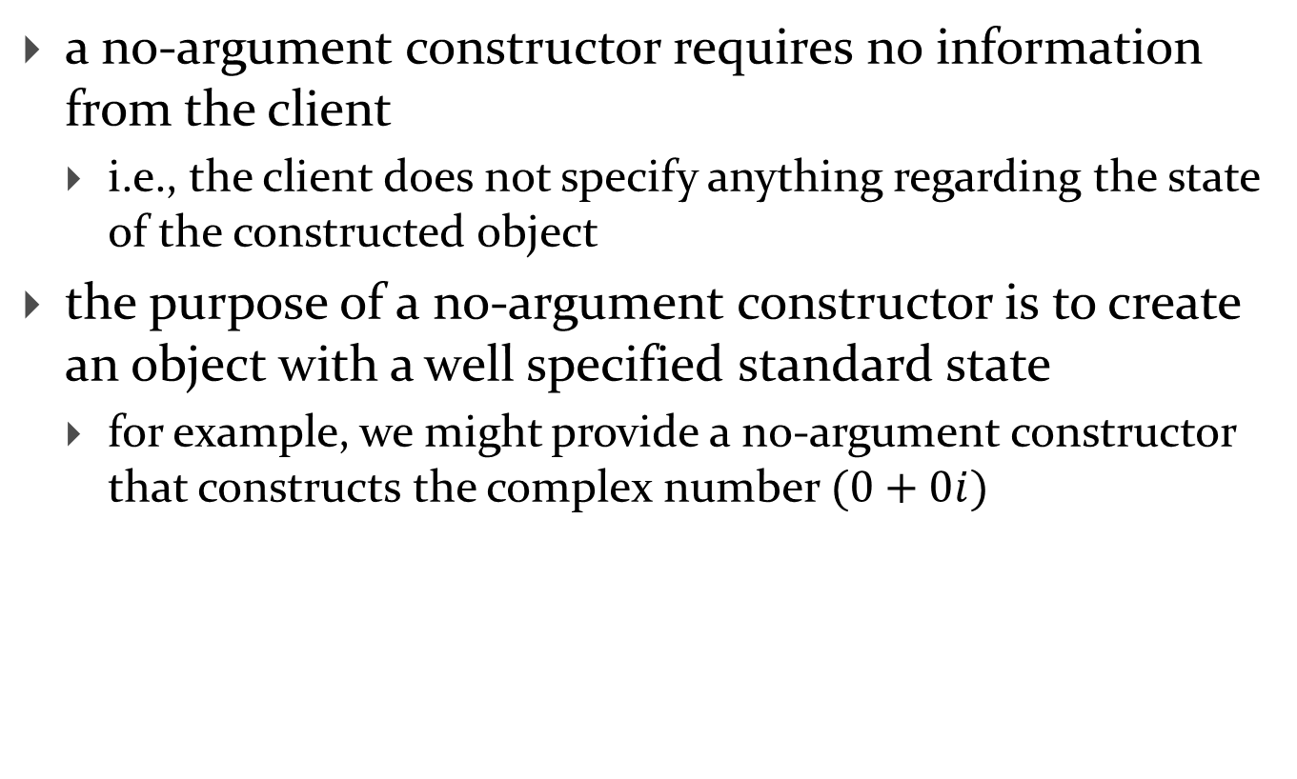
No-argument constructor
a no-argument constructor requires no information from the client
  i.e., the client does not specify anything regarding the state of the constructed object
the purpose of a no-argument constructor is to create an object with a well specified standard state
  for example, we might provide a no-argument constructor that constructs the complex number $(0+0i)$

Slide 6
public class Complex {
private double real;
private double imag;
public Complex(double real, double imag) {
this.real = real;
this.imag = imag;
}
public Complex() {
this.real = 0;
this.imag = 0;
}

Slide 7
Copy constructor
a copy constructor copies the state of another object of the same type as the class
  it has a single parameter that is the same type as the class
a copy constructor for our complex number class would copy the real and imaginary parts of another complex number

Slide 8
public Complex(double real, double imag) {
this.real = real;
this.imag = imag;
}
public Complex() {
this.real = 0;
this.imag = 0;
}
public Complex(Complex other) {
this.real = other.getReal();
this.imag = other.getImag();
}

Slide 9
Avoiding Code Duplication
notice that the constructor bodies are almost identical to each other
  all three constructors have 2 lines of code
  all three constructors set the real and imaginary parts
whenever you see duplicated code you should consider moving the duplicated code into a method
in this case, one of the constructors already does everything we need to implement the other constructors…

Slide 10
Constructor chaining
a constructor is allowed to invoke another constructor
when a constructor invokes another constructor it is called constructor chaining
to invoke a constructor in the same class you use the this keyword
  if you do this then it must occur on the first line of the constructor body
    but you cannot use this in a method to invoke a constructor
we can re-write two of our constructors to use constructor chaining...

Slide 11
public Complex(double real, double imag) {
this.real = real;
this.imag = imag;
}
public Complex() {
this(0.0, 0.0);
}
public Complex(Complex other) {
this(other.getReal(), other.getImag());
}
invokes
invokes

Slide 12
compareTo

Slide 13
Comparable Objects
many value types have a natural ordering
  that is, for two objects x and y, x is less than y is meaningful
    Short, Integer, Float, Double, etc
    Strings can be compared in dictionary order
    Dates can be compared in chronological order
    you might compare Complex numbers by their absolute value
if your class has a natural ordering, consider implementing the Comparable interface
  doing so allows clients to sort arrays or Collections of your object

Slide 14
Interfaces
an interface is (usually) a group of related methods with empty bodies
  the Comparable interface has just one method
  public interface Comparable<T>
  {
  int compareTo(T t);
  }
a class that implements an interfaces promises to provide an implementation for every method in the interface

Slide 15
compareTo()
Compares this object with the specified object for order. Returns a negative integer, zero, or a positive integer as this object is less than, equal to, or greater than the specified object.
Throws a ClassCastException if the specified object type cannot be compared to this object.

Slide 16
Complex compareTo
public class Complex implements Comparable<Complex> {
// fields, constructors, methods...
@Override
public int compareTo(Complex other) {
double thisAbs = this.abs();
double otherAbs = other.abs();
if (thisAbs > otherAbs) {
return 1;
}
else if (thisAbs < otherAbs) {
return -1;
}
return 0;
}

Slide 17
Complex compareTo
don't forget what you learned in EECS1020
  you should delegate work to well-tested components where possible
for complex numbers, we need to compare two double values
  java.lang.Double has methods that do exactly this

Slide 18
Complex compareTo
public class Complex implements Comparable<Complex> {
// fields, constructors, methods...
@Override
public int compareTo(Complex other) {
return Double.compare(this.abs(), other.abs());
}

Slide 19
Comparable Contract
the sign of the returned int must flip if the order of the two compared objects flip
  if x.compareTo(y) > 0 then y.compareTo(x) < 0
  if x.compareTo(y) < 0 then y.compareTo(x) > 0
  if x.compareTo(y) == 0 then y.compareTo(x) == 0

Slide 20
Comparable Contract
compareTo() must be transitive
  if x.compareTo(y) > 0 && y.compareTo(z) > 0 then x.compareTo(z) > 0
  if x.compareTo(y) < 0 && y.compareTo(z) < 0 then x.compareTo(z) < 0
  if x.compareTo(y) == 0 && y.compareTo(z) == 0 then x.compareTo(z) == 0

Slide 21
Comparable Contract
if x.compareTo(y) == 0 then the signs of x.compareTo(z) and y.compareTo(z) must be the same

Slide 22
Consistency with equals
an implementation of compareTo() is said to be consistent with equals() when
  if x.compareTo(y) == 0 then
  x.equals(y) == true
  and
  if x.equals(y) == true then
  x.compareTo(y) == 0

Slide 23
Not in the Comparable Contract
it is not required that compareTo() be consistent with equals()
  that is
  if x.compareTo(y) == 0 then
  x.equals(y) == false is acceptable
  similarly
  if x.equals(y) == true then
  x.compareTo(y) != 0 is acceptable
try to come up with examples for both cases above
is Complex compareTo consistent with equals?

Slide 24
Implementing compareTo
if you are comparing fields of type float or double you should use Float.compare or Double.compare instead of <, >, or ==
if your compareTo implementation is broken, then any classes or methods that rely on compareTo will behave erratically
  TreeSet, TreeMap
  many methods in the utility classes Collections and Arrays

