Slide 1
Non-static classes
Part 2

Slide 2
Methods
like constructors, all non-static methods have an implicit parameter named this
for methods, this refers to the object that was used to call the method

Slide 3
Accessors
an accessor method enables the client to gain access to an otherwise private field of the class
the name of an accessor method often begins with get
for fields of primitive type or immutable type, the accessor method implementation simply returns the value of the field
  for fields that are object references the implementer must think more carefully about the implementation
    this will be discussed later on in the course

Slide 4
public class Complex {
private double real;
private double imag;
public Complex(double re, double im) {
this.real = re;
this.imag = im;
}
public double getReal() {
return this.real;
}
public double getImag() {
return this.imag;
}

Slide 5
Mutators
a mutator method enables the client to modify (or mutate) an otherwise private field of the class
the name of an accessor method often begins with set
for fields of primitive type or immutable type, the mutator method implementation simply modifies the value of the field
  for fields that are object references the implementer must think more carefully about the implementation
    this will be discussed later on in the course

Slide 6
public void setReal(double newReal) {
this.real = newReal;
}
public void setImag(double newImag) {
this.imag = newImag;
}

Slide 7

conj
to compute the complex conjugate of
  $a+bi$
  we return a new complex number equal to
  $a+\left(−b\right)i$

Slide 8
public Complex conj() {
return new Complex(this.getReal(), -this.getImag());
}

Slide 9

abs
to compute the absolute value of
  $a+bi$
  we return a new real number equal to
  $\sqrt{a^{2}+b^{2}}$

Slide 10
public double abs() {
// "obvious" implementation
double a = this.getReal();
double b = this.getImag();
return Math.sqrt(a * a + b * b);
}

Slide 11
abs
the problem with the obvious implementation is that it fails in cases where the value of
z.abs()
can be represented using double but the value of
a * a + b * b
cannot be represented using double

Slide 12
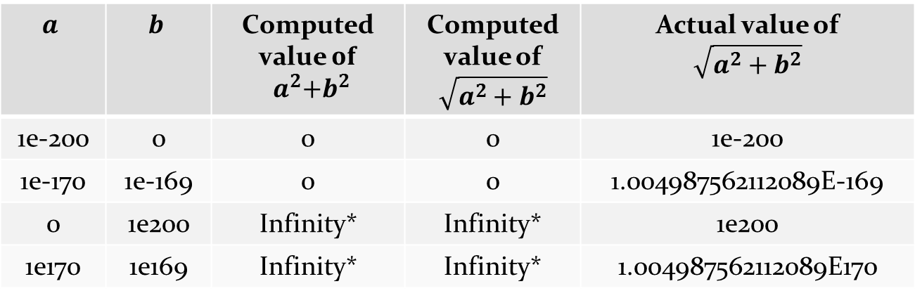

abs
examples of underflow and overflow
java.lang.Math provides a way to avoid intermediate under- and overflow for $\sqrt{a^{2}+b^{2}}$
$$a$$ | $$b$$ | Computed value $of$ $${ a}^{2}+b^{2}$$ | Computed value of $\sqrt{a^{2}+b^{2}}$ | Actual value of $$\sqrt{a^{2}+b^{2}}$$
1e-200 | 0 | 0 | 0 | 1e-200
1e-170 | 1e-169 | 0 | 0 | 1.004987562112089E-169
0 | 1e200 | Infinity* | Infinity* | 1e200
1e170 | 1e169 | Infinity* | Infinity* | 1.004987562112089E170
* Double.POSITIVE_INFINITY

Slide 13
public double abs() {
// avoids intermediate under- and overflow
return Math.hypot(this.getReal(), this.getImag());
}

Slide 14
abs
the field that studies solving mathematical problems using computational techniques is called numerical analysis
  of interest in computer science, mathematics, engineering, and science
how does Math.hypot work?
  for a pure Java implementation the ideas described in the following link work
    http://blogs.mathworks.com/cleve/2012/07/30/pythagorean-addition/

Slide 15

add
to add two complex numbers
$\left(a+bi\right)+\left(c+di\right)$
we return a new complex number equal to
$$\left(a+c\right)+\left(b+d\right)i$$
this
other

Slide 16
public Complex add(Complex other) {
double a = this.getReal();
double b = this.getImag();
double c = other.getReal();
double d = other.getImag();
return new Complex(a + c, b + d);
}

Slide 17

multiply
to multiply two complex numbers
$\left(a+bi\right)×\left(c+di\right)$
we return a new complex number equal to
$$\left(ac−bd\right)+\left(bc+ad\right)i$$
this
other

Slide 18
public Complex multiply(Complex other) {
double a = this.getReal();
double b = this.getImag();
double c = other.getReal();
double d = other.getImag();
return new Complex(a * c - b * d,
b * c + a * d);
}

Slide 19
Obligatory methods
recall that all classes in Java inherit from java.lang.Object
  http://docs.oracle.com/javase/7/docs/api/java/lang/Object.html
any class you create inherits all of the public and protected fields and methods of java.lang.Object
  the course notes refers to the methods inherited from java.lang.Object as obligatory methods
  there are 11 such methods in total, but we are only interested in 3 of them
    toString, equals, hashCode

Slide 20
toString
toString() returns a String representation of the calling object
  we can call toString() with our current Complex class even though we have not implemented it
  this prints something like Complex@fff003c1 on my computer
// client of Complex
Complex z = new Complex(1, 2);
System.out.println(z.toString());

Slide 21
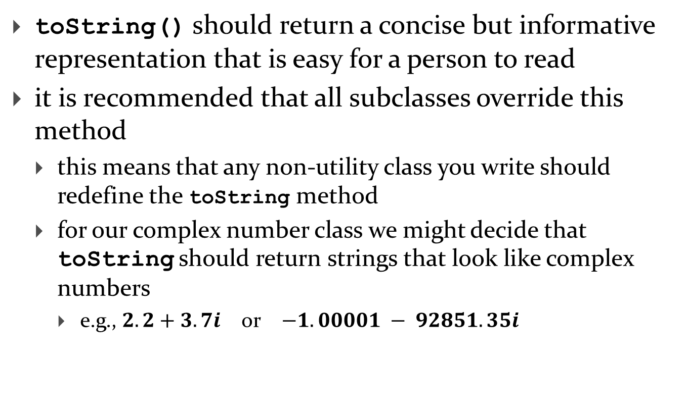
toString
toString() should return a concise but informative representation that is easy for a person to read
it is recommended that all subclasses override this method
  this means that any non-utility class you write should redefine the toString method
  for our complex number class we might decide that toString should return strings that look like complex numbers
    e.g., $2.2+3.7i$ or $−1.00001 − 92851.35i$

Slide 22
@Override
public String toString() {
StringBuilder b = new StringBuilder();
b.append(this.getReal());
double imag = this.getImag();
if (imag < 0) {
b.append(" - ");
}
else {
b.append(" + ");
}
b.append(Math.abs(imag));
b.append('i');
return b.toString();
}

Slide 23
Overriding methods
our class is a subclass or child class of java.lang.Object
when a subclass redefines a public or protected method inherited from its superclass, we say that the subclass overrides the inherited method
to override a method, you create a method that has the exact same signature and return type of the method that you want to override
  the return type may also be a subtype of the return type of the overridden method (but this is not important for now)

Slide 24
Overriding methods
when you override a method you may use the annotation @Override immediately before the method header
  if you do so, the compiler will generate an error message if your method does not have the identical signature and return type of a method in a superclass

Slide 25
equals()
suppose you write a value class that extends Object but you do not override equals()
  what happens when a client tries to use equals()?
    Object.equals() is called
// Complex client
Complex z = new Complex(1, 2);
System.out.println( z.equals(z) ); // true
Complex z2 = z;
System.out.println( z2.equals(z) ); // true
Complex z3 = new Complex(1, 2);
System.out.println( z3.equals(z)); // false!
[notes 3.2.4]

Slide 26
Complex z = new Complex(1, 2);
Complex z2 = z;
Complex z3 = new Complex(1, 2);
 | 64 | client
z
600
z2
600
z3
700
 | 600 | Complex object
real |  | 1
imag |  | 2
z and z2 refer to the object at
address 600
equal
states
but
different
objects
 | 700 | Complex object
real |  | 1
imag |  | 2
z3 refers to the object at
address 700

Slide 27
Object.equals
Object.equals checks if two references refer to the same object
  x.equals(y) is true if and only if x and y are references to the same object

Slide 28
Complex.equals
most value classes should support logical equality
  an instance is equal to another instance if their states are equal
    e.g. two complex numbers are equal if their real and imaginary parts both have the same values

Slide 29
implementing equals() is surprisingly hard
  "One would expect that overriding equals(), since it is a fairly common task, should be a piece of cake. The reality is far from that. There is an amazing amount of disagreement in the Java community regarding correct implementation of equals(). Look into the best Java source code or open an arbitrary Java textbook and take a look at what you find. Chances are good that you will find several different approaches and a variety of recommendations."
      Angelika Langer, Secrets of equals() – Part 1
  http://www.angelikalanger.com/Articles/JavaSolutions/SecretsOfEquals/Equals.html

Slide 30
what we are about to do does not always produce the result you might be looking for
    but it is always satisfies the equals() contract
    and it's what the notes and textbook do

Slide 31
EECS1030 Requirements for equals
an instance is equal to itself
an instance is never equal to null
only instances of the exact same type can be equal
instances with the same state are equal

Slide 32
1. An Instance is Equal to Itself
x.equals(x) should always be true
also, x.equals(y) should always be true if x and y are references to the same object
you can check if two references are equal using ==

Slide 33
@Override
public boolean equals(Object obj) {
if (this == obj) {
return true;
}
}

Slide 34
2. An Instance is Never Equal to null
Java requires that x.equals(null) returns false
and you must not throw an exception if the argument is null
  so it looks like we have to check for a null argument...

Slide 35
@Override
public boolean equals(Object obj) {
if (this == obj) {
return true;
}
if (obj == null) {
return false;
}
}

Slide 36
3. Instances of the Same Type can be Equal
the implementation of equals() used in the notes and the textbook is based on the rule that an instance can only be equal to another instance of the same type
you can find the class of an object using Object.getClass()
public final Class<? extends Object> getClass()
Returns the runtime class of an object.

Slide 37
@Override
public boolean equals(Object obj) {
if (this == obj) {
return true;
}
if (obj == null) {
return false;
}
if (this.getClass() != obj.getClass()) {
return false;
}
}

Slide 38
Instances with Same State are Equal
recall that the value of the attributes of an object define the state of the object
  two instances are equal if all of their attributes are equal
unfortunately, we cannot yet retrieve the attributes of the parameter obj because it is declared to be an Object in the method signature
  we need a cast

Slide 39
@Override
public boolean equals(Object obj) {
if (this == obj) {
return true;
}
if (obj == null) {
return false;
}
if (this.getClass() != obj.getClass()) {
return false;
}
Complex other = (Complex) obj;
}

Slide 40
Instances with Same State are Equal
there is a recipe for checking equality of fields
  if the field is a primitive type other than float or double use ==
  if the attribute type is float use Float.compare()
  if the attribute type is double use Double.compare()
  if the attribute is an array consider Arrays.equals()
  if the attribute is a reference type use equals(), but beware of attributes that might be null

Slide 41
@Override
public boolean equals(Object obj) {
if (this == obj) {
return true;
}
if (obj == null) {
return false;
}
if (this.getClass() != obj.getClass()) {
return false;
}
Complex other = (Complex) obj;
if (Double.compare(this.getReal(), other.getReal()) != 0) {
return false;
}
if (Double.compare(this.getImag(), other.getImag()) != 0) {
return false;
}
return true;
}

Slide 42
The equals() Contract
for reference values equals() is
  reflexive
  symmetric
  transitive
  consistent
  must not throw an exception when passed null

Slide 43
The equals() contract: Reflexivity
reflexive :
  an object is equal to itself
  x.equals(x) is true

Slide 44
The equals() contract: Symmetry
symmetric :
  two objects must agree on whether they are equal
  x.equals(y) is true if and only if y.equals(x) is true

Slide 45
The equals() contract: Transitivity
transitive :
  if a first object is equal to a second, and the second object is equal to a third, then the first object must be equal to the third
  if
  x.equals(y) is true
  and
  y.equals(z) is true
  then
  x.equals(z) must be true

Slide 46
The equals() contract: Consistency
consistent :
  repeatedly comparing two objects yields the same result (assuming the state of the objects does not change)

Slide 47
The equals() contract: Non-nullity
x.equals(null) is always false and never does not throw an exception

Slide 48
The equals() contract and getClass()
using getClass() makes it relatively easy to ensure that the equals() contract is obeyed
  e.g., symmetry and transitivity are easy to ensure
however, using getClass() means that your equals() method won't work as expected in inheritance hierarchies
  more on this when we talk about inheritance

Slide 49
One more thing regarding equals()
if you override equals() you must override hashCode()
  otherwise, the hashed containers won't work properly
we will see how to implement hashCode()in the next lecture or so

