Slide 1
Non-static classes

Slide 2
Non-static classes
a utility class has features (fields and methods) that are all static
all features belong to the class
therefore, you do not need objects to use those features
a well implemented utility class should have a single, empty private constructor to prevent the creation of objects
most Java classes are not utility classes
they are intended to be used to create to objects
each object has its own copy of all non-static fields
it is useful to imagine that each object has its own copy of all non-static methods

Slide 3
Why objects?
each object has its own copy of all non-static fields
this allows objects to have their own state
in Java the state of an object is the set of current values of all of its non-static fields
e.g., we can create multiple Fraction objects that all represent different fraction values

Slide 4
Fraction x = new Fraction(1, 2);
Fraction y = new Fraction(-3, 8);
Fraction z = new Fraction(5, 13);
 | 600 | Fraction object
numer |  | 1
denom |  | 2
 | 64 | client
x |  | 600
y |  | 700
z |  | 800
 | 700 | Fraction object
numer |  | -3
denom |  | 8
 | 100 | Fraction class
numer
denom
 | 800 | Fraction object
numer |  | 5
denom |  | 13

Slide 5
Value Type Classes
a value type is a class that represents a value
examples of values: name, date, colour, mathematical vector
Java examples: String, Date, Integer
the objects created from a value type class can be:
mutable: the state of the object can change
Date
immutable: the state of the object is constant once it is created
String, Integer (and all of the other primitive wrapper classes)

Slide 6
Imaginary numbers
imaginary numbers occur when you try to take the square root of a negative value
for example, $\sqrt{−1}$ has no value in the set of real numbers
mathematicians have found that it is very useful to say that there exists some number (not real) that when squared is equal to $−1$
this value is usually given the symbol $i$ or $j$ and is called the imaginary unit
$$i^{2}=−1$$

Slide 7
Imaginary numbers
an imaginary number is any real valued number multiplied by $i$
$$3i$$ | $${\left(3i\right)}^{2}=−9$$
$$−3i$$ | $${\left(−3i\right)}^{2}=−9$$
$$2.5i$$ | $${\left(2.5i\right)}^{2}=−6.25$$
$$0.01i$$ | $${\left(0.01i\right)}^{2}=−0.0001$$

Slide 8
Complex numbers
a complex number occurs when you add a real number and an imaginary number
e.g., $\left(7+2i\right)$ is a complex number
the imaginary part of a complex number is the imaginary number
e.g, the imaginary part of $\left(7+2i\right)$ is $2i$
the real part of a complex number is the real number (that was added to the imaginary part)
e.g, the imaginary part of $\left(7+2i\right)$ is $7$

Slide 9
Complex numbers
more generally, we say that a complex number is a number that can be written as
$$a+bi$$
where $a$ and $b$ are real numbers and $i$ is the imaginary unit

Slide 10
Why study complex numbers?
applications
any scientific or engineering application that involves vibrations, waves, or signals probably
complex analysis in mathematics
quantum mechanics in physics and chemistry
differential equations
many others
from an EECS1030 perspective
easily implemented value type
also, you can make pretty pictures

Slide 11
Mandelbrot set

Slide 12
Class Complex
when creating a class you should first analyze the requirements of the class
what fields does each object need?
how do you construct an object?
what methods should each object provide?
this information can be summarized in a UML class diagram
Complex
←class name
←fields
←constructors and methods

Slide 13
Class Complex
what fields does each Complex object need?
a field to represent the real part
a field to represent the complex part
Complex
real
imag

Slide 14
Class Complex
what are appropriate types for the fields?
the real part
double
the complex part
double
Complex
real : double
imag : double

Slide 15
Class Complex
how do you create a Complex object?
by specifying the values of the real and imaginary parts
Complex
real : double
imag : double
Complex(double, double)

Slide 16
What operations?
there are many possible operations involving complex numbers
implementing them all is impractical for our current purposes
we will consider the following
complex conjugate
absolute value
addition
multiplication

Slide 17
Complex conjugate
to compute the complex conjugate of a complex number, simply change the sign of the imaginary part
the complex conjugate of
$a+bi$
is
$a+\left(−b\right)i$
note that the result is a complex number

Slide 18
Absolute value
the absolute value or magnitude of
$a+bi$
is
$\sqrt{a^{2}+b^{2}}$
note that the result is a real number

Slide 19
Addition
addition of two complex number is defined as
$\left(a+bi\right)+\left(c+di\right)=\left(a+c\right)+\left(b+d\right)i$
that is, you sum the real parts and sum the imaginary parts separately
note that the result is a complex number

Slide 20
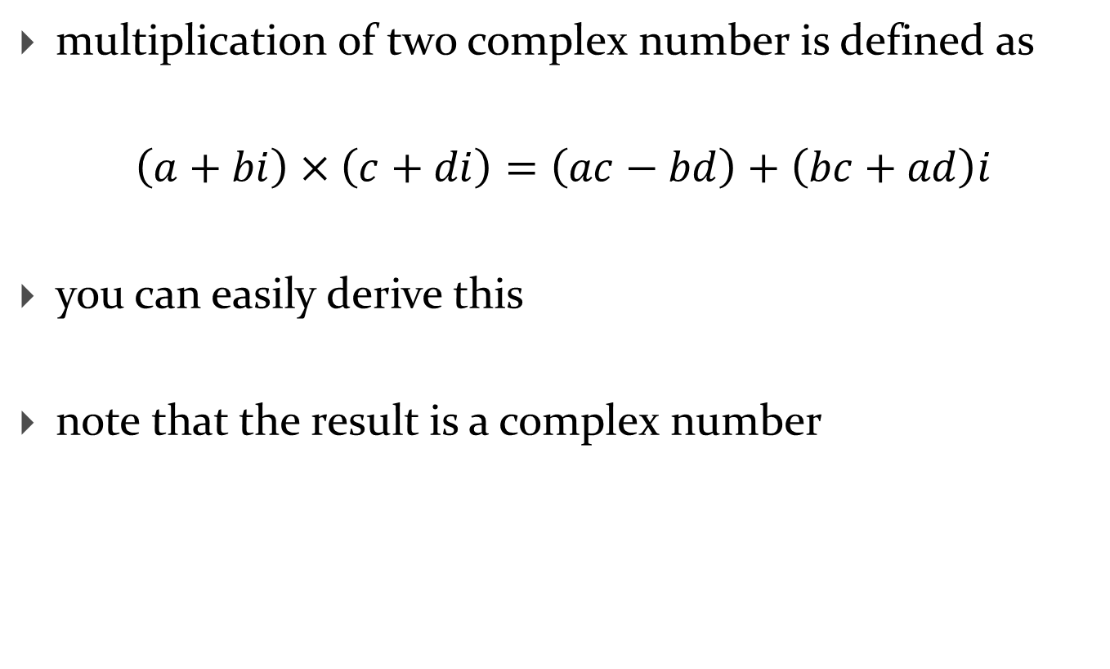
Multiplication
multiplication of two complex number is defined as
$\left(a+bi\right)×\left(c+di\right)=\left(ac−bd\right)+\left(bc+ad\right)i$
you can easily derive this
note that the result is a complex number

Slide 21
Class Complex
what methods should Complex provide?
Complex
real : double
imag : double
Complex(double, double)
conj() : Complex
abs() : double
add(Complex) : Complex
multiply(Complex) : Complex

Slide 22
Class Complex
what other methods might a client find useful?
get the value of the real part
get the value of the imaginary part
set the value of the real part
set the value of the imaginary part
methods that get information about the state of an object are called accessor methods
methods that change the state of an object are called mutator methods

Slide 23
Class Complex
Complex
real : double
imag : double
Complex(double, double)
conj() : Complex
abs() : double
add(Complex) : Complex
mult(Complex) : Complex
getReal() : double
getImag() : double
setReal(double) : void
setImag(double) : void

Slide 24
Class Complex
there are three more important methods, but we will look at these later

Slide 25
Class and fields
start by creating the class and adding the fields
if you decide to organize your classes into packages, then you should first create the appropriate package

Slide 26
public class Complex {
private double real;
private double imag;
}

Slide 27
Class and fields
notice that the class is marked public
this means that the class is visible to all clients
notice that the fields are marked private
this means that the fields are visible only inside of the class

Slide 28
Constructor
we can now implement the constructor
a constructor:
must have the same name as the class
never returns a value (not even void)
constructors are not methods
can have zero or more parameters
the purpose of a constructor is to initialize the state of an object
it should set the values of the non-static fields to appropriate values
we should set the fields named real and imag

Slide 29
public class Complex {
private double real;
private double imag;
public Complex(double real, double imag) {
this.real = real;
this.imag = imag;
}
}

Slide 30
this
every constructor and non-static method has a parameter that does not explicitly appear in the parameter list
the parameter is called an implicit parameter and its name in Java is always this
in a constructor, this is a reference to the object currently being constructed

Slide 31
this
in our constructor
public Complex(double real, double imag) {
this.real = real;
this.imag = imag;
}
this.real refers to the field named real
this.imag refers to the field named imag
real refers to the parameter named real
imag refers to the parameter name imag

Slide 32
Complex z = new Complex(-1.5, 2.25);
 | 64 | client
z
new allocates memory for a Complex object
the Complex constructor is invoked by passing the memory address of the object and the arguments -1.5 and 2.25 to the constructor
the constructor runs, setting the values of the fields this.real and this.imag
the value of z is set to the memory address of the constructed object
600
 | 600 | Complex object
real
imag
-1.5
fields
-2.25
 | 700 | Complex constructor
this |  | 600
real |  | -1.5
imag |  | 2.25
parameters

Slide 33
this
in our constructor
public Complex(double real, double imag) {
this.real = real;
this.imag = imag;
}
there are parameters with the same names as fields
when this occurs, the parameter has precedence over the field
we say that the parameter shadows the field
when shadowing occurs you must use this to refer to the field

