Slide 1
Ordinary differential equations

Slide 2
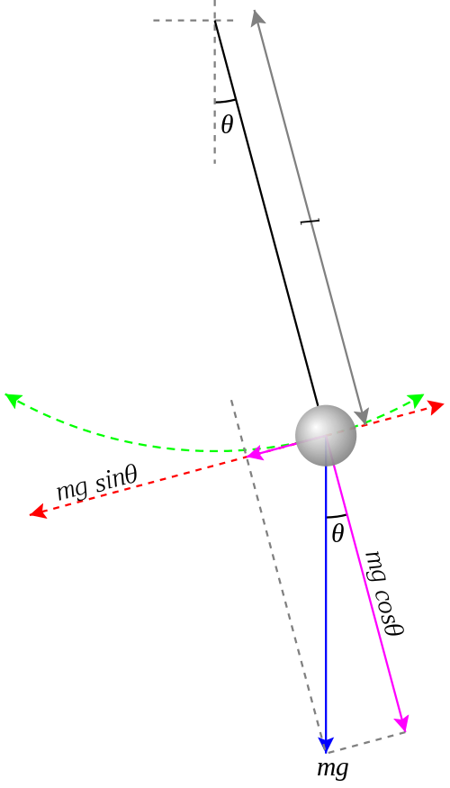
"Simple" pendulum
the simple pendulum is a standard topic in most introductory physics courses
the tangential component of the net force acting on the pendulum is
$$F=ma=−mg\sin{θ} \\ a=−g\sin{θ} \\ ≈−gθ$$
http://commons.wikimedia.org/wiki/File%3APendulum_gravity.svg

Slide 3
"Simple" pendulum
the small angle approximation is required to find a simple solution for the horizontal position of the pendulum as a function of time
using computational methods we can try to see what happens if we don't make the small angle approximation
$$x\left(t\right)=x_{0}\cos\left(\sqrt{\frac{g}{ℓ}}t\right)$$

Slide 4
"Simple" pendulum
the differential equation describing the pendulum motion is normally written in terms of the angular position $θ$
$$α=\frac{d^{2}θ}{dt^{2}}=−\frac{g}{ℓ}\sin{θ}$$
$$a=−g\sin{θ}$$

Slide 5
"Simple" pendulum
to use Euler's method, we use the same trick as for projectile motion
introduce the angular velocity $ω$
$$\frac{dθ}{dt}=ω$$
$$α=\frac{d^{2}θ}{dt^{2}}=\frac{dω}{dt}=−\frac{g}{ℓ}\sin{θ}$$

Slide 6
"Simple" pendulum
we can now apply Euler's method
$$\frac{dθ}{dt}≈\frac{θ_{i}−θ_{i−1}}{∆t}=ω_{i−1} ⟹ θ_{i}=θ_{i−1}+ω_{i−1}∆t$$
$$\frac{dω}{dt}≈\frac{ω_{i}−ω_{i−1}}{∆t}=−\frac{g}{ℓ}\sin{θ_{i−1}} ⟹ ω_{i}=ω_{i−1}−\frac{g}{ℓ}\sin{θ_{i−1}}∆t$$

Slide 7
"Simple" pendulum
the code is almost identical to that for projectile motion; only the changes are shown below:
% estimated angular position and velocity
theta = zeros(size(t));
omega = zeros(size(t));
theta(1) = theta0;
omega(1) = omega0;
for i = 2:n
theta(i) = theta(i - 1) + omega(i - 1) * dt;
omega(i) = omega(i - 1) - 9.81 / L * sin(theta(i - 1)) * dt;
end

Slide 8
"Simple" pendulum
(video clip) dt = 0.1

Slide 9
"Simple" pendulum
(video clip) dt = 0.01

Slide 10
"Simple" pendulum
(video clip) dt = 0.001

Slide 11
"Simple" pendulum
it turns out that for any finite positive value of dt, Euler's method will cause the pendulum to swing faster and faster
it is possible to show that the energy of the pendulum continually increases using Euler's method
this isn't completely surprising given the simplicity of Euler's method
slightly more sophisticated methods are needed to obtain a more realistic solution

Slide 12
"Simple" pendulum
(video clip) solved using MATLAB ode45

Slide 13
"Simple" pendulum

Slide 14
Summary

Slide 15
Weeks 1–6
computer math is not the same as math
MATLAB
creating and using vectors and matrices
indexing (numeric vs logical)
operators (normal form vs element-by-element form)
logical operators
if statements
loops
plotting

Slide 16
Week 7
basic statistics
location
mean, median
spread
variance, standard deviation, interquartile range
percentiles
(requires the Statistics toolbox; you won't be asked to compute these)
boxplots

Slide 17
Week 8
random numbers and simulation
rand, randi, randn, randperm
histograms

Slide 18
Week 9
least squares line and polynomial fitting
polyfit, polyval
transforming non-linear curve fitting problems into linear curve fitting problems
principle of least squares and how the least squares problem can be solved mathematically

Slide 19
Week 10
root finding
Newton's method
bisection method
the principle of recursion (but not how to implement a recursive method)
function functions
fzero

Slide 20
Week 11
numerical differentiation
finite differences
numerical integration
composite rectangle, trapezoid, and Simpson's rules
integral

Slide 21
Week 12
ordinary differential equations
I do not expect you to be able to formulate a problem in terms of a differential equation
Euler's method

