Slide 1
Graphical User Interfaces
notes Chap 7

Slide 2
Java Swing
Swing is a Java toolkit for building graphical user interfaces (GUIs)
  http://docs.oracle.com/javase/tutorial/uiswing/TOC.html
old version of the Java tutorial had a visual guide of Swing components
  http://da2i.univ-lille1.fr/doc/tutorial-java/ui/features/components.html

Slide 3
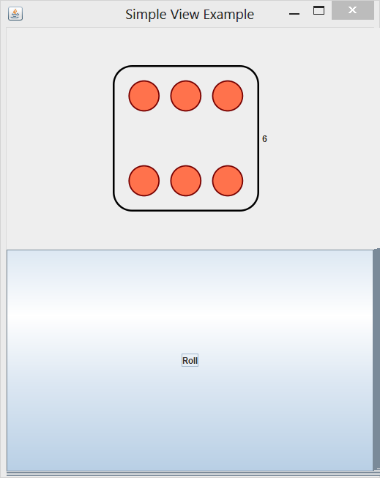
App to Roll a Die
a simple application that lets the user roll a die
  when the user clicks the “Roll” button the die is rolled to a new random value
    “event driven programming”

Slide 4
App to Roll a Die
this application is simple enough to write as a single class
  SimpleRoll.java

Slide 5
Model-View-Controller
model
  represents state of the application and the rules that govern access to and updates of state
view
  presents the user with a sensory (visual, audio, haptic) representation of the model state
  a user interface element (the user interface for simple applications)
controller
  processes and responds to events (such as user actions) from the view and translates them to model method calls

Slide 6
Model—View—Controller
TV
- on : boolean
- channel : int
- volume : int
+ power(boolean) : void
+ channel(int) : void
+ volume(int) : void
Model
View
RemoteControl
+ togglePower() : void
+ channelUp() : void
+ volumeUp() : void
Controller

Slide 7
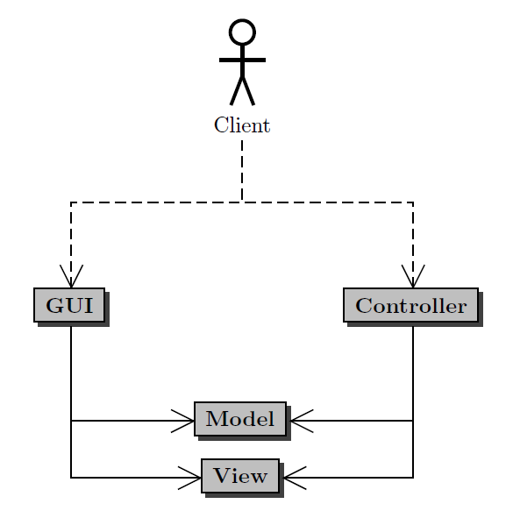
Model-View-Controller
Client uses the application (GUI)
GUI invokes Model methods and View methods
Controller invokes Model methods and View methods

Slide 8
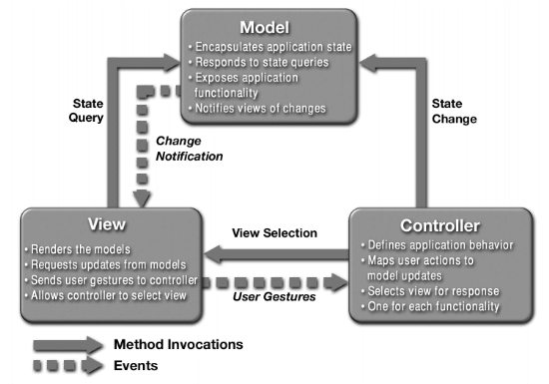
a different MVC structure than in the notes

Slide 9
App to Roll a Die: MVC
we can also write the application using the model-view-controller pattern

Slide 10
App to Roll a Die: Model
model
  the data
  methods that get the data (accessors)
  methods that modify the data (mutators)
the data
  a 6-sided die
accessors
  get the current face value
mutators
  roll the die

Slide 11
App to Roll a Die: Model
1
Die
SimpleModel
+ getValue() : String
+ roll()

Slide 12
App to Roll a Die: View
view
  a visual (or other) display of the model
  a user interface that allows a user to interact with the view
  methods that get information from the view (accessors)
  methods that modify the view (mutators)
a visual (or other) display of the model
  an image of the current face of the die
a user interface that allows a user to interact with the view
  roll button

Slide 13
App to Roll a Die: View
Swing top-level
window
JFrame
1
1
JLabel
SimpleView
+ setRoll(String)
JButton
shows an image
of the die value
allows the user to
roll the die; will emit an action event when pressed

Slide 14
App to Roll a Die: Controller
controller
  methods that map user interactions to model updates
interface for receiving action events (e.g., when a button is pressed)
« interface » ActionListener
SimpleController
+ actionPerformed(ActionEvent)

Slide 15
App to Roll a Die: MVC
SimpleModel
1
SimpleController
SimpleApp
1
SimpleView

Slide 16
App to Roll a Die
we can also write the application using the model-view-controller pattern
  SimpleModel.java
  SimpleView.java
  SimpleController.java
  SimpleApp.java

Slide 17
Simple Calculator
implement a simple calculator using the model-view-controller (MVC) design pattern
features:
  sum, subtract, multiply, divide
  clear

Slide 18

Application Appearance

Slide 19
Creating the Application
the calculator application is launched by the user
  the notes refers to the application as the GUI
the application:
  creates the model for the calculator, and then
  creates the view of the calculator

Slide 20
CalcMVC Application
public class CalcMVC
{
public static void main(String[] args)
{
CalcController controller = new CalcController();
CalcModel model = new CalcModel();
CalcView view = new CalcView(model, controller);
controller.setModel(model);
controller.setView(view);
view.setVisible(true);
}
}

Slide 21
Model
features:
  sum, subtract, multiply, divide
  clear

Slide 22
CalcModel
- calcValue : int
+ getCalcValue() : int
+ getLastUserValue() : int
+ sum(int) : void
+ subtract(int) : void
+ multiply(int) : void
+ divide(int) : void
+ clear() : void

Slide 23
CalcModel: Attributes and Ctor
public class CalcModel
{
private int calcValue;
/**
* Creates a model with a calculated value of zero.
*/
public CalcModel() {
this.calcValue = 0;
}

Slide 24
CalcModel: clear
/**
* Clears the user values and the calculated value.
*/
public void clear() {
this.calcValue = 0;
}

Slide 25
CalcModel: getCalcValue
/**
* Get the current calculated value.
*
* @return The current calculated value.
*/
public int getCalcValue() {
return this.calcValue;
}

Slide 26
CalcModel: sum
/**
* Adds the calculated value by a user value.
*
* @param userValue
* The value to add to the current calculated
* value by.
*/
public void sum(int userValue) {
this.calcValue += userValue;
}

Slide 27
CalcModel: subtract and multiply
public void subtract(int userValue) {
this.calcValue -= userValue;
}
public void multiply(int userValue) {
this.calcValue *= userValue;
}

Slide 28
CalcModel: divide
/**
* Divides the calculated value by a user value.
*
* @param userValue
* The value to multiply the current calculated
* value by.
* @pre. userValue is not equivalent to zero.
*/
public void divide(int userValue) {
this.calcValue /= userValue;
}

Slide 29
Other model examples
consider the Boggle app from CSE1030 last term
  http://www.eecs.yorku.ca/course_archive/2013-14/F/1030/labs/07/lab7.html
consider Eclipse
pick your favourite game and design a model for the game

