Slide 1
Inheritance
Notes Chapter 6

Slide 2
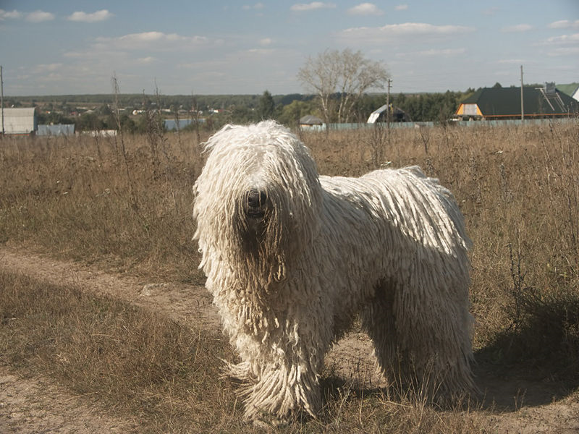
Inheritance
you know a lot about an object by knowing its class
for example what is a Komondor?
http://en.wikipedia.org/wiki/File:Komondor_delvin.jpg

Slide 3
Object
Dog
Dog is-a Object
PureBreed is-a Dog
PureBreed is-a Object
PureBreed
Mix
BloodHound
Komondor
...
Komondor is-a PureBreed
Komondor is-a Dog
Komondor is-a Object

Slide 4
superclass of Dog
(and all other classes)
Object
superclass ==
base class
parent class
subclass ==
derived class
extended class
child class
subclass of Object
superclass of PureBreed
Dog
subclass of Dog
superclass of Komondor
PureBreed
Mix
BloodHound
Komondor
...

Slide 5
Object
Dog
Dog extends Object
PureBreed
Mix
PureBreed extends Dog
BloodHound
Komondor
...
Komondor extends
PureBreed

Slide 6
Some Definitions
we say that a subclass is derived from its superclass
with the exception of Object, every class in Java has one and only one superclass
Java only supports single inheritance
a class X can be derived from a class that is derived from a class, and so on, all the way back to Object
X is said to be descended from all of the classes in the inheritance chain going back to Object
all of the classes X is derived from are called ancestors of X

Slide 7
Why Inheritance?
a subclass inherits all of the non-private members (attributes and methods but not constructors) from its superclass
if there is an existing class that provides some of the functionality you need you can derive a new class from the existing class
the new class has direct access to the public and protected attributes and methods without having to re-declare or re-implement them
the new class can introduce new fields and methods
the new class can re-define (override) its superclass methods

Slide 8
Is-A
inheritance models the is-a relationship between classes
from a Java point of view, is-a means you can use a derived class instance in place of an ancestor class instance
public someMethod(Dog dog)
{ // does something with dog }
// client code of someMethod
Komondor shaggy = new Komondor();
someMethod( shaggy );
Mix mutt = new Mix ();
someMethod( mutt );

Slide 9
Is-A Pitfalls
is-a has nothing to do with the real world
is-a has everything to do with how the implementer has modelled the inheritance hierarchy
the classic example:
Circle is-a Ellipse?
Ellipse
Circle

Slide 10
Circle is-a Ellipse?
if Ellipse can do something that Circle cannot, then Circle is-a Ellipse is false
remember: is-a means you can substitute a derived class instance for one of its ancestor instances
if Circle cannot do something that Ellipse can do then you cannot (safely) substitute a Circle instance for an Ellipse instance

Slide 11
// method in Ellipse
/*
* Change the width and height of the ellipse.
* @param width The desired width.
* @param height The desired height.
* @pre. width > 0 && height > 0
*/
public void setSize(double width, double height)
{
this.width = width;
this.height = height;
}

Slide 12
there is no good way for Circle to support setSize (assuming that the attributes width and height are always the same for a Circle) because clients expect setSize to set both the width and height
can't Circle override setSize so that it throws an exception if width != height?
no; this will surprise clients because Ellipse setSize does not throw an exception if width != height
can't Circle override setSize so that it sets width == height?
no; this will surprise clients because Ellipse setSize says that the width and height can be different

Slide 13
But I have a Ph.D. in Mathematics, and I'm sure a Circle is a kind of an Ellipse! Does this mean Marshall Cline is stupid? Or that C++ is stupid? Or that OO is stupid? [C++ FAQs http://www.parashift.com/c++-faq-lite/proper-inheritance.html#faq-21.8 ]
Actually, it doesn't mean any of these things. But I'll tell you what it does mean — you may not like what I'm about to say: it means your intuitive notion of "kind of" is leading you to make bad inheritance decisions. Your tummy is lying to you about what good inheritance really means — stop believing those lies.

Slide 14
what if there is no setSize method?
if a Circle can do everything an Ellipse can do then Circle can extend Ellipse

Slide 15
Implementing Inheritance
suppose you want to implement an inheritance hierarchy that represents breeds of dogs for the purpose of helping people decide what kind of dog would be appropriate for them
many possible fields:
appearance, size, energy, grooming requirements, amount of exercise needed, protectiveness, compatibility with children, etc.
we will assume two fields measured on a 10 point scale
size from 1 (small) to 10 (giant)
energy from 1 (lazy) to 10 (high energy)

Slide 16
Dog
public class Dog extends Object
{
private int size;
private int energy;
// creates an "average" dog
Dog()
{ this(5, 5); }
Dog(int size, int energy)
{ this.setSize(size); this.setEnergy(energy); }

Slide 17
public int getSize()
{ return this.size; }
public int getEnergy()
{ return this.energy; }
public final void setSize(int size)
{ this.size = size; }
public final void setEnergy(int energy)
{ this.energy = energy; }
}
why final? stay tuned…

Slide 18
What is a Subclass?
a subclass looks like a new class that has the same API as its superclass with perhaps some additional methods and fields
inheritance does more than copy the API of the superclass
the derived class contains a subobject of the parent class
the superclass subobject needs to be constructed (just like a regular object)
the mechanism to perform the construction of the superclass subobject is to call the superclass constructor

Slide 19
Constructors of Subclasses
the first line in the body of every constructor must be a call to another constructor
if it is not then Java will insert a call to the superclass default constructor
if the superclass default constructor does not exist or is private then a compilation error occurs
a call to another constructor can only occur on the first line in the body of a constructor
the superclass constructor must be called during construction of the derived class

Slide 20
Mix UML Diagram
Dog
1
Mix
ArrayList<String>
breeds

Slide 21
Mix (version 1)
public final class Mix extends Dog
{ // no declaration of size or energy; inherited from Dog
private ArrayList<String> breeds;
public Mix ()
{ // call to a Dog constructor
super();
this.breeds = new ArrayList<String>();
}
public Mix(int size, int energy)
{ // call to a Dog constructor
super(size, energy);
this.breeds = new ArrayList<String>();
}

Slide 22
public Mix(int size, int energy,
ArrayList<String> breeds)
{ // call to a Dog constructor
super(size, energy);
this.breeds = new ArrayList<String>(breeds);
}

Slide 23
Mix (version 2)
public final class Mix extends Dog
{ // no declaration of size or energy; inherited from Dog
private ArrayList<String> breeds;
public Mix ()
{ // call to a Mix constructor
this(5, 5);
}
public Mix(int size, int energy)
{ // call to a Mix constructor
this(size, energy, new ArrayList<String>());
}

Slide 24
public Mix(int size, int energy,
ArrayList<String> breeds)
{ // call to a Dog constructor
super(size, energy);
this.breeds = new ArrayList<String>(breeds);
}

Slide 25
why is the constructor call to the superclass needed?
because Mix is-a Dog and the Dog part of Mix needs to be constructed

Slide 26
Dog
- size : int
- energy : int
+ setSize()
+ setEnergy()
+ equals(Object) : boolean
+ hashCode() : int
+ toString() : String
...
Mix
- breeds : ArrayList<String>
+ equals(Object) : boolean
+ hashCode() : int
+ toString() : String
...

Slide 27
Mix mutt = new Mix(1, 10);
Mix object
Dog object
Mix constructor starts running
creates new Dog subobject by invoking the Dog constructor
Dog constructor starts running
creates new Object subobject by (silently) invoking the Object constructor
Object constructor runs
sets size and energy
creates a new empty ArrayList and assigns it to breeds
Object object
size | 1
energy | 10
breeds | 1000

Slide 28
Invoking the Superclass Ctor
why is the constructor call to the superclass needed?
because Mix is-a Dog and the Dog part of Mix needs to be constructed
similarly, the Object part of Dog needs to be constructed

Slide 29
Invoking the Superclass Ctor
a derived class can only call its own constructors or the constructors of its immediate superclass
Mix can call Mix constructors or Dog constructors
Mix cannot call the Object constructor
Object is not the immediate superclass of Mix
Mix cannot call PureBreed constructors
cannot call constructors across the inheritance hierarchy
PureBreed cannot call Komondor constructors
cannot call subclass constructors

Slide 30
Constructors & Overridable Methods
if a class is intended to be extended then its constructor must not call an overridable method
Java does not enforce this guideline
why?
recall that a derived class object has inside of it an object of the superclass
the superclass object is always constructed first, then the subclass constructor completes construction of the subclass object
the superclass constructor will call the overridden version of the method (the subclass version) even though the subclass object has not yet been constructed

Slide 31
Superclass Ctor & Overridable Method
public class SuperDuper
{
public SuperDuper()
{
// call to an over-ridable method; bad
this.overrideMe();
}
public void overrideMe()
{
System.out.println("SuperDuper overrideMe");
}
}

Slide 32
Subclass Overrides Method
public class SubbyDubby extends SuperDuper {
private final Date date;
public SubbyDubby()
{ super(); this.date = new Date(); }
@Override public void overrideMe()
{ System.out.print("SubbyDubby overrideMe : ");
System.out.println( this.date ); }
public static void main(String[] args)
{ SubbyDubby sub = new SubbyDubby();
sub.overrideMe(); }
}

Slide 33
the programmer's intent was probably to have the program print:
SuperDuper overrideMe
SubbyDubby overrideMe : <the date>
or, if the call to the overridden method was intentional
SubbyDubby overrideMe : <the date>
SubbyDubby overrideMe : <the date>
but the program prints:
SubbyDubby overrideMe : null
SubbyDubby overrideMe : <the date>
final attribute in
two different states!

Slide 34
What's Going On?
new SubbyDubby() calls the SubbyDubby constructor
the SubbyDubby constructor calls the SuperDuper constructor
the SuperDuper constructor calls the method overrideMe which is overridden by SubbyDubby
the SubbyDubby version of overrideMe prints the SubbyDubby date attribute which has not yet been assigned to by the SubbyDubby constructor (so date is null)
the SubbyDubby constructor assigns date
SubbyDubby overrideMe is called by the client

Slide 35
remember to make sure that your base class constructors only call final methods or private methods
if a base class constructor calls an overridden method, the method will run in an unconstructed derived class

Slide 36
Other Methods
methods in a subclass will often need or want to call methods in the immediate superclass
a new method in the subclass can call any public or protected method in the superclass without using any special syntax
a subclass can override a public or protected method in the superclass by declaring a method that has the same signature as the one in the superclass
a subclass method that overrides a superclass method can call the overridden superclass method using the super keyword

Slide 37
Dog equals
we will assume that two Dogs are equal if their size and energy are the same
@Override public boolean equals(Object obj)
{
boolean eq = false;
if(obj != null && this.getClass() == obj.getClass())
{
Dog other = (Dog) obj;
eq = this.getSize() == other.getSize() &&
this.getEnergy() == other.getEnergy();
}
return eq;
}

Slide 38
Mix equals (version 1)
two Mix instances are equal if their Dog subobjects are equal and they have the same breeds
@Override public boolean equals(Object obj)
{ // the hard way
boolean eq = false;
if(obj != null && this.getClass() == obj.getClass()) {
Mix other = (Mix) obj;
eq = this.getSize() == other.getSize() &&
this.getEnergy() == other.getEnergy() &&
this.breeds.size() == other.breeds.size() &&
this.breeds.containsAll(other.breeds);
}
return eq;
}
subclass can call
public method of
the superclass

Slide 39
Mix equals (version 2)
two Mix instances are equal if their Dog subobjects are equal and they have the same breeds
Dog equals already tests if two Dog instances are equal
Mix equals can call Dog equals to test if the Dog subobjects are equal, and then test if the breeds are equal
also notice that Dog equals already checks that the Object argument is not null and that the classes are the same
Mix equals does not have to do these checks again

Slide 40
@Override public boolean equals(Object obj)
{
boolean eq = false;
if(super.equals(obj))
{ // the Dog subobjects are equal
Mix other = (Mix) obj;
eq = this.breeds.size() == other.breeds.size() &&
this.breeds.containsAll(other.breeds);
}
return eq;
}
subclass method that overrides a superclass
method can call the overridden superclass method

Slide 41
Dog toString
@Override public String toString()
{
String s = "size " + this.getSize() +
"energy " + this.getEnergy();
return s;
}

Slide 42
Mix toString
@Override public String toString()
{
StringBuffer b = new StringBuffer();
b.append(super.toString());
for(String s : this.breeds)
b.append(" " + s);
b.append(" mix");
return b.toString();
}

Slide 43
Dog hashCode
// similar to code generated by Eclipse
@Override public int hashCode()
{
final int prime = 31;
int result = 1;
result = prime * result + this.getEnergy();
result = prime * result + this.getSize();
return result;
}

Slide 44
Mix hashCode
// similar to code generated by Eclipse
@Override public int hashCode()
{
final int prime = 31;
int result = super.hashCode();
result = prime * result + this.breeds.hashCode();
return result;
}

Slide 45
Mix Memory Diagram
500 | Mix object
size | 5
energy | 5
breeds | 1750
inherited from superclass
private in superclass
not accessible by name to Mix

