Slide 1
A Singleton Puzzle: What is Printed?
public class Elvis {
public static final Elvis INSTANCE = new Elvis();
private final int beltSize;
private static final int CURRENT_YEAR =
Calendar.getInstance().get(Calendar.YEAR);
private Elvis() { this.beltSize = CURRENT_YEAR – 1930; }
public int getBeltSize() { return this.beltSize; }
public static void main(String[] args) {
System.out.println("Elvis has a belt size of " +
INSTANCE.getBeltSize());
}
}
from Java Puzzlers by Joshua Bloch and Neal Gafter

Slide 2
A Singleton Puzzle: Solution
Elvis has a belt size of -1930 is printed
to solve the puzzle you need to know how Java initializes classes (JLS 12.4)
the call to main() triggers initialization of the Elvis class (because main() belongs to the class Elvis)
the static attributes INSTANCE and CURRENT_YEAR are first given default values (null and 0, respectively)
then the attributes are initialized in order of appearance

Slide 3
public static final Elvis INSTANCE = new Elvis();
this.beltSize = CURRENT_YEAR – 1930;
private static final int CURRENT_YEAR =
Calendar.getInstance().get(Calendar.YEAR);
the problem occurs because initializing INSTANCE requires a valid CURRENT_YEAR
solution: move CURRENT_YEAR before INSTANCE
CURRENT_YEAR == 0
at this point

Slide 4
Aggregation and Composition
[notes Chapter 4]

Slide 5
Aggregation and Composition
the terms aggregation and composition are used to describe a relationship between objects
both terms describe the has-a relationship
    the university has-a collection of departments
    each department has-a collection of professors

Slide 6
Aggregation and Composition
composition implies ownership
    if the university disappears then all of its departments disappear
    a university is a composition of departments
aggregation does not imply ownership
    if a department disappears then the professors do not disappear
    a department is an aggregation of professors

Slide 7
Aggregation
suppose a Person has a name and a date of birth
public class Person {
private String name;
private Date birthDate;
public Person(String name, Date birthDate) {
this.name = name;
this.birthDate = birthDate;
}
public Date getBirthDate() {
return birthDate;
}
}

Slide 8
the Person example uses aggregation
  notice that the constructor does not make a copy of the name and birth date objects passed to it
  the name and birth date objects are shared with the client
  both the client and the Person instance are holding references to the same name and birth date
// client code somewhere
String s = "Billy Bob";
Date d = new Date(91, 2, 26); // March 26, 1991
Person p = new Person(s, d);

Slide 9
 | 64 | client
s |  | 250
d |  | 350
p |  | 450
 |  | ...
 | 250 | String object
 |  | ...
 |  | ...
 | 350 | Date object
 |  | ...
 |  | ...
 | 450 | Person object
name |  | 250
birthDate |  | 350

Slide 10
what happens when the client modifies the Date instance?
  prints Fri Nov 03 00:00:00 EST 1995
// client code somewhere
String s = "Billy Bob";
Date d = new Date(90, 2, 26); // March 26, 1990
Person p = new Person(s, d);
d.setYear(95); // November 3, 1995
d.setMonth(10);
d.setDate(3);
System.out.println( p.getBirthDate() );

Slide 11
because the Date instance is shared by the client and the Person instance:
  the client can modify the date using d and the Person instance p sees a modified birthDate
  the Person instance p can modify the date using birthDate and the client sees a modified date d

Slide 12
note that even though the String instance is shared by the client and the Person instance p, neither the client nor p can modify the String
  immutable objects make great building blocks for other objects
  they can be shared freely without worrying about their state

Slide 13
UML Class Diagram for Aggregation
number of Date
objects each Person has
number of String
objects each Person has
1
1
Date
Person
String
open diamonds
indicate aggregation

Slide 14
Another Aggregation Example
3D videogames use models that are a three-dimensional representations of geometric data
  the models may be represented by:
    three-dimensional points (particle systems)
    simple polygons (triangles, quadrilaterals)
    smooth, continuous surfaces (splines, parametric surfaces)
    an algorithm (procedural models)
rendering the objects to the screen usually results in drawing triangles
  graphics cards have specialized hardware that does this very fast

Slide 15
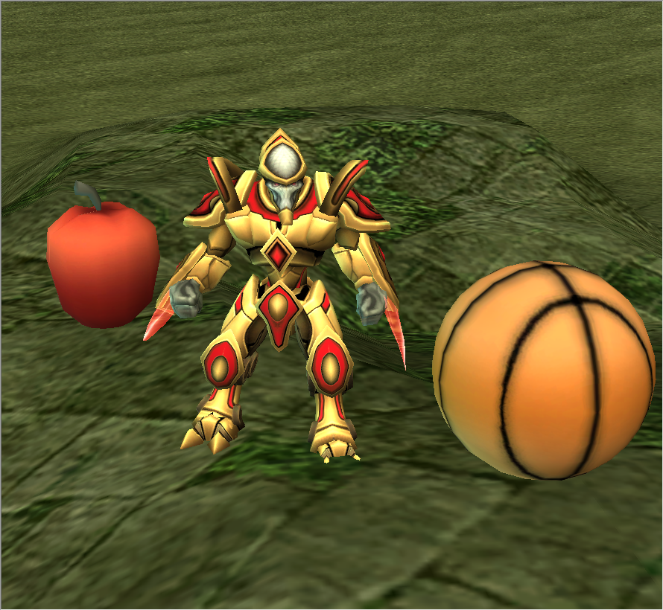

Slide 16
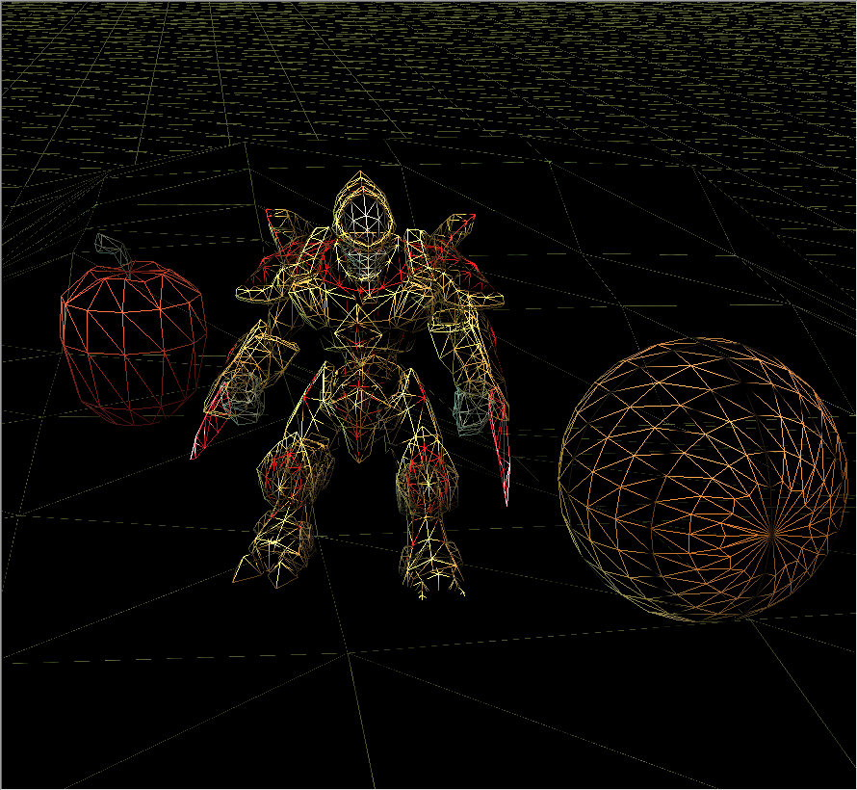

Slide 17
Aggregation Example
a Triangle has 3 three-dimensional Points
3
Triangle
Point
Triangle
+ Triangle(Point, Point, Point)
+ getA() : Point
+ getB() : Point
+ getC() : Point
+ setA(Point) : void
+ setB(Point) : void
+ setC(Point) : void
Point
+ Point(double, double, double)
+ getX() : double
+ getY() : double
+ getZ() : double
+ setX(double) : void
+ setY(double) : void
+ setZ(double) : void

Slide 18
Triangle
// attributes and constructor
public class Triangle {
private Point pA;
private Point pB;
private Point pC;
public Triangle(Point c, Point b, Point c) {
this.pA = a;
this.pB = b;
this.pC = c;
}

Slide 19
Triangle
// accessors
public Point getA() {
return this.pA;
}
public Point getB() {
return this.pB;
}
public Point getC() {
return this.pC;
}

Slide 20
Triangle
// mutators
public void setA(Point p) {
this.pA = p;
}
public void setB(Point p) {
this.pB = p;
}
public void setC(Point p) {
this.pC = p;
}
}

Slide 21
Triangle Aggregation
implementing Triangle is very easy
attributes (3 Point references)
  are references to existing objects provided by the client
accessors
  give clients a reference to the aggregated Points
mutators
  set attributes to existing Points provided by the client
we say that the Triangle attributes are aliases

Slide 22
// client code
Point a = new Point(-1.0, -1.0, -3.0);
Point b = new Point(0.0, 1.0, -3.0);
Point c = new Point(2.0, 0.0, -3.0);
Triangle tri = new Triangle(a, b, c);

Slide 23
 | 64 | client
a |  | 250
b |  | 350
c |  | 450
tri |  | 550
 | 250 | Point object
x |  | -1.0
y |  | -1.0
z |  | -3.0
 | 350 | Point object
x |  | 0.0
y |  | 1.0
z |  | -3.0
 | 450 | Point object
x |  | 2.0
y |  | 0.0
z |  | -3.0
 | 550 | Triangle object
pA |  | 250
pB |  | 350
pC |  | 450

Slide 24
// client code
Point a = new Point(-1.0, -1.0, -3.0);
Point b = new Point(0.0, 1.0, -3.0);
Point c = new Point(2.0, 0.0, -3.0);
Triangle tri = new Triangle(a, b, c);
Point d = tri.getA();
boolean sameObj = a == d;
client asks the triangle for one
of the triangle points and checks
if the point is the same object
that was used to create the triangle

Slide 25
 | 64 | client
a |  | 250
b |  | 350
c |  | 450
tri |  | 550
d |  | 250
sameObj |  | true
 | 250 | Point object
x |  | -1.0
y |  | -1.0
z |  | -3.0
 | 350 | Point object
x |  | 0.0
y |  | 1.0
z |  | -3.0
 | 450 | Point object
x |  | 2.0
y |  | 0.0
z |  | -3.0
 | 550 | Triangle object
pA |  | 250
pB |  | 350
pC |  | 450

Slide 26
// client code
Point a = new Point(-1.0, -1.0, -3.0);
Point b = new Point(0.0, 1.0, -3.0);
Point c = new Point(2.0, 0.0, -3.0);
Triangle tri = new Triangle(a, b, c);
Point d = tri.getA();
boolean sameObj = a == d;
tri.setC(d);
client asks the triangle to set
one point of the triangle to d

Slide 27
 | 64 | client
a |  | 250
b |  | 350
c |  | 450
tri |  | 550
d |  | 250
sameObj |  | true
 | 250 | Point object
x |  | -1.0
y |  | -1.0
z |  | -3.0
 | 350 | Point object
x |  | 0.0
y |  | 1.0
z |  | -3.0
 | 450 | Point object
x |  | 2.0
y |  | 0.0
z |  | -3.0
 | 550 | Triangle object
pA |  | 250
pB |  | 350
pC |  | 250

Slide 28
// client code
Point a = new Point(-1.0, -1.0, -3.0);
Point b = new Point(0.0, 1.0, -3.0);
Point c = new Point(2.0, 0.0, -3.0);
Triangle tri = new Triangle(a, b, c);
Point d = tri.getA();
boolean sameObj = a == d;
tri.setC(d);
b.setX(0.5);
b.setY(6.0);
b.setZ(2.0);
client changes the coordinates of
one of the points (without asking
the triangle for the point first)

Slide 29
 | 64 | client
a |  | 250
b |  | 350
c |  | 450
tri |  | 550
d |  | 250
sameObj |  | true
 | 250 | Point object
x |  | -1.0
y |  | -1.0
z |  | -3.0
 | 350 | Point object
x |  | 0.5
y |  | 6.0
z |  | 2.0
 | 450 | Point object
x |  | 2.0
y |  | 0.0
z |  | -3.0
 | 550 | Triangle object
pA |  | 250
pB |  | 350
pC |  | 250

Slide 30
Triangle Aggregation
if a client gets a reference to one of the triangle's points, then the client can change the position of the point without asking the triangle
run demo program in class here

Slide 31
pointB = new Point(0.0, 1.0, -3.0);
tri = new Triangle(new Point(-1.0, -1.0, -3.0),
pointB,
new Point(2.0, 0.0, -3.0));
// Draw triangle
gl.glBegin(GL2.GL_TRIANGLES);
gl.glColor3f(0.0f, 1.0f, 1.0f); // set the color
gl.glVertex3d(tri.getA().getX(),
tri.getA().getY(),
tri.getA().getZ());
gl.glVertex3d(tri.getB().getX(),
tri.getB().getY(),
tri.getB().getZ());
gl.glVertex3d(tri.getC().getX(),
tri.getC().getY(),
tri.getC().getZ());
gl.glEnd();
// the client moves a point without help from the triangle
delta += 0.05f;
pointB.setY(1.0 + Math.sin(delta));
client and triangle
share a reference to
pointB
draw the triangle
by asking tri for
the coordinates
of each of its points
client uses pointB
to change the point
coordinates

Slide 32
Composition

Slide 33
Composition
recall that an object of type X that is composed of an object of type Y means
  X has-a Y object and
  X owns the Y object
in other words
the X object, and only the X object, is responsible for its Y object

Slide 34
Composition
this means that the X object will generally not share references to its Y object with clients
  constructors will create new Y objects
  accessors will return references to new Y objects
  mutators will store references to new Y objects
the “new Y objects” are called defensive copies
the X object, and only the X object, is responsible for its Y object

Slide 35
Composition & the Default Constructor
if a default constructor is defined it must create a suitable Y object
public X()
{
// create a suitable Y; for example
this.y = new Y( /* suitable arguments */ );
}
the X object, and only the X object, is responsible for its Y object
defensive copy

Slide 36
Test Your Knowledge
Re-implement Triangle so that it is a composition of 3 points. Start by adding a default constructor to Triangle that creates 3 new Point objects with suitable values.

Slide 37
Composition & Copy Constructor
if a copy constructor is defined it must create a new Y that is a deep copy of the other X object’s Y object
public X(X other)
{
// create a new Y that is a copy of other.y
this.y = new Y(other.getY());
}
the X object, and only the X object, is responsible for its Y object
defensive copy

Slide 38
Composition & Copy Constructor
what happens if the X copy constructor does not make a deep copy of the other X object’s Y object?
// don’t do this
public X(X other)
{
this.y = other.y;
}
  every X object created with the copy constructor ends up sharing its Y object
    if one X modifies its Y object, all X objects will end up with a modified Y object
    this is called a privacy leak

Slide 39
Test Your Knowledge
Suppose Y is an immutable type. Does the X copy constructor need to create a new Y? Why or why not?
Implement the Triangle copy constructor.

Slide 40
Suppose you have a Triangle copy constructor and main method like so:
public Triangle(Triangle t)
{ this.pA = t.pA; this.pB = t.pB; this.pC = t.pC; }
public static void main(String[] args) {
Triangle t1 = new Triangle();
Triangle t2 = new Triangle(t1);
t1.getA().set( -100.0, -100.0, 5.0 );
System.out.println( t2.getA() );
}
What does the program print? How many Point objects are there in memory? How many Point objects should be in memory?

Slide 41
Composition & Other Constructors
a constructor that has a Y parameter must first deep copy and then validate the Y object
public X(Y y)
{
// create a copy of y
Y copyY = new Y(y);
// validate; will throw an exception if copyY is invalid
this.checkY(copyY);
this.y = copyY;
}
the X object, and only the X object, is responsible for its Y object
defensive copy

Slide 42
Composition and Other Constructors
why is the deep copy required?
  if the constructor does this
  // don’t do this for composition
  public X(Y y) {
  this.y = y;
  }
  then the client and the X object will share the same Y object
    this is called a privacy leak
the X object, and only the X object, is responsible for its Y object

Slide 43
Test Your Knowledge
Suppose Y is an immutable type. Does the X constructor need to copy the other X object’s Y object? Why or why not?
Implement the following Triangle constructor:
/**
* Create a Triangle from 3 points
* @param p1 The first point.
* @param p2 The second point.
* @param p3 The third point.
* @throws IllegalArgumentException if the 3 points are
* not unique
*/
Triangle has a class
invariant: the 3 points
of a Triangle are unique

Slide 44
Composition and Accessors
never return a reference to an attribute; always return a deep copy
public Y getY()
{
return new Y(this.y);
}
the X object, and only the X object, is responsible for its Y object
defensive copy

Slide 45
Composition and Accessors
why is the deep copy required?
  if the accessor does this
  // don’t do this for composition
  public Y getY() {
  return this.y;
  }
  then the client and the X object will share the same Y object
    this is called a privacy leak
the X object, and only the X object, is responsible for its Y object

Slide 46
Test Your Knowledge
Suppose Y is an immutable type. Does the X accessor need to copy it’s Y object before returning it? Why or why not?
Implement the following 3 Triangle accessors:
/**
* Get the first/second/third point of the triangle.
* @return The first/second/third point of the triangle
*/

Slide 47
Test Your Knowledge
Given your Triangle accessors from question 2, can you write an improved Triangle copy constructor that does not make copies of the point attributes?

Slide 48
Composition and Mutators
if X has a method that sets its Y object to a client-provided Y object then the method must make a deep copy of the client-provided Y object and validate it
public void setY(Y y)
{
Y copyY = new Y(y);
// validate; will throw an exception if copyY is invalid
this.checkY(copyY);
this.y = copyY;
}
the X object, and only the X object, is responsible for its Y object
defensive copy

Slide 49
Composition and Mutators
why is the deep copy required?
  if the mutator does this
  // don’t do this for composition
  public void setY(Y y) {
  this.y = y;
  }
  then the client and the X object will share the same Y object
    this is called a privacy leak
the X object, and only the X object, is responsible for its Y object

Slide 50
Test Your Knowledge
Suppose Y is an immutable type. Does the X mutator need to copy the Y object? Why or why not? Does it need to the validate the Y object?
Implement the following 3 Triangle mutators:
/**
* Set the first/second/third point of the triangle.
* @param p The desired first/second/third point of
* the triangle.
* @return true if the point could be set;
* false otherwise
*/
Triangle has a class
invariant: the 3 points
of a Triangle are unique

