Slide 1
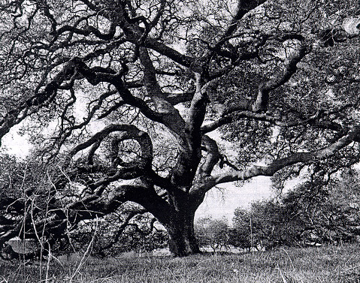
Trees
Chapter 8

Slide 2
Outline
Definitions
Traversing trees
Binary trees

Slide 3
Outline
Definitions
Traversing trees
Binary trees

Slide 4
Graph
a
b
Node ~ city or computer
Edge ~ road or data cable
c
Undirected or Directed
A surprisingly large number of computational problems can be expressed as graph problems.

Slide 5
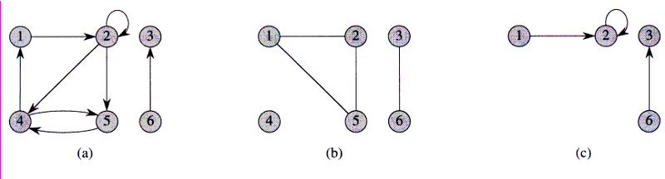
Directed and Undirected Graphs
A directed graph G = (V, E), where V = {1,2,3,4,5,6} and
E = {(1,2), (2,2), (2,4), (2,5), (4,1), (4,5), (5,4), (6,3)}.
The edge (2,2) is a self-loop.
(b) An undirected graph G = (V,E), where V = {1,2,3,4,5,6} and
E = {(1,2), (1,5), (2,5), (3,6)}. The vertex 4 is isolated.
(c) The subgraph of the graph in part (a) induced by the vertex set {1,2,3,6}.

Slide 6
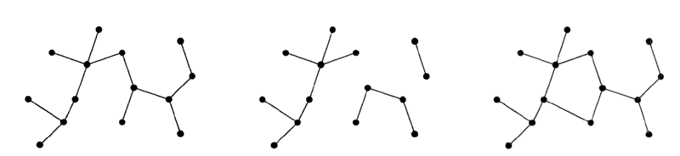
Trees
Tree
Forest
Graph with Cycle
A tree is a connected, acyclic, undirected graph.
A forest is a set of trees (not necessarily connected)

Slide 7
Rooted Trees
Trees are often used to represent hierarchical structure
In this view, one of the vertices (nodes) of the tree is distinguished as the root.
This induces a parent-child relationship between nodes of the tree.
Applications:
  Organization charts
  File systems
  Programming environments
root
Computers”R”Us
Sales
Manufacturing
R&D
US
International
Laptops
Desktops
Europe
Asia
Canada

Slide 8
Formal Definition of Rooted Tree
A rooted tree may be empty.
Otherwise, it consists of
  A root node r
  A set of subtrees whose roots are the children of r
r
B
C
D
E
F
G
H
subtree
I
J
K

Slide 9
Tree Terminology
Root: node without parent (A)
Internal node: node with at least one child (A, B, C, F)
External node (a.k.a. leaf ): node without children (E, I, J, K, G, H, D)
Ancestors of a node: self, parent, grandparent, great-grandparent, etc.
  NB: A node is considered an ancestor of itself!
Descendent of a node: self, child, grandchild, great-grandchild, etc.
  NB: A node is considered a descendent of itself!
Siblings: two nodes having the same parent
Depth of a node: number of ancestors (excluding the node itself)
Height of a tree: maximum depth of any node (3)
Subtree: tree consisting of a node and its descendents
A
subtree
B
C
D
E
F
G
H
I
J
K

Slide 10
Outline
Definitions
Traversing trees
Binary trees

Slide 11
Traversing Trees
One of the basic operations we require is to be able to traverse over the nodes of a tree.
To do this, we will make use of a Position ADT.

Slide 12
Position ADT
The Position ADT models the notion of place within a data structure where a single object is stored
It gives a unified view of diverse ways of storing data, such as
  a cell of an array
  a node of a linked list
  a node of a tree
Just one method:
  object p.element(): returns the element stored at the position p.

Slide 13
Tree ADT
We use positions to abstract the nodes of a tree.
Generic methods:
  integer size()
  boolean isEmpty()
  Iterator iterator()
  Iterable positions()
Accessor methods:
  Position root()
  Position parent(p)
  Iterable children(p)
Query methods:
  boolean isInternal(p)
  boolean isExternal(p)
  boolean isRoot(p)
Update method:
  object replace(p, o)
  Additional update methods may be defined by data structures implementing the Tree ADT

Slide 14
Positions vs Elements
Why have both
  Iterator iterator()
  Iterable positions()
The iterator returned by iterator() provides a means for stepping through the elements stored by the tree.
The positions() method returns a collection of the nodes of the tree.
Each node includes the element but also the links connecting the node to its parent and its children.
This allows you to move around the tree by following links to parents and children.

Slide 15
Preorder Traversal
A traversal visits the nodes of a tree in a systematic manner
Each time a node is visited, an action may be performed.
Thus the order in which the nodes are visited is important.
In a preorder traversal, a node is visited before its descendants
Algorithm preOrder(v)
  visit(v)
  for each child w of v
  preOrder (w)
1
Make Money Fast!
2
5
9
1. Motivations
2. Methods
References
3
4
6
7
8
1.2 Avidity
2.1 Stock
Fraud
2.2 Ponzi
Scheme
2.3 Bank
Robbery
1.1 Greed

Slide 16
Postorder Traversal
In a postorder traversal, a node is visited after its descendants
Algorithm postOrder(v)
  for each child w of v
  postOrder (w)
  visit(v)
9
cs16/
8
3
7
homeworks/
programs/
todo.txt
1K
1
2
4
5
6
h1c.doc
3K
h1nc.doc
2K
DDR.java
10K
Stocks.java
25K
Robot.java
20K

Slide 17
Linked Structure for Trees
A node is represented by an object storing
  Element
  Parent node
  Sequence of children nodes
Node objects implement the Position ADT
Ø
B
Ø
Ø
A
D
F
B
A
D
F
C
E
Ø
Ø
C
E

Slide 18
Outline
Definitions
Traversing trees
Binary trees

Slide 19
Binary Trees
A binary tree is a tree with the following properties:
  Each internal node has at most two children (exactly two for proper binary trees)
  The children of a node are an ordered pair
We call the children of an internal node left child and right child
Applications:
  arithmetic expressions
  decision processes
  searching
A
B
C
D
E
F
G
H
I

Slide 20
Arithmetic Expression Tree
Binary tree associated with an arithmetic expression
  internal nodes: operators
  external nodes: operands
Example: arithmetic expression tree for the expression (2 × (a − 1) + (3 × b))
+
⋅
⋅
2
−
3
b
a
1

Slide 21
Decision Tree
Binary tree associated with a decision process
  internal nodes: questions with yes/no answer
  external nodes: decisions
Example: dining decision
Want a fast meal?
Yes
No
How about coffee?
On expense account?
Yes
No
Yes
No
Second Cup
Blueberry Hill
Canoe
Cafe Diplomatico

Slide 22

Proper Binary Trees
A binary tree is said to be proper if each node has either 0 or 2 children.

Slide 23
Properties of Proper Binary Trees
Notation
  n number of nodes
  e number of external nodes
  i number of internal nodes
  h height
Properties:
  e = i + 1
  n = 2e - 1
  h ≤ i
  h ≤ (n - 1)/2
  e ≤ 2^{h}
  h ≥ log₂e
  h ≥ log₂(n + 1) - 1

Slide 24
BinaryTree ADT
The BinaryTree ADT extends the Tree ADT, i.e., it inherits all the methods of the Tree ADT
Additional methods:
  Position left(p)
  Position right(p)
  boolean hasLeft(p)
  boolean hasRight(p)
Update methods may be defined by data structures implementing the BinaryTree ADT

Slide 25
Representing Binary Trees
Linked Structure Representation
Array Representation

Slide 26
Linked Structure for Binary Trees
A node is represented by an object storing
  Element
  Parent node
  Left child node
  Right child node
Node objects implement the Position ADT
Ø
B
Ø
Ø
B
A
D
A
D
Ø
Ø
Ø
Ø
C
E
C
E

Slide 27
Implementation of Linked Binary Trees in net.datastructures
Query Methods:
size()
isEmpty()
isInternal(p)
isExternal(p)
isRoot(p)
hasLeft(p)
hasRight(p)
root()
left(p)
right(p)
parent(p)
children(p)
sibling(p)
positions()
iterator()
Modification Methods:
replace(p, e)
addRoot(e)
insertLeft(p)
insertRight(p)
remove(e)
…
Tree<E>
BinaryTree<E>
LinkedBinaryTree<E>

Slide 28
BTPosition in net.datastructures
The implementation of Positions for binary trees in net.datastructures is a bit subtle.
  BTPosition<E> is an interface in net.datastructures that represents the positions of a binary tree. This is used extensively to define the types of objects used by the LinkedBinaryTree<E> class that LinkedBinaryTreeLevel<E> extends.
  You do not have to implement BTPosition<E>: it is already implemented by BTNode<E>. Note that LinkedBinaryTree<E> only actually uses the BTNode<E> class explicitly when instantiating a node of the tree, in method createNode. In all other methods it refers to the nodes of the tree using the BTPosition<E> class (i.e., a widening cast). This layer of abstraction makes it easier to change the specific implementation of a node down the road – it would only require a change to the one method createNode.
  We use BTPosition<E> in testLinkedBinary to define the type of father, mother, daughter and son, and to cast the returned values from T.addRoot, T.insertLeft and T.insertRight. These three methods are implemented by LinkedBinaryTree and return nodes created by the createNode method.
  In LinkedBinaryTreeLevel, you can use the BTPosition<E> interface to define the type of the nodes stored in your NodeQueue. These nodes will be returned from queries on your binary tree, and thus will have been created by the createNode method using the BTNode<E> Class.
Position<E>
LinkedBinaryTree
public hasLeft (p)
public hasRight (p)
…
protected createNode (e, parent, left, right)
BTPosition<E>
BTNode<E>

Slide 29
Array-Based Representation of Binary Trees
nodes are stored in an array, using a level-numbering scheme.
1
A
…
2
B
D
3
let rank(node) be defined as follows:
  rank(root) = 1
  if node is the left child of parent(node), rank(node) = 2*rank(parent(node))
  if node is the right child of parent(node), rank(node) = 2*rank(parent(node))+1
4
5
6
7
E
F
C
J
10
G
H
11

Slide 30
Comparison
Linked Structure
Array
Requires explicit representation of 3 links per position:
  parent, left child, right child
Data structure grows as needed – no wasted space.
Parent and children are implicitly represented:
  Lower memory requirements per position
Memory requirements determined by height of tree. If tree is sparse, this is highly inefficient.

Slide 31
Inorder Traversal of Binary Trees
In an inorder traversal a node is visited after its left subtree and before its right subtree
Application: draw a binary tree
  x(v) = inorder rank of v
  y(v) = depth of v
Algorithm inOrder(v)
  if hasLeft (v)
    inOrder (left (v))
  visit(v)
  if hasRight (v)
    inOrder (right (v))
6
2
8
1
4
7
9
3
5

Slide 32
Print Arithmetic Expressions
Specialization of an inorder traversal
  print operand or operator when visiting node
  print “(“ before traversing left subtree
  print “)“ after traversing right subtree
Algorithm printExpression(v)
  if hasLeft (v)
  print(“(’’)
    inOrder (left(v))
  print(v.element ())
  if hasRight (v)
    inOrder (right(v))
  print (“)’’)
Input:
+
⋅
⋅
Output:
((2 × (a − 1)) + (3 × b))
2
−
3
b
a
1

Slide 33
Evaluate Arithmetic Expressions
Specialization of a postorder traversal
  recursive method returning the value of a subtree
  when visiting an internal node, combine the values of the subtrees
Algorithm evalExpr(v)
  if isExternal (v)
    return v.element ()
  else
  x ⬅ evalExpr (leftChild (v))
  y ⎜ evalExpr (rightChild (v))
  υ ⎜ operator stored at v
    return x υ y
+
⋅
⋅
2
−
3
2
5
1

Slide 34
Euler Tour Traversal
Generic traversal of a binary tree
Includes as special cases the preorder, postorder and inorder traversals
Walk around the tree and visit each node three times:
  on the left (preorder)
  from below (inorder)
  on the right (postorder)
+
L
⋅
R
⋅
B
2
−
3
2
5
1

Slide 35
Template Method Pattern
Generic algorithm that can be specialized by redefining certain steps
Implemented by means of an abstract Java class
Visit methods can be redefined by subclasses
Template method eulerTour
  Recursively called on the left and right children
  A Result object with fields leftResult, rightResult and finalResult keeps track of the output of the recursive calls to eulerTour
public abstract class EulerTour {
protected BinaryTree tree;
protected void visitExternal(Position p, Result r) { }
protected void visitLeft(Position p, Result r) { }
protected void visitBelow(Position p, Result r) { } protected void visitRight(Position p, Result r) { }
protected Object eulerTour(Position p) {
Result r = new Result();
if tree.isExternal(p) { visitExternal(p, r); }
else {
visitLeft(p, r);
r.leftResult = eulerTour(tree.left(p));
visitBelow(p, r);
r.rightResult = eulerTour(tree.right(p));
visitRight(p, r);
return r.finalResult;
} …

Slide 36
Specializations of EulerTour
We show how to specialize class EulerTour to evaluate an arithmetic expression
Assumptions
  External nodes store Integer objects
  Internal nodes store Operator objects supporting method
  operation (Integer, Integer)
public class EvaluateExpression
extends EulerTour {
protected void visitExternal(Position p, Result r) {
r.finalResult = (Integer) p.element();
}
protected void visitRight(Position p, Result r) {
Operator op = (Operator) p.element();
r.finalResult = op.operation(
(Integer) r.leftResult,
(Integer) r.rightResult
);
}
…
}

Slide 37
Outline
Definitions
Traversing trees
Binary trees

