Slide 1
Recursion
Chapter 5

Slide 2
Outline
Induction
Linear recursion
Example 1: Factorials
Example 2: Powers
Example 3: Reversing an array
Binary recursion
Example 1: The Fibonacci sequence
Example 2: The Tower of Hanoi
Drawbacks and pitfalls of recursion

Slide 3
Outcomes
By understanding this lecture you should be able to:
Use induction to prove the correctness of a recursive algorithm.
Identify the base case for an inductive solution
Design and analyze linear and binary recursion algorithms
Identify the overhead costs of recursion
Avoid errors commonly made in writing recursive algorithms

Slide 4
Outline
Induction
Linear recursion
Example 1: Factorials
Example 2: Powers
Example 3: Reversing an array
Binary recursion
Example 1: The Fibonacci sequence
Example 2: The Tower of Hanoi
Drawbacks and pitfalls of recursion

Slide 5
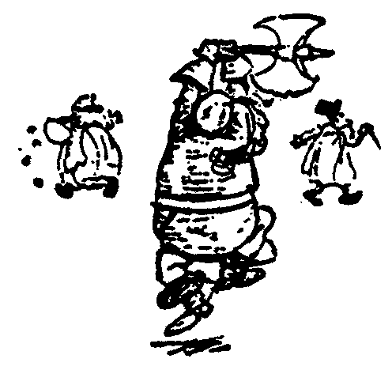
Divide and Conquer
When faced with a difficult problem, a classic technique is to break it down into smaller parts that can be solved more easily.
Recursion uses induction to do this.

Slide 6
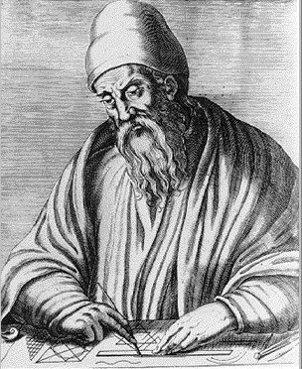
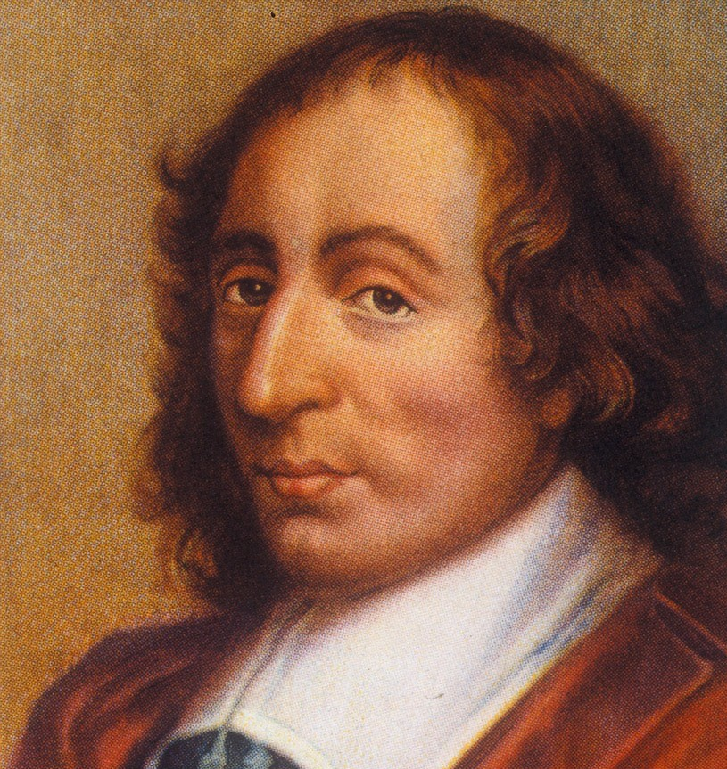
History of Induction
Implicit use of induction goes back at least to Euclid’s proof that the number of primes is infinite (c. 300 BC).
The first explicit formulation of the principle is due to Pascal (1665).
Euclid of Alexandria,
"The Father of Geometry"
c. 300 BC
Blaise Pascal, 1623 - 1662

Slide 7
Induction: Review
Induction is a mathematical method for proving that a statement is true for a (possibly infinite) sequence of objects.
There are two things that must be proved:
The Base Case: The statement is true for the first object
The Inductive Step: If the statement is true for a given object, it is also true for the next object.
If these two statements hold, then the statement holds for all objects.

Slide 8
Induction Example: An Arithmetic Sum
Claim:
Proof:
Base Case. The statement holds for n = 0:
Inductive Step. If the claim holds for n = k, then it also holds for n = k+1.
✓
✓

Slide 9
Recursive Divide and Conquer
You are given a problem input that is too big to solve directly.
You imagine,
“Suppose I had a friend who could give me the answer to the same problem with slightly smaller input.”
“Then I could easily solve the larger problem.”
In recursion this “friend” will actually be another instance (clone) of yourself.
Tai (left) and Snuppy (right): the first puppy clone.

Slide 10
Friends & Induction
Recursive Algorithm:
Assume you have an algorithm that works.
Use it to write an algorithm that works.
If I could get in,
I could get the key.
Then I could unlock the door
so that I can get in.
Circular Argument!
Example from J. Edmonds – Thanks Jeff!

Slide 11
Friends & Induction
Recursive Algorithm:
Assume you have an algorithm that works.
Use it to write an algorithm that works.
To get into my house
I must get the key from a smaller house

Slide 12
Friends & Induction
Recursive Algorithm:
Assume you have an algorithm that works.
Use it to write an algorithm that works.
The “base case”
Use brute force
to get into
the smallest house.

Slide 13
Outline
Induction
Linear recursion
Example 1: Factorials
Example 2: Powers
Example 3: Reversing an array
Binary recursion
Example 1: The Fibonacci sequence
Example 2: The Tower of Hanoi
Drawbacks and pitfalls of recursion

Slide 14
Recall: Design Pattern
A template for a software solution that can be applied to a variety of situations.
Main elements of solution are described in the abstract.
Can be specialized to meet specific circumstances.

Slide 15
Linear Recursion Design Pattern
Test for base cases
Begin by testing for a set of base cases (there should be at least one).
Every possible chain of recursive calls must eventually reach a base case, and the handling of each base case should not use recursion.
Recurse once
Perform a single recursive call. (This recursive step may involve a test that decides which of several possible recursive calls to make, but it should ultimately choose to make just one of these calls each time we perform this step.)
Define each possible recursive call so that it makes progress towards a base case.

Slide 16
Example 1
The factorial function:
n! = 1· 2· 3· ··· · (n-1)· n
Recursive definition:
As a Java method:
// recursive factorial function
public static int recursiveFactorial(int n) {
if (n == 0) return 1; // base case
else return n * recursiveFactorial(n- 1); // recursive case
}

Slide 17
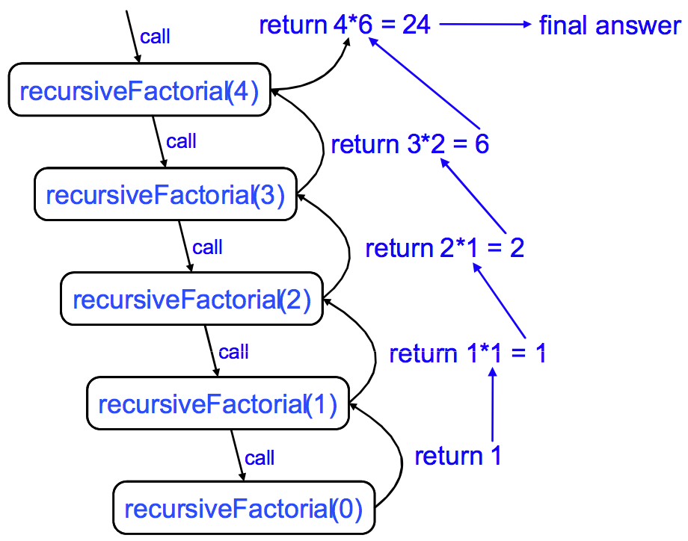
Tracing Recursion

Slide 18
Linear Recursion
recursiveFactorial is an example of linear recursion: only one recursive call is made per stack frame.
Since there are n recursive calls, this algorithm has O(n) run time.
// recursive factorial function
public static int recursiveFactorial(int n) {
if (n == 0) return 1; // base case
else return n * recursiveFactorial(n- 1); // recursive case
}

Slide 19
Example 2: Computing Powers
The power function, p(x,n) = x^{n}, can be defined recursively:
Assume multiplication takes constant time (independent of value of arguments).
This leads to a power function that runs in O(n) time (for we make n recursive calls).
Can we do better than this?

Slide 20
Recursive Squaring
We can derive a more efficient linearly recursive algorithm by using repeated squaring:
For example,
2⁴ = 2^{(4/2)2} = (2^{4/2})² = (2²)² = 4² = 16
2⁵ = 2^{1+(4/2)2} = 2(2^{4/2})² = 2(2²)² = 2(4²) = 32
2⁶ = 2^{(6/ 2)2} = (2^{6/2})² = (2³)² = 8² = 64
2⁷ = 2^{1+(6/2)2} = 2(2^{6/2})² = 2(2³)² = 2(8²) = 128.

Slide 21
A Recursive Squaring Method
Algorithm Power(x, n):
Input: A number x and integer n
Output: The value x^{n}
if n = 0 then
return 1
if n is odd then
y = Power(x, (n - 1)/ 2)
return x · y ·y
else
y = Power(x, n/ 2)
return y · y

Slide 22
Analyzing the Recursive Squaring Method
Algorithm Power(x, n):
Input: A number x and integer n = 0
Output: The value x^{n}
if n = 0 then
return 1
if n is odd then
y = Power(x, (n - 1)/ 2)
return x · y ·y
else
y = Power(x, n/ 2)
return y · y
Although there are 2 statements that recursively call Power, only one is executed per stack frame.
Each time we make a recursive call we halve the value of n (roughly).
Thus we make a total of log n recursive calls. That is, this method runs in O(log n) time.

Slide 23
Tail Recursion
Tail recursion occurs when a linearly recursive method makes its recursive call as its last step.
Such a method can easily be converted to an iterative methods (which saves on some resources).

Slide 24
Example: Recursively Reversing an Array
Algorithm ReverseArray(A, i, j):
Input: An array A and nonnegative integer indices i and j
Output: The reversal of the elements in A starting at index i and ending at j
if i < j then
Swap A[i] and A[ j]
ReverseArray(A, i + 1, j - 1)
return

Slide 25
Example: Iteratively Reversing an Array
Algorithm IterativeReverseArray(A, i, j ):
Input: An array A and nonnegative integer indices i and j
Output: The reversal of the elements in A starting at index i and ending at j
while i < j do
Swap A[i ] and A[ j ]
i = i + 1
j = j - 1
return

Slide 26
Defining Arguments for Recursion
Solving a problem recursively sometimes requires passing additional parameters.
ReverseArray is a good example: although we might initially think of passing only the array A as a parameter at the top level, lower levels need to know where in the array they are operating.
Thus the recursive interface is ReverseArray(A, i, j).
We then invoke the method at the highest level with the message ReverseArray(A, 1, n).

Slide 27
Outline
Induction
Linear recursion
Example 1: Factorials
Example 2: Powers
Example 3: Reversing an array
Binary recursion
Example 1: The Fibonacci sequence
Example 2: The Tower of Hanoi
Drawbacks and pitfalls of recursion

Slide 28
Binary Recursion
Binary recursion occurs whenever there are two recursive calls for each non-base case.
Example 1: The Fibonacci Sequence

Slide 29
The Fibonacci Sequence
Fibonacci numbers are defined recursively:
F₀ = 0
F₁ = 1
F_{i} = F_{i-1} ⁺ F_{i-2} for i > 1.
(The “Golden Ratio”)
Fibonacci (c. 1170 - c. 1250)
(aka Leonardo of Pisa)

Slide 30
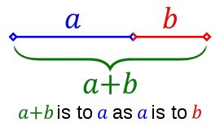
The Golden Ratio
Two quantities are in the golden ratio if the ratio of the sum of the quantities to the larger quantity is equal to the ratio of the larger quantity to the smaller one.

Slide 31
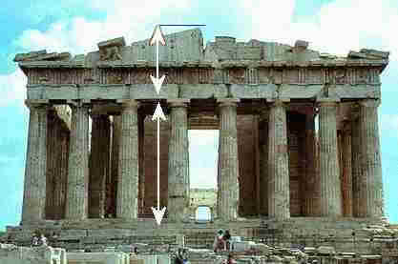
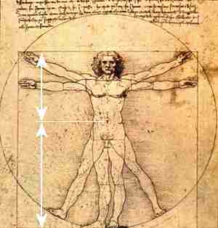
The Golden Ratio
The Parthenon
Leonardo

Slide 32
Computing Fibonacci Numbers
F₀ = 0
F₁ = 1
F_{i} = F_{i-1} ⁺ F_{i-2} for i > 1.
A recursive algorithm (first attempt):
Algorithm BinaryFib(k):
Input: Positive integer k
Output: The kth Fibonacci number F_{k}
if k < 2 then
return k
else
return BinaryFib(k - 1) + BinaryFib(k - 2)

Slide 33
Analyzing the Binary Recursion Fibonacci Algorithm
Let n_{k} denote number of recursive calls made by BinaryFib(k). Then
n₀ = 1
n₁ = 1
n₂ = n₁ + n₀ + 1 = 1 + 1 + 1 = 3
n₃ = n₂ + n₁ + 1 = 3 + 1 + 1 = 5
n₄ = n₃ + n₂ + 1 = 5 + 3 + 1 = 9
n₅ = n₄ + n₃ + 1 = 9 + 5 + 1 = 15
n₆ = n₅ + n₄ + 1 = 15 + 9 + 1 = 25
n₇ = n₆ + n₅ + 1 = 25 + 15 + 1 = 41
n₈ = n₇ + n₆ + 1 = 41 + 25 + 1 = 67.
Note that n_{k} more than doubles for every other value of n_{k}. That is, n_{k} > 2^{k/2}. It increases exponentially!

Slide 34
A Better Fibonacci Algorithm
Use linear recursion instead:
Algorithm LinearFibonacci(k):
Input: A positive integer k
Output: Pair of Fibonacci numbers (F_{k}, F_{k-1})
if k = 1 then
return (k, 0)
else
(i, j) = LinearFibonacci(k - 1)
return (i +j, i)
Runs in O(k) time.
LinearFibonacci(k): F_{k}, F_{k-1}
LinearFibonacci(k-1): F_{k-1}, F_{k-2}

Slide 35
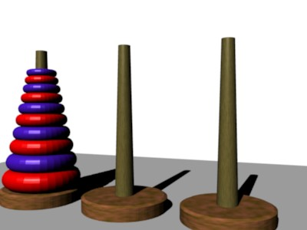
Binary Recursion
Second Example: The Tower of Hanoi

Slide 36
Example

Slide 37
Tower of Hanoi
This job of mine is a bit daunting.
Where do I start?
And I am lazy.
Example from J. Edmonds – Thanks Jeff!

Slide 38
Tower of Hanoi
At some point, the biggest disk moves.
I will do that job.

Slide 39
Tower of Hanoi
To do this, the other disks must be in the middle.

Slide 40
Tower of Hanoi
How will these move?
I will get a friend to do it.
And another to move these.
I only move the big disk.

Slide 41
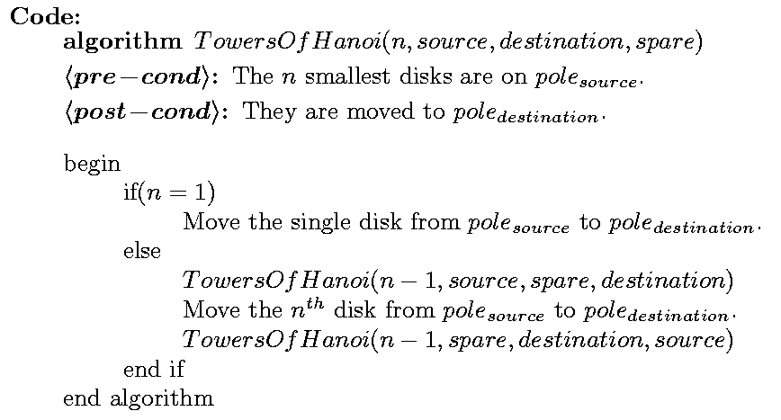
Tower of Hanoi
2 recursive calls!

Slide 42
Tower of Hanoi
Time: T(1) = 1,
T(n) =
≈ 2(2T(n-2))
≈ 4(2T(n-3))
1 + 2T(n-1)
≈ 2T(n-1)
≈ 4T(n-2)
≈ 8T(n-3)
≈ 2^{i} T(n-i)
≈ 2^{n}

Slide 43
Binary Recursion: Summary
Binary recursion spawns an exponential number of recursive calls.
If the inputs are only declining arithmetically (e.g., n-1, n-2,…) the result will be an exponential running time.
In order to use binary recursion, the input must be declining geometrically (e.g., n/2, n/4, …).
We will see efficient examples of binary recursion with geometricaly declining inputs when we discuss heaps and sorting.

Slide 44
Outline
Induction
Linear recursion
Example 1: Factorials
Example 2: Powers
Example 3: Reversing an array
Binary recursion
Example 1: The Fibonacci sequence
Example 2: The Tower of Hanoi
Drawbacks and pitfalls of recursion

Slide 45
The Overhead Costs of Recursion
Many problems are naturally defined recursively.
This can lead to simple, elegant code.
However, recursive solutions entail a cost in time and memory: each recursive call requires that the current process state (variables, program counter) be pushed onto the system stack, and popped once the recursion unwinds.
This typically affects the running time constants, but not the asymptotic time complexity (e.g., O(n), O(n²) etc.)
Thus recursive solutions may still be preferred unless there are very strict time/memory constraints.

Slide 46
The “Curse” in Recursion: Errors to Avoid
// recursive factorial function
public static int recursiveFactorial(int n) {
return n * recursiveFactorial(n- 1);
}
There must be a base condition: the recursion must ground out!

Slide 47
The “Curse” in Recursion: Errors to Avoid
// recursive factorial function
public static int recursiveFactorial(int n) {
if (n == 0) return recursiveFactorial(n); // base case
else return n * recursiveFactorial(n- 1); // recursive case
}
The base condition must not involve more recursion!

Slide 48
The “Curse” in Recursion: Errors to Avoid
// recursive factorial function
public static int recursiveFactorial(int n) {
if (n == 0) return 1; // base case
else return (n – 1) * recursiveFactorial(n); // recursive case
}
The input must be converging toward the base condition!

Slide 49
Outline
Induction
Linear recursion
Example 1: Factorials
Example 2: Powers
Example 3: Reversing an array
Binary recursion
Example 1: The Fibonacci sequence
Example 2: The Tower of Hanoi
Drawbacks and pitfalls of recursion

Slide 50
Outcomes
By understanding this lecture you should be able to:
Use induction to prove the correctness of a recursive algorithm.
Identify the base case for an inductive solution
Design and analyze linear and binary recursion algorithms
Identify the overhead costs of recursion
Avoid errors commonly made in writing recursive algorithms

