Slide 1
Asymptotic Analysis of Algorithms
Chapter 4

Slide 2
Overview
Motivation
Definition of Running Time
Classifying Running Time
Asymptotic Notation & Proving Bounds
Algorithm Complexity vs Problem Complexity

Slide 3
Overview
Motivation
Definition of Running Time
Classifying Running Time
Asymptotic Notation & Proving Bounds
Algorithm Complexity vs Problem Complexity

Slide 4
The Importance of Asymptotic Analysis
<Adi Shamir <shamir@wisdom.weizmann.ac.il>>
Thu, 26 Jul 2001 00:50:03 +0300
Subject: New results on WEP (via Matt Blaze)
WEP is the security protocol used in the widely deployed IEEE 802.11 wireless LAN's. This protocol received a lot of attention this year, and several groups of researchers have described a number of ways to bypass its security.
Attached you will find a new paper which describes a truly practical direct attack on WEP's cryptography. It is an extremely powerful attack which can be applied even when WEP's RC4 stream cipher uses a 2048 bit secret key (its maximal size) and 128 bit IV modifiers (as proposed in WEP2). The attacker can be a completely passive eavesdropper (i.e., he does not have to inject packets, monitor responses, or use accomplices) and thus his existence is essentially undetectable. It is a pure known-ciphertext attack (i.e., the attacker need not know or choose their corresponding plaintexts). After scanning several hundred thousand packets, the attacker can completely recover the secret key and thus decrypt all the ciphertexts. The running time of the attack grows linearly instead of exponentially with the key size, and thus it is negligible even for 2048 bit keys.
Adi Shamir
Source: The Risks Digest (catless.ncl.ac.uk/Risks)

Slide 5
The Importance of Asymptotic Analysis
<Monty Solomon <monty@roscom.com>>
Sat, 31 May 2003 10:22:56 -0400
Denial of Service via Algorithmic Complexity Attacks
Scott A. Crosby <scrosby@cs.rice.edu>
Dan S. Wallach <dwallach@cs.rice.edu>
Department of Computer Science, Rice University
We present a new class of low-bandwidth denial of service attacks that exploit algorithmic deficiencies in many common applications' data structures. Frequently used data structures have ``average-case'' expected running time that's far more efficient than the worst case. For example, both binary trees and hash tables can degenerate to linked lists with carefully chosen input. We show how an attacker can effectively compute such input, and we demonstrate attacks against the hash table implementations in two versions of Perl, the Squid web proxy, and the Bro intrusion detection system. Using bandwidth less than a typical dialup modem, we can bring a dedicated Bro server to its knees; after six minutes of carefully chosen packets, our Bro server was dropping as much as 71% of its traffic and consuming all of its CPU. We show how modern universal hashing techniques can yield performance comparable to commonplace hash functions while being provably secure against these attacks.
Source: The Risks Digest (catless.ncl.ac.uk/Risks)

Slide 6
The Purpose of Asymptotic Analysis
To estimate how long a program will run.
To estimate the largest input that can reasonably be given to the program.
To compare the efficiency of different algorithms.
To help focus on the parts of code that are executed the largest number of times.
To choose an algorithm for an application.

Slide 7
Overview
Motivation
Definition of Running Time
Classifying Running Time
Asymptotic Notation & Proving Bounds
Algorithm Complexity vs Problem Complexity

Slide 8

Running Time
Most algorithms transform input objects into output objects.
The running time of an algorithm typically grows with the input size.
Average case time is often difficult to determine.
We focus on the worst case running time.
  Easier to analyze
  Reduces risk

Slide 9
Experimental Studies
Write a program implementing the algorithm
Run the program with inputs of varying size and composition
Use a method like System.currentTimeMillis() to get an accurate measure of the actual running time
Plot the results

Slide 10
Limitations of Experiments
It is necessary to implement the algorithm, which may be difficult
Results may not be indicative of the running time on other inputs not included in the experiment.
In order to compare two algorithms, the same hardware and software environments must be used

Slide 11
Theoretical Analysis
Uses a high-level description of the algorithm instead of an implementation
Characterizes running time as a function of the input size, n.
Takes into account all possible inputs
Allows us to evaluate the speed of an algorithm independent of the hardware/software environment

Slide 12
Primitive Operations
Basic computations performed by an algorithm
Identifiable in pseudocode
Largely independent from the programming language
Assumed to take a constant amount of time
Examples:
  Evaluating an expression
  Assigning a value to a variable
  Indexing into an array
  Calling a method
  Returning from a method

Slide 13
Counting Primitive Operations
By inspecting the pseudocode, we can determine the maximum number of primitive operations executed by an algorithm, as a function of the input size
Algorithm arrayMax(A, n)
# operations
currentMax ⎜ A[0] 2
for i ⎜ 1 to n - 1 do 2n
if A[i] > currentMax then 2(n -1)
currentMax ⎜ A[i] 2(n -1)
return currentMax 1
Total 6n -1
?
?
?
?
?
?

Slide 14
Estimating Running Time
Algorithm arrayMax executes 6n − 1 primitive operations in the worst case. Define:
  a = Time taken by the fastest primitive operation
  b = Time taken by the slowest primitive operation
Let T(n) be worst-case time of arrayMax. Then
a (6n − 1) ≤ T(n) ≤ b(6n − 1)
Hence, the running time T(n) is bounded by two linear functions

Slide 15
Growth Rate of Running Time
Changing the hardware/ software environment
  Affects T(n) by a constant factor, but
  Does not qualitatively alter the growth rate of T(n)
The linear growth rate of the running time T(n) is an intrinsic property of algorithm arrayMax

Slide 16
Overview
Motivation
Definition of Running Time
Classifying Running Time
Asymptotic Notation & Proving Bounds
Algorithm Complexity vs Problem Complexity

Slide 17
Constant Factors
On a logarithmic scale, the growth rate is not affected by
  constant factors or
  lower-order terms
Examples
  10²n + 10⁵ is a linear function
  10⁵n² + 10⁸n is a quadratic function

Slide 18
Seven Important Functions
Seven functions that often appear in algorithm analysis:
  Constant ≈ 1
  Logarithmic ≈ log n
  Linear ≈ n
  N-Log-N ≈ n log n
  Quadratic ≈ n²
  Cubic ≈ n³
  Exponential ≈ 2^{n}
In a log-log chart, the slope of the line corresponds to the growth rate of the function.

Slide 19
Classifying Functions
n
T(n)
10
100
1,000
10,000
log n
3
6
9
13
n^{1/2}
3
10
31
100
n
10
100
1,000
10,000
n log n
30
600
9,000
130,000
n²
100
10,000
10⁶
10⁸
n³
1,000
10⁶
10⁹
10¹²
2^{n}
1,024
10³⁰
10³⁰⁰
10³⁰⁰⁰
Note: The universe is estimated to contain ~10⁸⁰ particles.

Slide 20
Let’s practice classifying functions

Slide 21
Which are more alike?
n¹⁰⁰⁰
n²
2^{n}

Slide 22
Which are more alike?
n¹⁰⁰⁰
n²
2^{n}
Polynomials

Slide 23
Which are more alike?
1000n²
3n²
2n³

Slide 24
Which are more alike?
1000n²
3n²
2n³
Quadratic

Slide 25
Overview
Motivation
Definition of Running Time
Classifying Running Time
Asymptotic Notation & Proving Bounds
Algorithm Complexity vs Problem Complexity

Slide 26
Some Math to Review
Summations
Logarithms and Exponents
Existential and universal operators
Proof techniques
properties of logarithms:
  log_{b}(xy) = log_{b}x + log_{b}y
  log_{b} (x/y) = log_{b}x - log_{b}y
  log_{b}xª = alog_{b}x
  log_{b}a = log_{x}a/log_{x}b
properties of exponentials:
  a^{(b+c)} = a^{b}a ^{c}
  a^{bc} = (a^{b})^{c}
  a^{b} /a^{c} = a^{(b-c)}
  b = a ^{log}_{a}^{b}
  b^{c} = a ^{c*log}_{a}^{b}
existential and universal operators

Slide 27
Understand Quantifiers!!!
Could be a separate girl for each boy.
One girl
Sam | Mary
Bob | Beth
John | Marilyn Monro
Fred | Ann
Sam | Mary
Bob | Beth
John | Marilyn Monro
Fred | Ann

Slide 28
Asymptotic Notation
The notation was first introduced by number theorist Paul Bachmann in 1894, in the second volume of his book Analytische Zahlentheorie ("analytic number theory”).
The notation was popularized in the work of number theorist Edmund Landau; hence it is sometimes called a Landau symbol.
It was popularized in computer science by Donald Knuth, who (re)introduced the related Omega and Theta notations.
Knuth also noted that the (then obscure) Omega notation had been introduced by Hardy and Littlewood under a slightly different meaning, and proposed the current definition.
Source: Wikipedia

Slide 29
Big-Oh Notation
Given functions f(n) and g(n), we say that f(n) is O(g(n)) if there are positive constants
c and n₀ such that
f(n) ≤ cg(n) for n > n₀
Example: 2n + 10 is O(n)
  2n + 10 ≤ cn
  (c − 2) n > 10
  n > 10/(c − 2)
  Pick c = 3 and n₀ = 10

Slide 30
End of lecture, Jan 9, 2014

Slide 31
Definition of “Big Oh”

Slide 32
Big-Oh Example
Example: the function n² is not O(n)
  n² ≤ cn
  n < c
  The above inequality cannot be satisfied since c must be a constant

Slide 33
More Big-Oh Examples
7n-2
  7n-2 is O(n)
  need c > 0 and n₀ ≥ 1 such that 7n-2 ≤ c•n for n ≥ n₀
  this is true for c = 7 and n₀ = 1
3n³ + 20n² + 5
  3n³ + 20n² + 5 is O(n³)
  need c > 0 and n₀ ≥ 1 such that 3n³ + 20n² + 5 ≤ c•n³ for n ≥n₀
  this is true for c = 5 and n₀ = 20
3 log n + 5
  3 log n + 5 is O(log n)
  need c > 0 and n₀ ≥ 1 such that 3 log n + 5 ≤ c•log n for n ≥ n₀
  this is true for c = 4 and n₀ = 32

Slide 34
Big-Oh and Growth Rate
The big-Oh notation gives an upper bound on the growth rate of a function
The statement “f(n) is O(g(n))” means that the growth rate of f(n) is no more than the growth rate of g(n)
We can use the big-Oh notation to rank functions according to their growth rate
 | f(n) is O(g(n)) | g(n) is O(f(n))
g(n) grows more | Yes | No
f(n) grows more | No | Yes
Same growth | Yes | Yes

Slide 35
Big-Oh Rules
If f(n) is a polynomial of degree d, then f(n) is O(n^{d}), i.e.,
  Drop lower-order terms
  Drop constant factors
We generally specify the tightest bound possible
  Say “2n is O(n)” instead of “2n is O(n²)”
Use the simplest expression of the class
  Say “3n + 5 is O(n)” instead of “3n + 5 is O(3n)”

Slide 36
Asymptotic Algorithm Analysis
The asymptotic analysis of an algorithm determines the running time in big-Oh notation
To perform the asymptotic analysis
  We find the worst-case number of primitive operations executed as a function of the input size
  We express this function with big-Oh notation
Example:
  We determine that algorithm arrayMax executes at most 6n − 1 primitive operations
  We say that algorithm arrayMax “runs in O(n) time”
Since constant factors and lower-order terms are eventually dropped anyhow, we can disregard them when counting primitive operations

Slide 37
Computing Prefix Averages
We further illustrate asymptotic analysis with two algorithms for prefix averages
The i-th prefix average of an array X is the average of the first (i + 1) elements of X:
A[i] = (X[0] + X[1] + … + X[i])/(i+1)
Computing the array A of prefix averages of another array X has applications to financial analysis, for example.

Slide 38
Prefix Averages (v1)
The following algorithm computes prefix averages by applying the definition
Algorithm prefixAverages1(X, n)
Input array X of n integers
Output array A of prefix averages of X #operations
A ⎜ new array of n integers n
for i ⎜ 0 to n − 1 do n
s ⎜ X[0] n
for j ⎜ 1 to i do 1 + 2 + …+ (n − 1)
s ⎜ s + X[j] 1 + 2 + …+ (n − 1)
A[i] ⎜ s / (i + 1) n
return A 1

Slide 39
Arithmetic Progression
The running time of prefixAverages1 is
O(1 + 2 + …+ n)
The sum of the first n integers is n(n + 1) / 2
  There is a simple visual proof of this fact
Thus, algorithm prefixAverages1 runs in O(n²) time

Slide 40
Prefix Averages (v2)
The following algorithm computes prefix averages efficiently by keeping a running sum
Algorithm prefixAverages2(X, n)
Input array X of n integers
Output array A of prefix averages of X #operations
A ⎜ new array of n integers n
s ⎜ 0 1
for i ⎜ 0 to n − 1 do n
s ⎜ s + X[i] n
A[i] ⎜ s / (i + 1) n
return A 1
Algorithm prefixAverages2 runs in O(n) time

Slide 41
Relatives of Big-Oh
Big-Omega
  f(n) is Ω(g(n)) if there is a constant c > 0
  and an integer constant n₀ ≥ 1 such that
  f(n) ≥ c•g(n) for n ≥ n₀
Big-Theta
  f(n) is Θ(g(n)) if there are constants c₁ > 0 and c₂ > 0 and an integer constant n₀ ≥ 1 such that c₁•g(n) ≤ f(n) ≤ c₂•g(n) for n ≥ n₀

Slide 42
Intuition for Asymptotic Notation
Big-Oh
  f(n) is O(g(n)) if f(n) is asymptotically less than or equal to g(n)
big-Omega
  f(n) is Ω(g(n)) if f(n) is asymptotically greater than or equal to g(n)
big-Theta
  f(n) is Θ(g(n)) if f(n) is asymptotically equal to g(n)

Slide 43
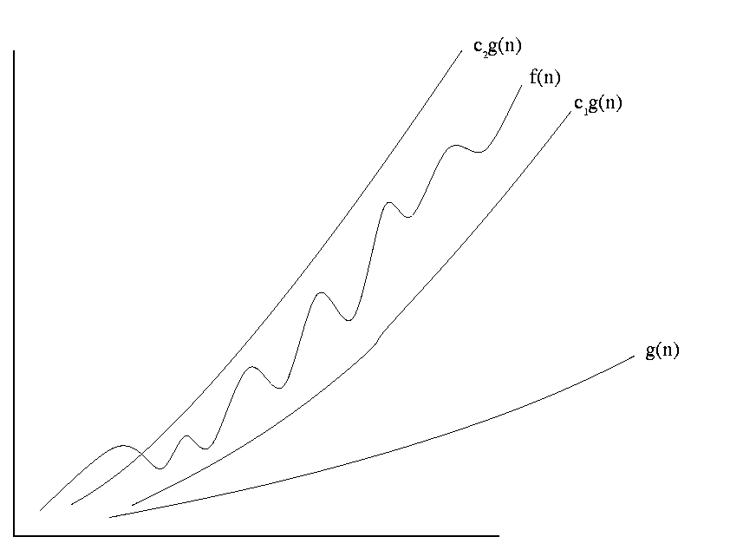
Definition of Theta
f(n) = θ(g(n))
f(n) is sandwiched between c₁g(n) and c₂g(n)

Slide 44
Overview
Motivation
Definition of Running Time
Classifying Running Time
Asymptotic Notation & Proving Bounds
Algorithm Complexity vs Problem Complexity

Slide 45
Time Complexity of an Algorithm
The time complexity of an algorithm is
the largest time required on any input
of size n. (Worst case analysis.)
O(n²): For any input size n ≥ n₀, the algorithm takes no more than cn² time on every input.
Ω(n²): For any input size n ≥ n₀, the algorithm takes at least cn² time on at least one input.
θ (n²): Do both.

Slide 46
What is the height of tallest person in the class?
Bigger than this?
Smaller than this?
Need to find
only one person
who is taller
Need to look at
every person

Slide 47
Time Complexity of a Problem
The time complexity of a problem is
the time complexity of the fastest algorithm that solves the problem.
O(n²): Provide an algorithm that solves the problem in no more than this time.
  Remember: for every input, i.e. worst case analysis!
Ω(n²): Prove that no algorithm can solve it faster.
  Remember: only need one input that takes at least this long!
θ (n²): Do both.

Slide 48
Overview
Motivation
Definition of Running Time
Classifying Running Time
Asymptotic Notation & Proving Bounds
Algorithm Complexity vs Problem Complexity

