Slide 1
CSE 2011 Fundamentals of Data Structures
Introduction
Computer programming is an art, because it applies accumulated knowledge to the world, because it requires skill and ingenuity, and especially because it produces objects of beauty.
- Donald Knuth

Slide 2
Instructor
Slawomir Kmiec
email: skmiec@cse.yorku.ca
website: www.cse.yorku.ca/~skmiec
Office Hour: LSB103 Wednesdays 6:00 PM - 7:00 PM

Slide 3
Teaching Assistants
TBD
Email: tbd@gmail.com
Office Hour: By appointment
TBD
Email: tbd@cse.yorku.ca
Office Hour: By appointment

Slide 4
Course Website
www.cse.yorku.ca/course/2011

Slide 5
Textbook
Goodrich, M.T. & Tamassia R. (2014). Data Structures and Algorithms in Java (6th ed.) John Wiley & Sons.

Slide 6
Summary of Requirements
Component | Weight
4 Assignments | 20%
Midterm test (closed book) | 30%
Final exam (closed book) | 50%
Please see syllabus posted on website for more detailed information.

Slide 7
How to do well in this course
Attend all of the lectures!
Do the readings prior to each lecture.
Work hard on each assignment.
Do not leave them to the last moment.
Ask one of the TAs or me if there is something you do not understand.

Slide 8
Course Outline
Introduction
Analysis Tools
Recursion
Arrays, Array Lists & Stacks
Queues & Linked Lists
Trees
Heaps
Priority Queues
Maps, Hash Tables, Dictionaries
Search Trees
The Java Collections Framework
Graphs
Directed Graphs
Weighted Graphs
Sorting
Graph Search
Strings & Dynamic Programming

Slide 9
On the slides
These slides:
are posted on the course website.
may change up to the last minute as I polish the lecture.
Incorporate slides produced by the textbook authors (Goodrich & Tamassia).

Slide 10
Please ask questions!
Help me know what people are not understanding!

Slide 11
Lecture 1
Data Structures and Object-Oriented Design

Slide 12
Data Structures & Object-Oriented Design
Definitions
Principles of Object-Oriented Design
Hierarchical Design in Java
Abstract Data Types & Interfaces
Casting
Generics
Pseudo-Code

Slide 13
Data Structures & Object-Oriented Design
Definitions
Principles of Object-Oriented Design
Hierarchical Design in Java
Interfaces
Casting
Generics
Pseudo-Code

Slide 14
Programs = Data Structures + Algorithms

Slide 15
Principles of Object Oriented Design
Programs consist of objects.
Objects consist of
Data structures
Algorithms to construct, access and modify these structures.

Slide 16
Data Structure
Definition: An organization of information, usually in memory, such as a queue, stack, linked list, heap, dictionary, or tree.

Slide 17
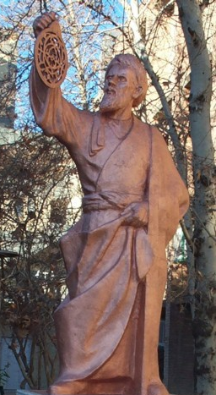
Algorithm
Definition: A finite set of unambiguous instructions performed in a prescribed sequence to achieve a goal, especially a mathematical rule or procedure used to compute a desired result.
The word algorithm comes from the name of the 9th century Persian mathematician Muhammad ibn Mūsā al-Khwārizmī.
He worked in Baghdad at the time when it was the centre of scientific studies and trade.
The word algorism originally referred only to the rules of performing arithmetic using Arabic numerals but evolved via European Latin translation of al-Khwarizmi's name into algorithm by the 18th century.
The word evolved to include all definite procedures for solving problems or performing tasks.

Slide 18
Data Structures We Will Study
Linear Data Structures
Arrays
Linked Lists
Stacks
Queues
Priority Queues
Non-Linear Data Structures
Trees
Heaps
Hash Tables
Search Trees
Graphs
Directed Graphs
Weighted Graphs

Slide 19
Some Algorithms We Will Study
Searching
Sorting
Graph Search
Dynamic Programming
Please see syllabus posted on website for detailed schedule (tentative).

Slide 20
Design Patterns
A template for a software solution that can be applied to a variety of situations.
Main elements of solution are described in the abstract.
Can be specialized to meet specific circumstances.
Example algorithm design patterns:
Recursion
Divide and Conquer

Slide 21
Data Structures & Object-Oriented Design
Definitions
Principles of Object-Oriented Design
Hierarchical Design in Java
Abstract Data Types & Interfaces
Casting
Generics
Pseudo-Code

Slide 22
Software Engineering
Software must be:
Readable and understandable
Allows correctness to be verified, and software to be easily updated.
Correct and complete
Works correctly for all expected inputs
Robust
Capable of handling unexpected inputs.
Adaptible
All programs evolve over time. Programs should be designed so that re-use, generalization and modification is easy.
Portable
Easily ported to new hardware or operating system platforms.
Efficient
Makes reasonable use of time and memory resources.

Slide 23
Premature Optimization
Premature optimization is the root of all evil.
Donald Knuth

Slide 24
Premature Optimization
In general we want programs to be efficient. But:
Obviously it is more important that they be correct.
It is often more important that they be
Understandable
Easily adapted
In striving for efficiency, it is easy to:
Introduce bugs
Make the program incomprehensible
Make the program very specific to a particular application, and thus hard to adapt or generalize.

Slide 25
Asymptotic Analysis
Asymptotic analysis is a general method for categorizing the efficiency of algorithms.
Asymptotic analysis helps to distinguish efficiencies that are important from those that may be negligable.
This will help us to balance the goal of efficiency with other goals of good design.
This will be the topic of Lecture 2.

Slide 26
Principles of Object Oriented Design
Object oriented design facilitates:
Debugging
Comprehensibility
Software re-use
Adaptation (to new scenarios)
Generalization (to handle many scenarios simultaneously)
Portability (to new operating systems or hardware)

Slide 27
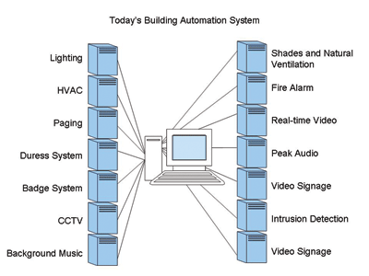
Principles of Object-Oriented Design
Abstraction
Encapsulation
Modularity
Hierarchical Organization

Slide 28
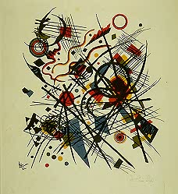
Abstraction
The psychological profiling of a programmer is mostly the ability to shift levels of abstraction, from low level to high level. To see something in the small and to see something in the large.
Donald Knuth
Wassily Kandinsky (Russian, 1866-1944)
Abstraction, 1922, Lithograph from the fourth Bauhaus portfolio

Slide 29
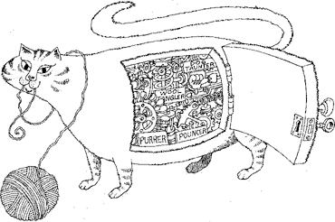
Encapsulation
Each object reveals only what other objects need to see.
Internal details are kept private.
This allows the programmer to implement the object as she or he wishes, as long as the requirements of the abstract interface are satisfied.

Slide 30
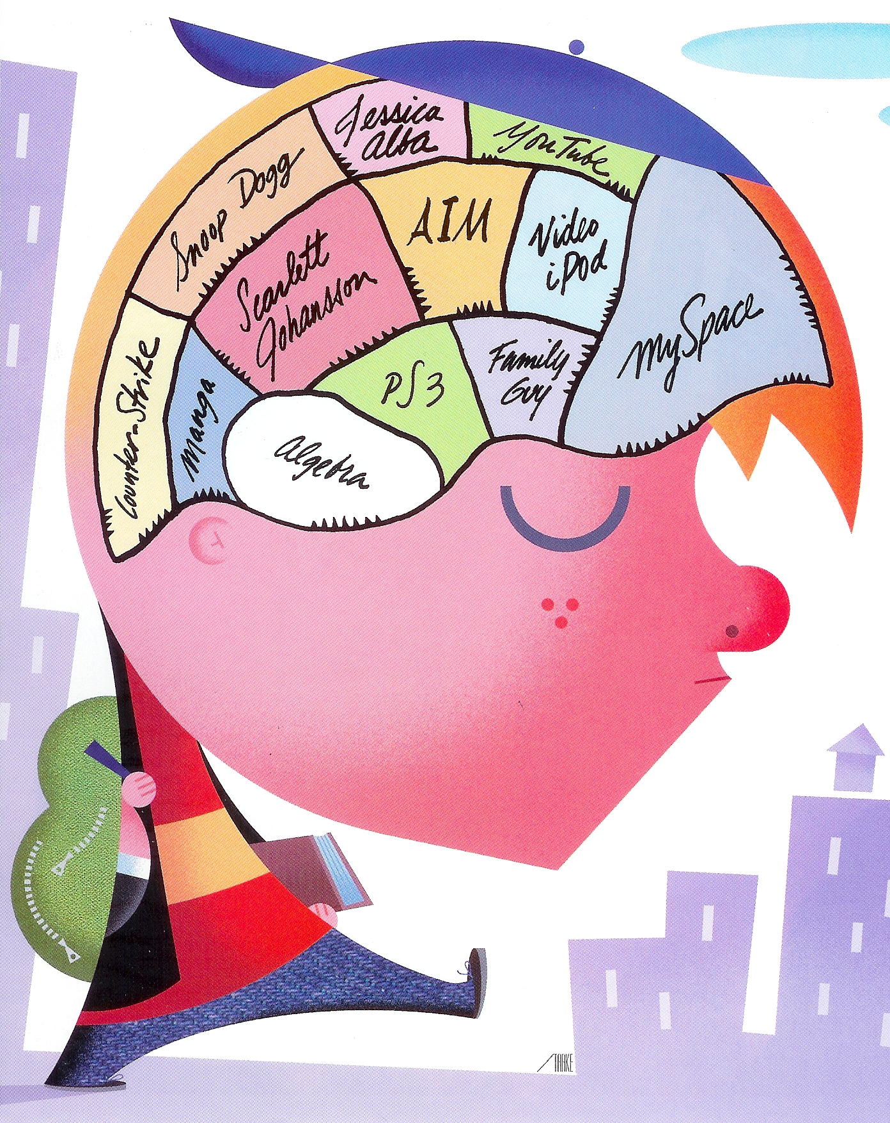
Modularity
Complex software systems are hard to conceptualize and maintain.
This is greatly facilitated by breaking the system up into distinct modules.
Each module has a well-specified job.
Modules communicate through well-specified interfaces.

Slide 31
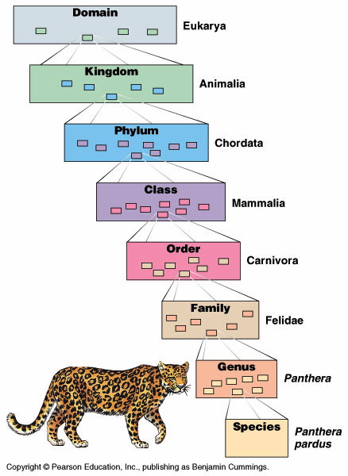
Hierarchical Design
Hierarchical class definitions allows efficient re-use of software over different contexts.
Is a

Slide 32
Data Structures & Object-Oriented Design
Definitions
Principles of Object-Oriented Design
Hierarchical Design in Java
Abstract Data Types & Interfaces
Casting
Generics
Pseudo-Code

Slide 33
Inheritance
Object-oriented design provides for hierarchical classes through the concept of inheritance.
A subclass specializes or extends a superclass.
In so doing, the subclass inherits the variables and methods of the superclass.
The subclass may override certain superclass methods, specializing them for its particular purpose.
The subclass may also define additional variables and methods that extend the definition of the superclass.

Slide 34
Types of Method Overriding
Generally methods of a subclass replace superclass methods.
An exception is constructor methods, which do not replace, but refine superclass constructor methods.
Thus invocation of a constructor method starts with the highest-level class, and proceeds down the hierarchy to the subclass of the object being instantiated.
This is either accomplished implicitly, or explicitly with the super keyword.

Slide 35
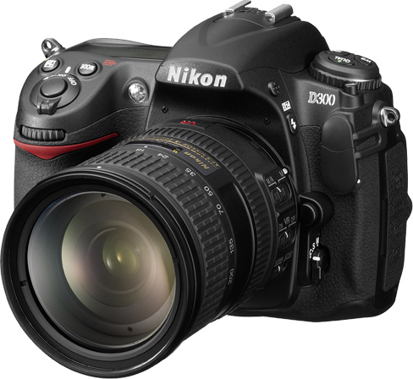
Refinement Overriding
public class Camera {
private String cameraMake;
private String cameraModel;
Camera(String mk, String mdl) { //constructor
cameraMake = mk;
cameraModel = mdl;
}
public String make() { return cameraMake; }
public String model() { return cameraModel; }
}
Superclass
Camera
extends
public class DigitalCamera extends Camera{
private int numPix;
DigitalCamera(String mk, String mdl, int n) { //constructor
super(mk, mdl);
numPix = n;
}
public int numberOfPixels() { return numPix; }
}
refines
Sublass
DigitalCamera
extends
instantiates
Object
myCam
DigitalCamera myCam = new DigitalCamera("Nikon", "D90", 12000000);

Slide 36
Refinement Overriding
public class Camera {
private String cameraMake;
private String cameraModel;
Camera(String mk, String mdl) { //constructor
cameraMake = mk;
cameraModel = mdl;
}
public String make() { return cameraMake; }
public String model() { return cameraModel; }
}
Superclass
Camera
extends
public class DigitalCamera extends Camera{
private int numPix;
DigitalCamera(String mk, String mdl) { //constructor
super(mk, mdl);
numPix = 0;
}
public int numberOfPixels() { return numPix; }
}
refines
Sublass
DigitalCamera
extends
instantiates
Object
myCam
DigitalCamera myCam = new DigitalCamera("Nikon", "D90”);

Slide 37
Refinement Overriding
public class Camera {
private String cameraMake;
private String cameraModel;
Camera() { //constructor
cameraMake = “Unknown make”;
cameraModel = “Unknown model”;
}
public String make() { return cameraMake; }
public String model() { return cameraModel; }
}
Superclass
Camera
extends
public class DigitalCamera extends Camera{
private int numPix;
DigitalCamera() { //constructor
numPix = 0;
}
public int numberOfPixels() { return numPix; }
}
refines
(implicit super() call)
Sublass
DigitalCamera
extends
instantiates
Object
myCam
DigitalCamera myCam = new DigitalCamera();

Slide 38
Replacement Overriding
public class DigitalCamera extends Camera{
private int numPix;
DigitalCamera(String mk, String mdl, int n) { //constructor
super(mk, mdl);
numPix = n;
}
public int numberOfPixels() { return numPix; }
public byte[][][] getDigitalImage() { return takeDigitalPhoto(); }
}
Superclass
DigitalCamera
extends
public class AutoDigitalCamera extends DigitalCamera{
AutoDigitalCamera(String mk, String mdl, int n) { //constructor
super(mk, mdl, n);
}
public byte[][][] getDigitalImage() {
autoFocus();
return takeDigitalPhoto();
}
}
Subclass
Auto-
DigitalCamera
replaces
instantiates
DigitalCamera myCam = new AutoDigitalCamera("Nikon", "D90", 12000000);
byte[][][] myImage = myCam.getDigitalImage();
Object
myCam
polymorphism

Slide 39
Polymorphism
Polymorphism = “many forms”
Polymorphism allows an object variable to take different forms, depending upon the specific class of the object it refers to.
Suppose an object o is defined to be of class S.
It is now valid to instantiate o as an object of any type T that extends S.
Thus o can potentially refer to a broad variety of objects.

Slide 40
Replacement Overriding
public class DigitalCamera extends Camera{
private int numPix;
DigitalCamera(String mk, String mdl, int n) { //constructor
super(mk, mdl);
numPix = n;
}
public int numberOfPixels() { return numPix; }
public byte[][][] getDigitalImage() { return takeDigitalPhoto(); }
}
Superclass
DigitalCamera
extends
public class AutoDigitalCamera extends DigitalCamera{
AutoDigitalCamera(String mk, String mdl, int n) { //constructor
super(mk, mdl, n);
}
public byte[][][] getDigitalImage() {
autoFocus();
return takeDigitalPhoto();
}
}
Subclass
Auto-
DigitalCamera
replaces
instantiates
DigitalCamera myCam = new AutoDigitalCamera("Nikon", "D90", 12000000);
byte[][][] myImage = myCam.getDigitalImage();
Object
myCam
polymorphism

Slide 41
Data Structures & Object-Oriented Design
Definitions
Principles of Object-Oriented Design
Hierarchical Design in Java
Abstract Data Types & Interfaces
Casting
Generics
Pseudo-Code

Slide 42
Abstract Data Type (ADT)
A set of data values and associated operations that are precisely specified independent of any particular implementation.
ADTs specify what each operation does, but not how it does it.
ADTs simplify the design of algorithms.

Slide 43
Abstract Data Type (ADT)
In Java, an ADT
can be expressed by an interface.
is realized as a complete data structure by a class.
is instantiated as an object.

Slide 44
Application Programming Interfaces (APIs)
The interface for an ADT specifies:
A type definition
A collection of methods for this type
Each method is specified by its signature, comprising
The name of the method
The number and type of the arguments for each method.

Slide 45
ADT Example
public interface Device {
public String make();
public String model();
}
Interface
Device
public class Camera implements Device {
private String cameraMake;
private String cameraModel;
private int numPix;
Camera(String mk, String mdl, int n) { //constructor
cameraMake = mk;
cameraModel = mdl;
numPix = n;
}
public String make() { return cameraMake; }
public String model() { return cameraModel; }
public int numberOfPixels() { return numPix; }
}
implements
Class
Camera
instantiates
Object
myCam
Camera myCam = new Camera("Nikon", "D90", 12000000);

Slide 46
Multiple Inheritance
In Java, a class can have at most one direct parent class.
Thus classes must form trees.
This avoids the ambiguity that would arise if two parents defined methods with the same signature.
Device
Camera
Actuator
Digital
Camera
Analog
Camera
Stepping
Motor

Slide 47
Multiple Inheritance
However, interfaces can have more than one direct parent.
Thus interfaces do not necessarily form trees, but directed acylic graphs (DAGs).
No ambiguity can arise, since methods with the same signature can be considered as one.
This allows mixin of unrelated interfaces to form more complex ADTs.
Device
Camera
Actuator
Pan/Tilt/Zoom
Camera
public interface PTZCamera extends Camera, Actuator {
…
}

Slide 48
Data Structures & Object-Oriented Design
Definitions
Principles of Object-Oriented Design
Hierarchical Design in Java
Abstract Data Types & Interfaces
Casting
Generics
Pseudo-Code

Slide 49
Casting
Casting may involve either a widening or a narrowing type conversion.
A widening conversion occurs when a type T is converted into a ‘wider’ type U.
Widening conversions are performed automatically.
A narrowing conversion occurs when a type T is converted into a ‘narrower’ type U.
Narrowing conversions require an explicit cast.

Slide 50
Casting Examples
DigitalCamera myCam1 = new DigitalCamera("Nikon","D90");
DigitalCamera myCam2 = new AutoDigitalCamera("Olympus","E30",12000000);
AutoDigitalCamera myCam3 = new AutoDigitalCamera("Sony","A550",14000000);
myCam1 = myCam3; //widening conversion
myCam3 = myCam1; //compiler error
myCam3 = myCam2; //compiler error
myCam3 = (AutoDigitalCamera) myCam1; //run-time exception
myCam3 = (AutoDigitalCamera) myCam2; // valid narrowing conversion
?
?
?
?
?

Slide 51
Casting Examples
DigitalCamera myCam1 = new DigitalCamera("Nikon","D90");
DigitalCamera myCam2 = new AutoDigitalCamera("Olympus","E30",12000000);
AutoDigitalCamera myCam3 = new AutoDigitalCamera("Sony","A550",14000000);
myCam1 = myCam3; //widening conversion
myCam3 = myCam1; //compiler error
myCam3 = myCam2; //compiler error
myCam3 = (AutoDigitalCamera) myCam1; //run-time exception
myCam3 = (AutoDigitalCamera) myCam2; // valid narrowing conversion

Slide 52
Data Structures & Object-Oriented Design
Definitions
Principles of Object-Oriented Design
Hierarchical Design in Java
Abstract Data Types & Interfaces
Casting
Generics
Pseudo-Code

Slide 53
Generics
A generic type is a type that is not defined at compilation time.
A generic type becomes fully defined only when instantiated as a variable.
This allows us to define a class in terms of a set of formal type parameters, that can be used to abstract certain variables.
Only when instantiating the object, do we specify the actual type parameters to be used.

Slide 54
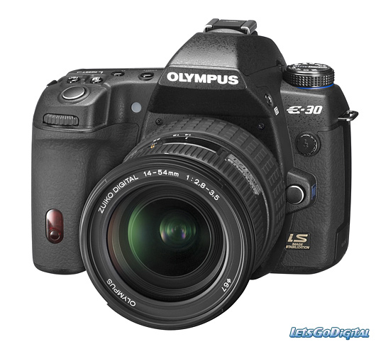
Generics Example
/** Creates a coupling between two objects */
public class Couple<A, B> {
A obj1;
B obj2;
public void set(A o1, B o2) {
obj1 = o1;
obj2 = o2;
}
}
Camera myCam1 = new DigitalCamera("Nikon","D90”,12000000);
Camera myCam2 = new AutoDigitalCamera("Olympus","E30",12000000);
Couple<Camera,Camera> stereoCamera = new Couple<Camera,Camera>();
stereoCamera.set(myCam1, myCam2);

Slide 55
Generics Example
Couple<Camera,Camera> stereoCamera = new Couple<Camera,Camera>();
Note that two things are happening here:
The variable stereoCamera is being defined of type Couple<Camera, Camera>
An object of type Couple<Camera, Camera> is created and stereoCamera is updated to refer to that object.

Slide 56
Inheritance with Generics
Couple<Camera,Camera> stereoCamera = new Couple<Camera,Camera>();
Generic classes can serve as superclasses or subclasses of other generic and non-generic classes.
Thus, for example, if a class CloselyCouple<T, T> is defined to extend Couple<T, T>, then it would be valid to instantiate stereoCamera as:
Couple<Camera,Camera> stereoCamera = new CloselyCouple<Camera,Camera>();

Slide 57
But be careful…
DigitalCamera is a subclass of Camera.
This does NOT mean that Couple<DigitalCamera, DigitalCamera> is a subclass of Couple<Camera, Camera>.
Thus
or
generate compile errors.
Couple<Camera,Camera> stereoCamera = new Couple<DigitalCamera,DigitalCamera>();
Couple<Camera,Camera> stereoCamera = new CloselyCouple<DigitalCamera,DigitalCamera>();

Slide 58
Subtyping with Wildcards
In order to obtain this kind of subtyping with generics, you can use wildcards.
For example:
or
Couple<? extends Camera, ? extends Camera> stereoCamera
= new Couple<DigitalCamera,DigitalCamera>();
Couple<? extends Camera, ? extends Camera> stereoCamera
= new CloselyCouple<DigitalCamera,DigitalCamera>();

Slide 59
Data Structures & Object-Oriented Design
Definitions
Principles of Object-Oriented Design
Hierarchical Design in Java
Abstract Data Types & Interfaces
Casting
Generics
Pseudo-Code

Slide 60
Pseudocode
High-level description of an algorithm
More structured than English prose
Less detailed than a program
Preferred notation for describing algorithms
Hides program design issues
Example: find max element of an array
Algorithm arrayMax(A, n)
Input array A of n integers
Output maximum element of A
currentMax ⎜ A[0]
for i ⎜ 1 to n - 1 do
if A[i] > currentMax then
currentMax ⎜ A[i]
return currentMax

Slide 61
Pseudocode Details
Control flow
if … then … [else …]
while … do …
repeat … until …
for … do …
Indentation replaces braces
Method declaration
Algorithm method (arg [, arg…])
Input …
Output …
Method call
var.method (arg [, arg…])
Return value
return expression
Expressions
⎜Assignment (like = in Java)
Equality testing (like == in Java)
n² Superscripts and other mathematical formatting allowed

Slide 62
Data Structures & Object-Oriented Design
Definitions
Principles of Object-Oriented Design
Hierarchical Design in Java
Abstract Data Types & Interfaces
Casting
Generics
Pseudo-Code

