Slide 1
Numerical integration

Slide 2

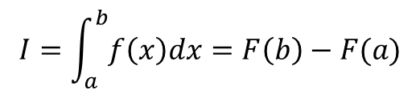

Numerical integration
numerical integration attempts to estimate the value of a definite integral without solving for the indefinite integral; i.e.,
  estimate the value of
  without solving for
recall the first fundamental theorem of calculus
$$I=\int_{a}^{b}{f\left(x\right)dx}$$
$$F\left(x\right)=\int{f\left(x\right)dx}$$
$$I=\int_{a}^{b}{f\left(x\right)dx}=F\left(b\right)−F(a)$$

Slide 3
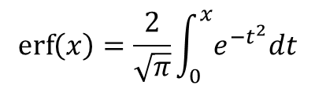
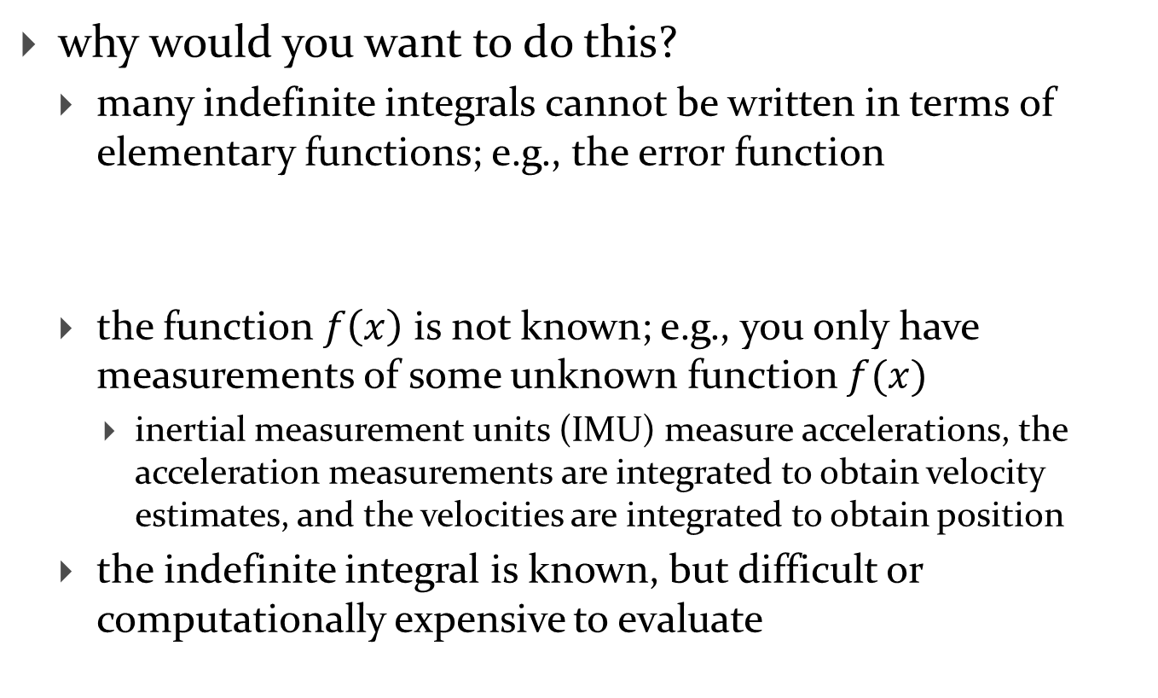
Numerical integration
why would you want to do this?
  many indefinite integrals cannot be written in terms of elementary functions; e.g., the error function
  the function $f\left(x\right)$ is not known; e.g., you only have measurements of some unknown function $f(x)$
    inertial measurement units (IMU) measure accelerations, the acceleration measurements are integrated to obtain velocity estimates, and the velocities are integrated to obtain position
  the indefinite integral is known, but difficult or computationally expensive to evaluate
$$\operatorname{erf}\left(x\right)=\frac{2}{\sqrt{π}}\int_{0}^{x}{e^{−t^{2}}dt}$$

Slide 4
Aside
many symbolic math programs can solve for the indefinite integral if the integral can be expressed in terms of elementary functions
how do they do this?
  http://en.wikipedia.org/wiki/Risch_algorithm

Slide 5
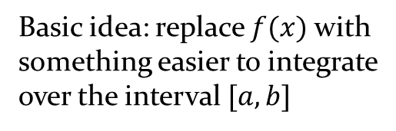
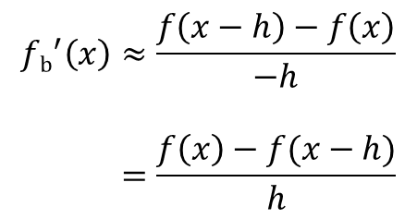

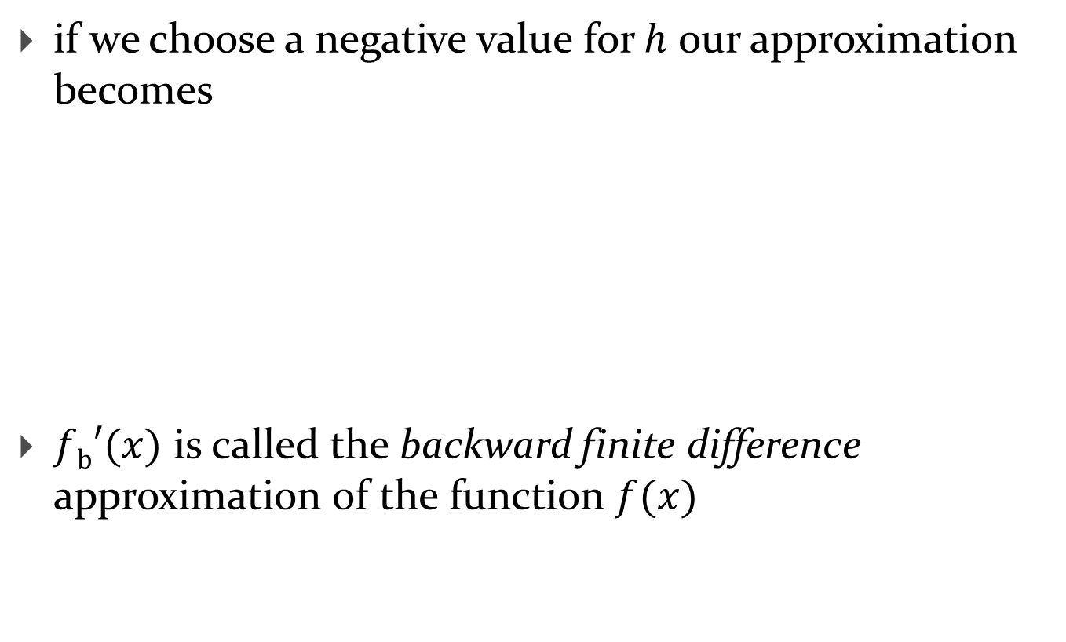


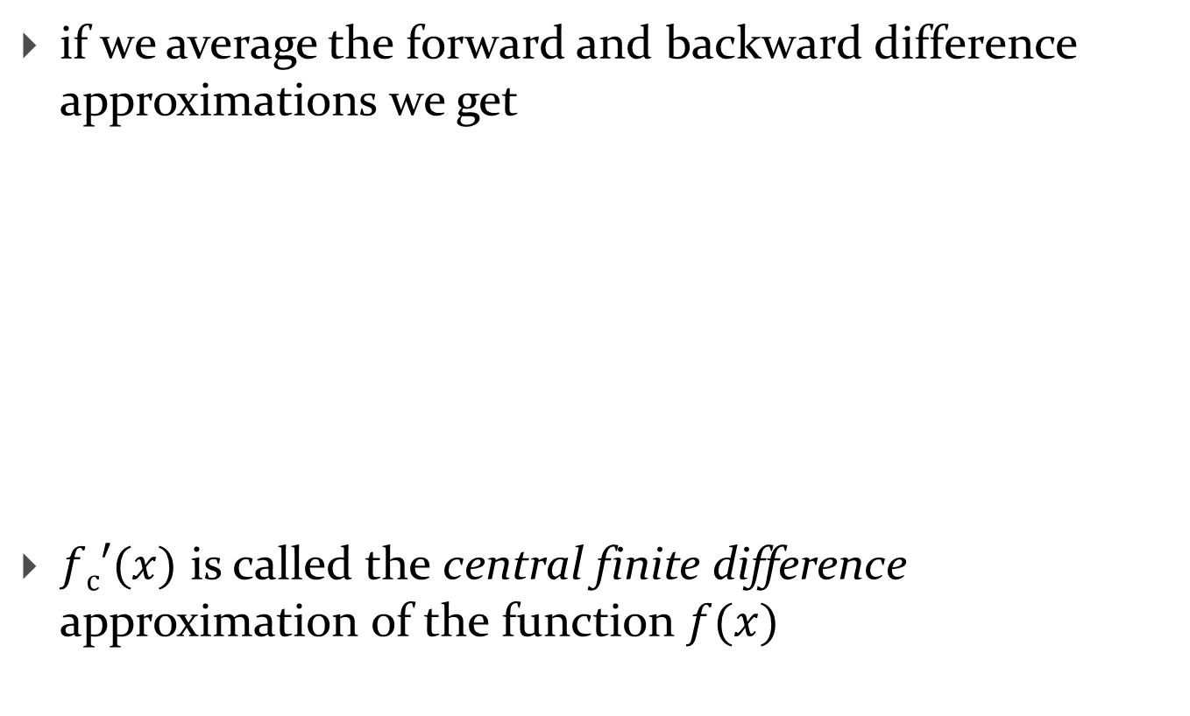
Numerical integration
$$y$$
Basic idea: replace $f(x)$ with
something easier to integrate
over the interval $[a, b]$
$$f(x)$$
$$I=\int_{a}^{b}{f\left(x\right)dx}$$
$$x$$
$$a$$
$$b$$

Slide 6

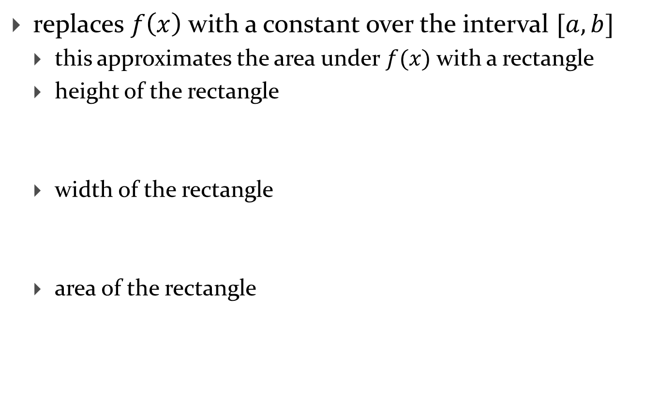


Rectangle (or midpoint) rule
replaces $f\left(x\right)$ with a constant over the interval $[a, b]$
  this approximates the area under $f(x)$ with a rectangle
  height of the rectangle
  width of the rectangle
  area of the rectangle
$$f(\frac{a+b}{2})$$
$$b−a$$
$$(b−a)×f(\frac{a+b}{2})$$

Slide 7



Rectangle (or midpoint) rule
$$y$$
$$f(x)$$
$$f\left(\frac{a+b}{2}\right)$$
$$I≈\left(b−a\right)×f(\frac{a+b}{2})$$
$$x$$
$$a$$
$$\frac{a+b}{2}$$
$$b$$

Slide 8
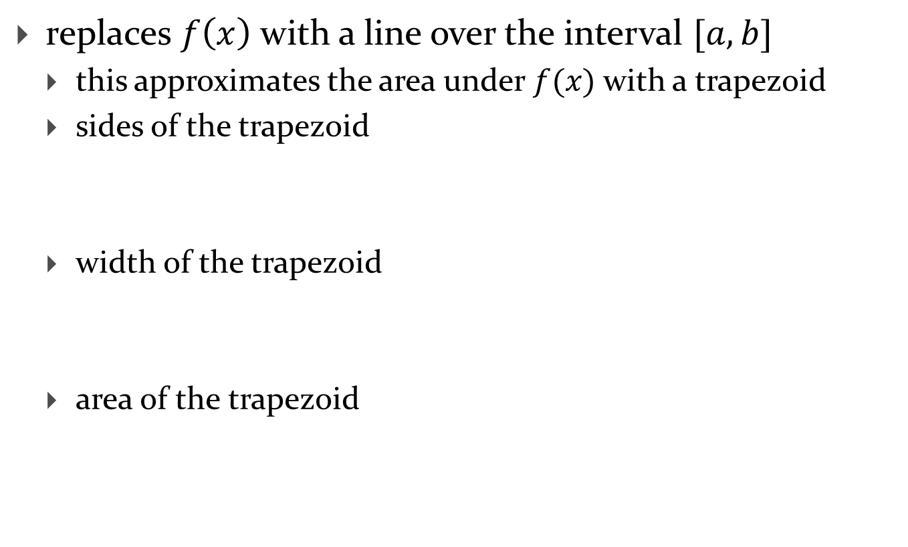
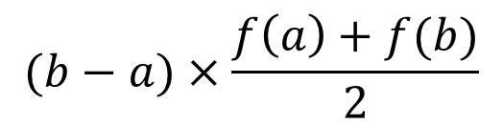

Trapezoid rule
replaces $f\left(x\right)$ with a line over the interval $[a, b]$
  this approximates the area under $f(x)$ with a trapezoid
  sides of the trapezoid
  width of the trapezoid
  area of the trapezoid
$$f\left(a\right) \text{and} f(b)$$
$$b−a$$
$$(b−a)×\frac{f\left(a\right)+f(b)}{2}$$

Slide 9

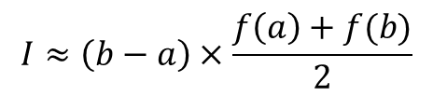

Trapezoid rule
$$y$$
$$f(x)$$
$$f\left(b\right)$$
$$f\left(a\right)$$
$$I≈\left(b−a\right)×\frac{f\left(a\right)+f(b)}{2}$$
$$x$$
$$a$$
$$b$$

Slide 10

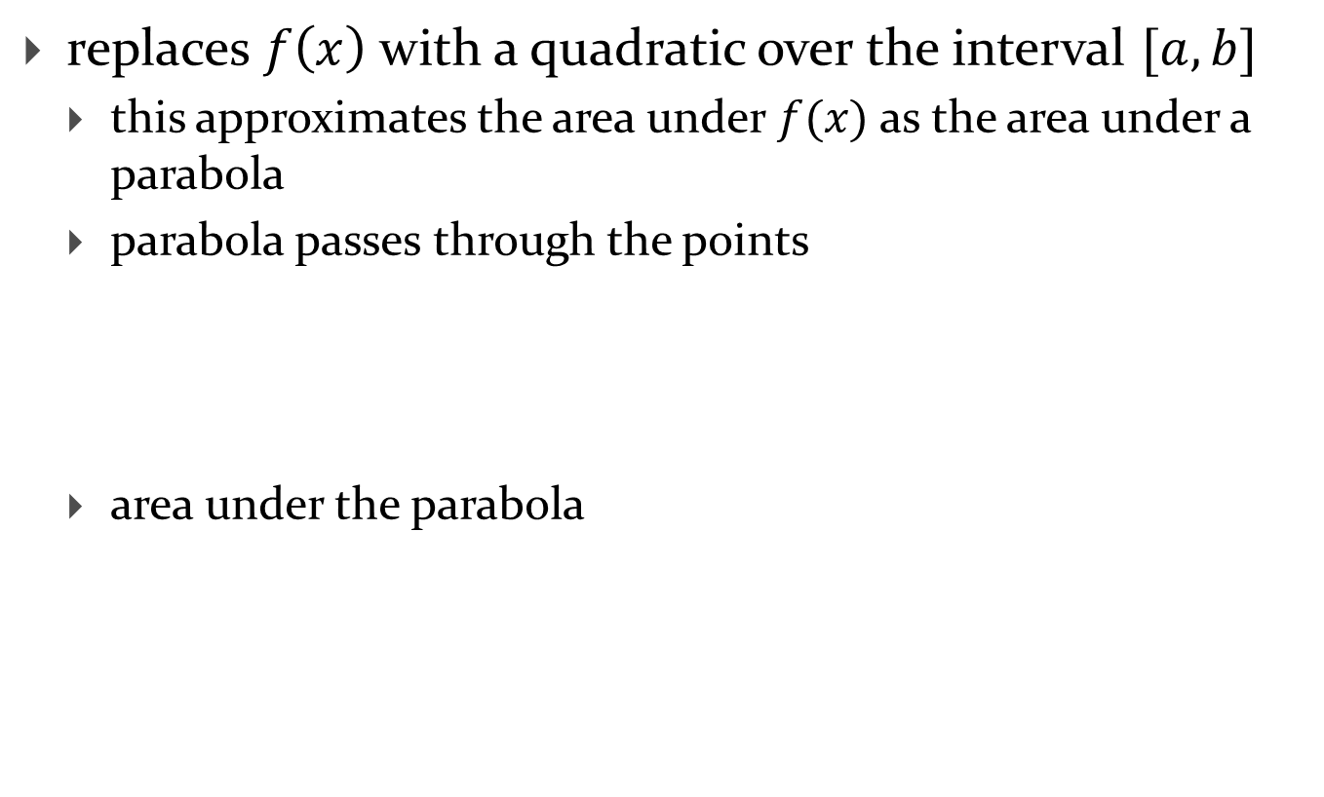
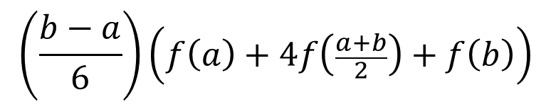
Simpson's rule
replaces $f\left(x\right)$ with a quadratic over the interval $[a, b]$
  this approximates the area under $f(x)$ as the area under a parabola
  parabola passes through the points
  area under the parabola
$$f\left(a\right) \text{and} f\left(\frac{a+b}{2}\right) \text{and} f(b)$$
$$\left(\frac{b−a}{6}\right)\left(f\left(a\right)+4f\left(\frac{a+b}{2}\right)+f\left(b\right)\right)$$

Slide 11

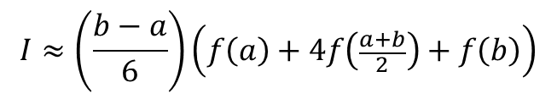

Simpson's rule
$$y$$
$$f(x)$$
$$f\left(b\right)$$
$$f\left(\frac{a+b}{2}\right)$$
$$I≈\left(\frac{b−a}{6}\right)\left(f\left(a\right)+4f\left(\frac{a+b}{2}\right)+f\left(b\right)\right)$$
$$f\left(a\right)$$
$$x$$
$$a$$
$$\frac{a+b}{2}$$
$$b$$

Slide 12
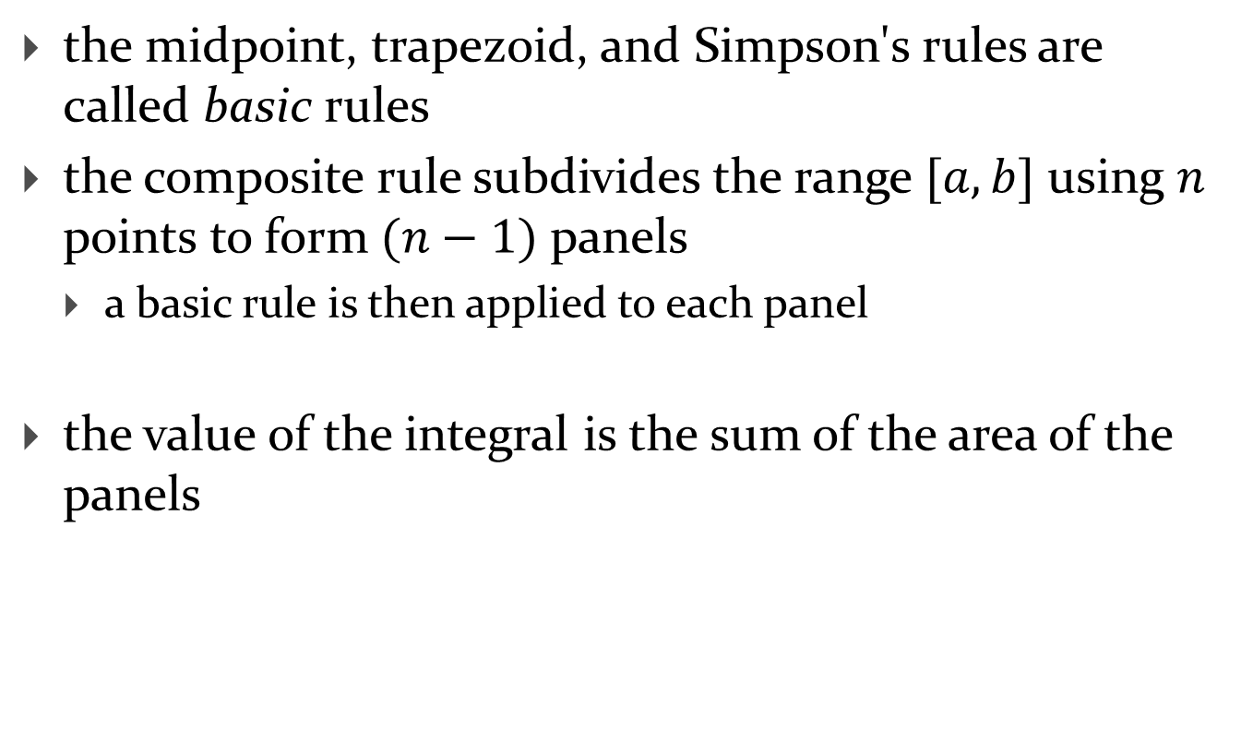
Composite rules
the midpoint, trapezoid, and Simpson's rules are called basic rules
the composite rule subdivides the range $[a, b]$ using $n$ points to form $(n−1)$ panels
  a basic rule is then applied to each panel
the value of the integral is the sum of the area of the panels

Slide 13


Composite rectangle (or midpoint) rule
$$y$$
$n=2$ panels
$$h=(b−a)/n$$
$$f(x)$$
$$x$$
$$a$$
$$b$$

Slide 14


Composite rectangle (or midpoint) rule
$$y$$
$n=4$ panels
$$h=(b−a)/n$$
$$f(x)$$
$$x$$
$$a$$
$$b$$

Slide 15
Composite trapezoid rule
$$y$$
$n=2$ panels
$$h=(b−a)/n$$
$$f(x)$$
$$x$$
$$a$$
$$b$$

Slide 16
Composite trapezoid rule
$$y$$
$n=4$ panels
$$h=(b−a)/n$$
$$f(x)$$
$$x$$
$$a$$
$$b$$

Slide 17
Composite Simpson's rule
$$y$$
$n=2$ panels
$$h=(b−a)/n$$
$$f(x)$$
$$x$$
$$a$$
$$b$$

Slide 18
In class exercise
implement composite rectangle, trapezoid, and Simpson's rule
test implementations using known integrals

Slide 19
Numerical integration in MATLAB
MATLAB provides functions for integration using
  the trapezoidal rule
    trapz
  a more sophisticated composite rule (global adaptive quadrature)
    integral, integral2, integral3

