Slide 1
Numerical differentiation

Slide 2
Announcement
there is a script and some functions available for this lecture on the course web site

Slide 3
Numerical differentiation
numerical differentiation attempts to estimate the value of the derivative of a function without computing the analytic form of the derivative
why would you want to do this?
  the function is difficult or impossible to differentiate
  the derivative is expensive to compute
  you don't actually know the function that you are trying to differentiate

Slide 4
Differentiating polynomials
polynomials are often used in numerical calculations, and MATLAB provides a function polyder that computes the derivative of a polynomial
  also computes the derivative of a product of polynomials or a quotient of polynomials

Slide 5
Differentiating polynomials
poly1 = [3 6 9]; % 3x^2 + 6x + 9
d = polyder(poly1)
d =
6 6
poly2 = [1 2 0]; % x^2 + 2x + 0
d = polyder(poly1, poly2) % derivative of product
d =
12 36 42 18

Slide 6
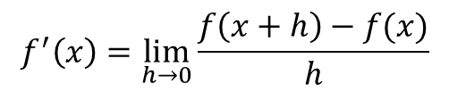
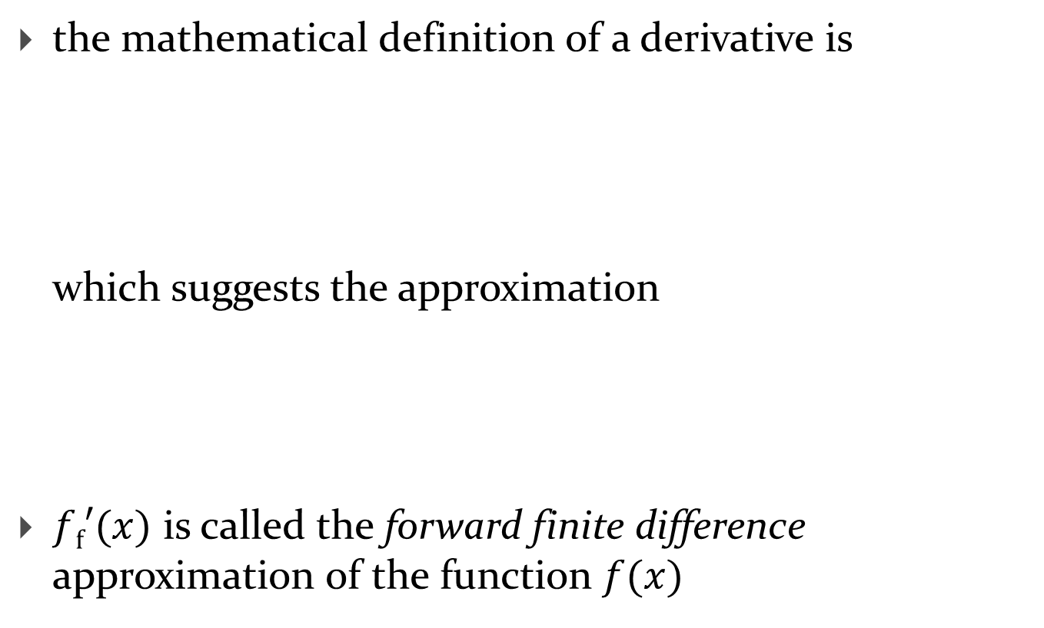
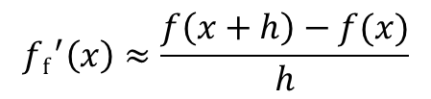
Forward finite difference
the mathematical definition of a derivative is
which suggests the approximation
$f\text{f}′(x)$ is called the forward finite difference approximation of the function $f(x)$
$$f^{′}\left(x\right)=\lim_{h→0}{\frac{f\left(x+h\right)−f(x)}{h}}$$
$${f\text{f}}^{′}\left(x\right)≈\frac{f\left(x+h\right)−f(x)}{h}$$

Slide 7









Forward finite difference
$$y$$
$$f(x)$$
$$f(x_{a}+h)$$
$$f\left(x_{a}+h\right)−f(x_{a})$$
$$f(x_{a})$$
$$h$$
$$x$$
$$x_{a}$$
$$x_{a}+h$$

Slide 8
Forward finite difference
function fprime = fdiff(f, x, h)
%FDIFF Forward finite difference derivative.
% FPRIME = FDIFF(F, X, H) computes the derivative FPRIME of the
% function F at all values in X using a step size of H.
fplus = f(x + h);
fx = f(x);
fprime = (fplus - fx) / h;

Slide 9
Forward finite difference
see day21.m for demonstration

Slide 10


Backward finite difference
if we choose a negative value for $h$ our approximation becomes
$f\text{b}′(x)$ is called the backward finite difference approximation of the function $f(x)$
$${f\text{b}}^{′}\left(x\right)≈\frac{f\left(x−h\right)−f\left(x\right)}{−h} \\ =\frac{f\left(x\right)−f(x−h)}{h}$$

Slide 11





Backward finite difference
$$y$$
$$f(x)$$
$$h$$
$$f(x_{a})$$
$$f\left(x_{a}\right)−f(x_{a}−h)$$
$$x$$
$$f(x_{a}−h)$$
$$x_{a}−h$$
$$x_{a}$$

Slide 12
Backward finite difference
function fprime = bdiff(f, x, h)
%BDIFF Backward finite difference derivative.
% FPRIME = BDIFF(F, X, H) computes the derivative FPRIME of the
% function F at all values in X using a step size of H.
fminus = f(x - h);
fx = f(x);
fprime = (fx - fminus) / h;

Slide 13
Backward finite difference
see day21.m for demonstration

Slide 14


Central finite difference
if we average the forward and backward difference approximations we get
$f\text{c}′(x)$ is called the central finite difference approximation of the function $f(x)$
$$f\text{c}′(x)≈\frac{f{\text{f}}^{′}\left(x\right)+f\text{b}′(x)}{2} \\ =\frac{f\left(x+h\right)−f(x)}{2h}+\frac{f\left(x\right)−f(x−h)}{2h} \\ =\frac{f\left(x+h\right)−f(x−h)}{2h}$$

Slide 15





Forward finite difference
$$y$$
$$f(x)$$
$$f(x_{a}+h)$$
$$f(x_{a})$$
$$f\left(x_{a}+h\right)−f(x_{a}−h)$$
$$x$$
$$f(x_{a}−h)$$
$$2h$$
$$x_{f}−h$$
$$x_{f}$$
$$x_{f}+h$$

Slide 16
Central finite difference
function fprime = cdiff(f, x, h)
%CDIFF Central finite difference derivative.
% FPRIME = CDIFF(F, X, H) computes the derivative FPRIME of the
% function F at all values in X using a step size of H.
fminus = f(x - h);
fplus = f(x + h);
fprime = (fplus - fminus) / (2 * h);

Slide 17
Central finite difference
see day21.m for demonstration

Slide 18
The effect of noise
a significant problem with computing derivatives using finite differences is that finite differences are very sensitive to noise
  e.g., consider a sine function with a small amount of additive Gaussian noise
function y = noisysin(x)
y = sin(x) + randn(size(x))*0.001;
end
see day21.m for demonstration

Slide 19

Higher order derivatives
higher order derivatives can be obtained by computing the finite difference of a finite difference
  e.g., the second-order forward finite difference
$$f{\text{f}}^{′′}≈\frac{\frac{f\left(x+2h\right)−f\left(x+h\right)}{h}−\frac{f\left(x+h\right)−f\left(x\right)}{h}}{h} \\ =\frac{f\left(x+2h\right)−2f\left(x+h\right)−f(x)}{h^{2}}$$

