Slide 1

Bisection method
we can implement the bisection method using:
  a loop to iterate until $f(c)$ is close to zero
  a function handle to the function $f$

Slide 2
function [root] = bisect(f, a, b, tol)
%BISECT Root finding by bisection method
% ROOT = BISECT(F, A, B, TOL) finds a root of
% the function F known to lie in the range [A, B].
% The root satisfies the inequality
% ABS(F(ROOT)) <= TOL
if a == b
error('range is zero');
elseif a > b
tmp = a;
a = b;
b = tmp;
end
% continued on next slide

Slide 3
c = mean([a b]);
fc = f(c);
while abs(fc) > tol
if sign(f(a)) ~= sign(fc) % root is to the left
b = c;
else % root is to the right?
a = c;
end
c = mean([a b]);
fc = f(c);
end
root = c;
end

Slide 4
Bisection method
an alternate approach to implement the bisection method is to observe the following:
  the bisection method repeatedly solves the same problem until it reaches the solution; i.e., finding a root via bisection looks something like:
    bisect(original range)
    bisect(smaller range)
    bisect(smaller range)
    ...
    bisect(smaller range), done!
can we have our bisection function call itself?
  yes, we can make bisection be a recursive function

Slide 5
Recursive definitions
in mathematics, a recursive definition is a definition that is defined in terms of itself
  if you define something only in terms of itself, you end up with a circular definition; e.g.,
    hill—a usually rounded natural elevation of land lower than a mountain
    mountain—a landmass that projects conspicuously above its surroundings and is higher than a hill
to prevent circular reasoning, a recursive definition requires one or more stopping points called base cases

Slide 6
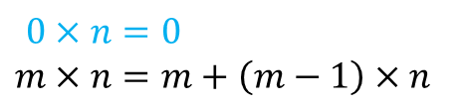
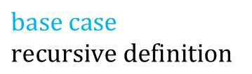
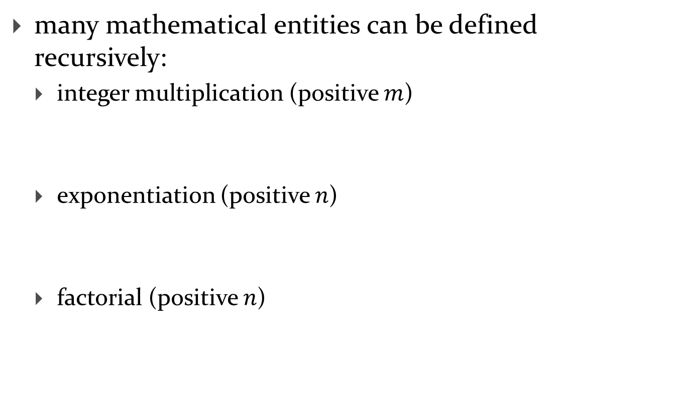

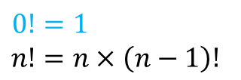

Recursive definitions
many mathematical entities can be defined recursively:
  integer multiplication (positive $m$)
  exponentiation (positive $n$)
  factorial (positive $n$)
$$0×n=0 \\ m×n=m+\left(m−1\right)×n$$
$$\text{base} \text{case} \\ \text{recursive} \text{definition}$$
$$x^{0}=1 \\ x^{n}=x×x^{n−1}$$
$$\text{base} \text{case} \\ \text{recursive} \text{definition}$$
$$0!=1 \\ n!=n×\left(n−1\right)!$$
$$\text{base} \text{case} \\ \text{recursive} \text{definition}$$

Slide 7
Factorial
recursive definitions naturally lead to recursive implementations in functions:
function f = fact(n)
%FACT Factorial of n
% F = FACT(N) is the product of all of the integers
% from 1 to N. N must be a positive integer.
if n == 0
f = 1;
else
f = n * fact(n - 1);
end

Slide 8
Rabbits
Month 0: 1 pair
0 additional pairs
Month 1: first pair
makes another pair
1 additional pair
Month 2: each pair
makes another pair;
oldest pair dies
1 additional pair
2 additional pairs
Month 3: each pair
makes another pair;
oldest pair dies

Slide 9
Fibonacci numbers
the sequence of additional pairs
  0, 1, 1, 2, 3, 5, 8, 13, ...
are called Fibonacci numbers
base cases
  F(0) = 0
  F(1) = 1
recursive definition
  F(n) = F(n – 1) + F(n – 2)

Slide 10
Fibonacci numbers
the recursive definition of the Fibonacci numbers leads naturally to a recursive implementation:
function fib = fibonacci(n)
% FIBONACCI nth Fibonacci number
% FIB = FIBONACCI(N) computes the nth Fibonacci number
if n == 0
fib = 0;
elseif n == 1
fib = 1;
else
fib = fibonacci(n - 1) + fibonacci(n - 2);
end

Slide 11
Bisection as a recursive function
function [root] = bisect2(f, a, b, tol)
%BISECT2 Root finding by recursive bisection method
% ROOT = BISECT(F, A, B, TOL) finds a root of
% the function F known to lie in the range [A, B].
% The root satisfies the inequality
% ABS(F(ROOT)) <= TOL
if a == b
error('range is zero');
elseif a > b
tmp = a;
a = b;
b = tmp;
end % continued on next slide

Slide 12
Bisection as a recursive function
c = mean([a b]);
fc = f(c);
if abs(fc) <= tol
root = c;
elseif sign(f(a)) ~= sign(fc)
root = bisect2(f, a, c, tol); % root is to the left
else
root = bisect2(f, c, b, tol); % root is to the right?
end
end

Slide 13
Recursion
any problem that can be solved using recursion can also be solved using iteration
  however, the recursive solution is often easier to implement

Slide 14
Towers of Hanoi
  move the stack of n disks from A to C
    can move one disk at a time from the top of one stack onto another stack
    cannot move a larger disk onto a smaller disk
A
B
C

Slide 15
Towers of Hanoi
legend says that the world will end when a 64 disk version of the puzzle is solved
several appearances in pop culture
  Doctor Who
  Rise of the Planet of the Apes
  Survior: South Pacific

Slide 16
Towers of Hanoi
n = 1
move disk from A to C
A
B
C

Slide 17
Towers of Hanoi
n = 1
A
B
C

Slide 18
Towers of Hanoi
n = 2
move disk from A to B
A
B
C

Slide 19
Towers of Hanoi
n = 2
move disk from A to C
A
B
C

Slide 20
Towers of Hanoi
n = 2
move disk from B to C
A
B
C

Slide 21
Towers of Hanoi
n = 2
A
B
C

Slide 22
Towers of Hanoi
n = 3
move disk from A to C
A
B
C

Slide 23
Towers of Hanoi
n = 3
move disk from A to B
A
B
C

Slide 24
Towers of Hanoi
n = 3
move disk from C to B
A
B
C

Slide 25
Towers of Hanoi
n = 3
move disk from A to C
A
B
C

Slide 26
Towers of Hanoi
n = 3
move disk from B to A
A
B
C

Slide 27
Towers of Hanoi
n = 3
move disk from B to C
A
B
C

Slide 28
Towers of Hanoi
n = 3
move disk from A to C
A
B
C

Slide 29
Towers of Hanoi
n = 3
A
B
C

Slide 30
Towers of Hanoi
n = 4
move (n – 1) disks from A to B using C
A
B
C

Slide 31
Towers of Hanoi
n = 4
move disk from A to C
A
B
C

Slide 32
Towers of Hanoi
n = 4
move (n – 1) disks from B to C using A
A
B
C

Slide 33
Towers of Hanoi
n = 4
A
B
C

Slide 34
base case n = 1
  move disk from A to C
recursive case
  move (n – 1) disks from A to B
  move 1 disk from A to C
  move (n – 1) disks from B to C

Slide 35
function [] = hanoi(n)
%HANOI Towers of Hanoi with n discs
% HANOI(N) prints a solution for the Towers
% of Hanoi problem for N discs.
move(n, 'A', 'C', 'B');
end
function [] = move(n, from, to, using)
%MOVE Recursive solution for Towers of Hanoi
if n == 1
s = sprintf('move disc from %s to %s', from, to);
disp(s);
else
move(n - 1, from, using, to);
move(1, from, to, using);
move(n - 1, using, to, from);
end
end

Slide 36
Root finding in MATLAB
MATLAB provides a function named fzero for root finding
  “The fzero command is a function file. The algorithm, which was originated by T. Dekker, uses a combination of bisection, secant, and inverse quadratic interpolation methods.”
fzero requires an initial estimate for the root and then finds a suitable interval to search for the root
fzero(@myf, 0.1)
ans =
0.1421

