Slide 1
Root finding

Slide 2
Root finding
suppose you have a mathematical function f(x) and you want to find x₀ such that f(x₀) = 0
why would you want to do this?
many problems in computer science, science, and engineering reduce to optimization problems
find the shape of an automobile that minimizes aerodynamic drag
find an image that is similar to another image (minimize the difference between the images)
find the sales price of an item that maximizes profit
if you can write the optimization criteria as a function g(x) then its derivative f(x) = dg/dx = 0 at the minimum or maximum of g (as long as g has certain properties)

Slide 3
Roots of polynomials
for roots of polynomials MATLAB has a function named roots
roots finds all of the roots of a polynomial defined by its coefficients vector; e.g.,
the roots of the polynomial $x^{3}−6x^{2}−72x−27$:
p = [1 -6 -72 -27];
r = roots(p)
r =
12.1229
-5.7345
-0.3884

Slide 4
Roots of non-polynomials
we've already seen Newton's method for root finding (Day 12)
start with an initial estimate of the root $x_{0}$
$i=0$
while $\left|f\left(x_{i}\right)\right|>ε$ $x_{i+1}=x_{i}−\frac{f\left(x_{i}\right)}{f^{′}\left(x_{i}\right)}$ $i=i+1$
this requires computation of both $f(x)$ and $f′(x)$

Slide 5
Newton's method
our previous implementation used local functions to represent both $f(x)$ and $f′(x)$
the problem with this approach is that we can only find roots of the local function that defines $f(x)$
e.g., our previous implementation can only find the roots of $f\left(x\right)=x^{2}−1$

Slide 6
function [ root, xvals ] = newton(x0, epsilon)
%NEWTON Newton's method for x^2 - 1
% ROOT = NEWTON(X0, EPSILON) finds a root of f(x) = x^2 - 1 using
% Newton's method starting from an initial estimate X0 and a tolerance EPSILON
%
% [ROOT, XVALS] = NEWTON(X0, EPSILON) also returns the iterative estimates
% in XVALS
xvals = x0;
xi = x0;
while abs(f(xi)) > epsilon
xj = xi - f(xi) / fprime(xi);
xi = xj;
xvals = [xvals xi];
end
root = xi;
end
function [ y ] = f(x)
y = x * x - 1;
end
function [ yprime ] = fprime(x)
yprime = 2 * x;
end
can only find the root of this function

Slide 7
Function handles
it would be nice if we could tell our implementation of Newton's method what function to use for $f(x)$ and $f′(x)$
MATLAB does not allow you to pass a function directly to another function
instead you must pass a function handle to the function
a function handle is a value that you can use to call a function (instead of using the name of the function)
because it is a value, you can store it in a variable!

Slide 8
Function handles
you can create a handle for any function by using @ before the function name
linspaceHandle = @linspace; % handle for linspace
cosHandle = @cos; % handle for cos
plotHandle = @plot; % handle for plot

Slide 9
Function handles
you can use the handle to call the function exactly the same way that you would use the function name to call the function
% use handle to call linspace
x = linspaceHandle(-1, 1, 50);
% use handle to call cos
y = cosHandle(2 * pi * x);
% use handle to call plot
plotHandle(x, y, 'b:');

Slide 10
Function functions
by using function handles, we can modify our implementation of Newton's method to find the root of any function
we just have to supply two function handles, one for $f(x)$ and a second for $f′(x)$
we also need MATLAB functions that implement $f(x)$ and $f′(x)$

Slide 11
function handles
function [ root, xvals ] = newton(f, fprime, x0, epsilon)
%NEWTON Newton's method for root finding
% ROOT = NEWTON(F, FPRIME, X0, EPSILON) finds a root of the
% function F having derivative FPRIME using Newton's method
% starting from an initial estimate X0 and a tolerance EPSILON
%
% [ROOT, XVALS] = NEWTON(F, FPRIME, X0, EPSILON) also returns
% the iterative estimates in XVALS
xvals = x0;
xi = x0;
while abs(f(xi)) > epsilon
xj = xi - f(xi) / fprime(xi);
xi = xj;
xvals = [xvals xi];
end
root = xi;
end
local functions have been removed

Slide 12
Function functions
let’s find a root of which has the derivative
$$f\left(x\right)=\sqrt{x}\tan\left(π\sqrt{x}\right)−\sqrt{1−x}$$
$$f^{′}\left(x\right)=\frac{1}{2}\left(\frac{1}{\sqrt{1−x}}+\frac{\tan\left(π\sqrt{x}\right)}{\sqrt{x}}+π\sec^{2}\left(π\sqrt{x}\right)\right)$$

Slide 13
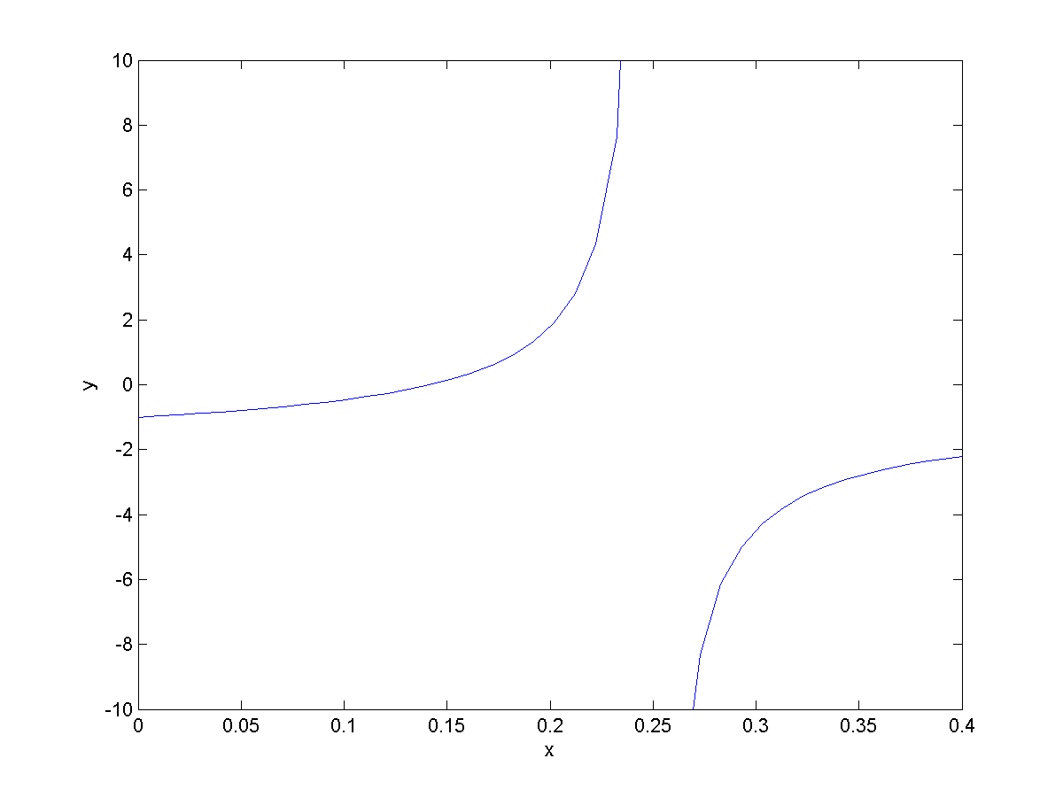
plot of $f(x)$

Slide 14
function [y] = myf(x)
%MYF Function to find the root of
y = sqrt(x) .* tan(pi * sqrt(x)) - sqrt(1 - x);
end

Slide 15
function [y] = myfprime(x)
%MYFPRIME Derivative of MYF
sqrtx = sqrt(x);
a = 1 / sqrt(1 - x);
b = tan(pi * sqrtx) / sqrtx;
c = pi * (sec(pi * sqrtx))^2;
y = 0.5 * (a + b + c);
end

Slide 16
Function functions
we can now use our Newton’s method implementation by passing in function handles for f and fprime
newton(@myf, @myfprime, 0.1, 1e-6)

Slide 17
Bracketing methods
Newton’s method requires an initial estimate of the root and the derivative of the function that we want to find the roots for
bracketing methods do not require the derivative

Slide 18
Bracketing methods
bracketing methods require two estimates $x_{1}=a$ and $x_{2}=b$ such that the root lies between the two estimates
f(x)
$$f\left(a\right)$$
$$f\left(x\right)=0$$
$$b$$
x
$$a$$
$$f\left(b\right)$$

Slide 19
Bisection method
the bisection method repeatedly evaluates $f$ at the midpoint $c_{i}$ of the interval $[a_{i}, b_{i}]$
$c_{i}$ becomes one of the new interval endpoints $[a_{i+1}, b_{i+1}]$ depending of the sign of $f(c_{i})$

Slide 20
Bisection Method
evaluate f(x) at two points x = a and x = b such that
f(a) > 0
f(b) < 0
f(x)
$$f\left(a\right)$$
$$b$$
x
$$a$$
$$f\left(b\right)$$

Slide 21
Bisection method
evaluate f(c) where c is halfway between a and b
if f(c) is not close to zero, repeat the bisection using c as one of the new endpoints
f(x)
$$f\left(a\right)$$
$$c$$
$$b$$
x
$$a$$
$$f\left(b\right)$$

Slide 22
Bisection method
in this example, the value of f(c) is not yet close enough to zero
c becomes the new b (because the sign of f(c) is negative) and the process repeats
f(x)
$$f\left(a\right)$$
$$b$$
x
$$a$$
$$f\left(b\right)$$

Slide 23
Bisection method
the method stops when f(c) becomes close enough to zero, and c is the estimate of the root of f
f(x)
$$f\left(a\right)$$
$$c$$
$$b$$
x
$$a$$
$$f\left(b\right)$$

