Slide 1
Line and curve fitting

Slide 2
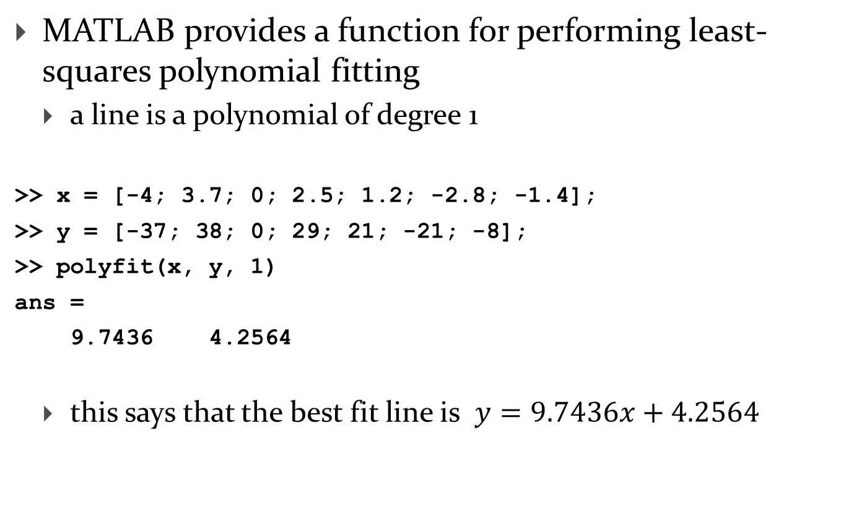
Line fitting in MATLAB
MATLAB provides a function for performing least-squares polynomial fitting
  a line is a polynomial of degree 1
>> x = [-4; 3.7; 0; 2.5; 1.2; -2.8; -1.4];
>> y = [-37; 38; 0; 29; 21; -21; -8];
>> polyfit(x, y, 1)
ans =
9.7436 4.2564
  this says that the best fit line is $y=9.7436x+4.2564$

Slide 3
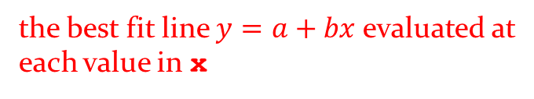
Line fitting in MATLAB
MATLAB provides a function named polyval for evaluating the polynomial computed by polyfit
>> coeffs = polyfit(x, y, 1);
>> yfit = polyval(coeffs, x)
yfit =
-34.7182
40.3079
4.2564
28.6155
15.9488
-23.0258
-9.3847
the best fit line $y=a+bx$evaluated at
each value in x

Slide 4

Line fitting in MATLAB
computing the residual errors is easy using polyval
>> coeffs = polyfit(x, y, 1);
>> yfit = polyval(coeffs, x);
>> res = y - yfit
res =
-2.2818
-2.3079
-4.2564
0.3845
5.0512
2.0258
1.3847
the residual errors $r_{i}=y_{i}−(a+bx_{i})$

Slide 5
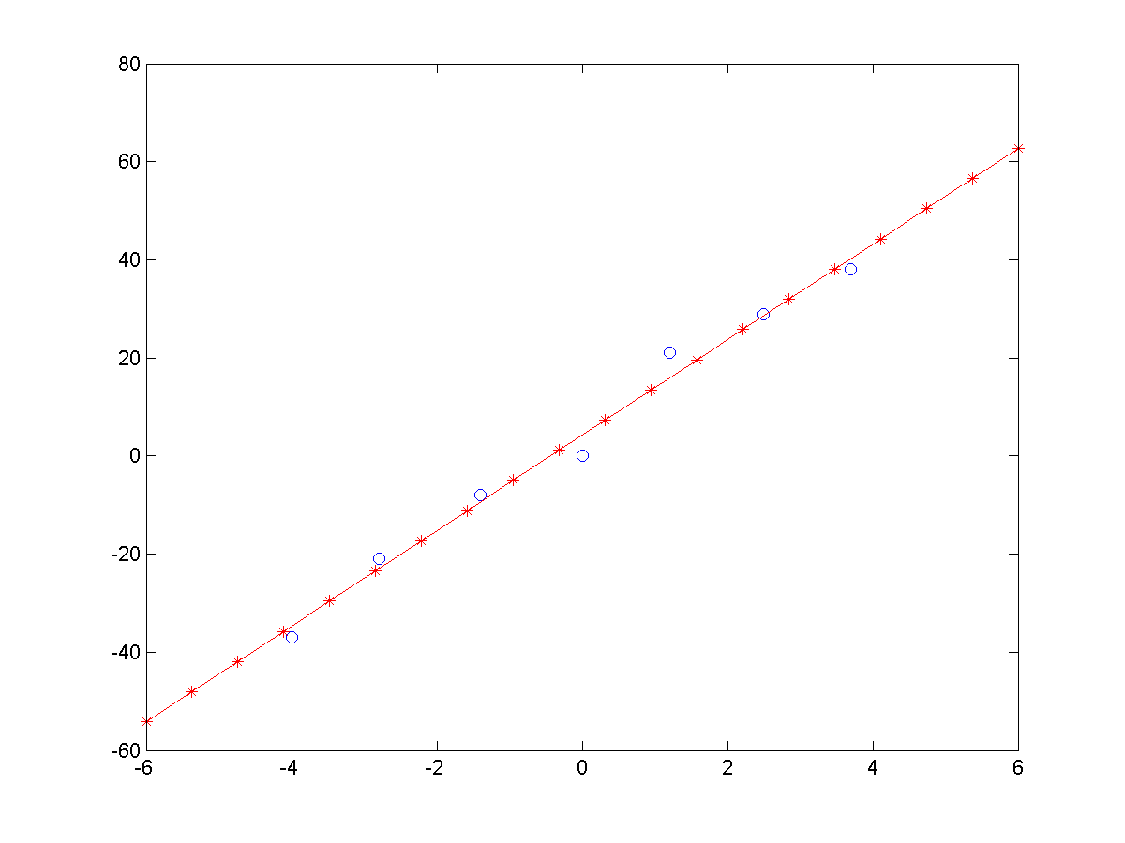
Line fitting in MATLAB
you can use any vector of values x in polyval
>> xfit = linspace(-6, 6, 20);
>> yfit = polyval(coeffs, xfit);
>> plot(x, y, 'bo', xfit, yfit, 'r*-')

Slide 6
Leverage points in line fitting
in line fitting, a high leverage point is a measurement made near the extremes of the range of independent variable
  if this measurement is erroneous, or can only be made with low precision, then it will have a large effect on the fitted line

Slide 7
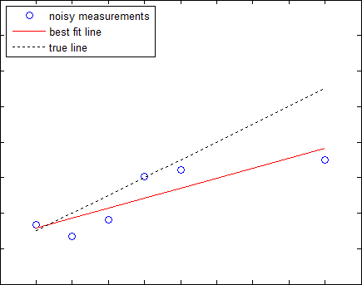
Leverage points in line fitting
effect of a high leverage point on a line fit

Slide 8
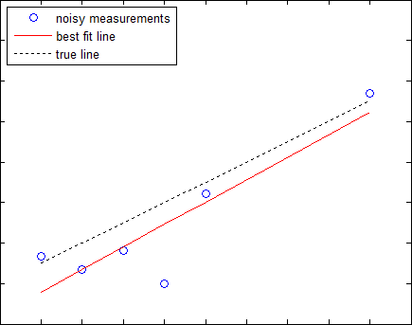
Leverage points in line fitting
effect of a low leverage point on a line fit

Slide 9
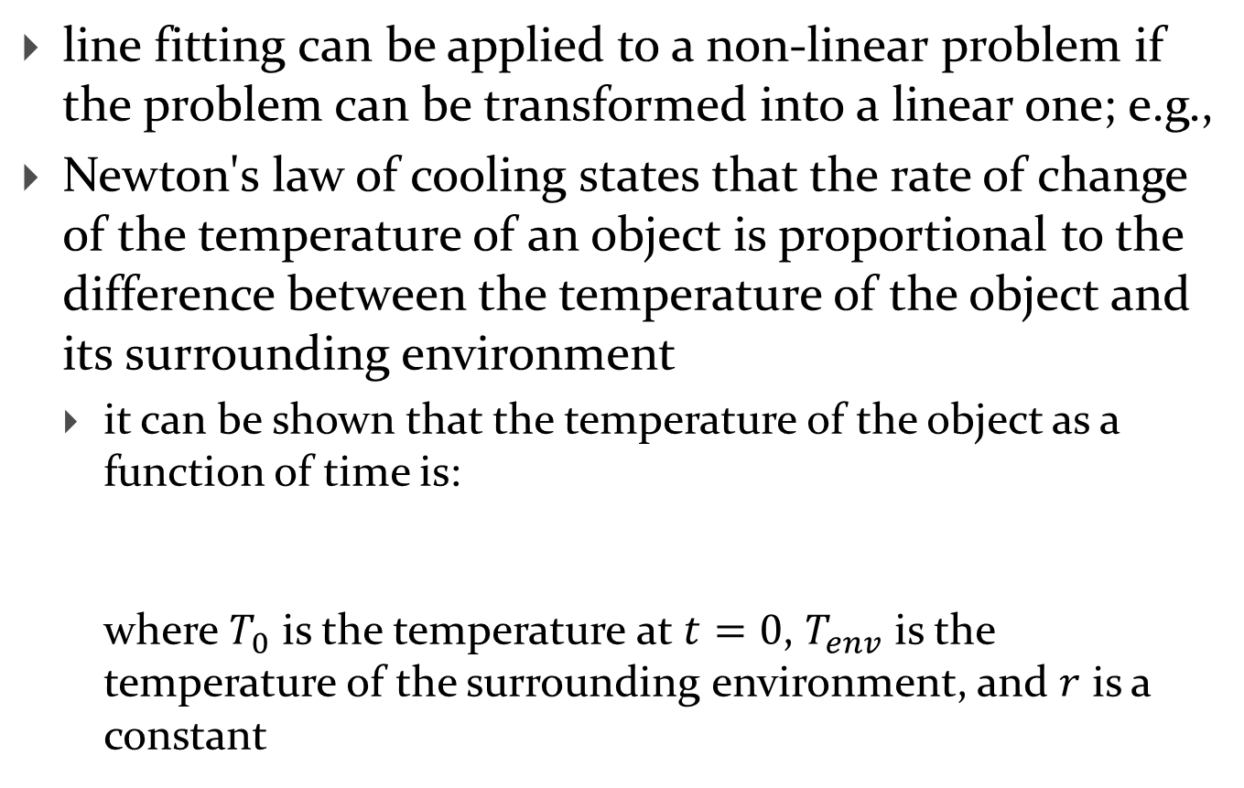

Transforming non-linear relationships
line fitting can be applied to a non-linear problem if the problem can be transformed into a linear one; e.g.,
Newton's law of cooling states that the rate of change of the temperature of an object is proportional to the difference between the temperature of the object and its surrounding environment
  it can be shown that the temperature of the object as a function of time is:
  where $T_{0}$ is the temperature at $t=0$, $T_{env}$ is the temperature of the surrounding environment, and $r$ is a constant
$$T\left(t\right)=T_{env}+(T_{0}−T_{env})e^{−rt}$$

Slide 10
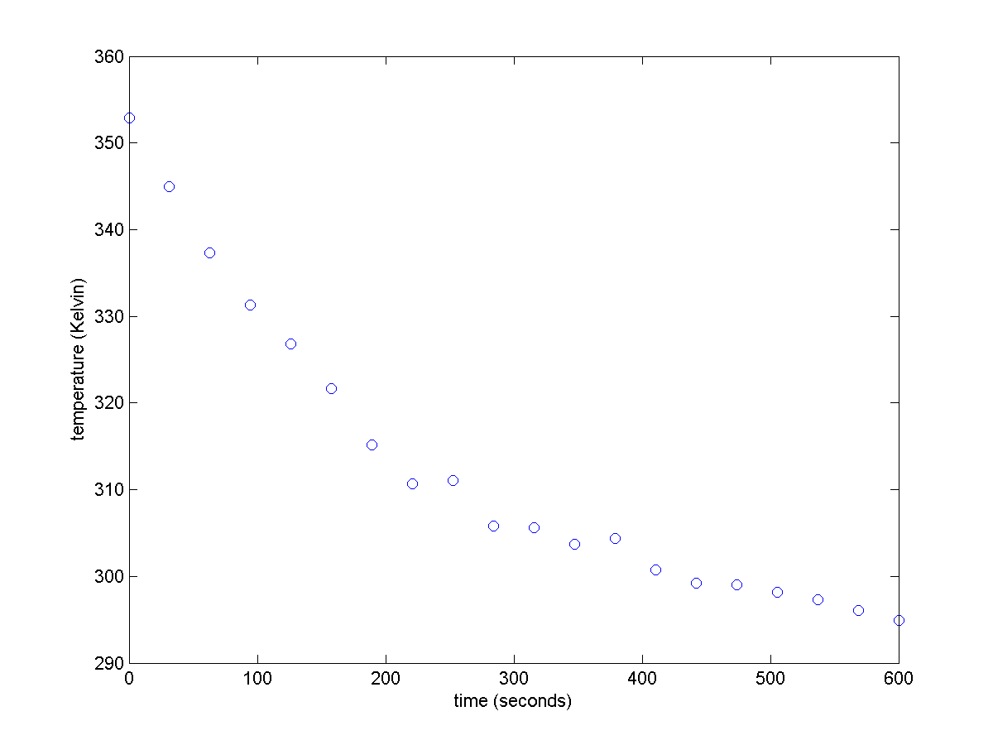

Transforming non-linear relationships
suppose that you have 20 measurements $T\left(t\right)$ and a measurement of $T_{env}$; what is the value of $r$?
$$T\left(t\right)=293.15+\left(353.15−293.15\right)e^{−0.005t}+𝒩(0,1^{2})$$

Slide 11


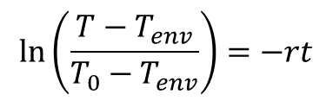

Transforming non-linear relationships
to use line fitting, we need a linear relationship in $t$
  in this case, a straightforward transformation exists:
$$T\left(t\right)=T_{env}+\left(T_{0}−T_{env}\right)e^{−rt}$$
$$\frac{T−T_{env}}{T_{0}−T_{env}}=e^{−rt}$$
$$\ln\left(\frac{T−T_{env}}{T_{0}−T_{env}}\right)=−rt$$

Slide 12
Transforming non-linear relationships
% t time vector
% T temperature measurements taken at t
% T0 353.15 K
% Tenv 293.15 K
U = log((T - Tenv) / (T0 - Tenv));
coeffs = polyfit(t, U, 1);
Ufit = polyval(coeffs, t);
plot(t, U, 'o', t, Ufit, 'r-');
slope = coeffs(1); % what is coeffs(2)?
r = -slope % should be 0.005

Slide 13
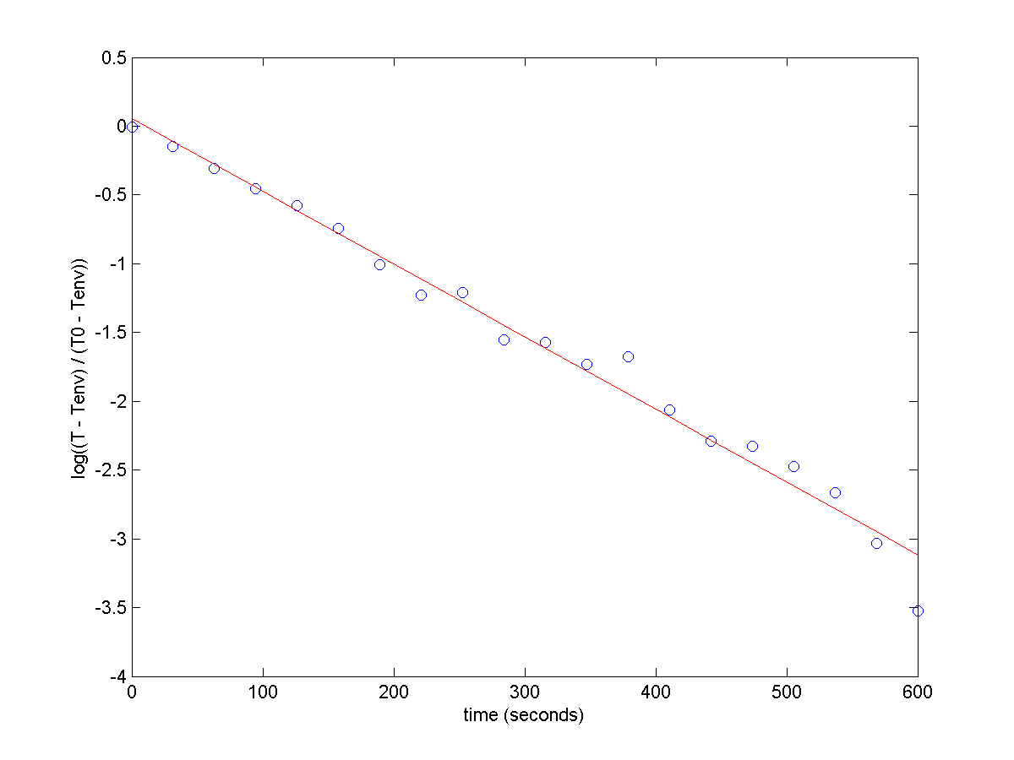
Transforming non-linear relationships

Slide 14
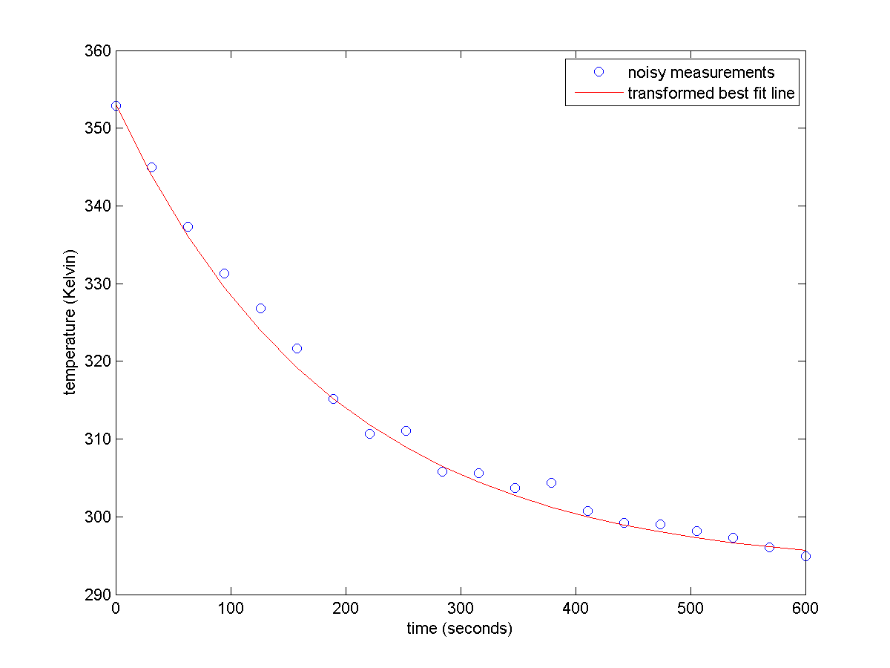
Transforming non-linear relationships

Slide 15
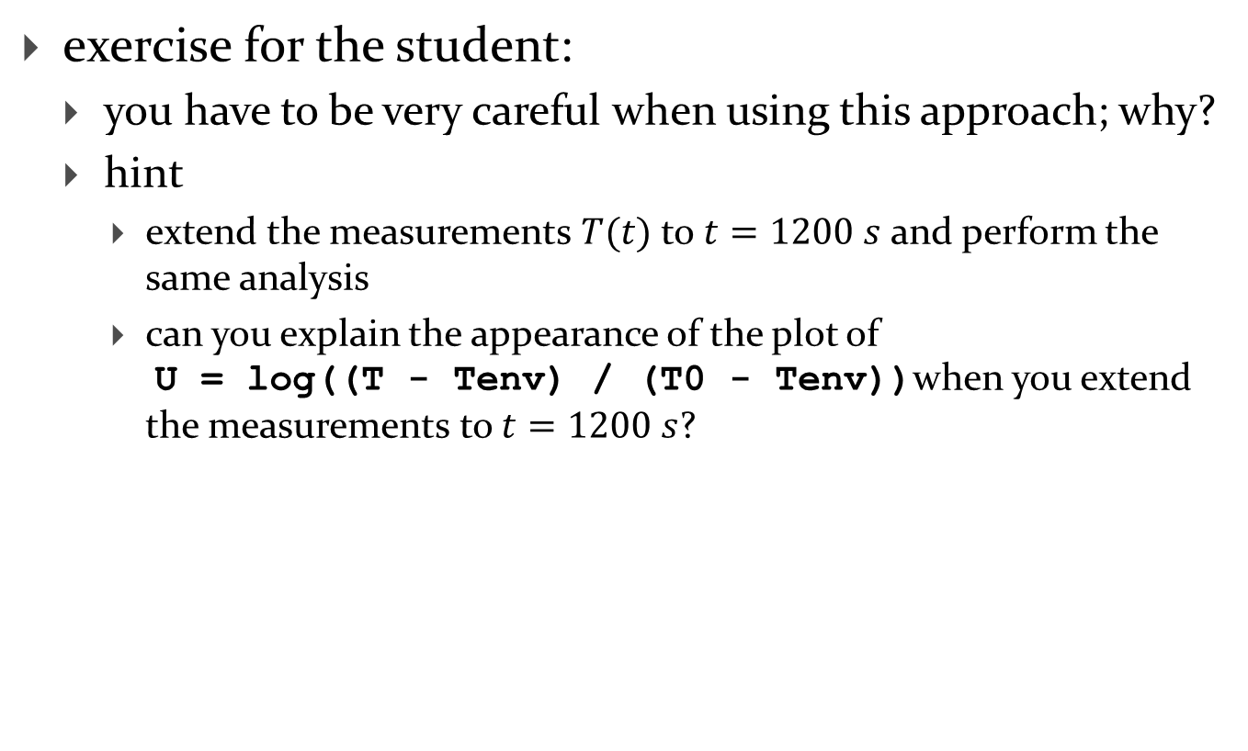
Transforming non-linear relationships
exercise for the student:
  you have to be very careful when using this approach; why?
  hint
    extend the measurements $T(t)$ to $t=1200 s$ and perform the same analysis
    can you explain the appearance of the plot of
    U = log((T - Tenv) / (T0 - Tenv))when you extend the measurements to $t=1200 s$?

Slide 16
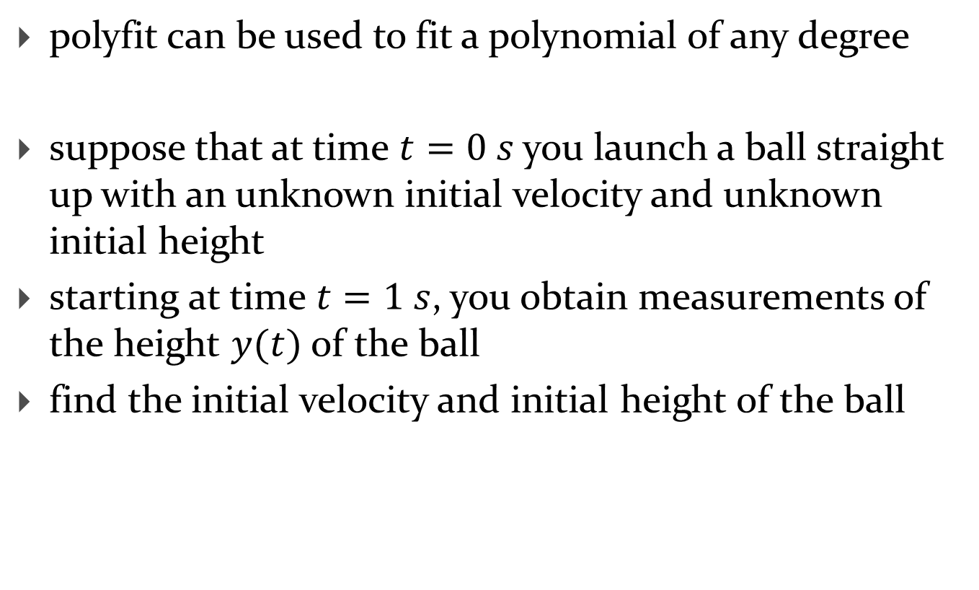
Polynomial fitting in MATLAB
polyfit can be used to fit a polynomial of any degree
suppose that at time $t=0 s$ you launch a ball straight up with an unknown initial velocity and unknown initial height
starting at time $t=1 s$, you obtain measurements of the height $y(t)$ of the ball
find the initial velocity and initial height of the ball

Slide 17
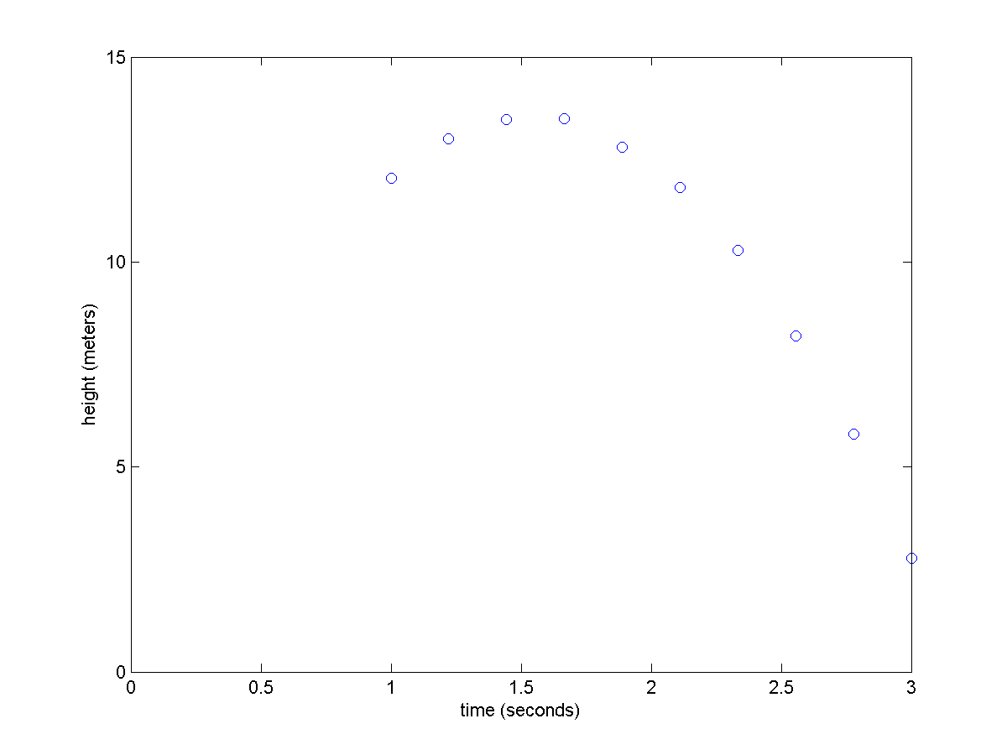



Polynomial fitting in MATLAB
$$v_{0}=15 \frac{m}{s} ,$$
$$y_{0}=2 m$$
$$y\left(t\right)=−\frac{1}{2}gt^{2}+15t+2+𝒩(0,{0.05}^{2})$$

Slide 18
Polynomial fitting in MATLAB
% t time vector (from 1 to 3 s)
% y height measurements taken at t
coeffs = polyfit(t, y, 2);
t2 = linspace(0, 3, 20);
yfit = polyval(coeffs, t2);
plot(t, y, 'o', t2, yfit, 'r-');
g = -2 * coeffs(1) % should be 9.81
v0 = coeffs(2) % should be 15
y0 = coeffs(3) % should be 2

Slide 19
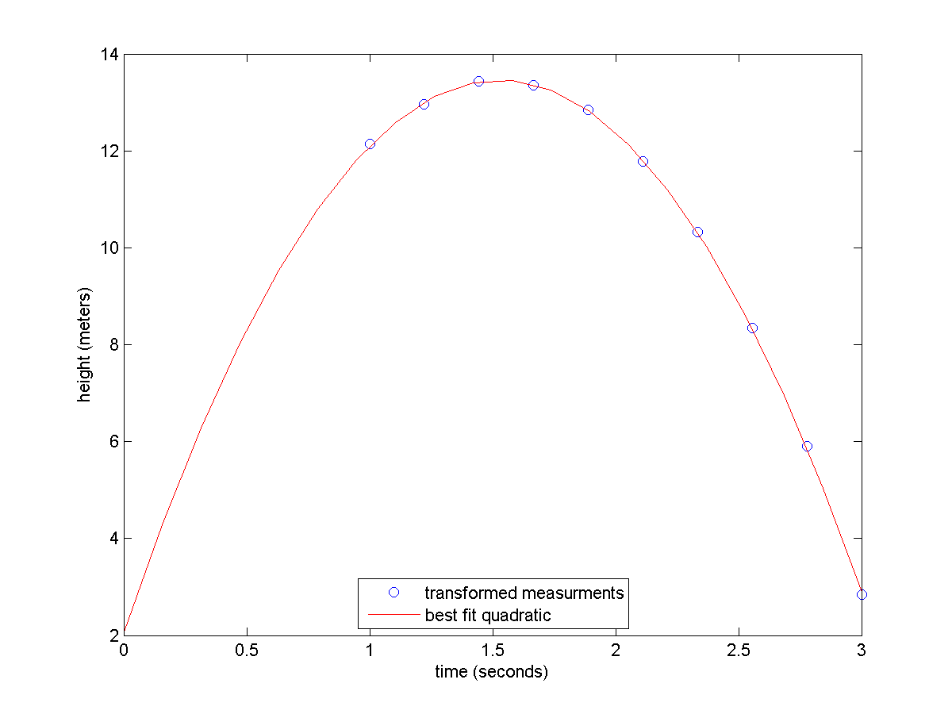



Polynomial fitting in MATLAB
values from fitting
$$\hat{g}=9.9842 \frac{m}{s^{2}}$$
$$\hat{v_{0}}=15.3073 \frac{m}{s} ,$$
$$\hat{y_{0}}=1.7568 m$$

Slide 20






Another view of line fitting
we can view line fitting as solving a system of linear equations
  given $n$ measurements $\left(x_{i}, y_{i}\right)$, find $a$ and $b$
$$a+bx_{1}=y_{1}$$
$$a+bx_{2}=y_{2}$$
$$a+bx_{3}=y_{3}$$
$$⋮$$
$$a+bx_{n}=y_{n}$$

Slide 21










Another view of line fitting
in matrix form:
which can be solved in MATLAB in a least-squares sense as $x=A∖y$
$$a+bx_{1}=y_{1}$$
$$a+bx_{2}=y_{2}$$
$$\left[\begin{matrix}\begin{matrix}1 & x_{1}\end{matrix} \\ \begin{matrix}\begin{matrix}1 & x_{2}\end{matrix} \\ \begin{matrix}\begin{matrix}1 & x_{3}\end{matrix} \\ \begin{matrix}⋮ \\ \begin{matrix}1 & x_{n}\end{matrix}\end{matrix}\end{matrix}\end{matrix}\end{matrix}\right]\left[\begin{matrix}a \\ b\end{matrix}\right]=\left[\begin{matrix}y_{1} \\ \begin{matrix}y_{2} \\ \begin{matrix}y_{3} \\ \begin{matrix}⋮ \\ y_{n}\end{matrix}\end{matrix}\end{matrix}\end{matrix}\right]$$
$$a+bx_{3}=y_{3}$$
$$⋮$$
$$a+bx_{n}=y_{n}$$
$$A$$
$$x$$
$$y$$

Slide 22
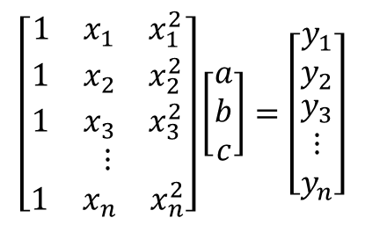









Another view of polynomial fitting
polynomials are almost exactly the same:
which can be solved in MATLAB in a least-squares sense as $x=A∖y$
$$a+bx_{1}+cx12 =y_{1}$$
$$a+bx_{2}+cx22 =y_{2}$$
$$\left[\begin{matrix}\begin{matrix}1 & x_{1} & x_{1}^{2}\end{matrix} \\ \begin{matrix}\begin{matrix}1 & x_{2} & x_{2}^{2}\end{matrix} \\ \begin{matrix}\begin{matrix}1 & x_{3} & x_{3}^{2}\end{matrix} \\ \begin{matrix}⋮ \\ \begin{matrix}1 & x_{n} & x_{n}^{2}\end{matrix}\end{matrix}\end{matrix}\end{matrix}\end{matrix}\right]\left[\begin{matrix}a \\ b \\ c\end{matrix}\right]=\left[\begin{matrix}y_{1} \\ y_{2} \\ \begin{matrix}y_{3} \\ ⋮ \\ y_{n}\end{matrix}\end{matrix}\right]$$
$$a+bx_{3}+cx32 =y_{3}$$
$$⋮$$
$$a+bx_{n}+cxn2 =y_{n}$$
$$A$$
$$x$$
$$y$$

Slide 23


Another view of polynomial fitting
a matrix $A$ of the form
is called a Vandermonde matrix
$$\left[\begin{matrix}\begin{matrix}1 & x_{1} & x_{1}^{2} & … & x_{1}^{m}\end{matrix} \\ \begin{matrix}\begin{matrix}1 & x_{2} & x_{2}^{2} & … & x_{2}^{m}\end{matrix} \\ \begin{matrix}\begin{matrix}1 & x_{3} & x_{3}^{2} & … & x_{3}^{m}\end{matrix} \\ \begin{matrix}⋮ \\ \begin{matrix}1 & x_{n} & x_{n}^{2} & … & x_{n}^{m}\end{matrix}\end{matrix}\end{matrix}\end{matrix}\end{matrix}\right]$$

