Slide 1
Random variables (continued)

Slide 2
Repeated measurements
student scientists are taught to perform multiple measurements and average the results
  one reason is to increase the precision of the estimated value
  if taking multiple measurements increases the precision then surely taking even more measurements would be better?
how does the precision of the average behave as a function of the number of measurements n?

Slide 3
Variance of the mean
precision = variance (or standard deviation)
assume the measurement is contaminated with additive Gaussian noise with mean zero and variance 1
write a simulation to study the behavior of the sample mean as a function of the number of measurements

Slide 4
Variance of the mean
%% Variance of the mean for n = 1, 2, ..., 64
N = 64;
VAR = ones(1, N);
for n = 1:N
X = randn(n, 10000);
if n == 1
VAR(n) = var(X);
else
VAR(n) = var(mean(X));
end
end
plot(VAR)

Slide 5


Variance of the mean
variance of the mean
standard deviation of the mean
$$var(\overline{x})∝\frac{1}{n}$$
$$stddev(\overline{x})∝\frac{1}{\sqrt{n}}$$

Slide 6
Gaussian random walk
a Gaussian random walk is a random walk where the step size is drawn from a Gaussian distribution with mean variance

Slide 7
Gaussian random walk
%% Gaussian random walk for n = 100 steps
n = 100;
w = zeros(1, n);
for step = 2:n
w(step) = w(step - 1) + randn(1);
end
plot(w)

Slide 8
Gaussian random walk
after n steps what does the walk look like?
%% Many Gaussian random walks
TRIALS = 100000;
W = zeros(TRIALS, n);
tic
for t = 1:TRIALS % there is faster way to do this...
for step = 2:n
W(t, step) = W(t, step - 1) + randn(1);
end
end
toc
plot(var(W))

Slide 9
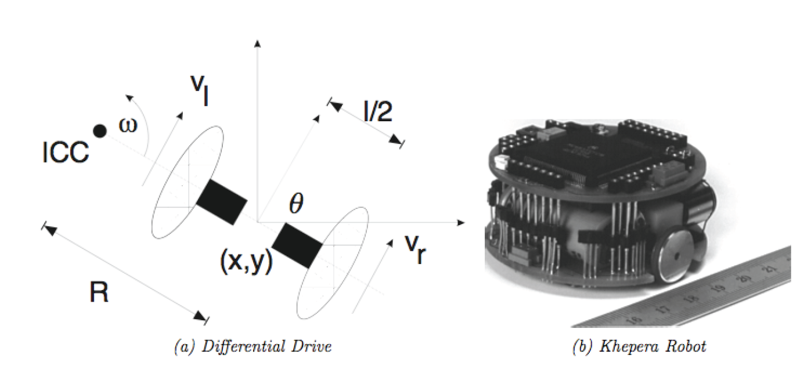
Differential drive
two independently driven wheels mounted on a common axis

Slide 10
Differential drive
velocity constraint defines the wheel ground velocities
instantaneous linear
velocity of left wheel
instantaneous linear
velocity of right wheel

Slide 11
Differential drive
given the wheel ground velocities it is easy to solve for the radius, R, and angular velocity ω
given the radius and angular velocity it is possible to estimate the path of the robot
  but let's look at a simpler model of the motion instead

Slide 12


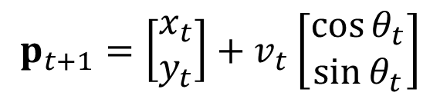

Differential drive
assume at time t the robot has position
orientation
and forward velocity
then after 1 unit of time has passed the new position of the robot is
$$p_{t}=\left[\begin{matrix}x_{t} \\ y_{t}\end{matrix}\right]$$
$$θ_{t}$$
$$v_{t}$$
$$p_{t+1}=\left[\begin{matrix}x_{t} \\ y_{t}\end{matrix}\right]+v_{t}\left[\begin{matrix}\cos{θ_{t}} \\ \sin{θ_{t}}\end{matrix}\right]$$

Slide 13
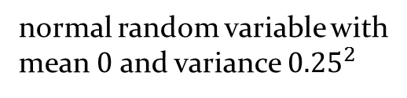
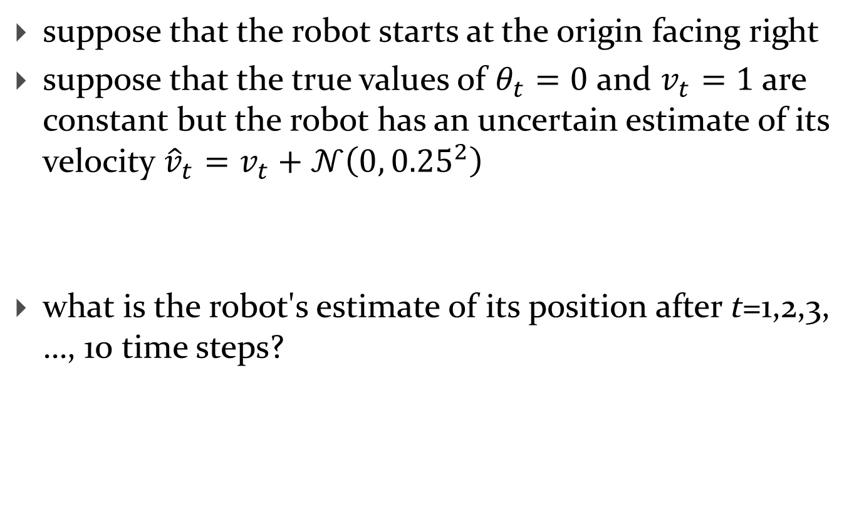
Differential drive
suppose that the robot starts at the origin facing right
suppose that the true values of $θ_{t}=0$ and $v_{t}=1$ are constant but the robot has an uncertain estimate of its velocity ${\hat{v}}_{t}=v_{t}+𝒩\left(0,{0.25}^{2}\right)$
what is the robot's estimate of its position after t=1,2,3, …, 10 time steps?
normal random variable with
mean $0$ and variance ${0.25}^{2}$

Slide 14
Differential drive
%% Differential drive (1 trial)
theta = 0;
v = 1;
P = zeros(2, 11);
for t = 2:11
vhat = v + 0.25*randn(1);
P(:, t) = P(:, t-1) + vhat * [cos(theta); sin(theta)];
end
plot(P(1, :), P(2, :), '.');

Slide 15
Differential drive
%% Differential drive (many trials)
TRIALS = 1000;
theta = 0;
v = 1;
Px = zeros(TRIALS, 11);
Py = zeros(TRIALS, 11);
for trial = 1:TRIALS
for t = 2:11
pprev = [Px(trial, t - 1); Py(trial, t - 1)];
vhat = v + 0.25*randn(1);
p = pprev + vhat*[cos(theta); sin(theta)];
Px(trial, t) = p(1);
Py(trial, t) = p(2);
end
end
hist(Px(:, 11))

Slide 16
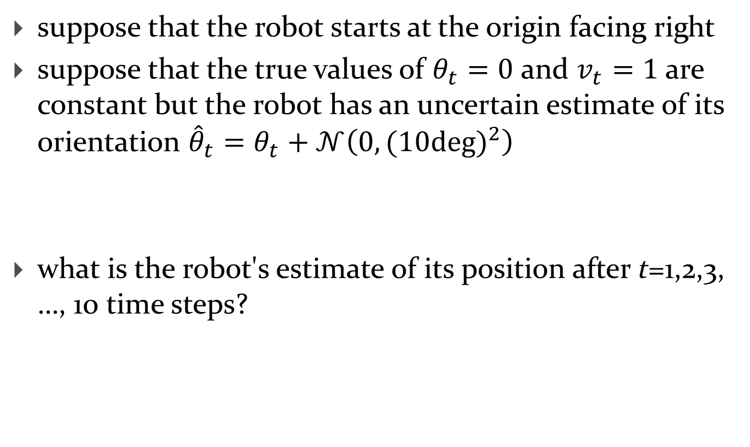
Differential drive
suppose that the robot starts at the origin facing right
suppose that the true values of $θ_{t}=0$ and $v_{t}=1$ are constant but the robot has an uncertain estimate of its orientation ${\hat{θ}}_{t}=θ_{t}+𝒩\left(0,{(10deg)}^{2}\right)$
what is the robot's estimate of its position after t=1,2,3, …, 10 time steps?

Slide 17
Differential drive
%% Differential drive (many trials)
TRIALS = 1000;
theta = 0;
v = 1;
Px = zeros(TRIALS, 11);
Py = zeros(TRIALS, 11);
for trial = 1:TRIALS
for t = 2:11
pprev = [Px(trial, t - 1); Py(trial, t - 1)];
thetahat = theta + (10 * pi/180)*randn(1);
p = pprev + v*[cos(thetahat); sin(thetahat)];
Px(trial, t) = p(1);
Py(trial, t) = p(2);
end
end
plot(Px(:, 11), Py(:,11), '.')

