Slide 1
Basic statistics (continued)

Slide 2
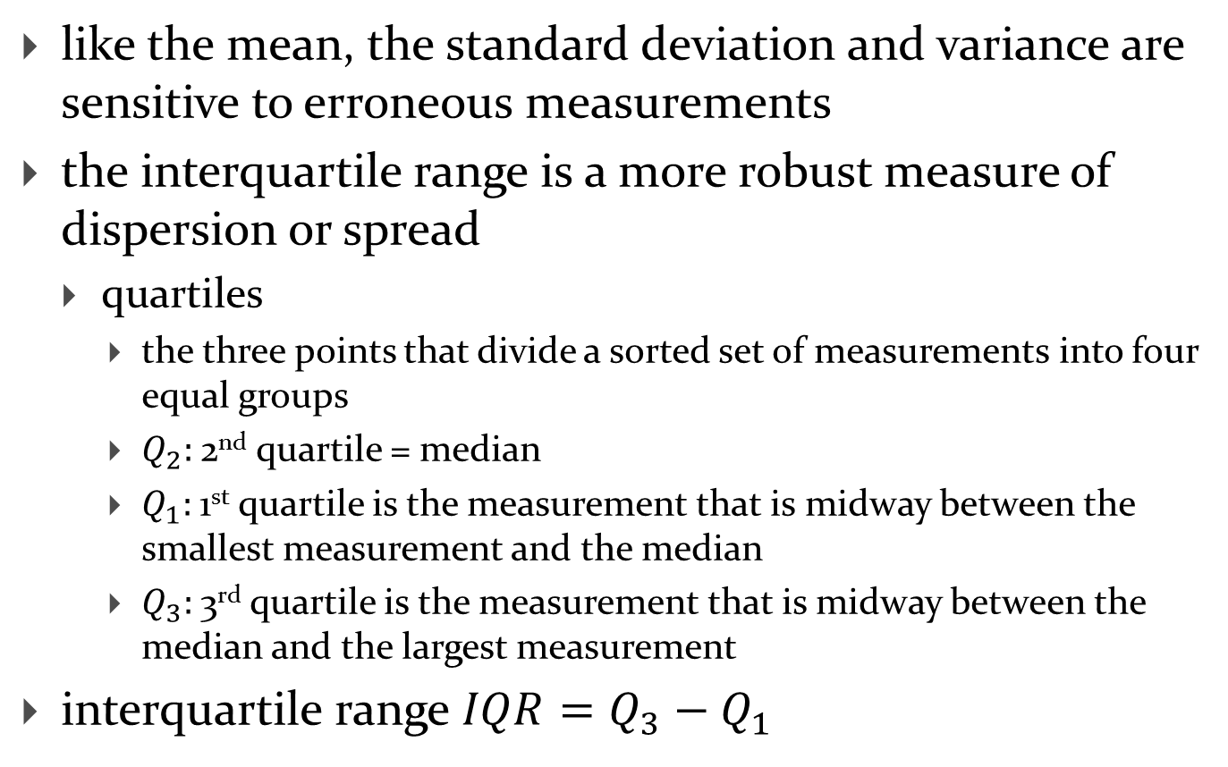
Interquartile range
like the mean, the standard deviation and variance are sensitive to erroneous measurements
the interquartile range is a more robust measure of dispersion or spread
  quartiles
    the three points that divide a sorted set of measurements into four equal groups
    $Q_{2}:$2nd quartile = median
    $Q_{1}:$1st quartile is the measurement that is midway between the smallest measurement and the median
    $Q_{3}:$3rd quartile is the measurement that is midway between the median and the largest measurement
interquartile range $IQR=Q_{3}−Q_{1}$

Slide 3
Interquartile range
measurements in sorted order
  650
  740
  760
  810 Q1
  850
  850
  900 median Q2 IQR
  930
  930
  950 Q3
  960
  960
  980

Slide 4
Boxplots
the box plot provides a graphical summary of the quartiles and extreme values of a group of measurements
closely related to the five-number summary
  sample minimum
  first quartile
  median
  third quartile
  sample maximum

Slide 5
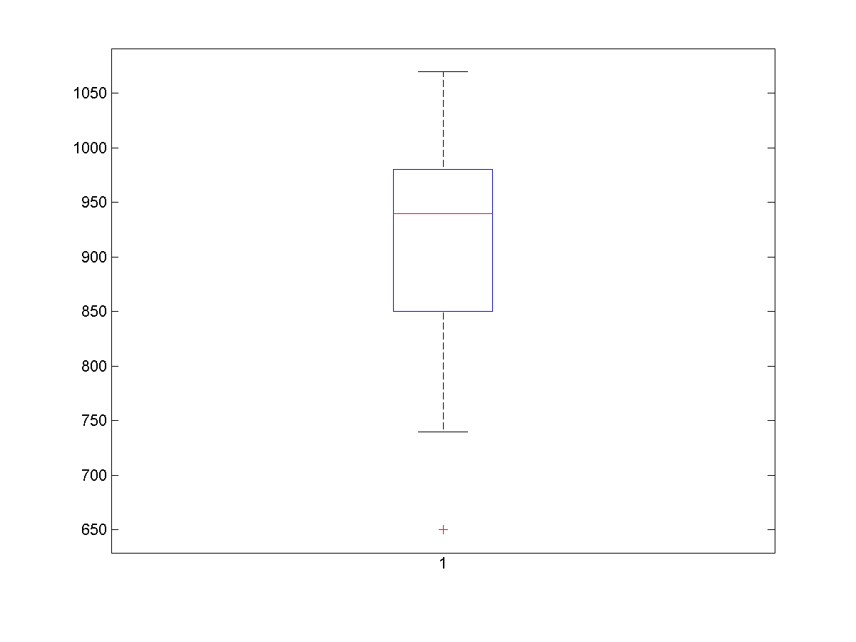
maximum inlier value
whisker
Q3
median (Q2)
Q1
whisker
minimum inlier value
outlier

Slide 6
Measuring the speed of light
the first accurate measurements of the velocity of light in air were performed by Albert Michelson and Simon Newcomb in 1879-1882
  based on methods developed by
    Armand Hippolyte Louis Fizeau (1849)
      313,300 kilometres per second
    Jean Bernard Léon Foucault (1862)
      298,000 kilometres per second
    http://en.wikipedia.org/wiki/Fizeau-Foucault_apparatus
    http://www.pas.rochester.edu/~pavone/particle-www/teachers/demonstrations/FoucaultDemonstration.htm

Slide 7
Michelson’s data
measured speed of light in air = 299,000 + number in table

Slide 8
Michelson’s data
Microsoft Excel spreadsheet here
MATLAB can read an Excel spreadsheet using xlsread
>> X = xlsread('michelson.xlsx');
>> boxplot(X)

Slide 9
Michelson's data
compute some summary statistics of Michelson's data (watch out for NaNs!)
  min
  max
  mean (compare to modern value of 299,705 km/s)
  median
  variance
  standard deviation
produce a box plot of Michelson's data

Slide 10
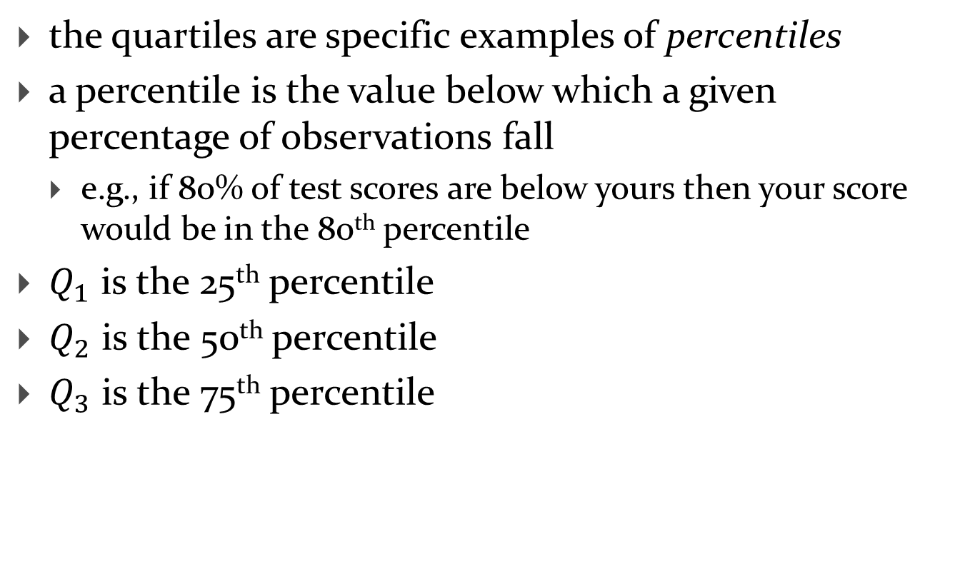
Percentiles
the quartiles are specific examples of percentiles
a percentile is the value below which a given percentage of observations fall
  e.g., if 80% of test scores are below yours then your score would be in the 80th percentile
$Q_{1}$ is the 25th percentile
$Q_{2}$ is the 50th percentile
$Q_{3}$ is the 75th percentile

Slide 11
Percentiles
there is no single method for computing percentiles for discrete distributions (finite numbers of measurements)
  e.g., what is the 33rd percentile of 10 measurements?
MATLAB computes percentiles in a particular way that may be different than other commonly used software
>> y = prctile(x, 95) % the 95th percentile of x
>> y = prctile(x, [25 50 75]) % the quartiles of x

Slide 12
Summary statistics are not enough
Anscombe provides 4 data sets where the mean and variance of each set are (almost) the same
  Microsoft Excel spreadsheet here
compute some summary statistics for Anscombe's data
draw a box plot for Anscombe's data
plot Anscombe's data

