Slide 1
Loops

Slide 2
Loops
loops allow you to repeatedly execute blocks of code
  each repetition is called an iteration
MATLAB has two kinds of loops
  for loop
    repeats a block of code a specific number of times, keeping track of each iteration using an incrementing loop variable
  while loop
    repeats a block of code as long as a logical condition remains true

Slide 3
for loop
a for loop repeats a block of code once for each element of a control vector*
  *the vector can be an array, but ignore this for now
the value of the element in the control vector is available inside the loop

Slide 4
for loop
for index = vector_of_values
end
index is the loop
variable; you can
use whatever
name you want
each iteration of the loop, the value of index is taken sequentially from vector_of_values
loop body: a sequence of MATLAB statements
repeated once for each element in vector_of_values

Slide 5
% display the value of index for each iteration
% of a loop
for index = 1:5
index
end

Slide 6
% display the integers 1 through 5 on separate lines
for index = 1:5
disp(num2str(index));
end
% you could also use sprintf
for index = 1:5
disp(sprintf('%d', index));
end

Slide 7
% display the integers start through stop
% on separate lines
if start <= stop
x = start:stop;
else
x = start:-1:stop;
end
for index = x
disp(num2str(index));
end

Slide 8
% compute the sum of the integers 1, 2, 3, ..., n
% we need a variable to accumulate the sum
total = 0;
for x = 1:n
total = total + x;
end
% you should use sum instead, though
total = sum(1:n);

Slide 9
% compute the dot product of two vectors x and y
len = length(x);
dotprod = 0;
for index = 1:len
dotprod = dotprod + x(index) * y(index);
end
% you should use dot instead, though
dotprod = dot(x, y);

Slide 10
for loop: matrix-vector multiplication
use a for loop to compute the product of a matrix and a vector
  use the function dot inside of the loop

Slide 11
for loop: radioactive decay
in radioactive decay, an energetically unstable atom spontaneously emits energy in the form of ionizing radiation
for a single atom, the decay occurs at random
  for many atoms, the decay occurs at an average constant rate
suppose that you start with N radioactive atoms:
after 1 unit of time there will be:

Slide 12


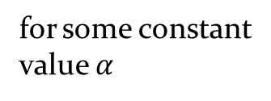

for loop: radioactive decay
suppose that you start with N radioactive atoms:
after 1 unit of time there will be:
after 2 units of time there will be:
and so on
$$U\left(1\right)=N$$
for some constant
value $α$
$$U\left(2\right)=\left(1−α\right)U(1)$$
$$U\left(3\right)=\left(1−α\right)U(2)$$

Slide 13
% compute the number of atoms at each time
% t = 1, 2, 3, ..., 10
N = 100000;
alpha = 0.05;
% we need a vector to store the results
U = zeros(1, 10);
U(1) = N;
for index = 2:length(U)
U(index) = (1 – alpha) * U(index – 1);
end
% what is the better way to compute U?

Slide 14
for loop: cumulative sum
the cumulative sum of the elements in a vector values is a vector of the same length as values where the element at index i is the sum of values(1) through values(i)

Slide 15
% compute the cumulative sum of the elements
% in a vector named values
csum = zeros(1, length(values));
csum(1) = values(1);
for index = 2:length(values)
csum(index) = csum(index - 1) + values(index);
end
% you should use cumsum instead, though
csum = cumsum(values);

Slide 16
while loop
a while loop repeats a block of code as long as a logical condition is true
  unlike a for loop
    there is no loop variable
    the number of times that the loop runs is not necessarily determined ahead of time

Slide 17
while loop
while
end
logical_condition
if logical_condition is true then the loop body is run once
loop body: a sequence of MATLAB statements
after the loop body is run, the loop restarts by checking the logical_condition

Slide 18
% repeat a loop until the user inputs 'y'
repeat = 1;
while (repeat)
%
% some code here that you want to repeat
%
% ask the user if they want to repeat again
answer = input('Continue? (y / n)');
repeat = strcmp(answer, 'y');
end

Slide 19
while loop: infinte loops
observe that it is very easy to create an infinite loop using a while loop
  you must ensure that whatever happens in the loop body eventually causes the logical condition to become false
if you encounter an infinite loop in your program you can press Ctrl + c to stop your program
  unfortunately this stops your entire program and not just your loop

Slide 20
% infinite loop example
repeat = 1;
while (repeat)
%
% some code here that you want to repeat
%
% ask the user if they want to repeat again
answer = input('Continue? (y / n)');
% comment out next line
% repeat = strcmp(answer, 'y');
end

Slide 21
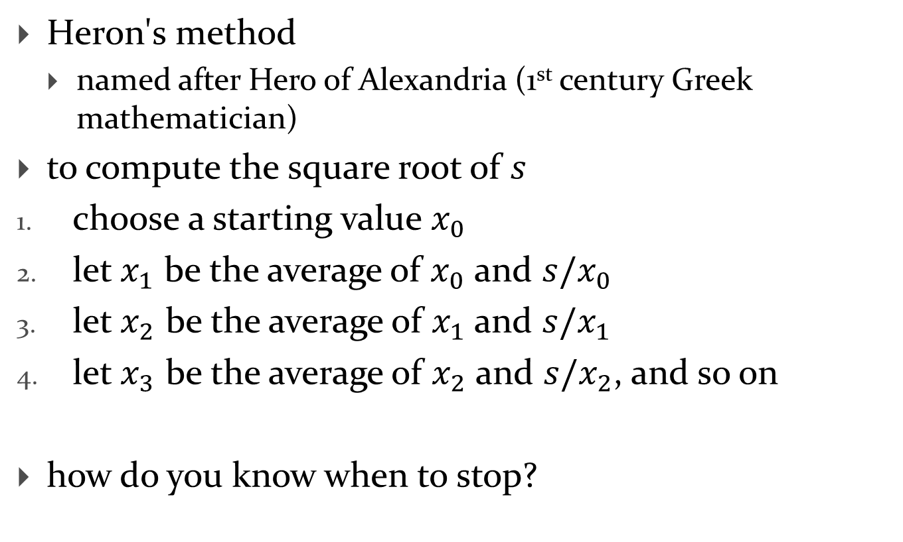
while loop: computing square root
Heron's method
  named after Hero of Alexandria (1st century Greek mathematician)
to compute the square root of $s$
choose a starting value $x_{0}$
let $x_{1}$ be the average of $x_{0}$ and $s/x_{0}$
let $x_{2}$ be the average of $x_{1}$ and $s/x_{1}$
let $x_{3}$ be the average of $x_{2}$ and $s/x_{2}$, and so on
how do you know when to stop?

Slide 22
% compute the square root of s
epsilon = 1e-9;
delta = Inf;
x = 0.5 * s;
while abs(delta) > epsilon
xi = mean([x, s / x]);
delta = xi – x;
x = xi;
end

