Slide 1
User-defined functions

Slide 2

Recall the script example from Day 5
an undamped spring-mass system is an example of a simple harmonic oscillator
the position of the mass is given by
$$x\left(t\right)=A\sin\left(\sqrt{\frac{k}{m}}t−\frac{π}{2}\right)$$

Slide 3
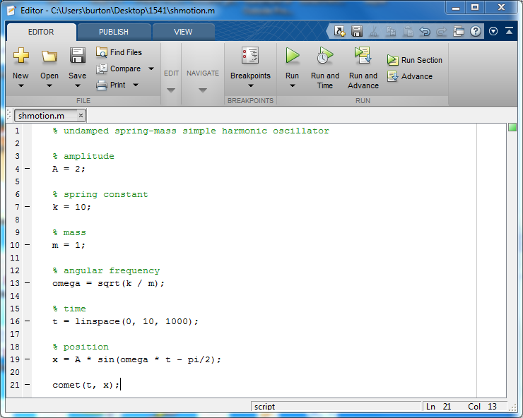

Slide 4
User-defined functions
scripts are useful but:
  the variables used in the script appear in the current workspace
  the values of the variables used in the script are fixed
contrast this to a user-defined MATLAB function
  the variables used in the function do not appear in the current workspace
  the user of the function can specify the input values to the function

Slide 5
User-defined functions
a user-defined function is usually a plaintext file having a filename with the following form:
yourFunctionName.m
where yourFunctionName must be a valid MATLAB variable name
  i.e., must begin with a letter and may only contain letters and spaces and underscores
    no spaces or symbols!

Slide 6
User-defined functions
let's replace the script that calculates the position of an undamped spring-mass system with a function
the position of the mass is given by
$$x\left(t\right)=A\sin\left(\sqrt{\frac{k}{m}}t−\frac{π}{2}\right)$$

Slide 7
User-defined functions
the first line of a MATLAB function is called the function header:
function [x] = shmotion2(t)
input parameters;
can be more than
one input parameter
function keyword
names of
output values;
can output more
than one value
function
name

Slide 8
User-defined functions
the block of comments immediately following the header is the help documentation for the function
  the help comments are not required but very useful
  you may have noticed that in the functions that come with MATLAB, the function name, names of the output values, and names of the input parameters are written in uppercase in the help comments
    this is so that these names are more apparent in the Command Window
    you don't have to do this, and there are good arguments against using this convention

Slide 9
User-defined functions
function [x] = shmotion2(t)
%SHMOTION2
% X = SHMOTION2(T) returns the position X
% of a simple harmonic oscillator evaluated
% at each time in the vector T
end

Slide 10
User-defined functions
you might prefer adding documentation in the same style that appears in the Help browser
  you can use Cell-mode style comments like you have been doing in the labs

Slide 11
User-defined functions
function [x] = shmotion2(t)
%% shmotion2
% Position of a simple harmonic oscillator.
%% Syntax
% x = shmotion2(0:0.1:5);
%% Description
% |x = shmotion(t)| for vector |t| computes the position |x|
% for each element in |t|
%% Examples
% x = shmotion2(0:0.1:0.5)
% x =
% -2.0000 -1.9008 -1.6132 -1.1655 -0.6023 0.0207
end

Slide 12
User-defined functions
the body of the function appears after the help comments
the body contains MATLAB statements that are interpreted in a separate workspace
  i.e., variables that appear in the body do not appear in the user workspace, and
  variables in the user workspace are not visible to the function

Slide 13
User-defined functions
function [x] = shmotion2(t)
% help comments not shown
% amplitude
A = 2;
% spring constant
k = 10;
% mass
m = 1;
% angular frequency
omega = sqrt(k / m);
% position
x = A * sin(omega * t - pi/2);
end
you must assign a value for every
output variable!

Slide 14
User-defined functions
to use the function, it must be in a folder on the current MATLAB path
you call (or invoke) the function in the usual way:
>> t = 0:0.01:5;
>> x = shmotion2(t);
>> comet(t, x)

Slide 15
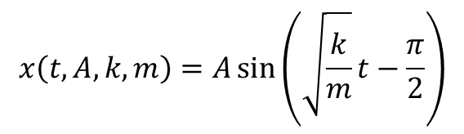
User-defined functions
so far our function is a function of time only
  i.e., the amplitude of oscillation, spring constant, and mass are still fixed
it would probably be useful to allow the user of the function to change these other parameters
$$x\left(t, A, k, m\right)=A\sin\left(\sqrt{\frac{k}{m}}t−\frac{π}{2}\right)$$

Slide 16
User-defined functions
function [x] = shmotion2(t, A, k, m)
% help comments not shown
% angular frequency
omega = sqrt(k / m);
% position
x = A * sin(omega * t - pi/2);
end

Slide 17
User-defined functions
can you generalize our function even more?

Slide 18

User-defined functions
write a function that computes the magnitude of force given by Newton's law of gravity
$$F= \frac{Gm_{1}m_{2}}{r^{2}}$$

Slide 19
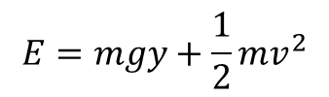
User-defined functions
write a function that computes the total energy, potential energy, and kinetic energy of a free falling mass at a height y above the earth's surface with instantaneous velocity v
$$E=mgy+\frac{1}{2}mv^{2}$$

