Slide 1
Matrix operations
Scripts

Slide 2
Matrix transpose
if A is an m x n matrix then the transpose of A is an
n x m matrix where the row vectors of A are written as column vectors

Slide 3
>> u = [1 2 3];
>> v = u'
v =
1
2
3
>> A = [1 2 3;
4 5 6];
>> B = A'
B =
1 4
2 5
3 6
matrix transpose

Slide 4
Arithmetic operations with arrays
you can perform element-by-element arithmetic with two arrays of the same size
operator | name
+ | addition
- | subtraction
.* | multiplication
./ | right array division
.\ | left array division

Slide 5
>> u = [1 2 3];
>> v = [7 8 9];
>> w = u + v
w =
8 10 12
>> A = [1 2 3;
4 5 6];
>> B = [6 5 4;
3 2 1];
>> C = A + B
C =
7 7 7
7 7 7
array addition

Slide 6
>> u = [1 2 3];
>> v = [7 8 9];
>> w = u – v
w =
-6 -6 -6
>> A = [1 2 3;
4 5 6];
>> B = [6 5 4;
3 2 1];
>> C = A – B
C =
-5 -3 -1
1 3 5
array subtraction

Slide 7
>> u = [1 2 3];
>> v = [7 8 9];
>> w = u .* v
w =
7 16 27
>> A = [1 2 3;
4 5 6];
>> B = [6 5 4;
3 2 1];
>> C = A .* B
C =
6 10 12
12 10 6
array multiplication
in mathematics,
called the Hadamard
product or the Schur
product

Slide 8
>> u = [1 2 3];
>> v = [7 8 9];
>> w = u ./ v
w =
0.1429 0.2500 0.3333
>> A = [1 2 3;
4 5 6];
>> B = [6 5 4;
3 2 1];
>> C = A ./ B
C =
0.1667 0.4000 0.7500
1.3333 2.5000 6.0000
right array division
the elements in u
divided by the
elements in v
the elements in A
divided by the
elements in B

Slide 9
>> u = [1 2 3];
>> v = [7 8 9];
>> w = u .\ v
w =
7 4 3
>> A = [1 2 3;
4 5 6];
>> B = [6 5 4;
3 2 1];
>> C = A .\ B
C =
6.0000 2.5000 1.3333
0.7500 0.4000 0.1667
left array division
the elements in v
divided by the
elements in u
the elements in B
divided by the
elements in A

Slide 10
Arithmetic operations with arrays
you can perform element-by-element arithmetic with an array and a scalar
operator | name
+ | addition
- | subtraction
* | multiplication
/ | right division
\ | left division
.^ | array power

Slide 11
>> u = [1 2 3];
>> w = 2 + u
w =
3 4 5
>> A = [1 2 3;
4 5 6];
>> C = A + 10
C =
11 12 13
14 15 16
array scalar addition

Slide 12
>> u = [1 2 3];
>> w = 2 - u
w =
1 0 -1
>> A = [1 2 3;
4 5 6];
>> C = A - 10
C =
-9 -8 -7
-6 -5 -4
array scalar subtraction

Slide 13
>> u = [1 2 3];
>> w = 2 * u
w =
2 4 6
>> A = [1 2 3;
4 5 6];
>> C = A * 10
C =
10 20 30
40 50 60
array scalar
multiplication

Slide 14
>> u = [1 2 3];
>> w = u / 2
w =
0.5000 1.0000 1.5000
>> A = [1 2 3;
4 5 6];
>> C = 10 \ A
C =
0.1000 0.2000 0.3000
0.4000 0.5000 0.6000
array scalar division

Slide 15
>> u = [1 2 3];
>> w = u .^ 2
w =
1 4 9
>> A = [1 2 3;
4 5 6];
>> C = A .^ 2
C =
1 4 9
16 25 36
array power

Slide 16
Example: Gaussian elimination
see http://en.wikipedia.org/wiki/Gaussian_elimination#Example_of_the_algorithm

Slide 17
>> A = [2 1 -1;
-3 -1 2;
-2 1 2]
A =
2 1 -1
-3 -1 2
-2 1 2
>> x = [8; -11; -3]
x =
8
-11
-3

Slide 18
>> B = [A x] % the augmented matrix [A | x]
B =
2 1 -1 8
-3 -1 2 -11
-2 1 2 -3
>> B(2, :) = B(2, :) + (3 / 2) * B(1, :)
B =
2.0000 1.0000 -1.0000 8.0000
0 0.5000 0.5000 1.0000
-2.0000 1.0000 2.0000 -3.0000

Slide 19
>> B(3, :) = B(3, :) + B(1, :)
B =
2.0000 1.0000 -1.0000 8.0000
0 0.5000 0.5000 1.0000
0 2.0000 1.0000 5.0000
>> B(3, :) = B(3, :) - 4 * B(2, :)
B =
2.0000 1.0000 -1.0000 8.0000
0 0.5000 0.5000 1.0000
0 0 -1.0000 1.0000
keep following the Wikipedia example to get the row reduced echelon form

Slide 20
Example: Gaussian elimination
you could also use the MATLAB function rref
>> rref(B) % row reduced echelon form of B
ans =
1 0 0 2
0 1 0 3
0 0 1 -1

Slide 21
Scripts

Slide 22
MATLAB Scripts
a script is text file containing a sequence of MATLAB commands
  each command usually occurs on a separate line of the file
MATLAB can run the commands in a script by reading the file and interpreting the text as MATLAB commands
  commands are run in order that they appear in the script file

Slide 23
MATLAB Scripts
the filename of a MATLAB script always has the following form:
yourScriptName.m
where yourScriptName must be a valid MATLAB variable name
  i.e., must begin with a letter and may only contain letters and spaces and underscores
    no spaces or symbols!

Slide 24

Script example
an undamped spring-mass system is an example of a simple harmonic oscillator
the position of the mass is given by
$$x\left(t\right)=A\sin\left(\sqrt{\frac{k}{m}}t−\frac{π}{2}\right)$$

Slide 25
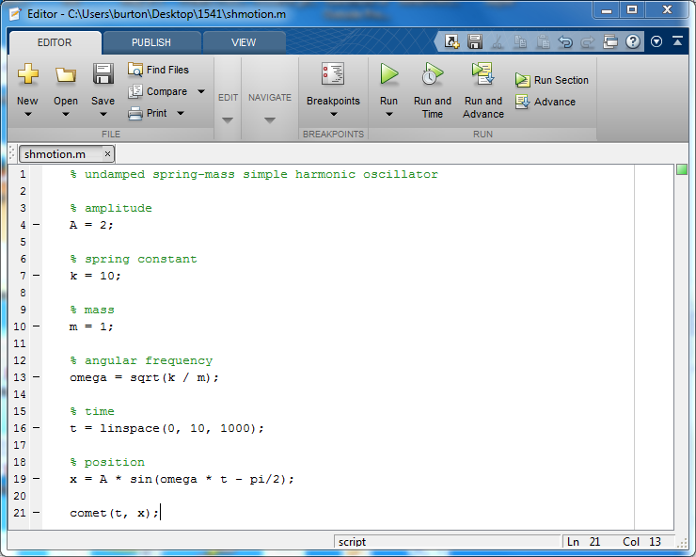

Slide 26
MATLAB Scripts
MATLAB will "run" the script if you type in the name of the script in the command window
  the script must saved in a folder that is on the current MATLAB path
    the current MATLAB path always includes the current working folder shown the MATLAB address bar
you will find it useful to organize all of your scripts and functions in a common folder
  see the path command (and its related functions)

Slide 27
MATLAB Scripts
a script can create new variables, or it can re-use existing variables in the workspace
  note: this means that a script can overwrite an existing variable in the workspace, too

