Slide 1
Computing for the Physical Sciences
CSE1541M
Notes:
login 5065

Slide 2
Who Am I?
Dr. Burton Ma
office
Lassonde 2046
hours : see syllabus on course web page
email
burton@cse.yorku.ca

Slide 3
Course Format
everything you need to know is on the course website
http://www.eecs.yorku.ca/course/1541
labs start next Tuesday (Jan 14)

Slide 4
CSE1541 Overview
an introductory programming course using MATLAB
examples and problems drawn from physics

Slide 5
What is MATLAB?
a numerical computing environment that has its own programming language
interactive: the user can enter commands and "stuff" happens
visualization: rich set of plotting functionality
programmable: the user can create programs that can be run within the MATLAB environment

Slide 6
A Quick Tour of MATLAB
the equation of a non-vertical line in 2D is:
plot the line on the domain -1 <= x <= 5

Slide 7
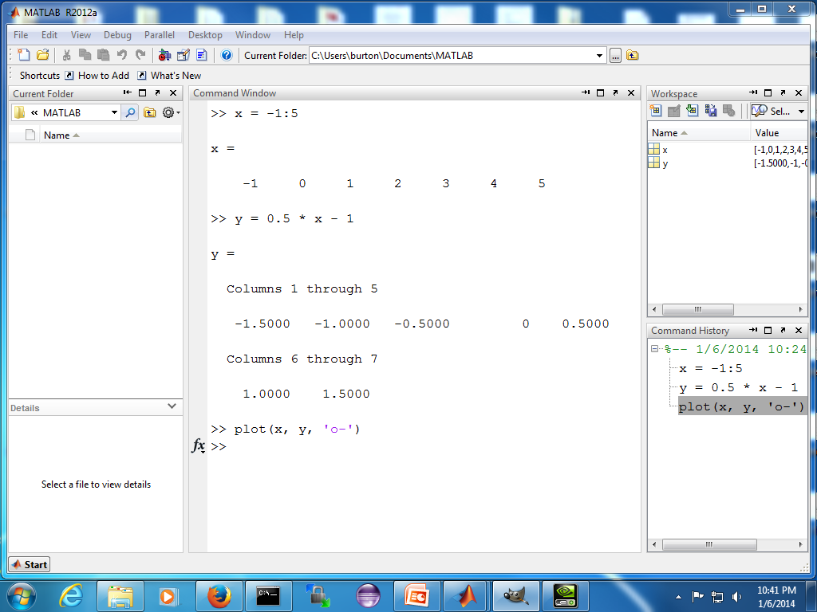

Slide 8
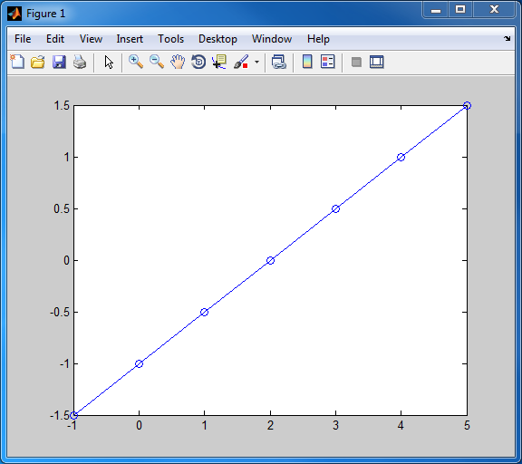

Slide 9
A Quick Tour of MATLAB
find the intersection of the two lines:

Slide 10
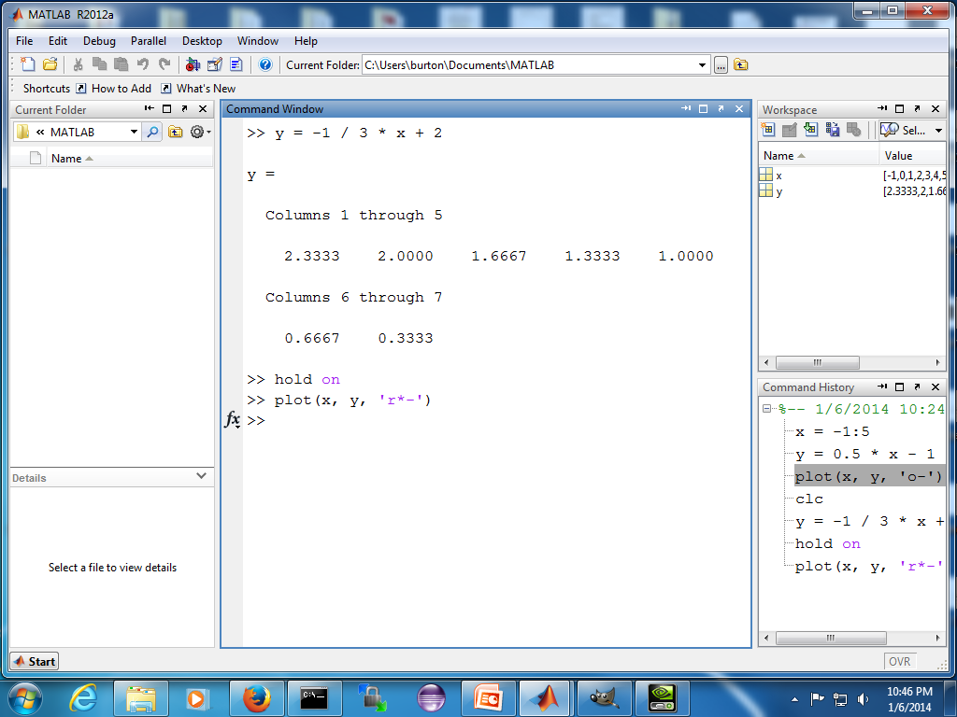

Slide 11
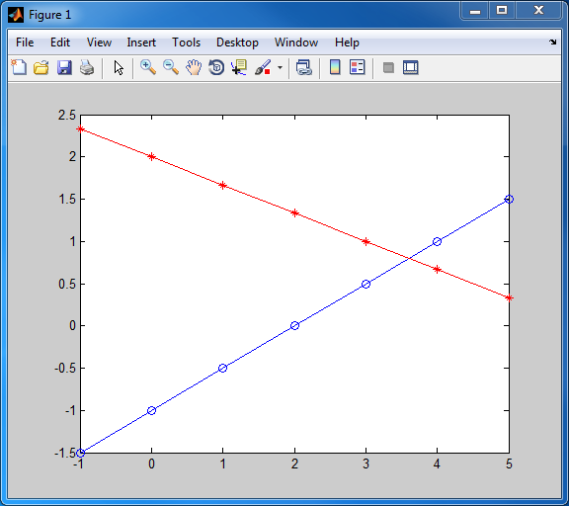

Slide 12
A Quick Tour of MATLAB
it looks like the intersection point is somewhere around
can we find the exact intersection point?

Slide 13
A Quick Tour of MATLAB
rewrite the equations of the lines as:
this system of two equations can be written in matrix form as:

Slide 14
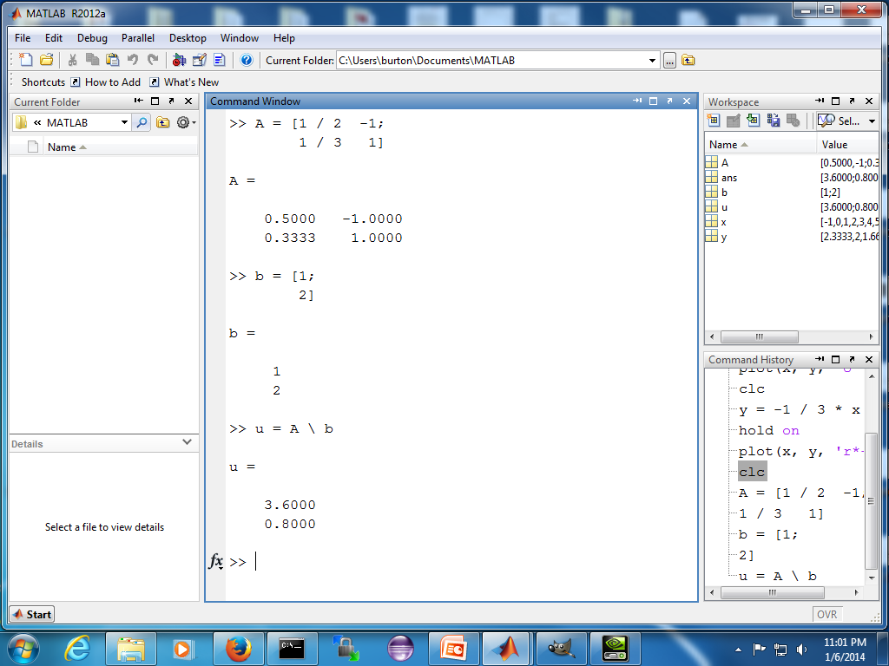

Slide 15
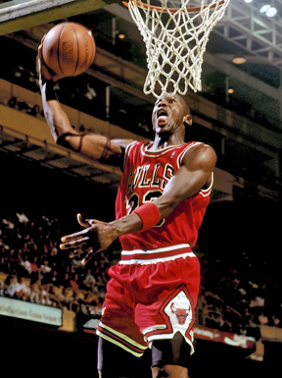
A Quick Tour of MATLAB
elite basketball players seemingly defy gravity by hanging in the air
in his prime, Michael Jordan's (MJ) vertical leap was approximately 1.2 m. Assuming g = 9.8 m/s², MJ would have to jump vertically with an initial velocity v₀ = 4.8497 m/s to achieve a maximum height of 1.2m
explain why elite jumpers appear to hang in midair

Slide 16
A Quick Tour of MATLAB
from the equations of projectile motion, we know that the vertical displacement of the jumper is given by:
let's plot y(t) for 0 <= t <= 1

Slide 17
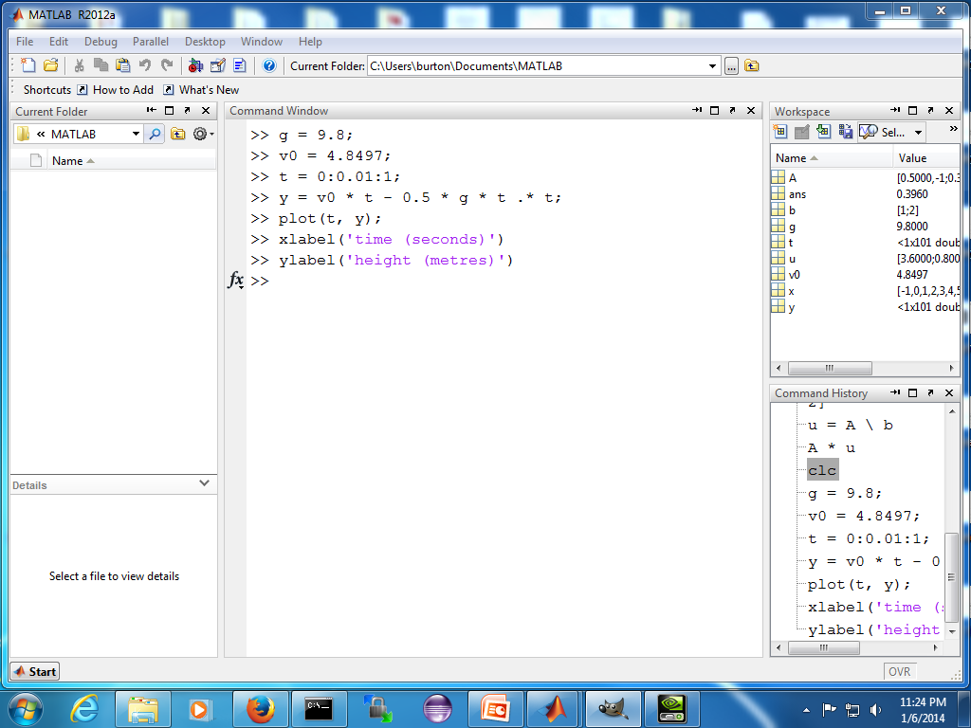

Slide 18
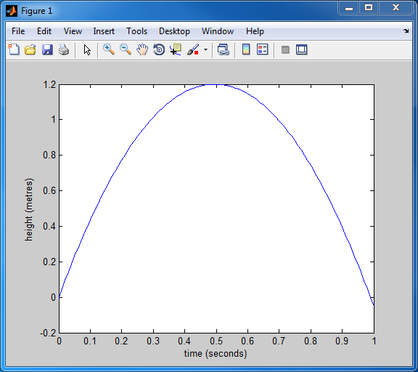

Slide 19
A Quick Tour of MATLAB
this still doesn't really explain why the jumper seems to hang mid-air
what fraction of the total time spent in the air is the jumper at a height of 1m or more?
we could solve this exactly using the quadratic equation
we could estimate this by counting the number of values of y where y >= 1

Slide 20
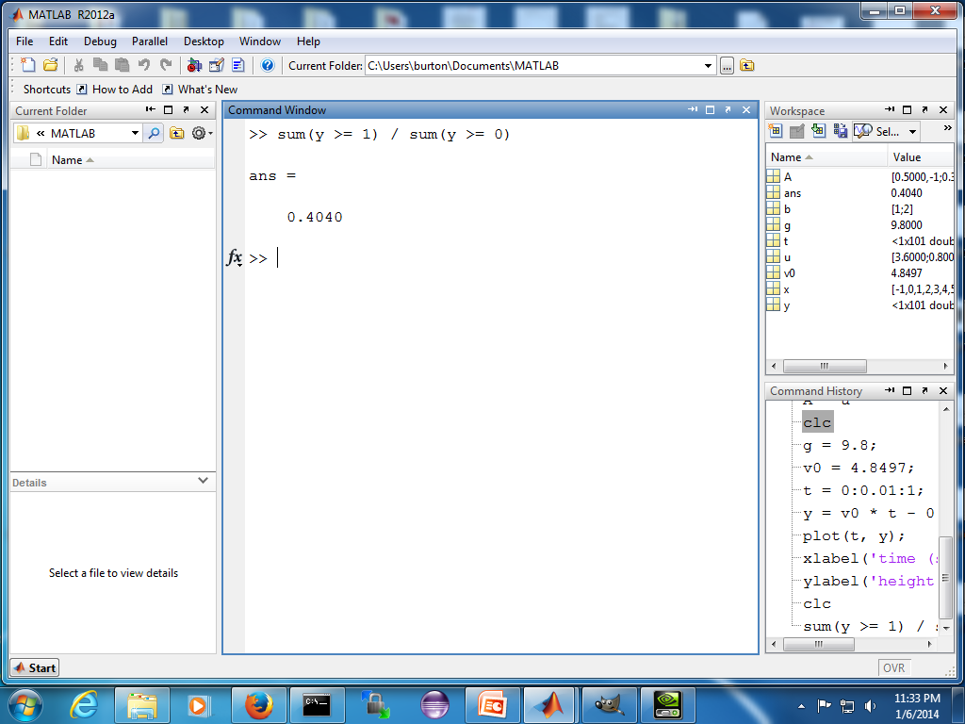

Slide 21
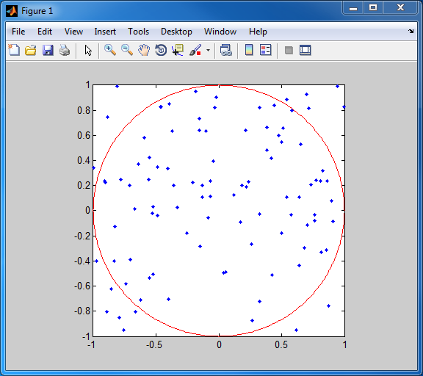
A Quick Tour of MATLAB
Monte Carlo integration is a technique for numerical integration that uses random numbers
a classic example is calculating the area of a circle of radius 1
generate n random points inside the square containing the circle
count the number of points m inside the circle
estimate the area as 4 * m / n

Slide 22
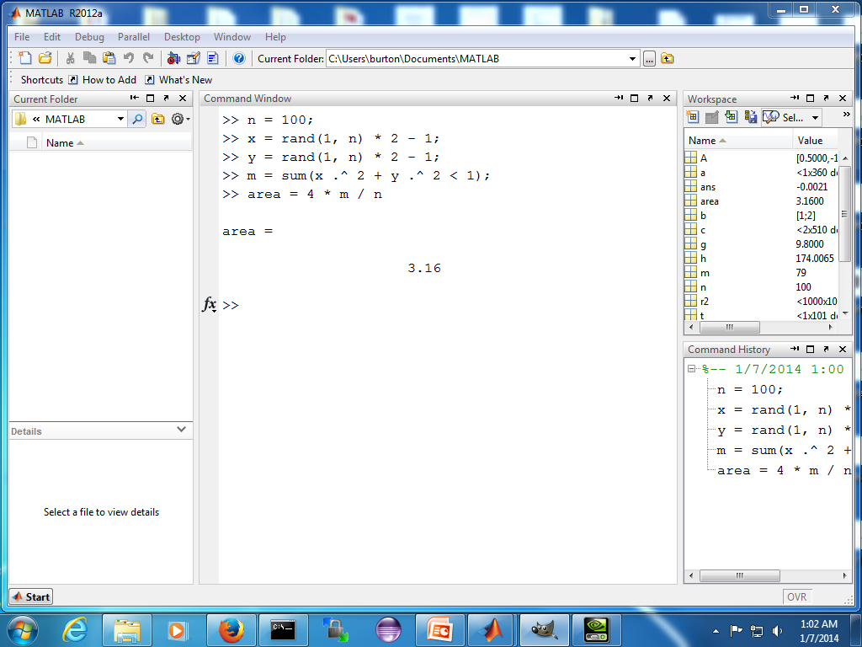

Slide 23
A Quick Tour of MATLAB
if you repeat the process, you will probably get a different answer
because the points are chosen at random

Slide 24
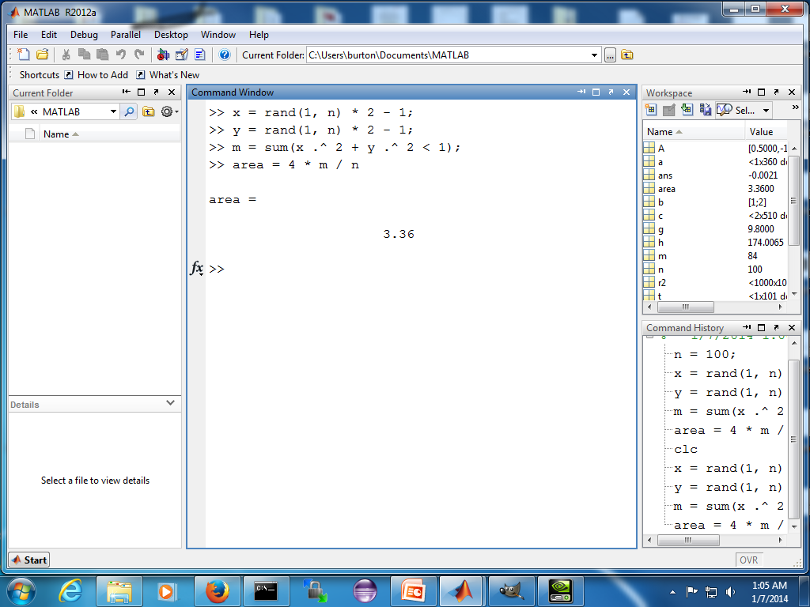

Slide 25
A Quick Tour of MATLAB
we might want to repeat the calculation many times to find out:
how much the estimate varies for a given value of n
how accurate the estimate is for a given value of n
how the precision and accuracy vary as a function of n
to repeat a calculation made up of several commands you can put the commands in a user-defined function
you (or anyone else) can then call the function with a single command

Slide 26
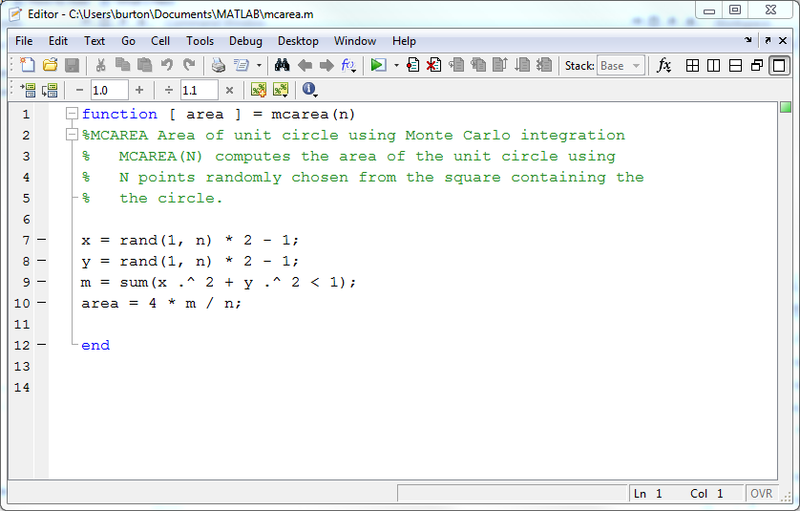

Slide 27
