Slide 1
Announcements
Study Groups for final exam
Library: Scott Library Learning Commons Room: 203A Reservation Date: 4 Dec 2013 Start Time: 11:30 am
Library: Scott Library Learning Commons Room: 203A Reservation Date: 3 Dec 2013 Start Time: 11:30 am

Slide 2
Announcements
Bethune College Hiring:
Peer Advisors, Peer Mentors, and Peer Tutors. http://bethune.yorku.ca/sos/ (http://bethune.yorku.ca/sos/) Facebook Group: Bethune College Academic Community ( Photos -> Recruitment Letters)

Slide 3
Announcements
Dr. Renda Lenton Meeting
November 27th at 5:30 PM in BC 320.Register Prior to attend: http://bethune.yorku.ca/events/lenton/
Free Food. :) :) :)

Slide 4
Recursive Objects (Part 4)

Slide 5
Trees
a tree is a data structure made up of nodes
each node stores data
each node has links to zero or more nodes in the next level of the tree
children of the node
each node has exactly one parent node
except for the root node

Slide 6
50
34
11
6
79
23
99
33
67
88
31
1
6
83

Slide 7
50
34
11
6
79
23
99
33
67
88
31
1
6
83

Slide 8
Trees
the root of the tree is the node that has no parent node
all algorithms start at the root

Slide 9
root
50
34
11
6
79
23
99
33
67
88
31
1
6
83

Slide 10
Trees
a node without any children is called a leaf

Slide 11
50
34
11
6
79
23
99
33
67
88
leaf
leaf
leaf
leaf
leaf
31
1
leaf
6
83
leaf
leaf

Slide 12
Trees
the recursive structure of a tree means that every node is the root of a tree

Slide 13
50
34
11
6
79
23
99
33
67
88
subtree
31
1
6
83

Slide 14
50
34
11
6
79
23
99
33
67
88
31
1
subtree
6
83

Slide 15
50
subtree
34
11
6
79
23
99
33
67
88
31
1
6
83

Slide 16
50
34
11
6
subtree
79
23
99
33
67
88
31
1
6
83

Slide 17
50
34
11
6
79
23
99
33
67
88
subtree
31
1
6
83

Slide 18
Binary Tree
a binary tree is a tree where each node has at most two children
very common in computer science
many variations
traditionally, the children nodes are called the left node and the right node

Slide 19
50
left
right
27
73
8
44
83
73
93

Slide 20
50
27
73
left
right
8
44
83
73
93

Slide 21
50
27
73
right
8
44
83
73
93

Slide 22
50
27
73
8
44
83
left
right
74
93

Slide 23
Binary Tree Algorithms
the recursive structure of trees leads naturally to recursive algorithms that operate on trees
for example, suppose that you want to search a binary tree for a particular element

Slide 24
public static <E> boolean contains(E element, Node<E> node) {
if (node == null) {
return false;
}
if (element.equals(node.data)) {
return true;
}
boolean inLeftTree = contains(element, node.left);
if (inLeftTree) {
return true;
}
boolean inRightTree = contains(element, node.right);
return inRightTree;
}

Slide 25
Iteration
visiting every element of the tree can also be done recursively
3 possibilities based on when the root is visited
inorder
visit left child, then root, then right child
preorder
visit root, then left child, then right child
postorder
visit left child, then right child, then root

Slide 26
50
27
73
8
44
83
74
93
inorder: 8, 27, 44, 50, 73, 74, 83, 93

Slide 27
50
27
73
8
44
83
74
93
preorder: 50, 27, 8, 44, 73, 83, 74, 93

Slide 28
50
27
73
8
44
83
74
93
postorder: 8, 44, 27, 74, 93, 83, 73, 50

Slide 29
Binary Search Trees (BST)
the tree from the previous slide is a special kind of binary tree called a binary search tree
in a binary search tree:
all nodes in the left subtree have data elements that are less than the data element of the root node
all nodes in the right subtree have data elements that are greater than the data element of the root node
rules 1 and 2 apply recursively to every subtree

Slide 30
rest of tree
not shown
50
right subtree
left subtree
27
73
8
44
51
83
74
93
76

Slide 31
Predecessors and Successors in a BST
in a BST there is something special about a node's:
left subtree right-most child
right subtree left-most child

Slide 32
rest of tree
not shown
50
right subtree
left subtree
27
73
8
44
51
83
rightmost
child
leftmost
child
74
93
rightmost child = inorder predecessor
76
leftmost child = inorder successor

Slide 33
Deletion from a BST
to delete a node in a BST there are 3 cases to consider:
deleting a leaf node
deleting a node with one child
deleting a node with two children

Slide 34
Deleting a Leaf Node
deleting a leaf node is easy because the leaf has no children
simply remove the node from the tree
e.g., delete 93

Slide 35
rest of tree
not shown
50
27
73
8
44
51
83
delete 93
74
93
76

Slide 36
rest of tree
not shown
50
27
73
8
44
51
83
74
76

Slide 37
Deleting a Node with One Child
deleting a node with one child is also easy because of the structure of the BST
remove the node by replacing it with its child
e.g., delete 83

Slide 38
rest of tree
not shown
50
27
73
delete 83
8
44
51
83
74
76

Slide 39
rest of tree
not shown
50
27
73
8
44
51
74
76

Slide 40
Deleting a Node with Two Children
deleting a node with two children is a little trickier
call the node to be deleted Z
find the inorder predecessor OR the inorder successor
call this node Y
if the inorder predecessor does not exist, then you must find the inorder successor (and vice versa)
copy the data element of Y into the data element of Z
delete Y
e.g., delete 50

Slide 41
rest of tree
not shown
delete 50
50
27
73
8
44
51
74
76

Slide 42
rest of tree
not shown
50
Z
27
73
8
44
51
74
Y
inorder
successor
to Z
76

Slide 43
rest of tree
not shown
copy Y data to Z data
51
Z
27
73
8
44
51
74
Y
inorder
successor
to Z
76

Slide 44
rest of tree
not shown
51
Z
27
73
delete Y
8
44
51
74
Y
76

Slide 45
rest of tree
not shown
51
27
73
8
44
74
76

Slide 46
Recursion and Data Structures in Computer Graphics
Ray Tracing

Slide 47
Forward Ray Tracing
imagine that you take a picture of a room using a camera
exactly what is the camera sensing?
light reflected from the surfaces of objects into the camera lens

Slide 48
Forward Ray Tracing
camera or
"eye"
light source

Slide 49
Forward Ray Tracing
forward ray tracing traces the paths of light from the light source to the camera to produce an image
computationally infeasible because almost all of the possible paths of light miss the camera

Slide 50
Backward Ray Tracing
backward ray tracing traces the paths of light from the camera out into the environment to produce an image
computationally feasible because the process starts with a single* ray per screen pixel

Slide 51
Why Ray Tracing: Shadows
shadows with ~1000 light sources
Ray Tracing for the Movie 'Cars', P. Christensen et al

Slide 52
Ray Tracing: Reflections
Ray Tracing for the Movie 'Cars', P. Christensen et al

Slide 53
Ray Tracing: Reflections
Ray Tracing for the Movie 'Cars', P. Christensen et al

Slide 54
Comment on Previous Images
most of the rendering in the previous images was not done using ray tracing
ray tracing was only used on those parts of the image that would produce a noticeable difference

Slide 55
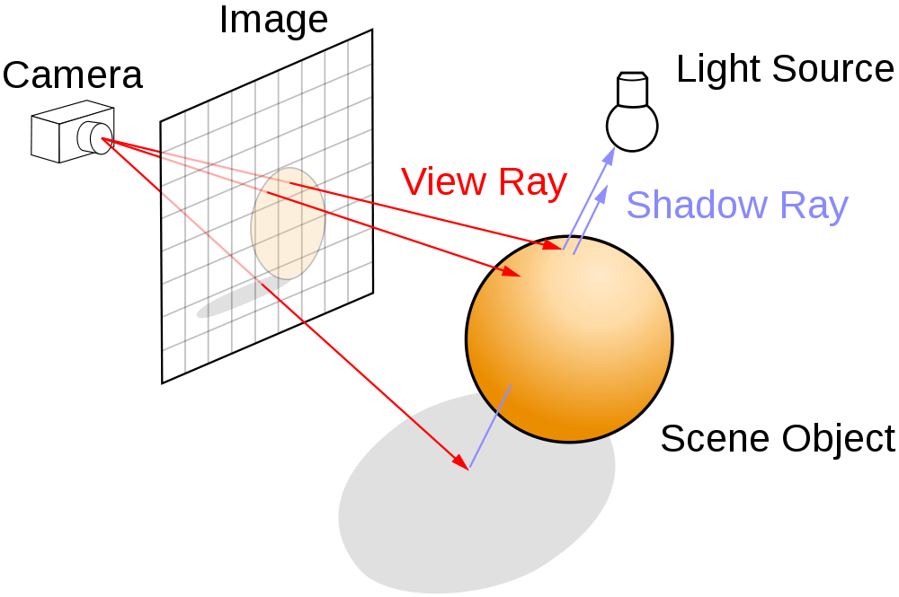
Backward Ray Tracing
http://en.wikipedia.org/wiki/File:Ray_trace_diagram.svg

Slide 56
Shadows
we can determine if a point is in shadow by tracing rays from the point to each light source
called shadow rays
if a shadow ray hits an object before it reaches the light source then the point is in shadow

Slide 57
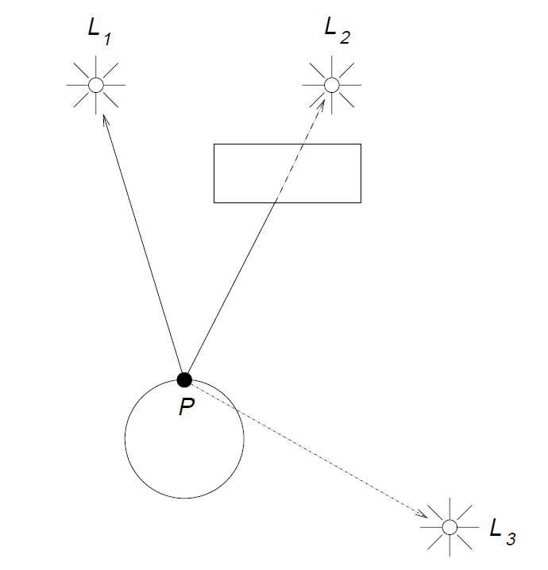
Shadows
not shadowed from L1
shadowed from L2
shadowed from L3

Slide 58
Reflections
if the ray hits a shiny object then we would like to know what reflection is seen at the hit point
we can cast a new ray in the mirror reflection direction to determine the reflection

Slide 59
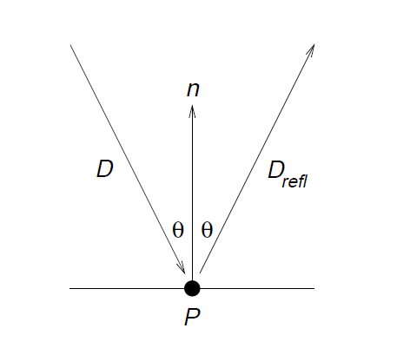
Reflections
incoming ray
reflection ray

Slide 60
Transparent Objects
if the ray hits a transparent object then we would like to know what can be seen through the object
we can cast a new ray in the refraction direction to determine what can be seen through the object

Slide 61
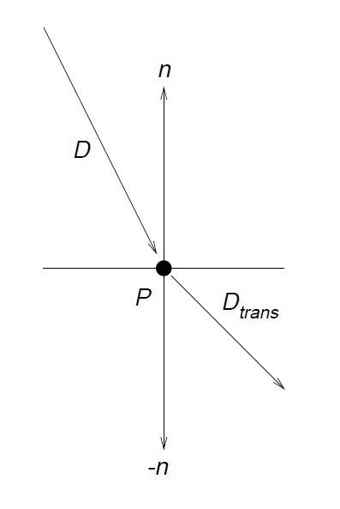
Transparent Objects
incoming ray
refraction ray

Slide 62
Recursion
each reflected and refracted ray can be treated as a new emanating from a hit point
i.e., we recursively trace the reflected and refracted rays

Slide 63
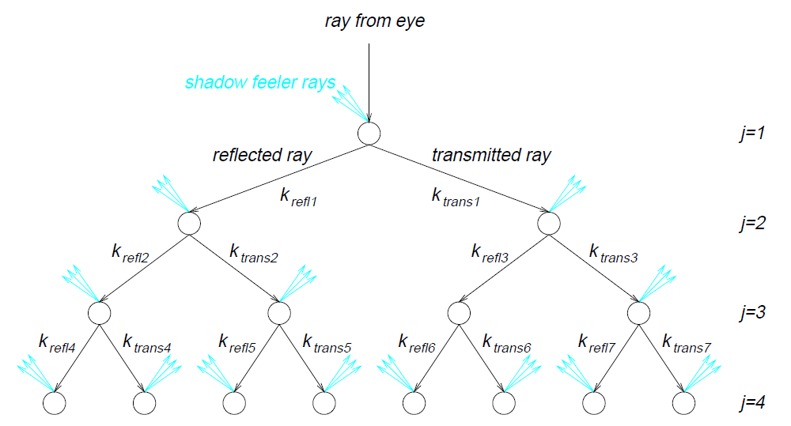
Ray Tracing as a Binary Tree
shadow rays

Slide 64
Stopping the Recursion
what are the base cases?
ray misses all objects
level of recursion exceeds a fixed value
other cases outside the scope of CSE1030

Slide 65
How Fast is Ray Tracing
approaching real time for non-cinematic quality, e.g.,
Brigade 2 game engine
NVIDA OptiX
demos here if you have a high-end NVIDIA graphics card
cinematic quality is much slower

Slide 66
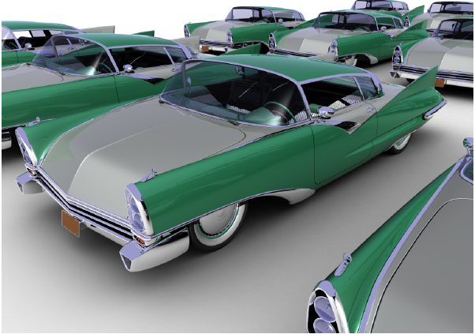
How Fast is Ray Tracing
678 million triangles
rays
111 million diffuse
37 million specular
26 million shadow
1.2 billion ray-triangle intersections
106 minutes on 2006 hardware

Slide 67
Bounding Volumes
it is easy to compute the intersection of a ray with certain shapes, e.g.,
spheres and cubes
it is hard or expensive to compute the intersection of a ray with arbitrary shapes
idea
put complex shapes inside simple ones

Slide 68
Bounding Volumes

Slide 69
Hierarchy of Bounding Volumes
why stop at putting complex shapes into bounding volumes?
why not put bounding volumes inside bounding volumes?

Slide 70
Hierarchy of Bounding Volumes

Slide 71
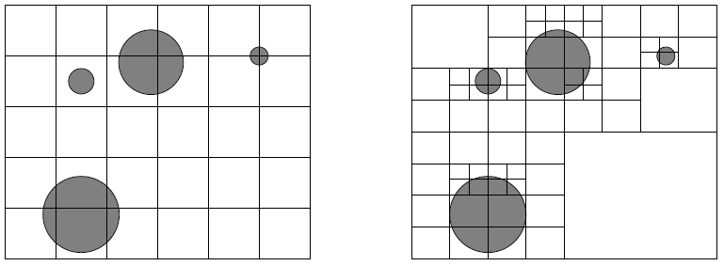
Spatial Subdivision
instead of putting objects inside volumes we can subdivide space

Slide 72
Quadtree Decomposition

Slide 73
Using a Quadtree in Ray Tracing

Slide 74
Open Source Ray Tracers
Art of Illusion
POV-Ray
YafaRay
Manta
several others

