Slide 1
Graphical User Interfaces
notes Chap 7

Slide 2
Java Swing
Swing is a Java toolkit for building graphical user interfaces (GUIs)
  http://docs.oracle.com/javase/tutorial/uiswing/TOC.html
old version of the Java tutorial had a visual guide of Swing components
  http://da2i.univ-lille1.fr/doc/tutorial-java/ui/features/components.html

Slide 3
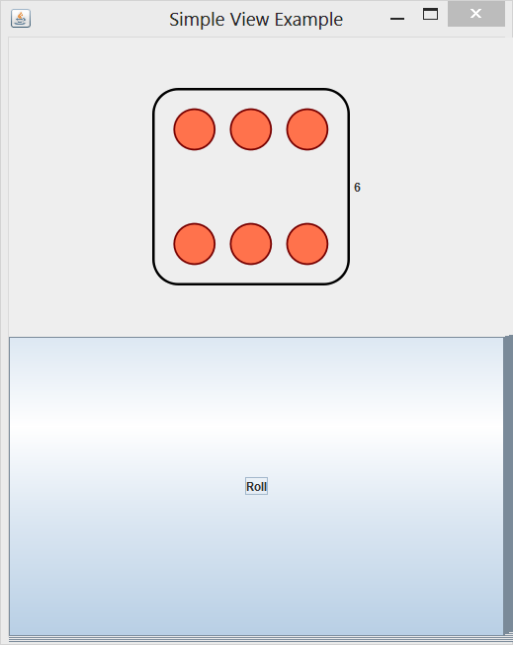
App to Roll a Die
a simple application that lets the user roll a die
  when the user clicks the “Roll” button the die is rolled to a new random value
    “event driven programming”

Slide 4
App to Roll a Die
this application is simple enough to write as a single class
  SimpleRoll.java

Slide 5
Model-View-Controller
model
  represents state of the application and the rules that govern access to and updates of state
view
  presents the user with a sensory (visual, audio, haptic) representation of the model state
  a user interface element (the user interface for simple applications)
controller
  processes and responds to events (such as user actions) from the view and translates them to model method calls

Slide 6
Model—View—Controller
TV
- on : boolean
- channel : int
- volume : int
+ power(boolean) : void
+ channel(int) : void
+ volume(int) : void
Model
View
RemoteControl
+ togglePower() : void
+ channelUp() : void
+ volumeUp() : void
Controller

Slide 7
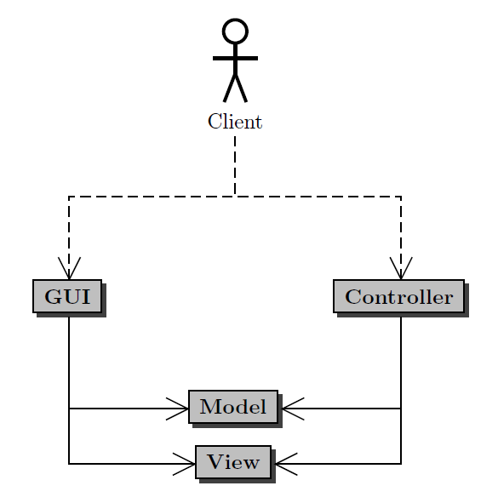
Model-View-Controller
Client uses the application (GUI)
GUI invokes Model methods and View methods
Controller invokes Model methods and View methods

Slide 8
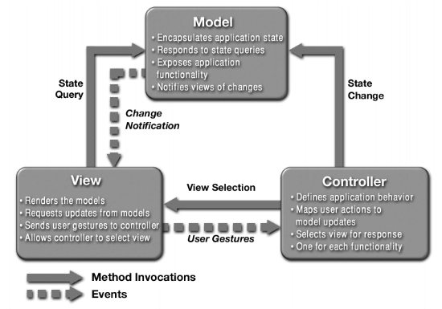
a different MVC structure than in the notes

Slide 9
App to Roll a Die: MVC
we can also write the application using the model-view-controller pattern

Slide 10
App to Roll a Die: Model
model
  the data
  methods that get the data (accessors)
  methods that modify the data (mutators)
the data
  a 6-sided die
accessors
  get the current face value
mutators
  roll the die

Slide 11
App to Roll a Die: Model
1
Die
SimpleModel
+ getValue() : String
+ roll()

Slide 12
App to Roll a Die: View
view
  a visual (or other) display of the model
  a user interface that allows a user to interact with the view
  methods that get information from the view (accessors)
  methods that modify the view (mutators)
a visual (or other) display of the model
  an image of the current face of the die
a user interface that allows a user to interact with the view
  roll button

Slide 13
App to Roll a Die: View
Swing top-level
window
JFrame
1
1
JLabel
SimpleView
+ setRoll(String)
JButton
shows an image
of the die value
allows the user to
roll the die; will emit an action event when pressed

Slide 14
App to Roll a Die: Controller
controller
  methods that map user interactions to model updates
interface for receiving action events (e.g., when a button is pressed)
« interface » ActionListener
SimpleController
+ actionPerformed(ActionEvent)

Slide 15
App to Roll a Die: MVC
SimpleModel
1
SimpleController
SimpleApp
1
SimpleView

Slide 16
App to Roll a Die
we can also write the application using the model-view-controller pattern
  SimpleModel.java
  SimpleView.java
  SimpleController.java
  SimpleApp.java

Slide 17
Simple Calculator
implement a simple calculator using the model-view-controller (MVC) design pattern
features:
  sum, subtract, multiply, divide
  clear
  records a log of the user actions
    save the log to file
    read the log from a file

Slide 18


Application Appearance

Slide 19
Creating the Application
the calculator application is launched by the user
  the notes refers to the application as the GUI
the application:
  creates the model for the calculator, and then
  creates the view of the calculator

Slide 20
CalcMVC Application
public class CalcMVC
{
public static void main(String[] args)
{
CalcController controller = new CalcController();
CalcModel model = new CalcModel();
CalcView view = new CalcView(model, controller);
controller.setModel(model);
controller.setView(view);
view.setVisible(true);
}
}

Slide 21
Model
features:
  sum, subtract, multiply, divide
  clear
  records a log of the user actions
    save the log to file
    read the log from a file

Slide 22
BigInteger:
Immutable arbitrary-precision integers
CalcModel
- calcValue : BigInteger
- log : ArrayList<String>
+ getCalcValue() : BigInteger
+ getLastUserValue() : BigInteger
+ sum(BigInteger) : void
+ subtract(BigInteger) : void
+ multiply(BigInteger) : void
+ divide(BigInteger) : void
+ clear() : void
+ save(File) : void
+ open(File) : void
- updateLog(String operation, String userValue) : void

Slide 23
CalcModel: Attributes and Ctor
public class CalcModel
{
private BigInteger calcValue;
private ArrayList<String> log;
// creates the log and initializes the attributes
// using the clear method
CalcModel()
{
this.log = new ArrayList<String>();
this.clear();
}

Slide 24
CalcModel: clear
// sets the calculated value to zero, clears the log,
// and adds zero to the log
public void clear()
{
this.calcValue = BigInteger.ZERO;
this.log.clear();
this.log.add(this.calcValue.toString());
}

Slide 25
CalcModel: getLastUserValue
// empty log looks like
// [0]
// non-empty log looks like:
// [0, +, 5, =, 5, -, 3, =, 2, *, 7, =, 14]
public BigInteger getLastUserValue()
{
if(this.log.size() == 1)
{
return BigInteger.ZERO;
}
final int last = this.log.size() - 1;
return new BigInteger(this.log.get(last - 2));
}

Slide 26
CalcModel: getCalcValue
// BigInteger is immutable; no privacy leak
public BigInteger getCalcValue()
{
return this.calcValue;
}

Slide 27
CalcModel: sum
// sums the user value with the current calculated value
// and updates the log using updateLog
public void sum(BigInteger userValue)
{
this.calcValue = this.calcValue.add(userValue);
this.updateLog("+", userValue.toString());
}

Slide 28
CalcModel: subtract and multiply
public void subtract(BigInteger userValue)
{
this.calcValue = this.calcValue.subtract(userValue);
this.updateLog("-", userValue.toString());
}
public void multiply(BigInteger userValue)
{
this.calcValue = this.calcValue.multiply(userValue);
this.updateLog("*", userValue.toString());
}

Slide 29
CalcModel: divide
// cannot divide by zero; options:
// 1. precondition userValue != 0
// 2. validate userValue; do nothing
// 3. validate userValue; return false
// 4. validate userValue; throw exception
public void divide(BigInteger userValue)
{
this.calcValue = this.calcValue.divide(userValue);
this.updateLog("/", userValue.toString());
}

Slide 30
CalcModel: save
// relies on fact ArrayList implements Serializable
public void save(File file)
{
FileOutputStream f = null;
ObjectOutputStream out = null;
try {
f = new FileOutputStream(file); // can throw
out = new ObjectOutputStream(f); // can throw
out.writeObject(this.log); // can throw
out.close();
}
catch(IOException ex)
{}
}

Slide 31
CalcModel: open
public void open(File file) {
FileInputStream f = null;
ObjectInputStream in = null;
ArrayList<String> log = null; // object to read from file
try {
f = new FileInputStream(file); // can throw
in = new ObjectInputStream(f); // can throw
log = (ArrayList<String>) in.readObject(); // can throw
in.close();
this.log = log;
final int last = this.log.size() - 1;
this.calcValue = new BigInteger(this.log.get(last));
}
catch(IOException ex) {}
catch(ClassNotFoundException ex) {}
}

