Slide 1
Inheritance
Closing Remarks

Slide 2
Object
Dog
italics = abstract
PureBreed
Mix
BloodHound
Komondor
...
concrete classes

Slide 3
UML Diagram for Interfaces
«interface»
DoubleToDoubleFunction
Square

Slide 4
UML Diagram for Interfaces
alternatively
DoubleToDoubleFunction
Square

Slide 5
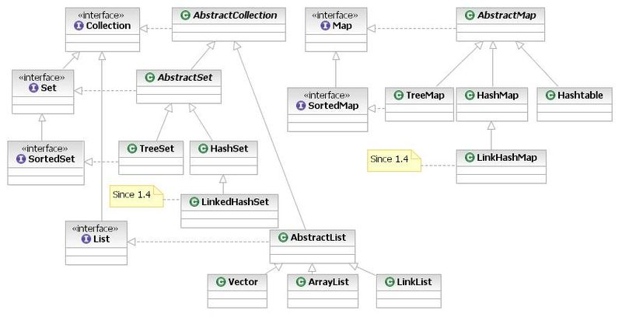
Java Collection Framework
an old version of the Collection framework
By Ervinn at en.wikibooks [CC-BY-SA-3.0 (http://creativecommons.org/licenses/by-sa/3.0) or CC-BY-SA-2.5 (http://creativecommons.org/licenses/by-sa/2.5)], from Wikimedia Commons

Slide 6
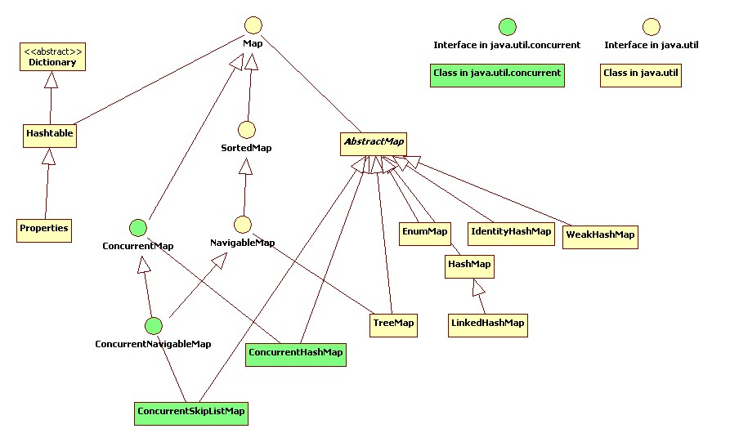
Java Map
http://en.wikipedia.org/wiki/File:Map_Classes.jpg

Slide 7
Single Inheritance, Multiple Implements
Java allows for only single inheritance of classes
a child class has only one direct parent
Java allows for multiple implementation of interfaces
a class can implement multiple interfaces
also, a class can implement an interface through multiple paths
e.g., TreeMap implements Map through:
AbstractMap (its parent class), and
NavigableMap
why is this not a problem?

Slide 8
Multiple Inheritance
some object-oriented languages support multiple inheritance
a child class can have more than one parent
http://stackoverflow.com/questions/3556652/how-do-java-interfaces-simulate-multiple-inheritance
suppose that you have unrelated Truck and Kitchen classes
Truck
Kitchen
+ driveTo(Location)
+ cook(Food)

Slide 9
Multiple Inheritance
you could implement a FoodTruck using multiple inheritance
Truck
Kitchen
+ driveTo(Location)
+ cook(Food)
FoodTruck

Slide 10
Multiple Inheritance
a problem that the implementer must deal with when using multiple inheritance is that the same feature might be inherited from different parents

Slide 11
Multiple Inheritance
suppose that you are designing software to control optical disc drives
OpticalDiscDrive
+ read()
CdDrive
DvdDrive
BluRayDrive
+ read()
+ read()
+ read()

Slide 12
Multiple Inheritance
suppose you implement a ComboDrive
which read() runs when you invoke read() on a ComboDrive?
OpticalDiscDrive
+ read()
CdDrive
DvdDrive
BluRayDrive
+ read()
+ read()
+ read()
ComboDrive

Slide 13
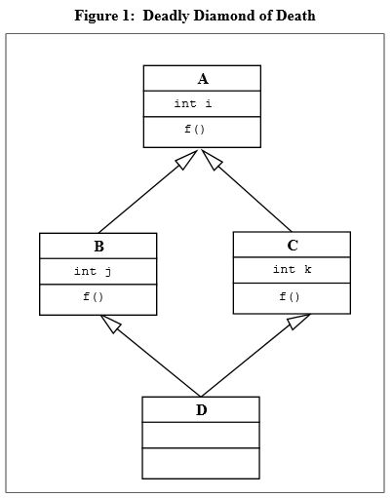
Multiple Inheritance
common fields inherited from two or more parents are also problematic
does D inherit two copies of i? Or B's copy of i? Or C's copy of i?
http://objectmentor.com/resources/articles/javacpp.pdf

Slide 14
Multiple Inheritance
multiple inheritance would also complicate Java's object model
does D have two A subobjects? Or B's A subobject? Or C's A subobject?
http://objectmentor.com/resources/articles/javacpp.pdf

Slide 15
Exercises for the Student
how could you implement FoodTruck in Java?
how could you implement ComboDrive in Java?

Slide 16
Abusing Inheritance
inheritance allows a child class to reuse fields and methods from its parent classes
i.e., it is a mechanism for code reuse
it can be very tempting to use inheritance to reuse code from a class that does something similar to what you want your class to do
e.g., consider implementing BoggleDie by extending Die

Slide 17
UML Diagram for Die
Comparable<Die>
Die
+ roll() + getFaces() : int
+ getValue() : int
+ compareTo(Die other) : int

Slide 18
Abusing Inheritance
another example:
suppose that you need a list of integers that is always in sorted order
i.e., whenever you add an integer to the list, the list reorders its elements so that the list is in sorted order
let's try extending ArrayList<Integer>

