Slide 1
Introduction to Computer Science II
CSE1030Z
Notes:
login 5065

Slide 2
Academic Support Programs: Bethune
having trouble with your FSC and LSE courses?
consider using the Academic Support Programs at Bethune College
PASS
free, informal, structured, facilitated study groups: http://bethune.yorku.ca/pass/
peer tutoring
free, one-on-one, drop-in tutoring: http://bethune.yorku.ca/tutoring/

Slide 3
Academic Support Programs: Bethune
Bethune College is looking for Class Representatives
http://bethune.yorku.ca/classreps/

Slide 4
ACM Programming Contest
http://icpc.baylor.edu
EECS team website
https://wiki.cse.yorku.ca/project/ACM
first contest
Fri Sep 13 at 13:13 in Lassonde 1004

Slide 5
Who Am I?
Dr. Burton Ma
office
Lassonde 2046
hours : see syllabus on course web page
email
burton@cse.yorku.ca

Slide 6
Course Format
everything you need to know is on the course website
http://www.eecs.yorku.ca/course/1030
labs start next Tuesday (Sep 17)

Slide 7
CSE1030 Overview
in CSE1020, you learned how to use objects to write Java programs
a Java program is made up of one or more interacting objects
each object is an instance of a class
where do the classes come from?
in CSE1030, you will learn how to design and implement classes
introduction to concepts in software engineering and computer science

Slide 8
What You Should Know from CSE1020
how to read an API
determine what package a class is located in
determine what the class/interface/field/method is supposed to do
determine the name of a method
determine what types a method requires for its parameters
determine what type a method returns
determine what exceptions might be thrown

Slide 9
What You Should Know from CSE1020
create and use primitive type variables and their associated operators
int, double, boolean, char

Slide 10
What You Should Know from CSE1020
create (using a constructor) and use reference variables
e.g., type.lib.Fraction, java.util.Date
Random, String, List, Set, Map

Slide 11
What You Should Know from CSE1020
understand the difference between primitive and reference types
memory diagrams

Slide 12
What You Should Know from CSE1020
understand the difference between == and equals

Slide 13
What You Should Know from CSE1020
use class methods (and fields)
e.g., double value = Math.sqrt(2.0);
use instance methods (and fields)
e.g., String s = "hello"; String t = s.toUpperCase();

Slide 14
What You Should Know from CSE1020
if statements
e.g. if (grade >= 65) { System.out.println("Go to second year"); } else { System.out.println("Try again"); }

Slide 15
What You Should Know from CSE1020
for loops
e.g., for some String reference s for (int i = 0; i < s.length(); i++) { char c = s.charAt(i); if (c == 'a') { System.out.println(s + " contains an \'a\'"); break; } }

Slide 16
What You Should Know from CSE1020
for each loops
e.g., for some List<String> reference t for (String s : t) { for (int i = 0; i < s.length(); i++) { char c = s.charAt(i); if (c == 'a') { System.out.println(s + " contains an \'a\'"); break; } } }

Slide 17
What You Should Know from CSE1020
the difference between aggregation and composition
the differences between aliasing, shallow copying, and deep copying

Slide 18
What You Should Know from CSE1020
inheritance and substitutability

Slide 19
What You Should Know from CSE1020
what an exception is
the difference between a checked and unchecked exception
how to handle exceptions (try and catch)

Slide 20
What You Should Know from CSE1020
style
public class hairsOnHead
{
public static void main(String[] args) {
int Diameter = 17;
double f = 0.5;
double areaCovered=f*Math.PI*Diameter*Diameter;
int d = 200;
double numberofhairs = areaCovered * d;
System.out.print("The number of hairs on a human head is ");
System.out.println(numberofhairs);
}
}
class names should start with a capital letter
inconsistent brace alignment
variable names should start with a lowercase letter; magic number
variable names should be informative; magic number
1 space around operators
variable names should be informative; magic number
variable names should use camelcase
inconsistent indenting

Slide 21
Organization of a Java Program
Packages, classes, fields, and methods

Slide 22
In This Lecture
demonstrate the use of eclipse by solving a CSE1020 eCheck problem
review the organization of a typical CSE1020 Java program
improve the organization of the program by writing a method
explain the organization of a typical Java program that uses packages and multiple classes

Slide 23
eCheck04A
in a nutshell:
write a program that computes the fraction where x, y, z, and t are proper fractions entered by a user from the command line

Slide 24
eCheck04A Sample Output
For each fraction enter its numerator/denominator,
pressing ENTER after each
Enter x
83
100
Enter y
5
9
Enter z
667
1000
Enter t
-2
3
A = 12470/3 = 4156 2/3 = 4156.666666666667

Slide 25
eclipse Demo Here
if you missed this class then you missed this demo

Slide 26
Organization of a CSE1020 Program
one file
Check04A.java

Slide 27
Organization of a CSE1020 Program
one file
Check04A.java
zero or more import statements

Slide 28
Organization of a CSE1020 Program
file
Check04A.java
zero or more import statements
one class
Check04A

Slide 29
Organization of a CSE1020 Program
file
Check04A.java
zero or more import statements
one class
Check04A
one static method
main

Slide 30
Organization of a Typical Java Program
one or more files

Slide 31
Organization of a Typical Java Program
one or more files
one package name

Slide 32
Organization of a Typical Java Program
one or more files
zero or one package name
zero or more import statements

Slide 33
Organization of a Typical Java Program
one or more files
zero or one package name
zero or more import statements
one class

Slide 34
Organization of a Typical Java Program
one or more files
zero or one package name
zero or more import statements
one class
one or more fields (class variables)

Slide 35
Organization of a Typical Java Program
one or more files
zero or one package name
zero or more import statements
one class
zero or more fields (class variables)
zero or more more constructors

Slide 36
Organization of a Typical Java Program
one or more files
zero or one package name
zero or more import statements
one class
zero or more fields (class variables)
zero or more more constructors
zero or more methods

Slide 37
Organization of a Typical Java Program
it's actually more complicated than this
static initialization blocks
non-static initialization blocks
classes inside of classes (inside of classes ...)
classes inside of methods
see http://docs.oracle.com/javase/tutorial/java/javaOO/index.html

Slide 38
Packages
packages are used to organize Java classes into namespaces
a namespace is a container for names
the namespace also has a name

Slide 39
Packages
packages are use to organize related classes and interfaces
e.g., all of the Java API classes are in the package named java

Slide 40
Packages
packages can contain subpackages
e.g., the package java contains packages named lang, util, io, etc.
the fully qualified name of the subpackage is the fully qualified name of the parent package followed by a period followed by the subpackage name
e.g., java.lang, java.util, java.io

Slide 41
Packages
packages can contain classes and interfaces
e.g., the package java.lang contains the classes Object, String, Math, etc.
the fully qualified name of the class is the fully qualified name of the containing package followed by a period followed by the class name
e.g., java.lang.Object, java.lang.String, java.lang.Math

Slide 42
Packages
packages are supposed to ensure that fully qualified names are unique
this allows the compiler to disambiguate classes with the same unqualified name, e.g., your.Fraction f = new your.Fraction(1, 3); type.lib.Fraction g = new type.lib.Fraction(1, 3);

Slide 43
Packages
how do we ensure that fully qualified names are unique?
package naming convention
packages should be organized using your domain name in reverse, e.g.,
EECS domain name eecs.yorku.ca
package name ca.yorku.eecs
we might consider putting everything for this course under the following package
ca.yorku.eecs.cse1030

Slide 44
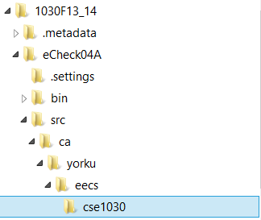
Packages
most Java implementations assume that your directory structure matches the package structure, e.g.,
there is a sequence of folders ca\yorku\eecs\cse1030 inside the project src folder
eclipse workspace folder
project folder
project sources folder
Java source files

Slide 45
Things For You to do this Week
get a CSE account if you do not already have one
do Lab 00 to get (re)acquainted with eclipse and the CSE labs
available tomorrow
review CSE1020

Slide 46
CSE1020 Review Questions

Slide 47
CSE1020 Review
what does the following program print?
public class Puzzle01
{
public static void main(String[] args)
{
System.out.print("C" + "S" + "E");
System.out.println('1' + '0' + '3' + '0' + 'z');
}
}
Notes:
CSE318
49 + 48 + 51 + 48 + 122

Slide 48
CSE1020 Review
which of the following methods are associated with a class?
static boolean disjoint(Collection<?> c1, Collection<?> c2)
void setIcon(Icon newIcon)
String toString()
static int round(double a)
static void showMessageDialog(Component parent, Object message)

Slide 49
CSE1020 Review
what is the return type for each of the following methods?
static boolean disjoint(Collection<?> c1, Collection<?> c2)
void setIcon(Icon newIcon)
String toString()
static int round(double a)
static void showMessageDialog(Component parent, Object message)

Slide 50
CSE1020 Review
how many parameters do each of the following methods have, and what are their types?
static boolean disjoint(Collection<?> c1, Collection<?> c2)
void setIcon(Icon newIcon)
String toString()
static int round(double a)
PrintStream printf(String format, Object... args)

Slide 51
CSE1020 Review
what is a method precondition
what is a method postcondition?
what happens if a precondition is violated?
who is responsible if a postcondition is false?

Slide 52
CSE1020 Review
a type.lib.Fraction object has two attributes: a numerator and a denominator
draw the memory diagram for the following program
after line 1 completes
after line 2 completes
import type.lib.Fraction;
public class Fraction1 {
public static void main(String[] args) {
Fraction f = new Fraction(1, 2); // 1
f.add(new Fraction(3, 4)); // 2
}
}

Slide 53
CSE1020 Review
class X is an aggregation of one Y; it has a method getY that returns a reference to its Y object
what are the values of sameState and sameObject?
Y y = new Y();
X x = new X(y); // x has a reference to y
boolean sameState = y.equals(x.getY());
boolean sameObject = y == x.getY();

Slide 54
CSE1020 Review
class X is an composition of one Y; it has a method getY that returns a reference to its Y object
what are the likely values of sameState and sameObject?
Y y = new Y();
X x = new X(y); // x uses composition with y
boolean sameState = y.equals(x.getY());
boolean sameObject = y == x.getY();

Slide 55
CSE1020 Review
class X is an composition of one Y; it has a method getY that returns a reference to its Y object
furthermore, Y is immutable
what are the likely values of sameState and sameObject?
Y y = new Y();
X x = new X(y); // x uses composition with y
boolean sameState = y.equals(x.getY());
boolean sameObject = y == x.getY();

Slide 56
CSE1020 Review
consider the following UML diagram
which statements are true?
Object is a CreditCard
CreditCard is an Object
RewardCard is an Object
RewardCard is a CreditCard
a CreditCard is usable anywhere a RewardCard is required
a RewardCard is usable anywhere a CreditCard is required

Slide 57
CSE1020 Review
t is a reference to a List<String> object
write some code that prints out each element of t
Notes:
for (String s : t)
System.out.println(s);

Slide 58
CSE1020 Review
p is a reference to a Map<String, Integer> object
write some code that prints out each key-value pair of p
Notes:
for (Map.Entry<String, Integer> e : p.entrySet())
System.out.println(e.getKey() + ": " + e.getValue());
for (String s : p.keySet())
System.out.println(s + “: “ + p.get(s));

Slide 59
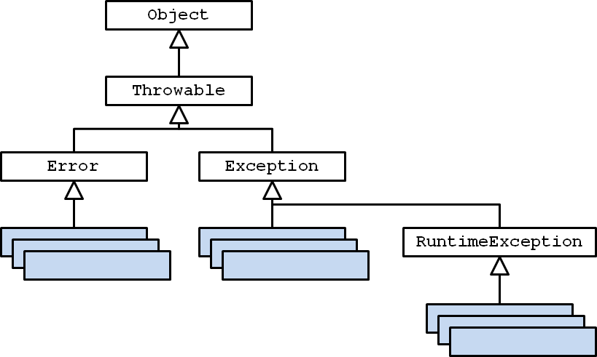
CSE1020 Review
consider the UML diagram for Java exceptions:
checked exceptions are subclasses of … ?
unchecked exceptions are subclasses of … ?

Slide 60
CSE1020 Review
consider the UML diagram for some common exceptions:
will the following code fragment compile?
try { // some legal code not shown here }
catch (IndexOutOfBoundsException e) { // not shown }
catch (StringIndexOutOfBoundsException e) { // not shown }

Slide 61
CSE1020 Review
more questions can be found here:
http://www.eecs.yorku.ca/course_archive/2011-12/F/1020/practice.shtml

