Slide 1
Target Registration Error
Fiducial Registration

Slide 2
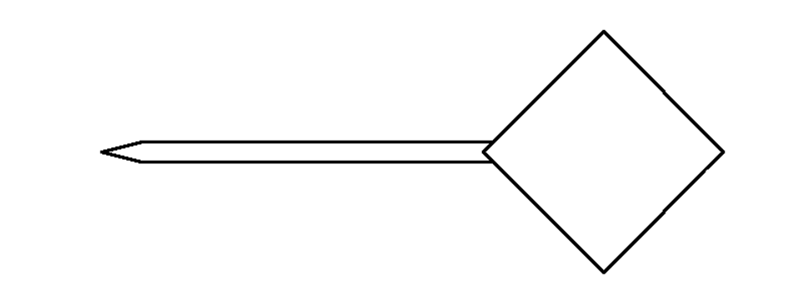
Registration Error
model pointer
Suppose we have a tracked pointing stylus with a DRB having 4 fiducial markers.

Slide 3

Registration Error
actual pointer
Because the of measurement errors in the tracking system, the locations of the
fiducial markers cannot be measured exactly. The error between the actual and
measured marker locations is called the fiducial localization error (FLE).

Slide 4
Registration Error
minimize : Σ ( FRE_{i} )²
actual pointer
model
pointer
fiducial registration
error ( FRE_{i} )
When the model pointer is registered to the measured pointer, the FLE will
lead to some error in the estimated rotation and translation. The residual
errors in the fiducial locations after registration is called the fiducial registration
error (FRE).

Slide 5
Registration Error
actual pointer
target registration
error (TRE)
Usually, we are interested in points that are not fiducial locations. Any such
point (not used for registration purposes) is called a target. The error between
the true target position and registered target position is called the target
registration error (TRE).

Slide 6
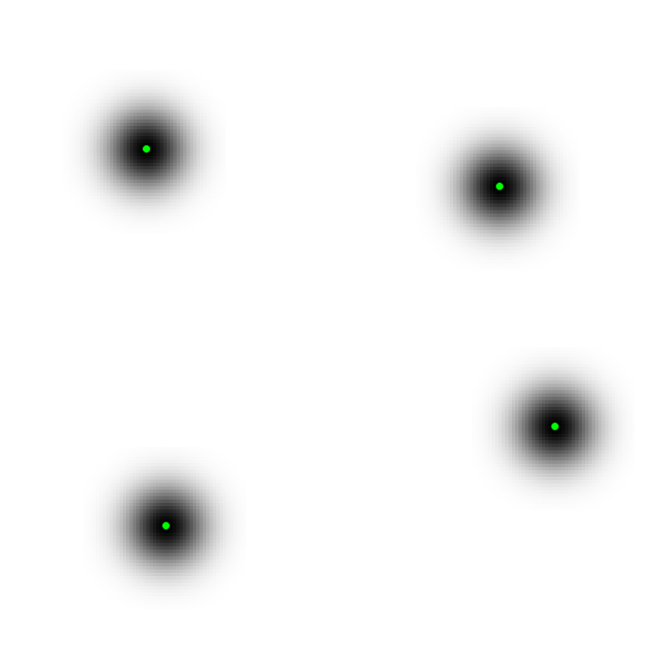
Horn's Method and FLE
Horn's method (and all other ordinary least-squares methods) is optimal when FLE is identical and isotropic
{L}
{R}

Slide 7
Horn's Method and TRE
early methods of studying the behaviour of TRE relied on simulation studies
    IEEE Transactions on Medical Imaging, vol. 16, no. 4, Aug. 1997
Given:
  a set of registration points P = {p₀, p₁, ..., p_{n-1}},
  a target point t, and
  an FLE variance σ ²:
define noise

Slide 8
Horn's Method and TRE
repeat 10,000 times
  create a noisy copy Q of P where
  register Q to P using Horn's method to obtain the rotation
  R_{j} and translation d_{j}
  compute the registered target location
  compute the squared TRE
compute the root mean squared (RMS) TRE

Slide 9
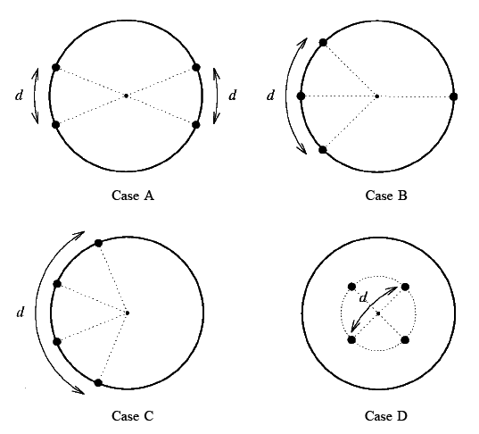
Horn's Method and TRE
simulations performed for different configurations of markers

Slide 10
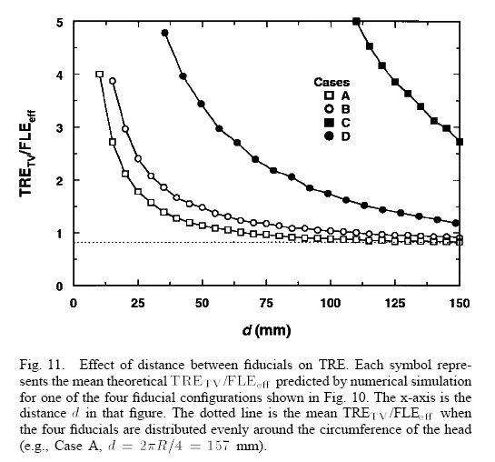
Horn's Method and TRE

Slide 11
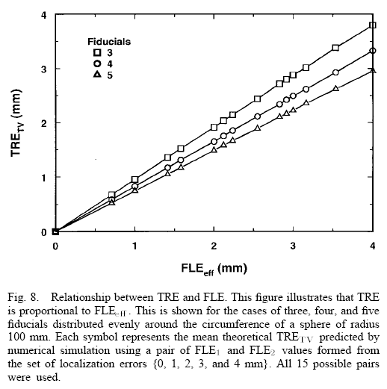
Horn's Method and TRE
simulation of TRE vs FLE

Slide 12
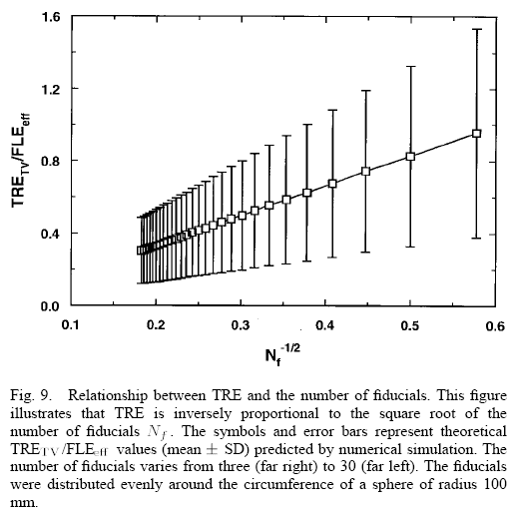
Horn's Method and TRE
simulation of TRE vs number of markers

Slide 13
Horn's Method and TRE
summary of results:
  TRE depends strongly on configuration of markers
  TRE²
  TRE²

Slide 14
Analysis of TRE
Fitzpatrick, West, and Maurer Jr performed a statistical analysis of fiducial registration (assuming identical isotropic FLE)
    IEEE Transactions on Medical Imaging, vol. 17, no. 5, Oct 1998
  t target location
  n number of markers
  d _{k} distance between the target and the k ^{th} principal axis
  f _{k} RMS distance between the fiducials and the k ^{th} principal axis
    see http://en.wikipedia.org/wiki/Moment_of_inertia

Slide 15
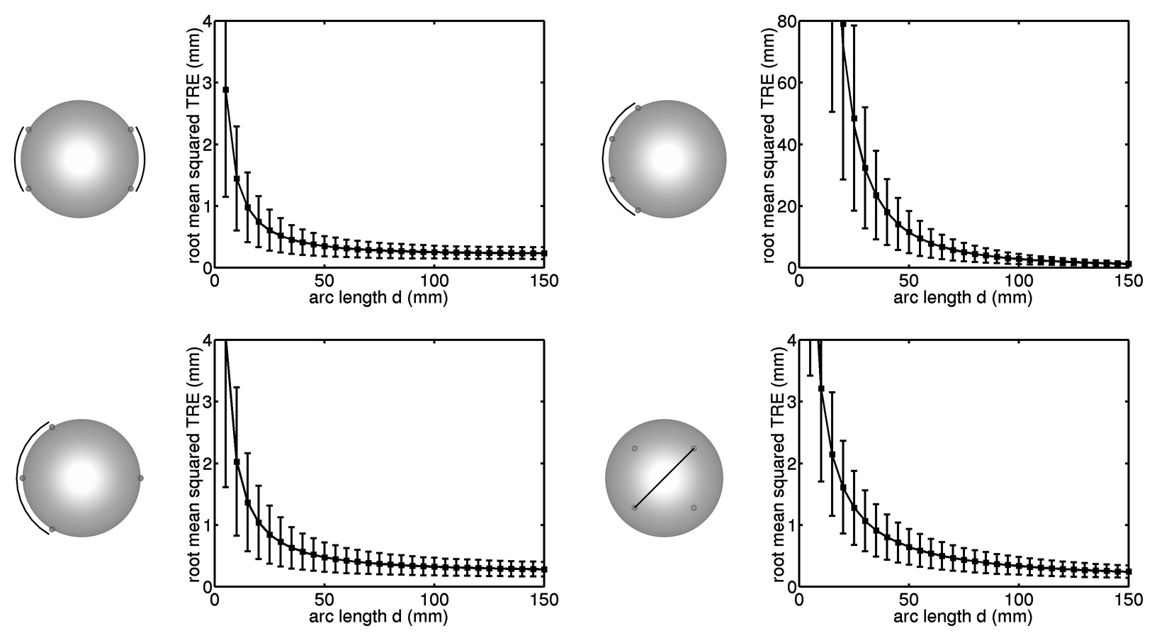
Analysis of TRE
TRE for different configurations of markers

Slide 16
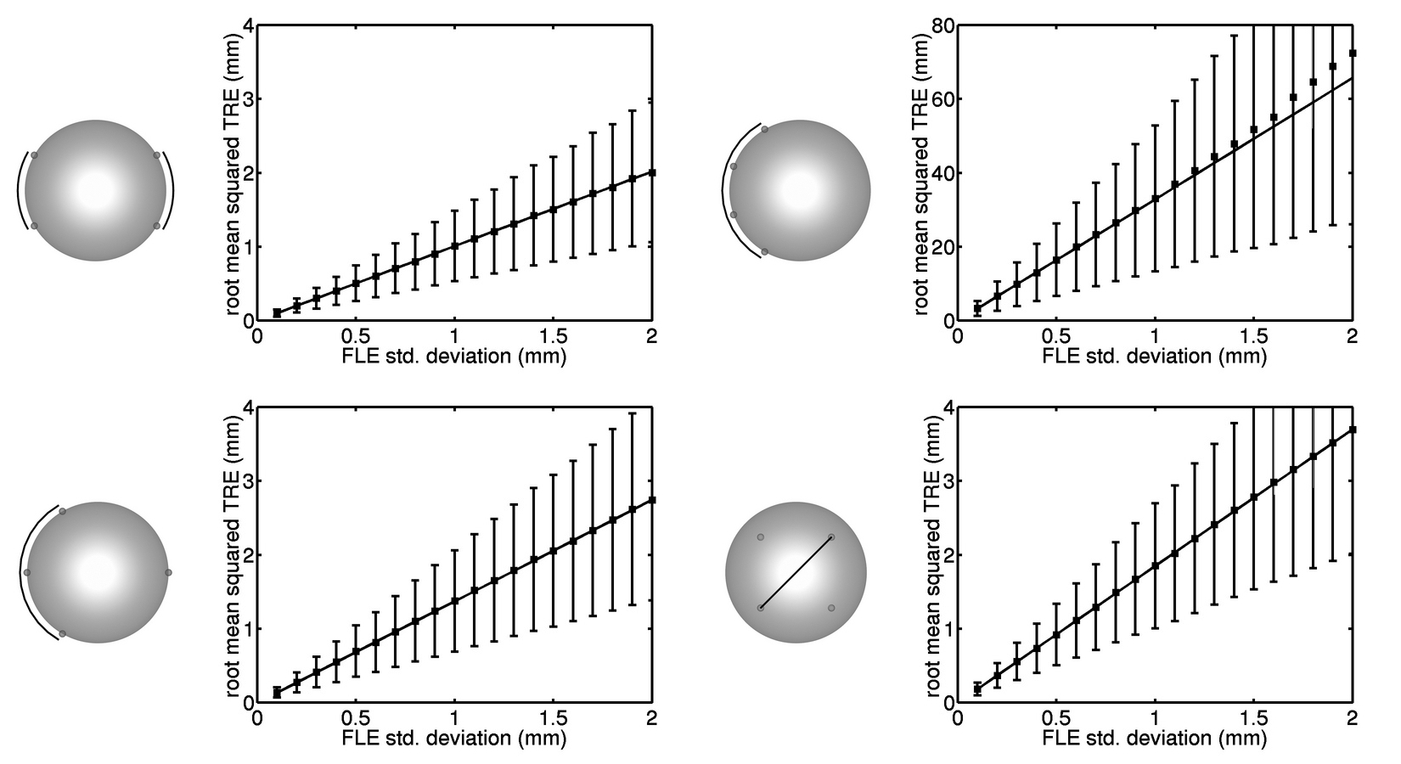
Analysis of TRE
TRE versus FLE

Slide 17
Analysis of TRE
other interesting results
  FRE is independent of the marker configuration!
  if you compute the TRE for the fiducial markers you get
    i.e., a small FRE implies a large TRE at the marker location!
    FRE is poor indicator of registration quality

Slide 18
Spatial Stiffness Analysis of TRE
a different approach to studying TRE
  B Ma, RE Ellis. A spatial-stiffness analysis of fiducial registration accuracy. In Medical Image Computing and Computer Assisted Intervention, 359 – 366.
  B Ma, MH Moghari, RE Ellis, P Abolmaesumi. Estimation of optimal fiducial target registration error in the presence of heteroscedastic noise. IEEE Transactions on Medical Imaging, 29 (3), 708 – 723.
notable because it easily generalizes to the case of heteroscedastic noise and for surface-based registration

Slide 19
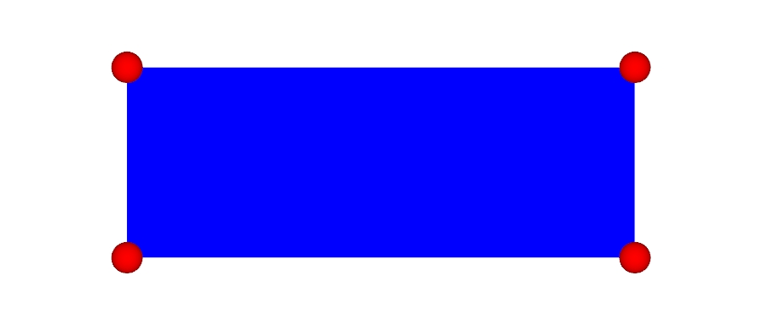
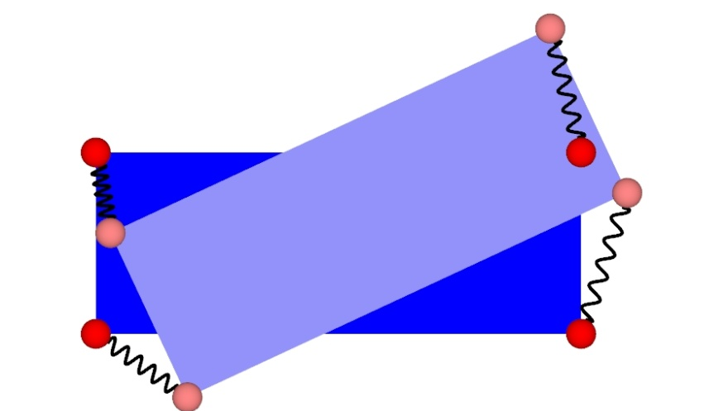
Spatial Stiffness Analysis of TRE
model the fiducial markers as a passive elastic mechanism
  behavior of an elastic mechanism is described by a spatial stiffness matrix K
  spatial stiffness matrix relates a small displacement (or twist) of the mechanism to the reaction force/torque (or wrench)

Slide 20
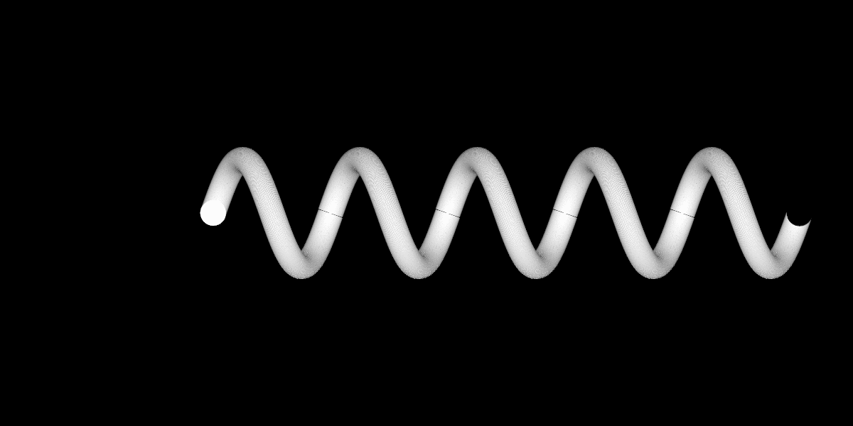
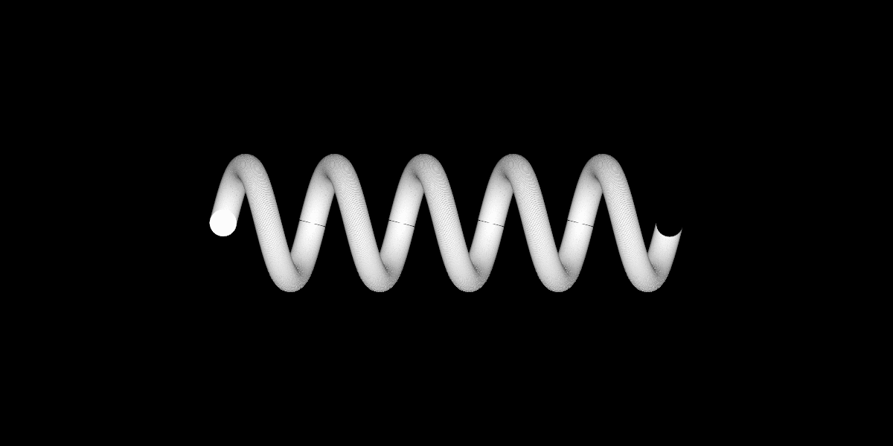
Spring Constant
x
spring
constant
energy
force

Slide 21
Spatial-Stiffness Matrix
“wrench”
stiffness
matrix
“twist”

Slide 22
Fiducial Spatial Stiffness Matrix

Slide 23
Frame Invariant Quantities
notice that K is not frame invariant
  i.e., if the marker coordinates are expressed in a different coordinate frame the stiffness matrix changes
however, it can be shown that the eigenvalues of
are frame invariant
and

Slide 24
Principal Translational Stiffnesses
the eigenvalues of A are called the principal translational stiffnesses
eigenvalues (principal translational stiffnesses)
eigenvectors

Slide 25
Principal Rotational Stiffnesses
the eigenvalues of D – B^{T}A⁻¹B are called the principal rotational stiffnesses
eigenvalues (principal rotational stiffnesses)
eigenvectors

Slide 26
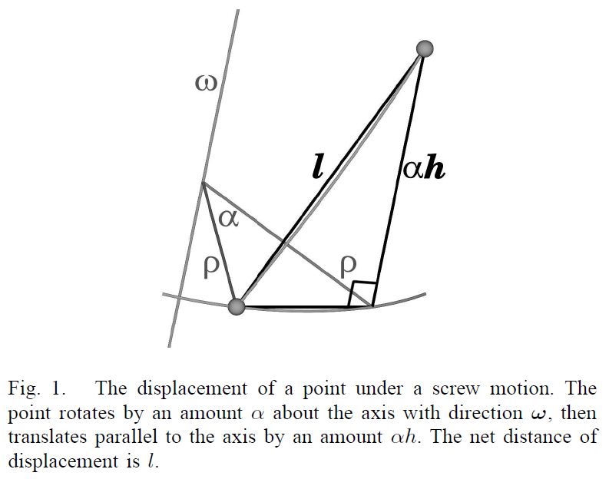
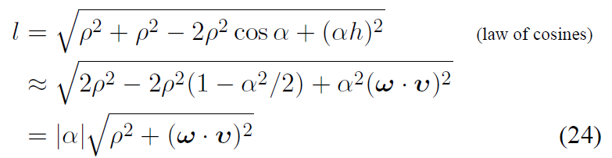
Equivalent Rotational Stiffnesses
the principal rotational stiffnesses correspond to torsional springs
it is possible to interpret them as linear springs
equivalent rotational stiffnesses

Slide 27
Spatial Stiffness TRE
now expected mean squared TRE can be expressed as

Slide 28
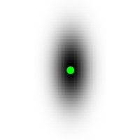
Anisotropic FLE
in most optical tracking systems, measurement error is largest along the viewing direction
{L}
{R}

Slide 29
Anisotropic FLE
suppose each point has zero-mean measurement noise with covariance matrix

Slide 30
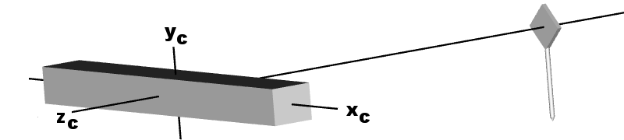
Anisotropic FLE
what happens if the DRB rotates about x-axis?

Slide 31
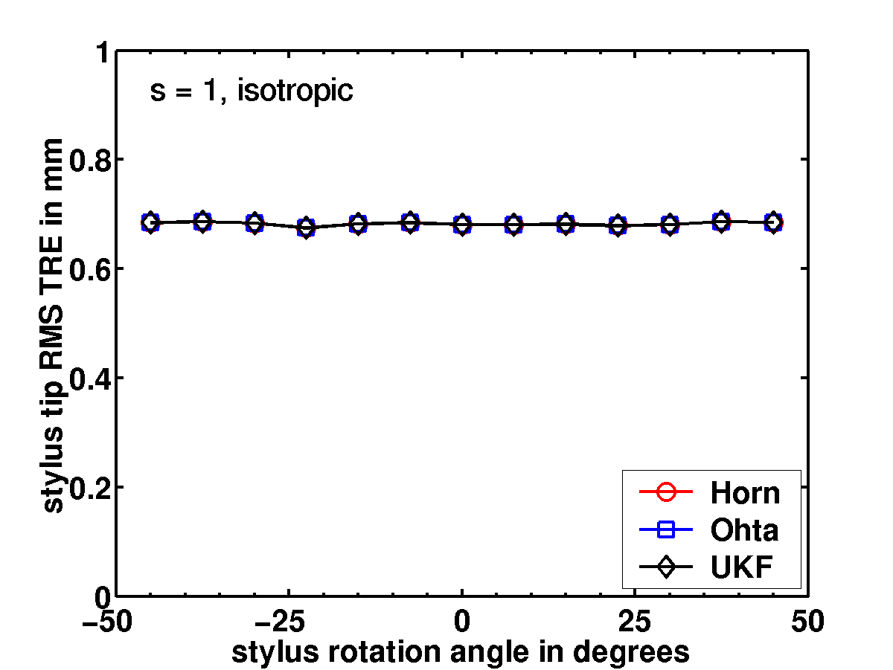
Isotropic FLE
TRE independent of rotation for isotropic noise

Slide 32
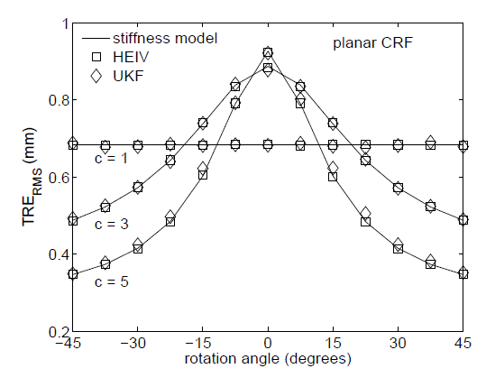
Anisotropic FLE
TRE strongly dependent of rotation for anisotropic noise

Slide 33
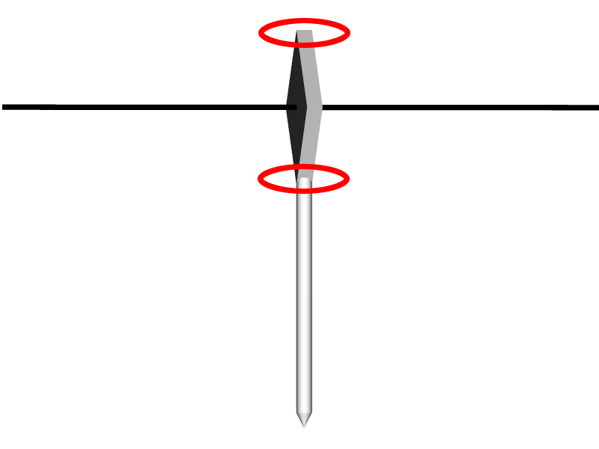
Why the Peak in TRE?
because rotational component of TRE_{RMS} is maximized when DRB faces the tracking camera

Slide 34
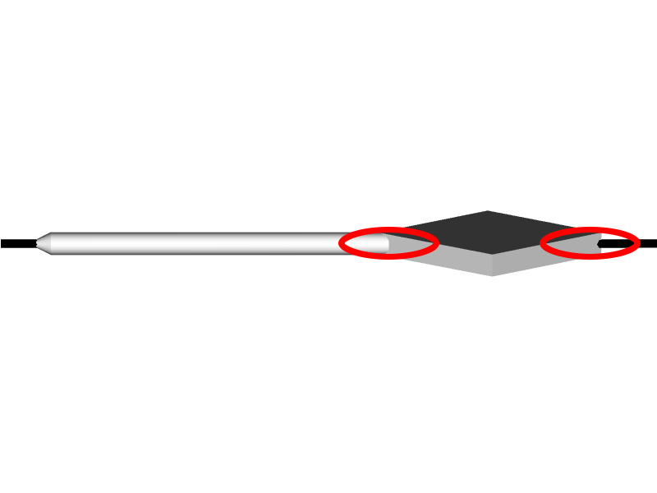
Why the Peak in TRE?
and minimized when the DRB is perpendicular to the tracking camera

Slide 35
Observed TRE
paradoxically, this behavior is exactly the opposite of what is observed in practice
  TRE is typically worse when the DRB is rotated away from the camera

Slide 36
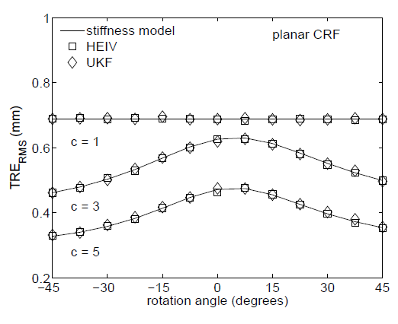
Non-planar Target
non-planar targets have better TRE behavior

Slide 37
Target Registration Error
Shape-Based Registration

Slide 38
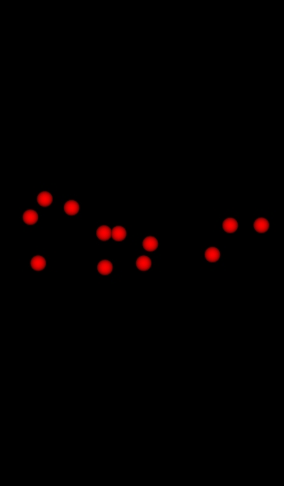
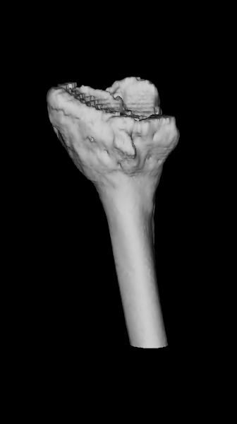
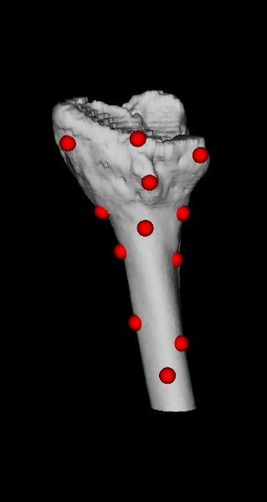
P_{n} = {p_{i=1..n}}
{L}
{R}
patient points
model
find rotation and translation that best matches
(registers) the points to the surface
registered

Slide 39
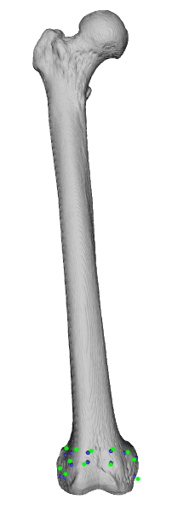
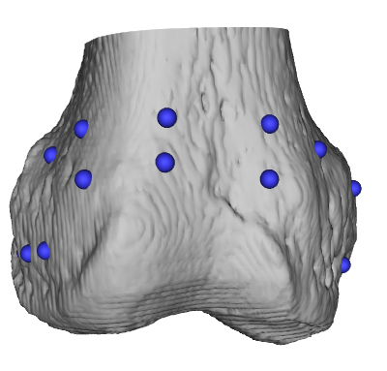
Registration Error
tracked pointing
device
x
x
target registration
error
model surface point
measured surface point
point localization
error (PLE)

Slide 40
model surface point

Slide 41
measured surface point

Slide 42
model surface normal
nearest model point
measured surface point

Slide 43
n_{i}
model surface normal
p_{i}
model surface point
nearest model point
q_{i}
measured surface point

Slide 44
Computing the Nearest Model Point
for small displacements we can assume that the model surface is locally planar
distance between measured point and nearest surface point
potential energy stored in spring

Slide 45
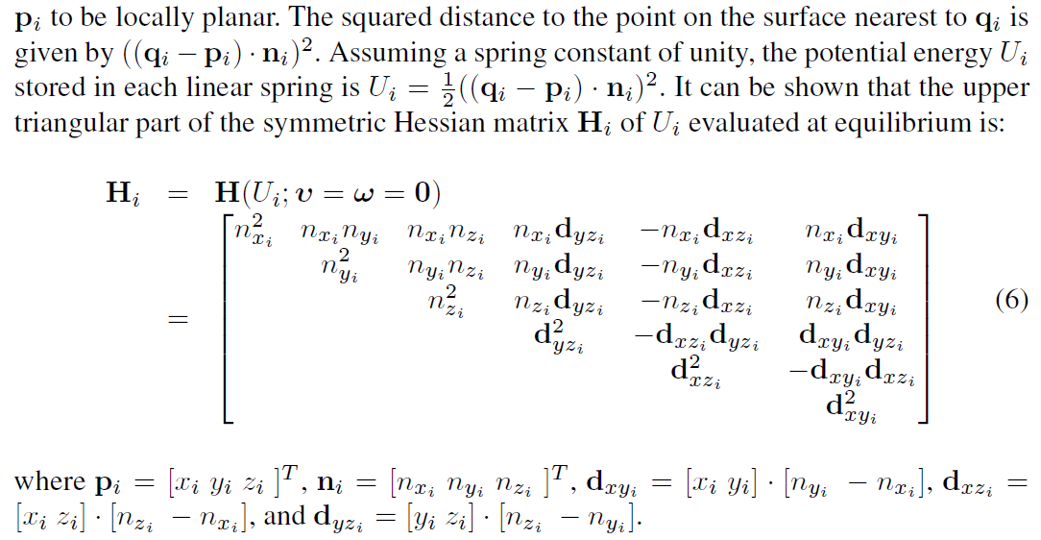
Hessian of Potential Energy

Slide 46
Hessian of Potential Energy
it turns out that there is a well known simple expression for H_{i}
this is the contribution of single simple linear spring to the stiffness matrix of a passive elastic mechanism
  S. Huang and J. Schimmels. The bounds and realization of spatial stiffnesses achieved with simple springs connected in parallel. IEEE Trans Robot Automat, 14(3):466–475, 1998.

Slide 47
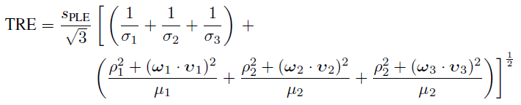
Shape-Based Target Registration Error
the stiffness matrix for shape-based registration
target registration error (identical isotropic noise)
where s_{PLE} is the expected magnitude of the point localization error

Slide 48
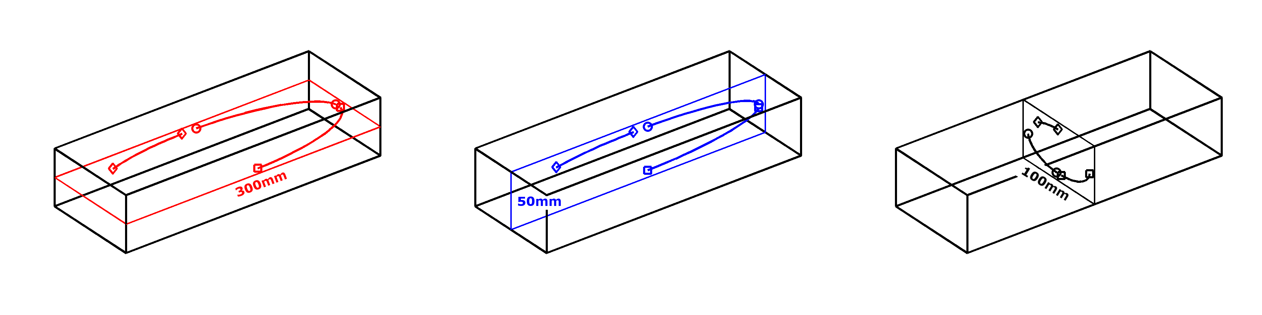
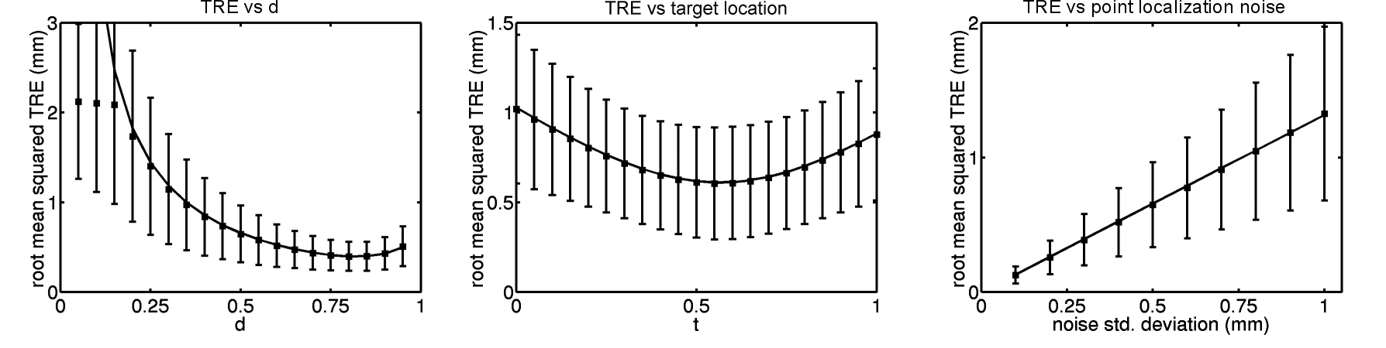
Simulation Results
using 9 points moving on the surface of an ellipsoid

Slide 49
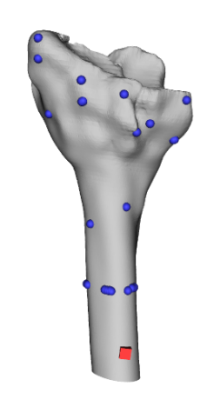
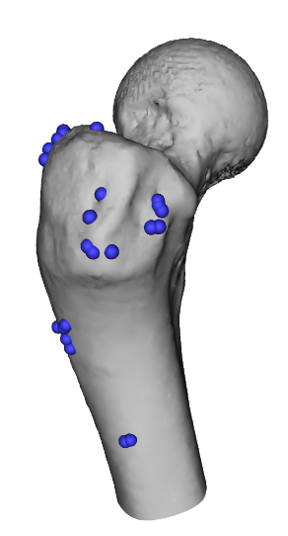
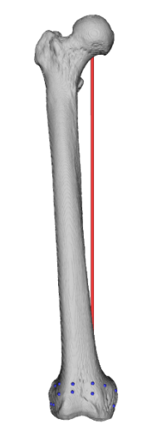
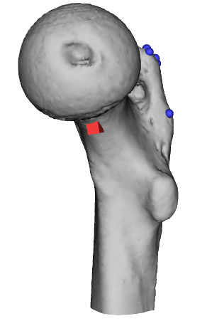
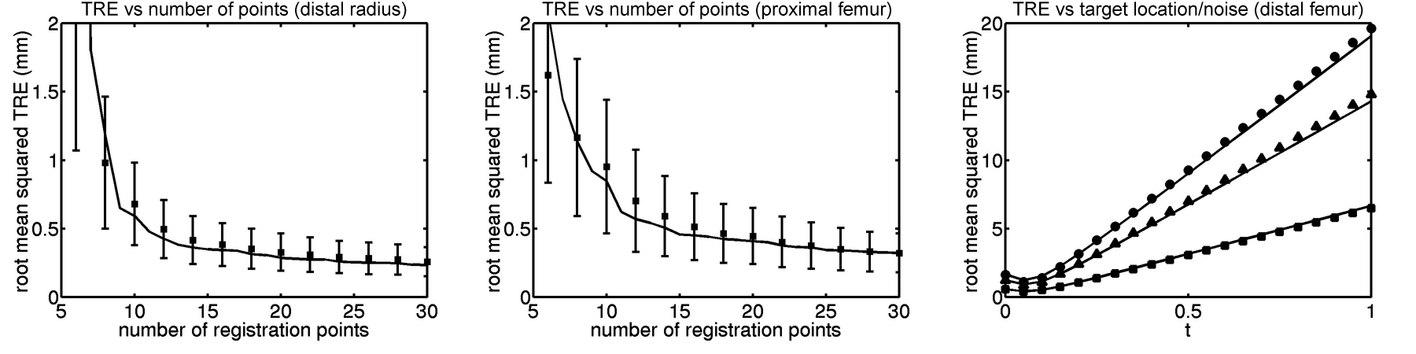
Simulation Results
using anatomic shapes

