Slide 1
Shape-based Registration

Slide 2
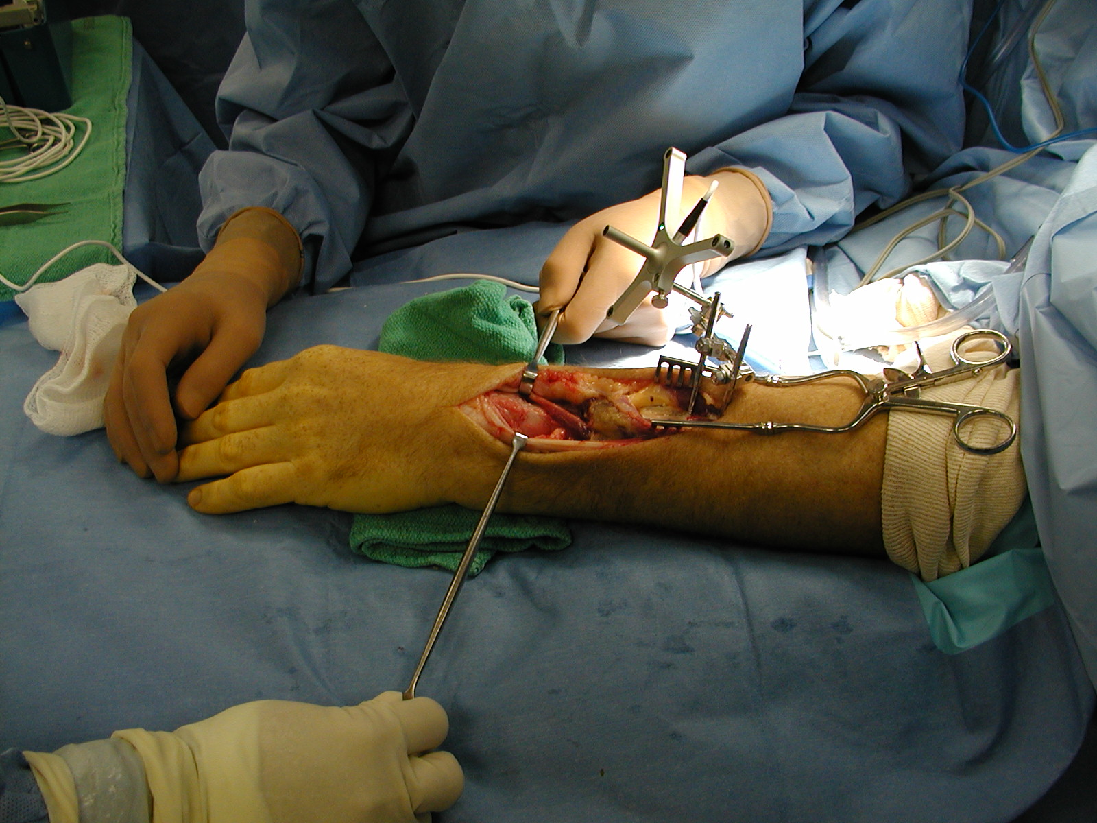

Slide 3
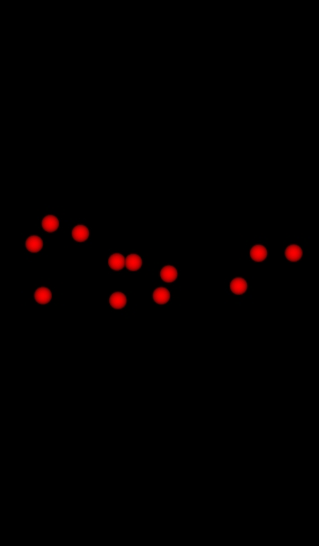
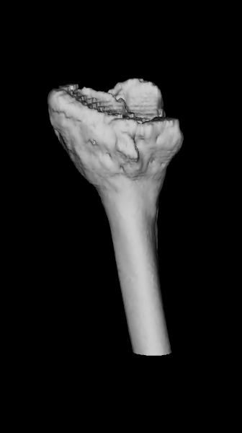
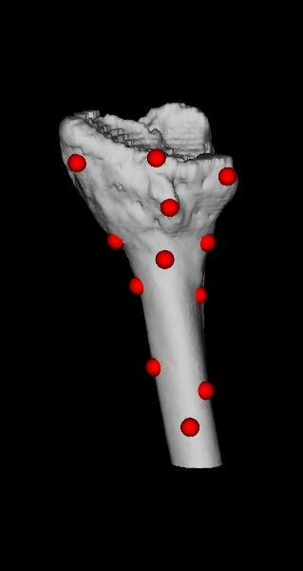
P_{n} = {p_{i=1..n}}
{L}
{R}
patient points
model
find rotation and translation that best matches (registers) the points to the surface
batch process
how many points?
where are the best points?
how do you improve a registration?
how good is the registration?
registered

Slide 4
Relationship to Absolute Orientation
notice that the shape registration problem is similar to the absolute orientation problem
the important difference is that we do not know the point correspondences
i.e., we do not know which surface point x_{i} corresponds to registration point p_{i}
if we did know the correspondences then the problem is solved; just use any solution to the absolute orientation problem

Slide 5
ICP Algorithm
iterated closest point algorithm
Besl and McKay. IEEE Transactions on Pattern Analysis and Machine Intelligence, vol. 14, no. 2, Feb 1992.
solves for the rotation and translation that best aligns a set of points to a surface
surface can have any representation that allows for a point-to-surface distance computation

Slide 6
ICP Algorithm
Find an initial guess for the rotation R and translation d.
Apply R and d to P to obtain Q₀ = {q₁, ..., q_{n}}
For k = 1, 2, ....
Find the points on the surface Y_{k} = {y₁, ..., y_{n}} closest to Q_{k-1}.
Use Horn's method to match P to Y_{k}; this yields the new estimate for R and d.
Apply R and d to P to obtain Q_{k} = {q₁, ..., q_{n}}
Compute the mean squared error
Until for some threshold value

Slide 7
ICP Algorithm
Find an initial guess for the rotation R and translation d.
Apply R and d to P to obtain Q₀ = {q₁, ..., q_{n}}
For k = 1, 2, ....
Find the points on the surface Y_{k} = {y₁, ..., y_{n}} closest to Q_{k-1}.
Use Horn's method to match P to Y_{k}; this yields the new estimate for R and d.
Apply R and d to P to obtain Q_{k} = {q₁, ..., q_{n}}
Compute the mean squared error
Until for some threshold value

Slide 8
Computational Complexity
for each iteration of ICP
compute set of closest points O(n_{p}n_{x})
compute registration using Horn's method O(n_{p})
apply registration O(n_{p})
overall O(n_{p}n_{x})

Slide 9
Accelerating Closest Point Search
common method for accelerating closest point search is to use a kd-tree
k is the dimension of the data
Jon Bentley. Communications of the ACM, 18(9), 1975.
supports O(log n) nearest neighbor queries if data is uniformly distributed

Slide 10
kd-tree
binary tree where every non-leaf node can be thought of as being on an axis aligned hyperplane that splits the hypervolume of space into two parts (called subspaces or cells)
points on the "left" side of the hyperplane are held in the left subtree of the node, and points on the "right" side of the hyperplane are held in the right subtree of the node
requires a splitting rule to determine where to put the hyperplane

Slide 11
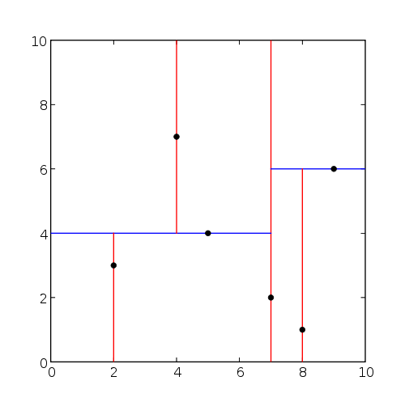
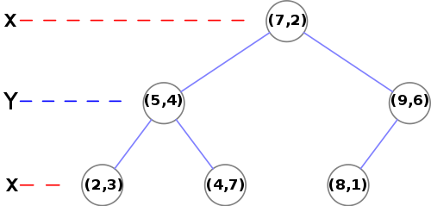
kd-tree Example
http://en.wikipedia.org/wiki/Kd-tree

Slide 12
Splitting Rules
standard split
splitting dimension is chosen to be the one for which the data points have the maximum spread
splitting value is the coordinate median
midpoint split
splitting hyperplane passes through the center of the cell and bisecting the longest side of the cell
sliding midpoint split
midpoint split attempted first; if there are no points on one side of the hyperplane then the hyperplane slides towards the data points until it reaches a data point

Slide 13
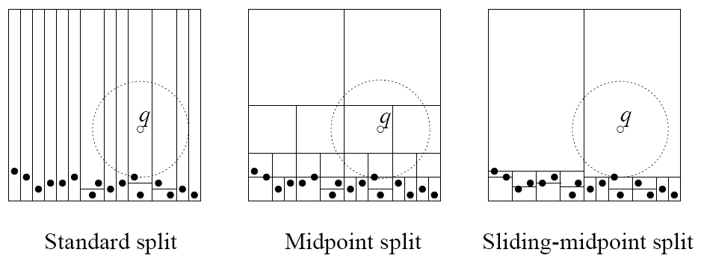
Splitting Rules
S. Maneewongvatana and D. M. Mount, 4th Annual CGC Workshop on Comptutational Geometry, 1999.

Slide 14
Nearest Neighbor Search
start at root node and descend recursively
when a leaf node is reached, save the node as the current best nearest neighbor (with distance r)
unwind the recursion, performing the following steps
if the current node is closer than the current best then it becomes the current best (update r)
check if points on the other side of the hyperplane might be closer than the current best
if the hypersphere of radius r intersects the hyperplane then the other branch of the tree must be searched
if there is no intersection then continue up the tree

Slide 15
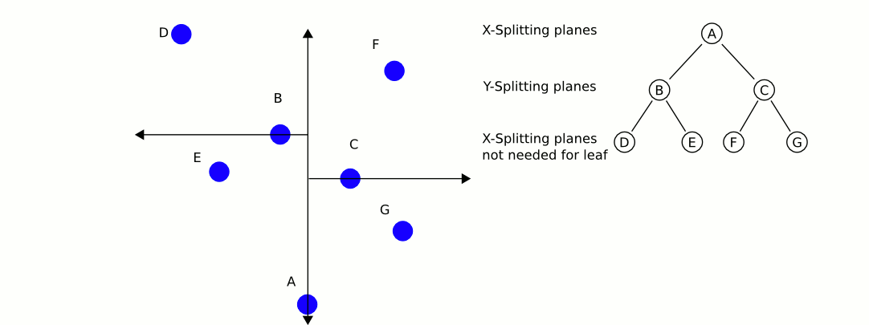
Search Animation
http://en.wikipedia.org/wiki/Kd-tree

Slide 16
Problems with Local Minima
ICP is guaranteed to converge to a minimum in the mean-squared error
there may be many local minima
the global minimum may not be the true registration

