Slide 1
Medical Imaging

Slide 2
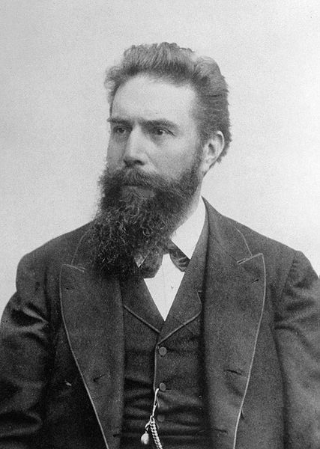
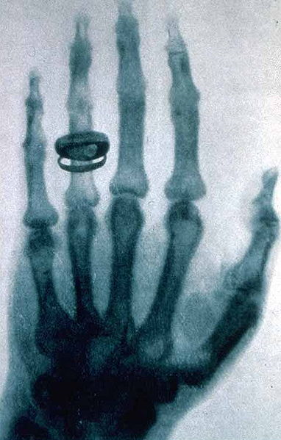
The First Revolution: X-Ray Radiography
discovered by Wilhelm Röntgen in 1895
  accidental discovery leading to the Nobel Price in 1901
  refused to patent the discovery
Notes:
X-ray imaging was the first type of medical imaging to be invented.
X-ray planar radiography is still the most common form of medical imaging. It is commonly used in orthopaedic applications (imaging of the skeletal system), dentistry, and many diseases of the soft tissues. Chest x-rays are used for detecting tuberculosis, pneumonia, lung cancer, and other diseases. Mammography uses x-ray to screen and diagnose breast cancer.

Slide 3
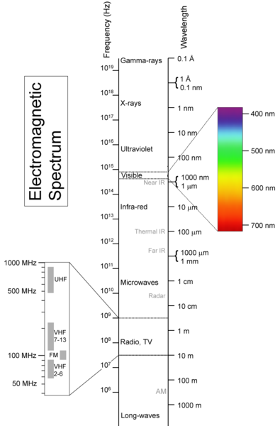
X-Rays
electromagnetic wave or photon
Notes:
X-rays are a form of short wavelength (high frequency) electromagnetic radiation. X-ray wavelength is in the range of 0.01 to 10 nanometers.

Slide 4
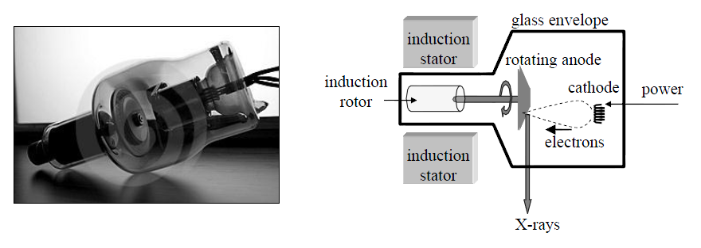
Generating X-Rays
Notes:
For medical applications, x-rays are often generated using an x-ray tube. The tube is an evacuated glass enclosure containing a tungsten wire coil (cathode) and a metal target (anode). The tube is immersed in oil for cooling and electrical insulation.
A high electric current is passed through the cathode to heat it up. When the temperature reaches approximately 2000+ degrees Celsius, free electrons in the tungsten wire have sufficient energy to leave the surface of the wire. The electrons are accelerated by an electric field between the cathode and anode which causes the electrons to strike the anode with high velocities. A small fraction of the kinetic energy of the collision is converted to x-ray radiation, with the rest of the energy being converted to heat; the anode is spun at high speed to reduce the localized heating that occurs.

Slide 5
Interaction with Matter
an X-ray image is formed by detecting the x-rays that are not absorbed by the object
for clinical radiography there are 2 main types of interactions with matter:
  photoelectric attenuation
  Compton scattering
Notes:
The basis of x-ray imaging is differential absorption of x-ray radiation; i.e., different materials absorb different amounts of the same incident x-ray beam. For example, bone typically absorbs much more x-ray radiation than the equivalent thickness of soft tissue; similarly, soft tissue absorbs much more x-ray radiation than the equivalent thickness of air. An x-ray imaging system basically consists of an x-ray source on one side of the patient and an x-ray detector on the other side of the patient.
There are two main types of interaction between x-rays and tissue. Photoelectric interaction is mainly responsible for the differential absorption between different tissue types. Compton scattering results in an x-ray being scattered from its original direction; however, the scattered x-ray might still make it through the tissue to reach the detector. This adds a random background signal to the overall image which reduces the contrast of the image.

Slide 6
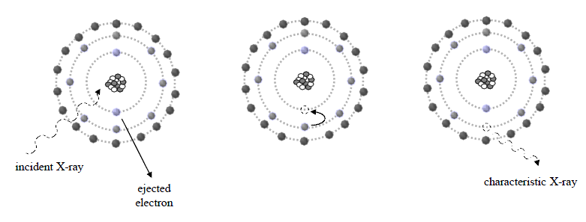
Photoelectric Attenuation
characteristic X-ray has low energy and is absorbed by tissue
net result is that the incident X-ray is completely absorbed and does not reach the detector

Slide 7
Photoelectric Attenuation
probability of a photoelectric interaction P_{pe} occurring is
Notes:
Approximate effective atomic numbers:
soft tissue 7.4
lipid (fat) 6.9
bone 13.8
The high value for bone is due to calcium.

Slide 8
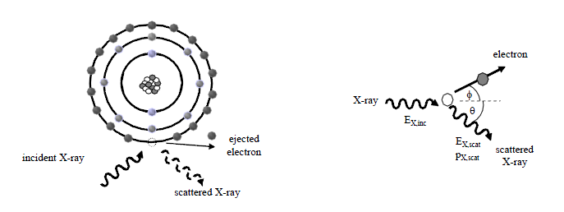
Compton Scattering
a fraction of the incident X-ray energy is transferred to a loosely bound electron causing the electron to be ejected and the X-ray to be deflected

Slide 9
X-Ray Attenuation
attenuation of X-ray through the body has been experimentally determined to be an exponential process
  number of X-rays, N, transmitted through tissue of thickness x

Slide 10
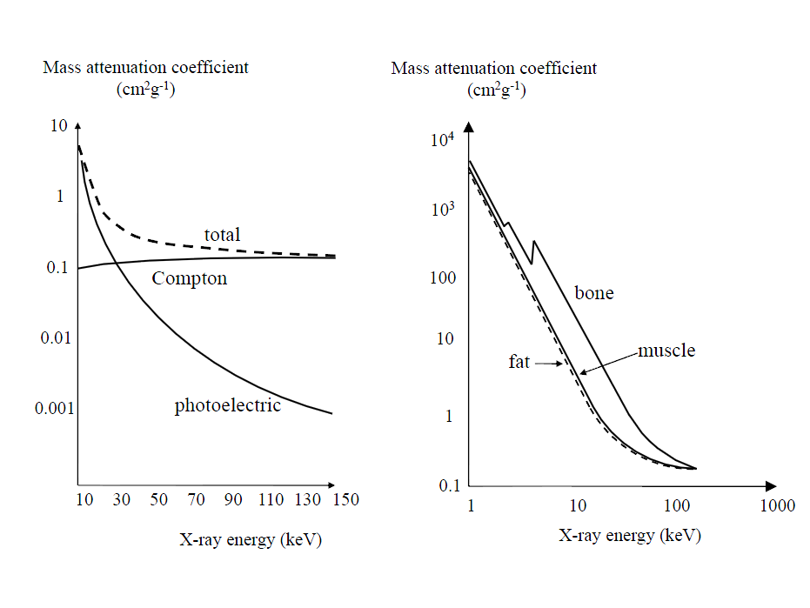
X-Ray Attenuation

Slide 11
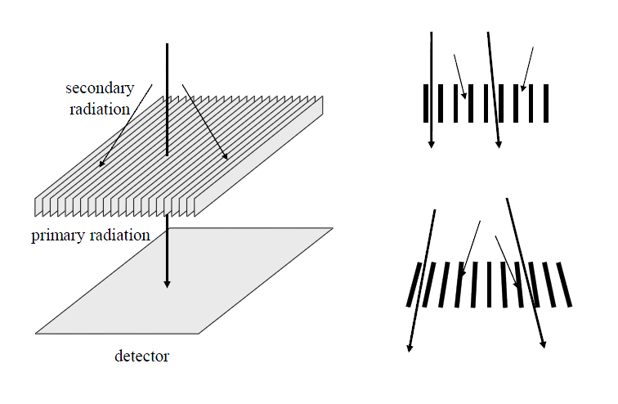
Anti-Scatter Grids
Compton scattered X-rays provide little spatial information and reduce image contrast
Notes:
Anti-scatter grids are used between the patient and the detector to filter out the contribution of Compton scattered x-rays.

Slide 12
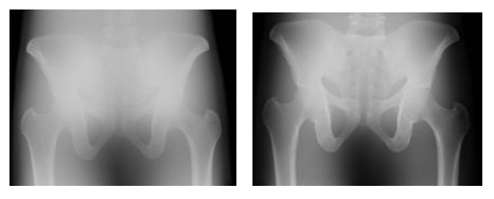
Anti-Scatter Grids
Notes:
Left: no anti-scatter grid. Notice how the image seems washed out (reduced contrast between different tissues).
Right: with anti-scatter grid.

Slide 13
Contrast Agents
a contrast agent is a chemical substance introduced into the body (orally or injected)
agent accumulates in a particular organ or structure and enhances the contrast between the structure and surrounding tissue
barium sulphate powder suspended in water is used in studies of the gastrointestinal tract
iodine based agents are used in digital subtraction angiography

Slide 14
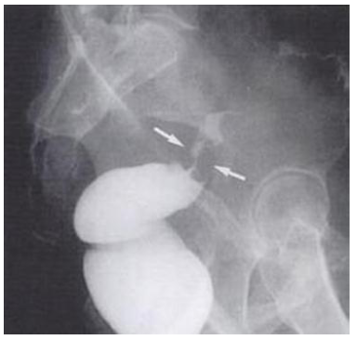
Contrast Agent
Notes:
Barium sulphate enhanced image of the colon. Barium sulphate is very good at absorbing x-ray radiation. The bright white part of the image is the colon filled with barium sulphate. The arrows indicate the presence of cancer (adenocarcinoma).

Slide 15
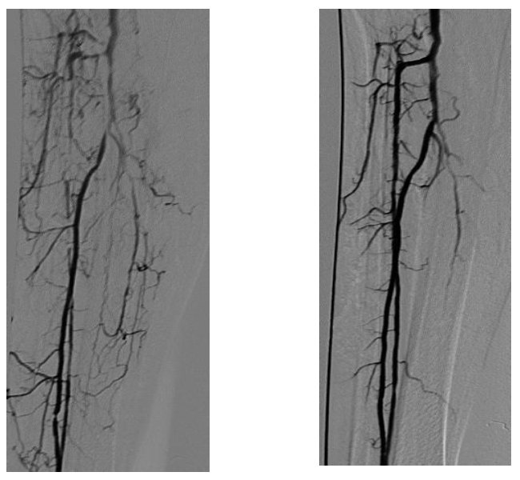
Contrast Agents
Notes:
Digital subtraction angiography is used to produce images of blood vessels. First, a normal x-ray image is acquired. Then an injection of an iodine based contrast agent is injected into the bloodstream, and a second image is acquired. The first image is then subtracted from the second image which produces an image of only the blood vessels. Such images are useful for detecting irregularities in blood flow (such as clots).

Slide 16
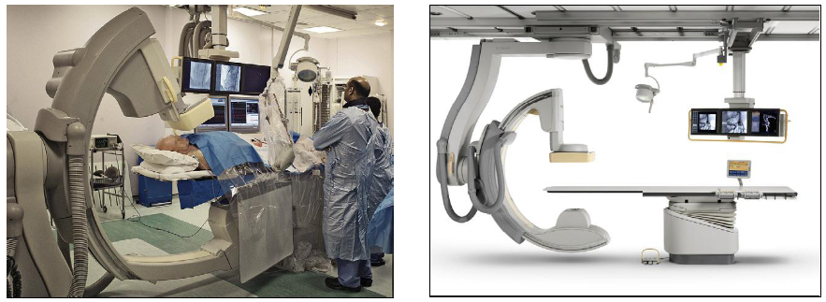
Hardware
Notes:
Intraoperatively, x-rays are used in fluoroscopic imaging. Traditionally, a fluoroscope consists of an x-ray source and an x-ray image intensifier+video camera mounted on a C-arm; video x-ray images are possible by leaving the x-ray source turned on. Modern fluoroscopes replace the image intensifier and camera with a solid state flat panel detector.
Most operating rooms use portable fluoroscopes mounted on a trolley. A technician maneuvers the fluoroscope into position and adjusts the orientation of the C-arm to take the desired image. Some (expensive) operating rooms have motorized fluoroscopes mounted to the ceiling or floor; these kinds of fluoroscopes are controlled from an instrument panel (either in the operating room or sometimes from a remote location).

Slide 17
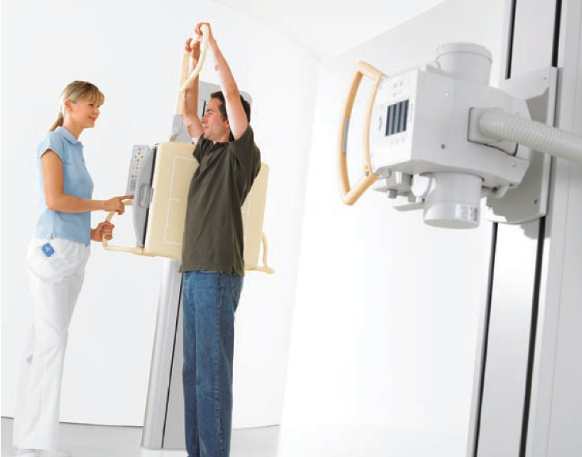
Hardware
Notes:
A modern x-ray system consists of a solid state flat panel detector that is positioned by the operator; the source moves in unison with the detector.

Slide 18
The Second Revolution: X-Ray CT
computed tomography (from the Greek ‘tomos’ meaning to slice)
Godfrey Hounsfield and Allan Cormack in 1972
  Nobel prize in 1979
  “the Beatles greatest gift”
basic principle
  2D structure of an object (X-ray attenuation coefficients) can be reconstructed from a series of 1D projections acquired at different angles
Notes:
Computed tomography (CT) or computed axial tomography (CAT) uses x-rays to produce images that look like cross-sectional slices of the body. CT was the second major advance in medical imaging. CT has been called “the Beatles greatest gift” because the technology was the technology was developed at EMI Central Research Laboratories, and EMI was the record company for the Beatles.
CT produces volumetric images, i.e., a series of images, each one coming from a different cross-section. The first CT machine required several minutes to perform the scan and then several hours to compute the series of cross sectional images. Some modern machines are capable of performing a scan in approximately one second.

Slide 19
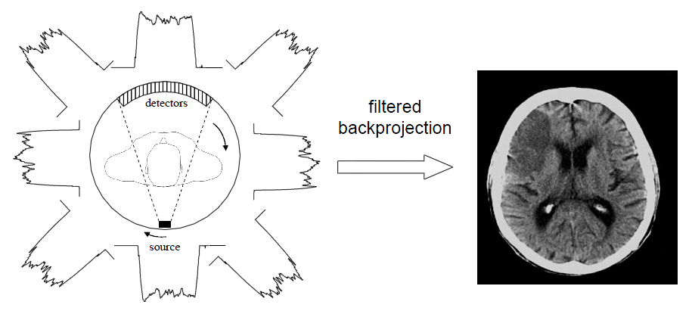
Notes:
A CT machine is basically an x-ray source and detector that is rotated around the patient. The detector measures the amount of x-ray radiation passing through the patient at many different angles of rotation. Each point in the image volume is thus “imaged” at many different rotation angles. It turns out that it is possible to take the many different detector measurements and work backwards to estimate the amount of x-ray absorption at each point in the volume. This forms the basis of each CT slice image.
Modern CT machines have multi-slice detectors; i.e., many detectors stacked together with each detector acquiring a different slice through the volume. Machines with 64 or more detectors are commercially available.

Slide 20
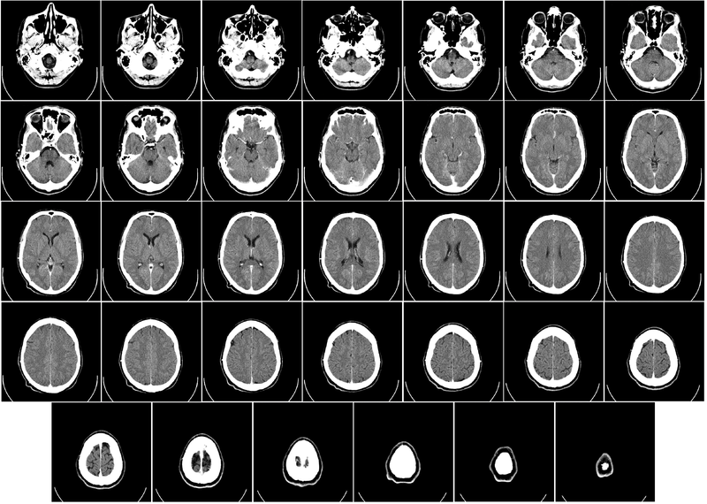

Slide 21
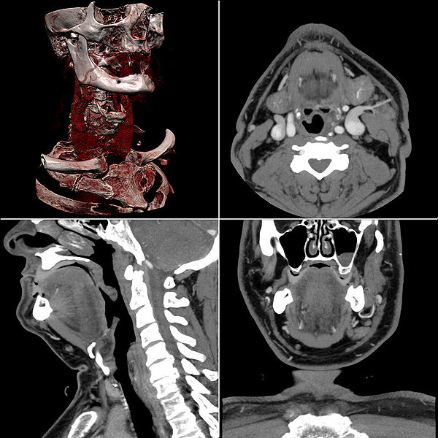

Slide 22
CT Images
in clinical machines:
  typically 512 x 512 pixels
  pixel values are in Hounsfield units (HU)
Notes:
In a CT slice image, the pixel intensities are recorded in Hounsfield units. This is just the attenuation coefficient shifted and scaled such that the attenuation coefficient of distilled water is zero and -1000 for air.

Slide 23
Numbers in a Box Puzzle
a | b | s₁=a+b
c | d | s₂=c+d
s₃ = a + c | s₄ = b + d
Notes:
There is a lot of mathematics behind computed tomography. For example, in “Introduction to the Mathematics of Medical Imaging, 2nd Edition” by Charles E. Epstein, the chapter titled “Reconstruction in X-ray Tomography” begins on page 401 with the previous 400 pages being largely mathematical preliminaries.
Consider a simpler version of the reconstruction problem where we wish to reconstruct a 2x2 image where we know only the sums of the rows and columns.

Slide 24
Numbers in a Box Puzzle
1 | 2 | s₁ = 3
3 | 4 | s₂ = 7
s₃ = 4 | s₄ = 6
Notes:
Suppose that the true pixel values are as shown. Recall that we only know the values of s₁, s₂, s₃, and s₄

Slide 25
Numbers in a Box Puzzle
a | b | s₁= 3
c | d | s₂= 7
s₃ = 4 | s₄ = 6
2.5 | 2.5 | s₁ = 3
2.5 | 2.5 | s₂ = 7
s₃ = 4 | s₄ = 6
Notes:
Assume that we know nothing about the image. We can choose, as an initial guess, to give each pixel the same value. The sum of all of the pixel values must be s₁ + s₂ (or s₃ + s₄) so a logical value to assign to each pixel is s₁ + s₂ divided by 4 (the number of pixels).

Slide 26
Numbers in a Box Puzzle
2.5 | 2.5 | s₁= 3
2.5 | 2.5 | s₂= 7
s₃ = 4 | s₄ = 6
1.5 | 1.5 | s₁ = 3
3.5 | 3.5 | s₂ = 7
s₃ = 4 | s₄ = 6
Notes:
Looking at the first row, we see that our guess results in a sum that is 2 units too large, so we adjust each value in the first row down by 1.
Looking at the second row, we see that our guess results in a sum that is 2 units too small, so we adjust each value in the second up by 1.

Slide 27
Numbers in a Box Puzzle
1.5 | 1.5 | s₁= 3
3.5 | 3.5 | s₂= 7
s₃ = 4 | s₄ = 6
1 | 2 | s₁ = 3
3 | 4 | s₂ = 7
s₃ = 4 | s₄ = 6
Notes:
Looking at the first column, we see that our guess results in a sum that is 1 unit too large, so we adjust each value in the first column down by 0.5.
Looking at the second column, we see that our guess results in a sum that is 1 unit too small, so we adjust each value in the second column up by 0.5.
Now the row and column sums are all consistent with their given values so we are done.
Of course, on a larger grid, many more iterations would be required to solve for the pixel values.
This process is called the algebraic reconstruction process. It illustrates the basic idea behind tomographic reconstruction: In the absence of any knowledge about the true image, we assume that pixel values along a row or column are uniform. For CT, replace “pixel values” with “x-ray attenuation coefficient” and “a row or column” with “the path between the x-ray source and detector”. The name of the basic reconstruction algorithm is the “filtered backprojection algorithm”.

Slide 28
Ultrasound

Slide 29
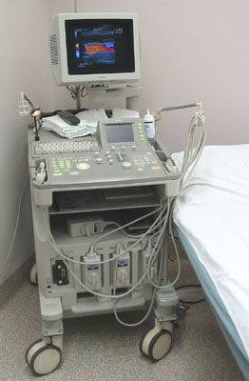
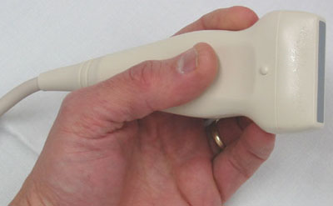
Ultrasound Imaging
ultrasound is a mechanical wave with frequency for clinical use between 1 and 15 MHz
Notes:
(Left) A typical ultrasound machine.
(Right) An ultrasound wand. The wand is held against the tissue being imaged (an internal organ if there is a surgical exposure, or the skin if imaging is being done percutaneously).

Slide 30
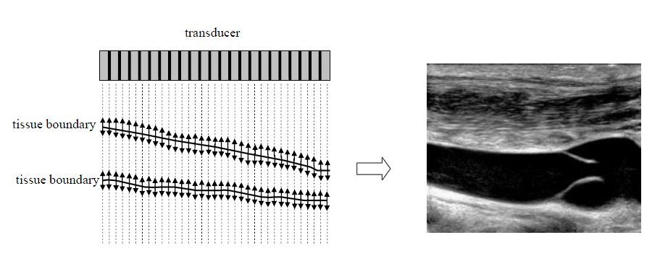
Basic Principle of Ultrasound Imaging
the ultrasound transducer sends a series of pressure waves through the tissue
  at tissue boundaries a fraction of the energy is reflected back towards the transducer where it is detected
  time between emission and detection is used to compute distance

Slide 31
Characteristics
advantages
  non-invasive
  inexpensive
  portable
  high temporal resolution (real time images)
  no ionizing radiation; generally considered a safe imaging modality
disadvantages
  noisy images
  difficulty penetrating bone and gas filled volumes
  limited depth of penetration

Slide 32
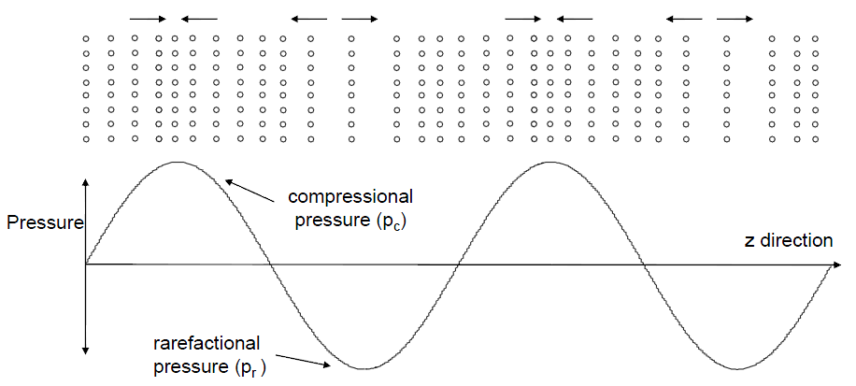
Acoustic Properties of Tissue
a simple model of tissue is a lattice of particles held together by elastic forces
  passage of US pressure wave causes particles to oscillate

Slide 33
Acoustic Properties of Tissue
ρ density
  mass per unit volume
κ compressibility
  relative volume change in response to pressure change
c speed of sound in tissue
 | c | ρ | κ
Air | 330 | 1.3 | 70000
Blood | 1570 | 1060 | 4
Bone | 4000 | 1908 | 0.3
Fat | 1450 | 925 | 5
Brain | 1540 | 1025 | 4.2
Muscle | 1590 | 1075 | 3.7
Liver | 1570 | 1050 | 3.9
Kidney | 1560 | 1040 | 4
Notes:
Several mechanical properties of tissue affect the speed of ultrasound through tissue.

Slide 34
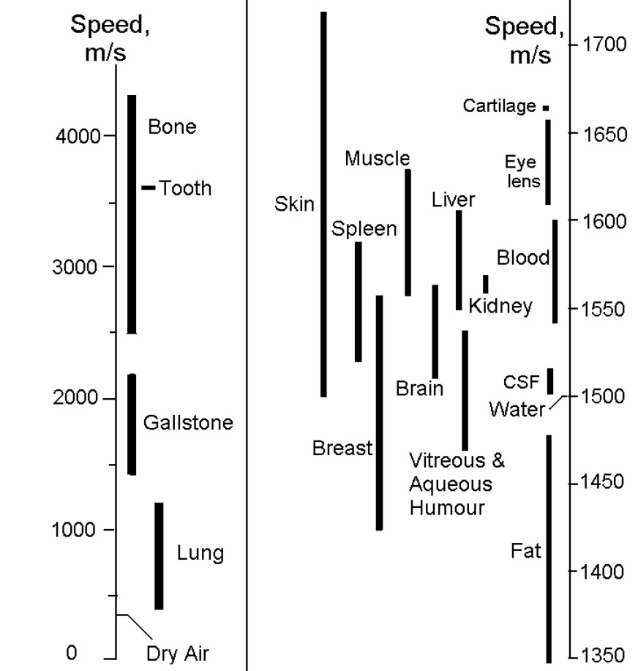
Acoustic Properties of Tissue
tissue properties have a range of values
Notes:
The speed of ultrasound through even the same tissue type is not constant; there can be wide range of values.

Slide 35
Acoustic Properties of Tissue
Z characteristic acoustic impedance
  analogous to electrical impedance
  determines behavior of US beam at the boundary of two tissues
 | Z x10⁵ | c | ρ | κ
Air | 0.0004 | 330 | 1.3 | 70000
Blood | 1.59 | 1570 | 1060 | 4
Bone | 7.8 | 4000 | 1908 | 0.3
Fat | 1.38 | 1450 | 925 | 5
Brain | 1.58 | 1540 | 1025 | 4.2
Muscle | 1.7 | 1590 | 1075 | 3.7
Liver | 1.65 | 1570 | 1050 | 3.9
Kidney | 1.62 | 1560 | 1040 | 4
Notes:
The characteristic acoustic impedance determines the behavior of the ultrasound beam at the boundary between two different tissues. If the difference in impedance is large then there will usually be a large change in the ultrasound image (it will be easy to see the boundary between the two tissues). If the difference in impedance is small then the boundary will be less apparent.

Slide 36
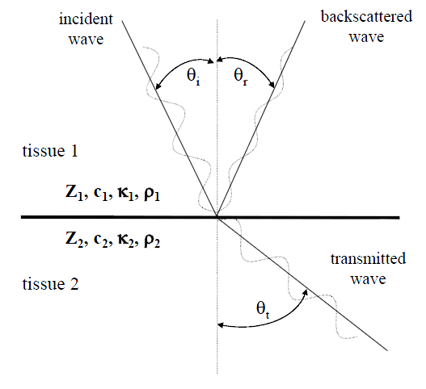
Wave Reflection, Transmission, and Refraction
at tissue boundaries, differences in acoustic impedance determine the fraction of the US beam that is reflected and transmitted

Slide 37
Wave Reflection, Transmission, and Refraction
angles are related by
Notes:
The angles for the incident wave and backscattered wave are the same (perfect reflection of the incident wave).
The angle for the transmitted wave is related to the incident wave angle by Snell’s law (which you may have seen in physics or computer graphics): the ratio of the sines of angles is equal to the ratio of the speeds of ultrasound in the two tissues.

Slide 38
Wave Reflection, Transmission, and Refraction
intensities are related by
Notes:
The intensities of the waves are typically expressed as ratios (to the incident wave intensity). These equations are typically derived in a second or third year undergraduate physics course in waves.

Slide 39
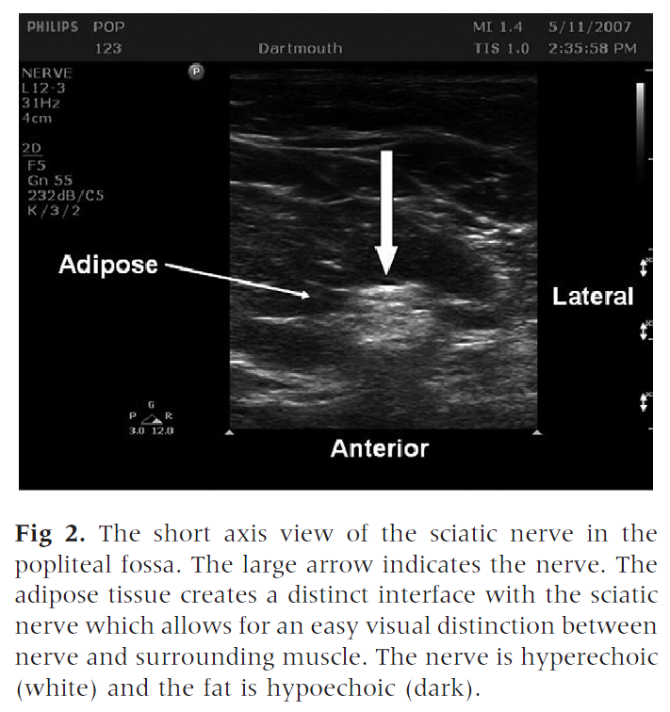
resolving structure is easier if the structure of interest is surrounded by tissue with a different acoustic impedance

Slide 40
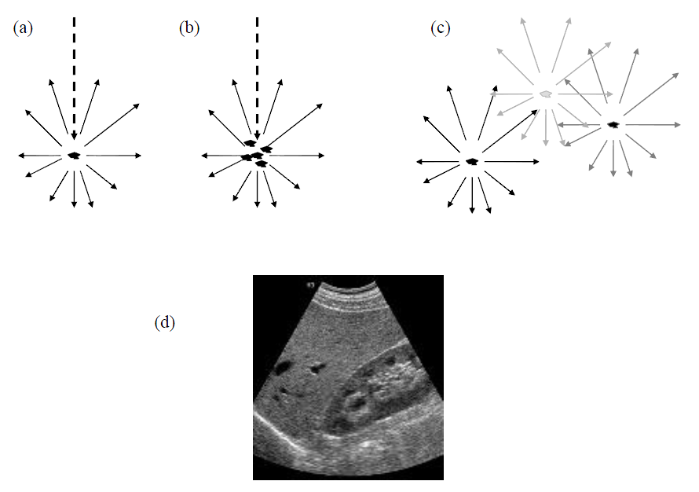
Wave Scattering
small structures (approximately the same size as the US wavelength) cause scattering as opposed to reflection and transmittance
Notes:
Small structures in tissue cause the ultrasound wave to scatter. If the size of the scattering structure is small relative to the wavelength (a), then the scattering is approximately uniform in all directions with slightly more scattering back towards the transducer. If there are many scattering structures close together (b), then the scattering tends to add constructively, and can produce a detectable ultrasound signal. This is the basis of Doppler ultrasound used to measure blood flow (the scattering structures are the red blood cells). If the scattering structures are relatively far apart (c), then the scattering produces complicated constructive and destructive interference which produces the characteristic speckle appearance typical in ultrasound images (d).

Slide 41
Attenuation
attenuation of US intensity is characterized by an exponential decrease as a function of propagation distance z
  I₀ intensity at z = 0 and μ is the tissue attenuation coefficient
μ usually given in (dB) per cm
  each 3dB reduction corresponds to a reduction in intensity by a factor of ~2
μ frequency dependence
  1dB per cm per MHz for soft tissue
  8.7 dB per cm per MHz for bone
US machines allow for time gain compensation
Notes:
Because ultrasound intensity decays exponentially with propagation distance, ultrasound machines typically boost the magnitude of the received ultrasound signal by an amount that depends on the amount of time between transmission and detection. This time gain compensation basically means that signals caused by structures close to the transducer are amplified less than signals caused by structures far from the transducer.

Slide 42
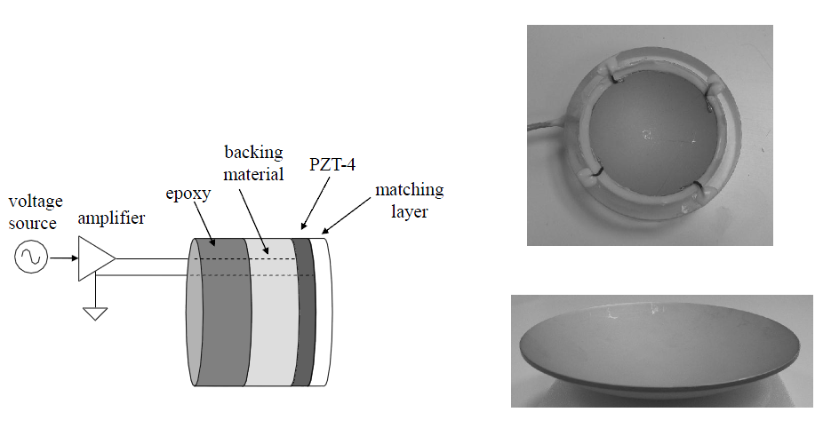
Single Element US Transducer
made from piezoelectric material (lead zirconate titanate, or PZT)
  first synthesized in Japan around 1952

Slide 43
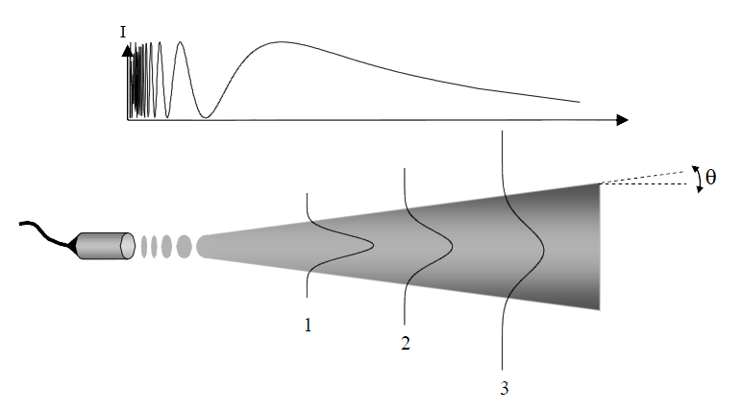
Beam Geometry
US wave pattern close to the transducer face is very complicated
  called Fresnel zone; not useful for diagnostic scanning

Slide 44
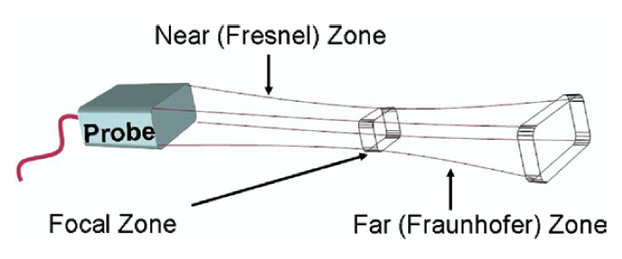
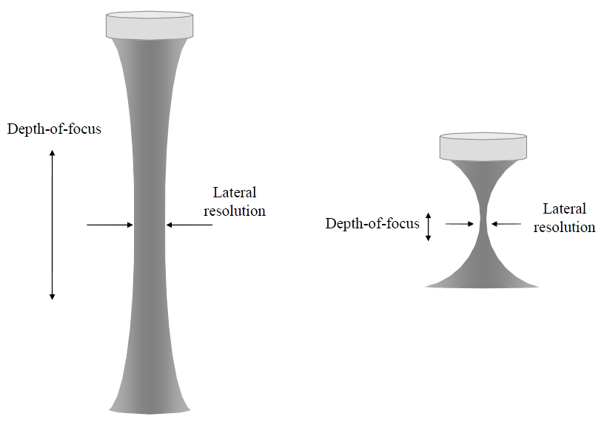
Beam Focusing
transducers are focused to produce tighter US beams and improve lateral resolution

Slide 45
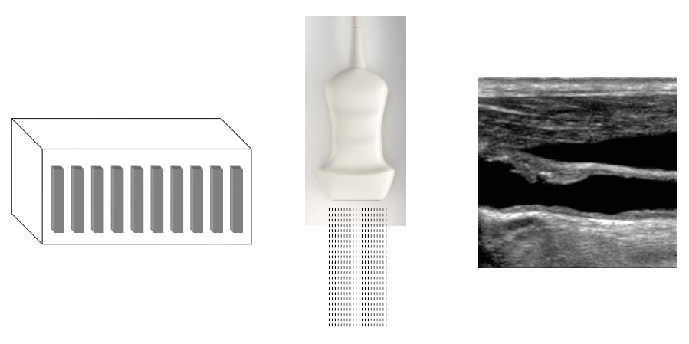
Transducer Geometries: Linear Array
large (~512) number of elements in a linear array
approximately 1cm x 10+ cm in size
Notes:
Several individual transducers can be arranged in a linear array. Such probes produce B-mode (brightness mode) ultrasound images.

Slide 46
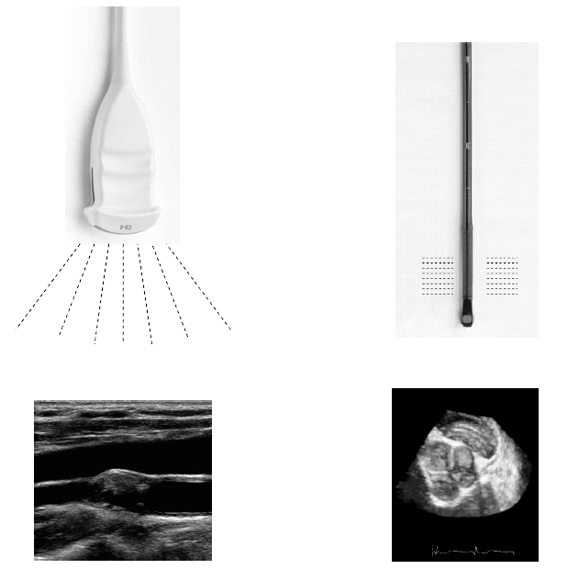
Transducer Geometries: Phased Array
typically smaller than linear array
elements are excited at slightly different times to steer the US beam in different directions

Slide 47
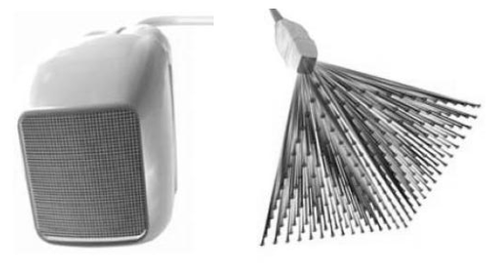
Trans. Geometries: Multidimensional Array
a grid of elements allows for 3D imaging

Slide 48
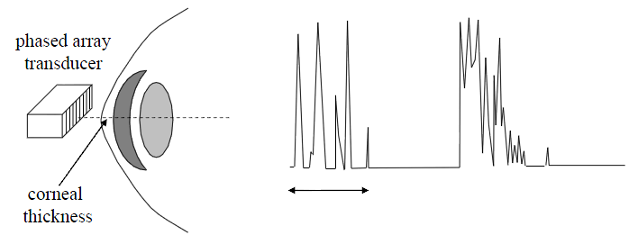
Scanning Modes: A-mode
amplitude (A)-mode acquires a 1D line image, plotting amplitude of the backscattered echo versus time
  not normally used anymore except in ophthalmology

Slide 49
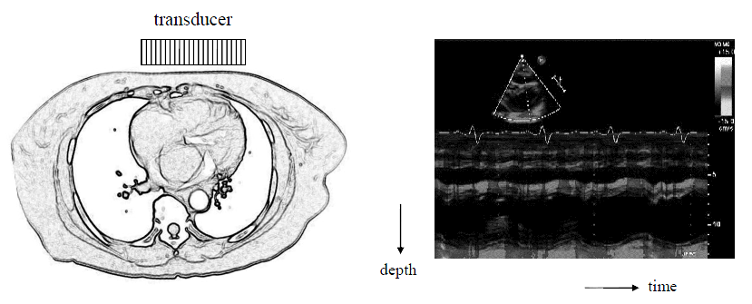
Scanning Modes: M-mode
motion (M)-mode
  continuous A-mode displayed as a function of time
  pixel brightness proportional to amplitude of backscatter echo
  several thousand A-mode lines per second can be acquired
    useful for measuring rates and motion

Slide 50
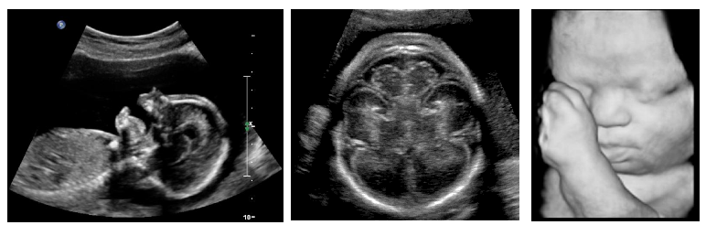
Scanning Modes: B-mode
brightness (B)-mode
  each line in the image is an A-mode line
  most commonly used
  3D and 4D images possible using multidimensional array transducer
Notes:
3D B-mode is a volumetric image. 4D B-mode is a volumetric movie.

Slide 51

Scanning Modes: B-mode
volumetric video

Slide 52
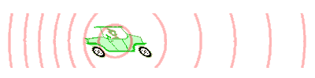
Doppler Ultrasound
used to measure blood velocity by exploiting the Doppler effect
  ambulance siren has higher frequency as it moves towards you and a lower frequency as it moves away from you
  if blood if flowing towards the transducer the backscatter echo is shifted higher in frequency than the incident pulse

Slide 53
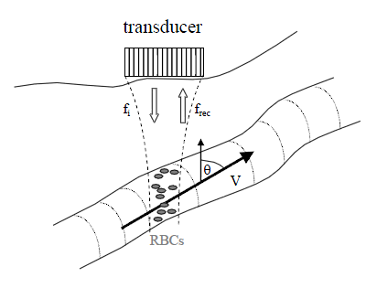
Doppler Ultrasound
Notes:
Doppler ultrasound can be used to measure the velocity of blood flow by examining the shift in frequency of the received ultrasound signal. The frequency shift occurs because the red blood cells (RBC) that cause the ultrasound signal are moving relative to the ultrasound wave.
In this example, the red blood cells have a velocity v that has a component oriented towards the transducer. The transducer emits an ultrasound wave with frequency f_{i}. Because the red blood cells are moving towards the transducer, they see an ultrasound wave with a slightly higher effective frequency f_{effective} > f_{i}. The blood cells cause a reflected wave to be sent back towards the transducer. Again, because the blood cells are travelling towards the transducer, the received wave is shifted slightly higher in frequency such that f_{rec} > f_{effective}. The total shift in frequency is
f_{D} = f_{rec} – f_{i}
which is approximately equal to the formula shown on the slide. The velocity of the blood flow can be determined from f_{D}.
Unfortunately, you need to know the angle theta to get an accurate estimate of the velocity. B-mode ultrasound is often used to determine the direction of the blood vessel when performing Doppler ultrasound.

Slide 54
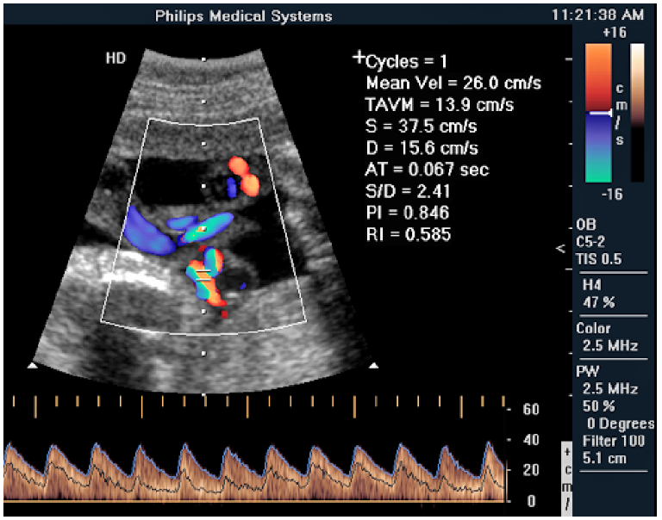
Doppler Ultrasound
Notes:
Simultaneous B-mode and Doppler ultrasound of umbilical cord blood flow. Note that you need a lot of training to interpret this image.

Slide 55
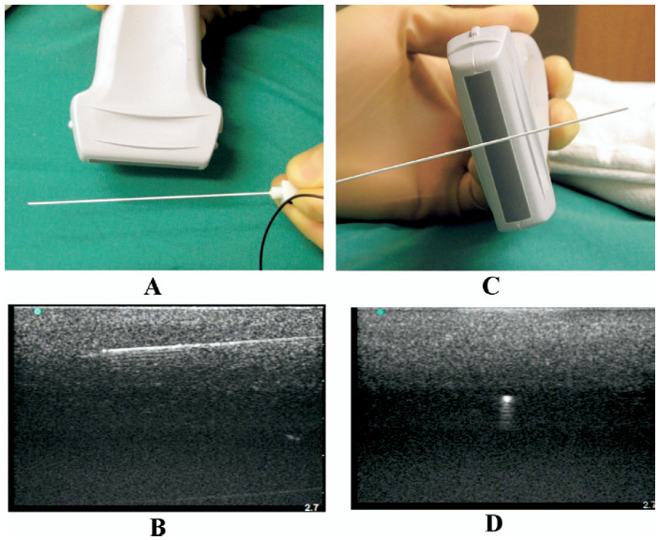
Applications: Needle Insertion
Notes:
B-mode ultrasound is often used to monitor the placement of a needle for biopsy purposes. The images on the left show the image of the needle when it is oriented along the length of the linear array. The images on the right show the image of the needle when it is oriented across the array.

Slide 56
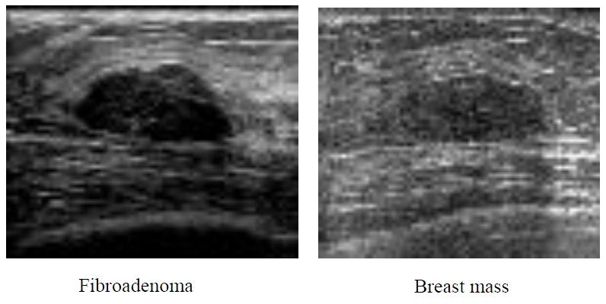
Applications: Breast Imaging
useful when x-ray may be dangerous or ineffective

Slide 57
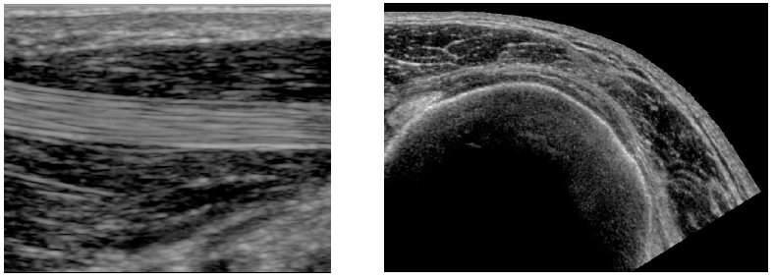
Applications: Musculosketal Imaging
flexor pollicus tendon
rotator cuff

