Slide 1
Snakes (Active Contour Models)
Kass, Witken, Terzopoulos. IJCV, 321-331, 1988
energy-minimizing spline
  bending energy
  image forces that pull it toward features such as lines and edges
  user-applied external constraints
http://www.mathworks.com/matlabcentral/fileexchange/28149

Slide 2
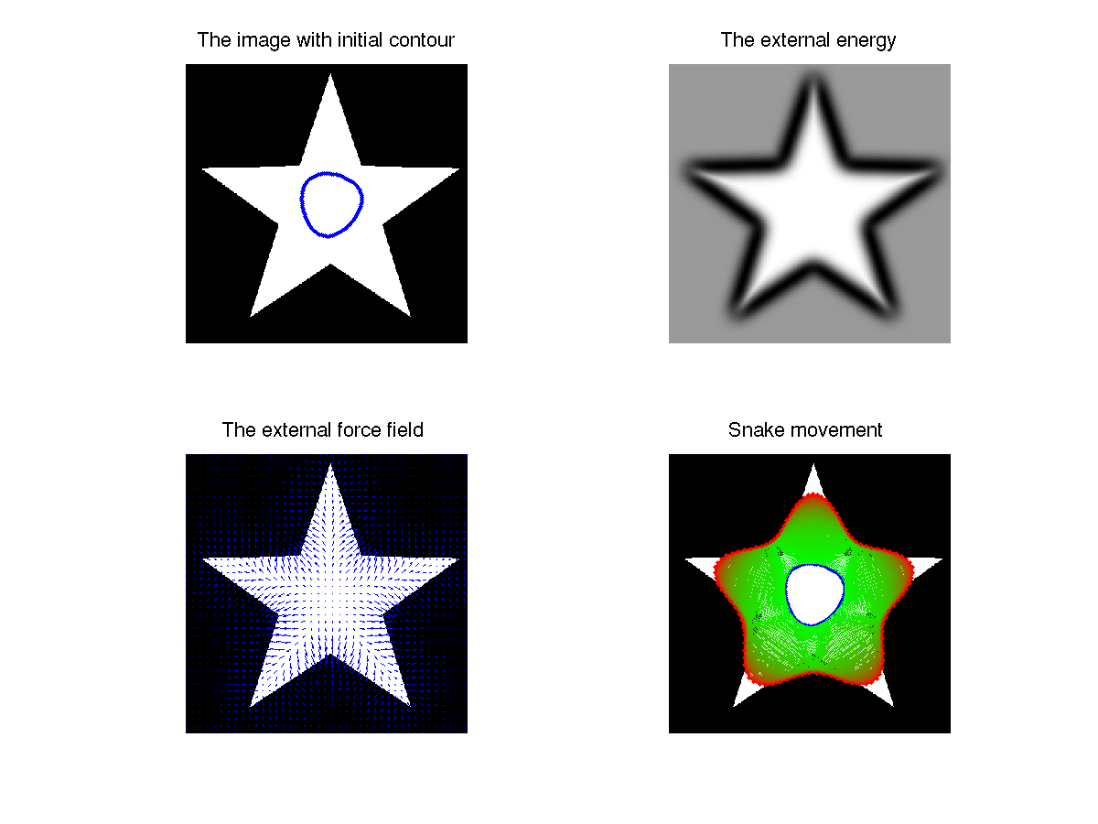

Slide 3
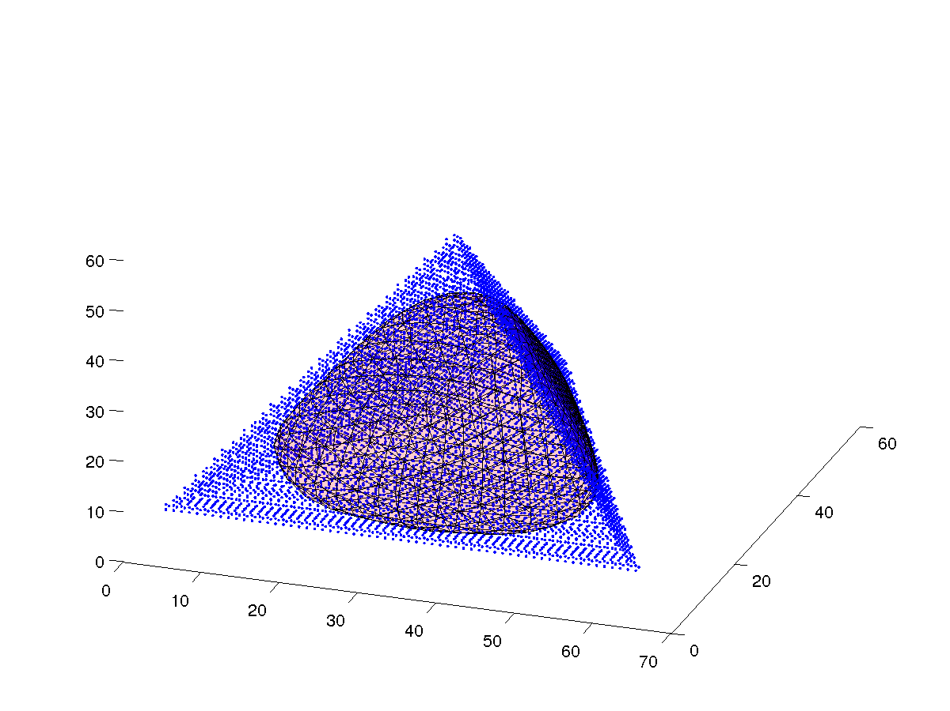

Slide 4
Snake Energy
snake is a parametric curve
snake energy

Slide 5
Internal Energy
internal energy represents the energies caused by stretching and bending
“membrane”
stretching/
contracting
“thin-plate”
bending

Slide 6
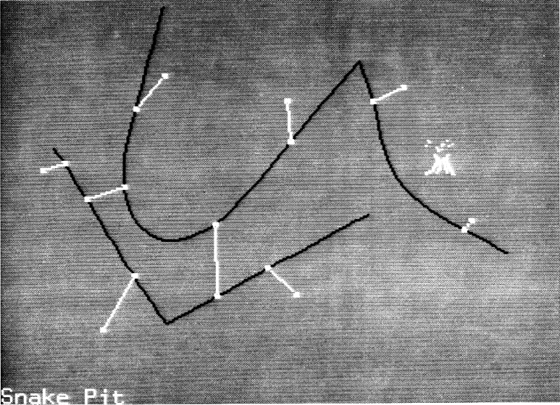
External Energy: Constraints
user specified constraints to control or guide the snake
  e.g., attach springs to the snake and image

Slide 7
External Energy: Image Forces
energy terms for attracting the snake to salient features in the image

Slide 8
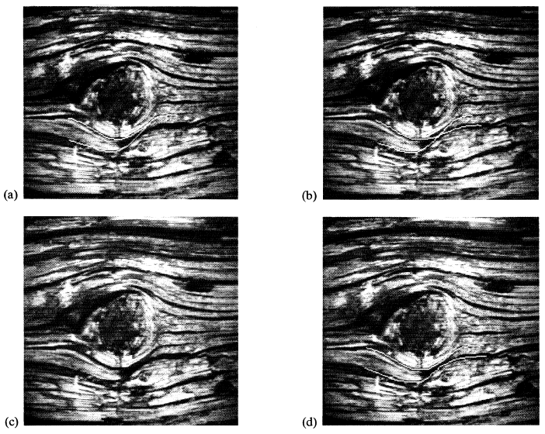
Image Forces: Line Functional
attracts the snake to light or dark lines (depending on the sign of w_{line})

Slide 9
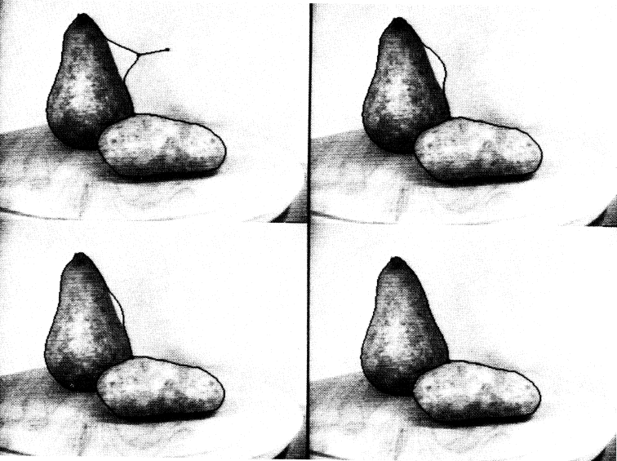
Image Forces: Edge Functional
energy term for attracting the snake to edges

Slide 10
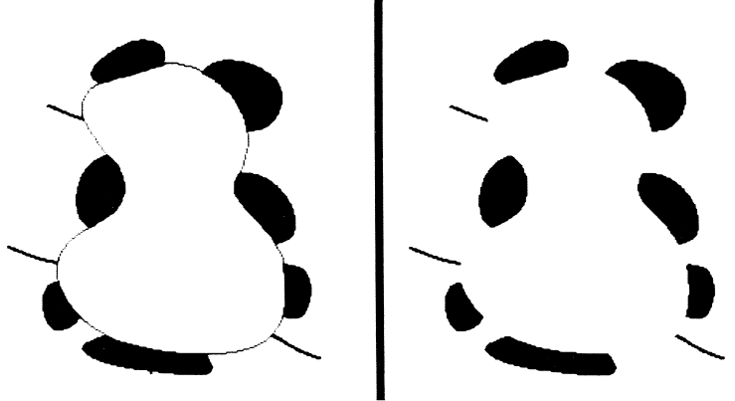
Image Forces: Termination Forces
energy term for attracting the snake to terminations of line segments and corners
  based on computing curvature (see paper for details)

Slide 11
Snake Issues
local minima
tend to miss small features because minimization occurs over the entire snake
sensitive to initialization
many adjustable parameters

Slide 12
Snake Variations
gradient vector flow (GVF) snakes
  Xu, Prince. Gradient vector flow: A new external force for snakes. CVPR, 197
geodesic active contours
  Caselles, Kimmel, Sapiro. Geodesic active contours. IJCV 22(1), 1997
diffusion snakes
  http://homepages.inf.ed.ac.uk/rbf/CVonline/LOCAL_COPIES/CREMERS2/

Slide 13
Active Shape Models
also called statistical atlases
model that captures the natural variability within a class of shapes
  can be used to search an image to find examples of shape
allows for variability (deformation) but still specific to the shape class represented

Slide 14
Point Distribution Model
objects represented by a set of points
  boundary
  internal features
  external features
points are placed in the same way on each image in a training set
  usually done manually
sets of points are registered
statistics of the positions of the points form the point distribution model

Slide 15
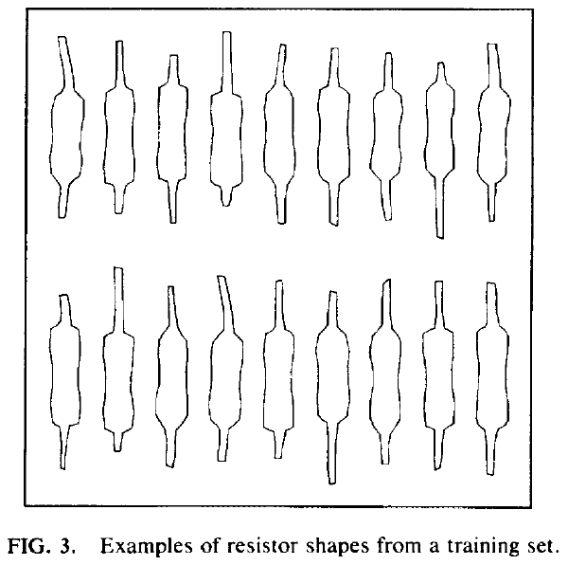
Training Set

Slide 16
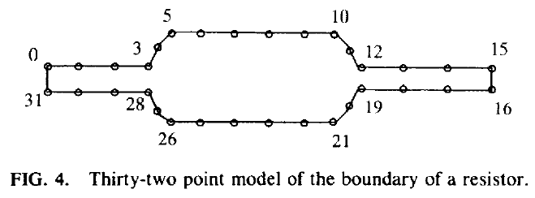
Labelling of the Training Set
each training shape must be labelled
each labelled point represents a particular part of the object
  want to capture how labelled points tend to move together as the shape varies
  incorrect labelling will lead to errors in estimating the shape variability

Slide 17
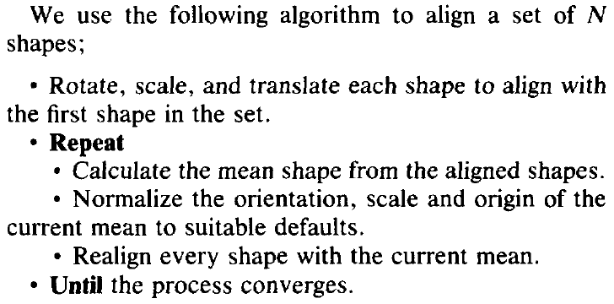
Aligning the Labels

Slide 18
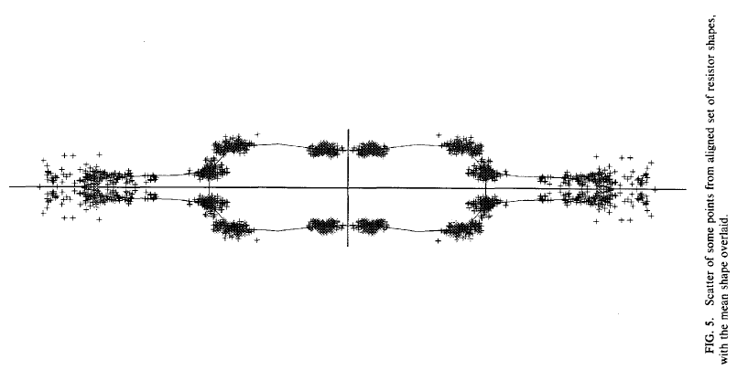
Aligning the Labels

Slide 19
Statistics of Aligned Shapes
let x_{i} be a vector of the coordinates of the n points of the i^{th} training shape
the mean shape is

Slide 20
Statistics of Aligned Shapes
the deviation of shape from the mean is
the covariance is
covariance matrix has eigenvalues/vectors

Slide 21
Statistics of Aligned Shapes
the shape variance explained by each eigenvector is equal to its corresponding eigenvalue
  i.e., there is more shape variation along eigenvectors with larger eigenvalues
many of the eigenvalues of S will be small
  i.e., most of the shape variation can be described using just the first few eigenvectors
a shape in the training set can be approximated using the first t eigenvectors

Slide 22
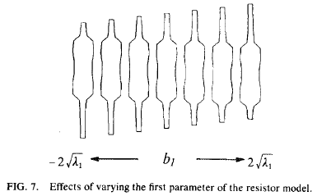
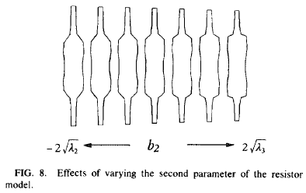
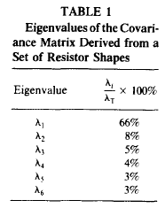
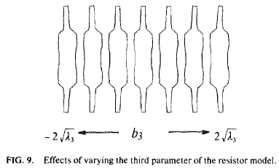
Statistics of Aligned Shapes

