Slide 1
Region-Based Segmentation
the basic idea
divide image into zones of maximum homogeneity
for some homogeneity measure H()
homogeneity can be computed based on
intensity
color (not usually applicable in medical imaging)
texture
shape

Slide 2
Region Merging
a possible approach
assume every pixel is a region and merge pixels based on similarity
alternatively
oversegment the image into regions and merge regions
partition image into regions
form region adjacency graph (RAG)
for each region
consider its adjacent region and test for homogeneity
if then merge the regions and update the RAG
repeat step 3 until no regions are merged

Slide 3
Region Merging
simple homogeneity test
compare mean region intensities and merge if the intensities are within a threshold distance
has the same problems as other threshold approaches

Slide 4
Region Merging
homogeneity test as hypothesis testing
assume or estimate a statistical distribution of the pixel intensities over a region and use a statistical hypothesis test
H₀: Both regions are the same (the pixel intensities come from the same distribution)
H₁: Both regions are different (the pixel intensities come from different distributions)

Slide 5
Region Merging
homogeneity test as hypothesis testing example
if we assume that pixel intensities are Gaussian distributed
if we assume pixel intensities are independent then the joint probability density under the null hypothesis is

Slide 6
Region Merging
homogeneity test as hypothesis testing example (cont)
if we assume pixel intensities are independent then the joint probability density under the null hypothesis is
the likelihood ratio is
if L is below a threshold value then merge the two regions

Slide 7
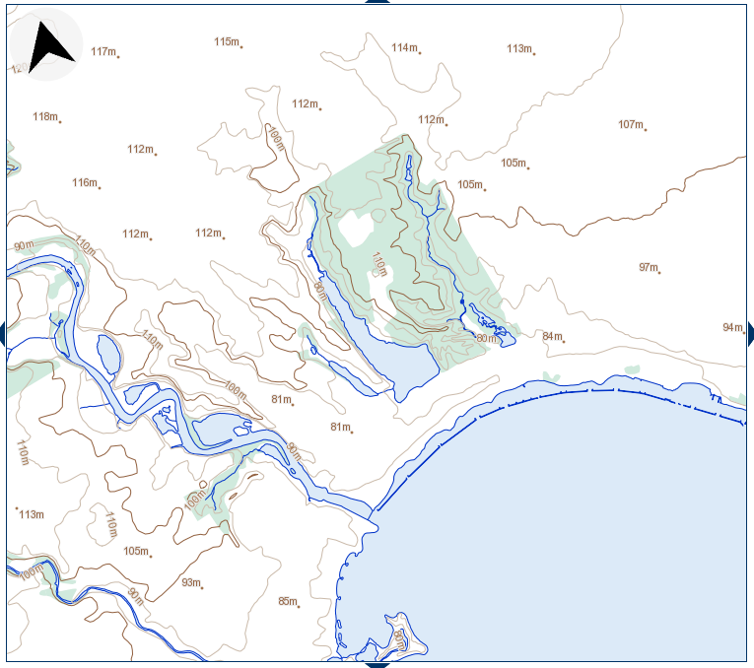
Watershed Segmentation
topographic map of High Park

Slide 8
Watershed Segmentation
watershed segmentation models the image as a topographic landscape with the pixel intensities representing elevation
there are 3 kinds of points
local minima
points where a drop of water would fall to a single local minima
“catchment basins”
points where a drop of water would be equally likely to fall into more than one minima
“watersheds”

Slide 9
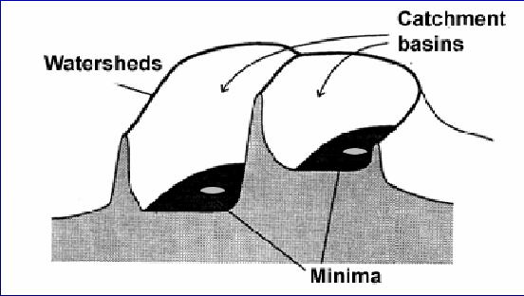
Watershed Segmentation

Slide 10
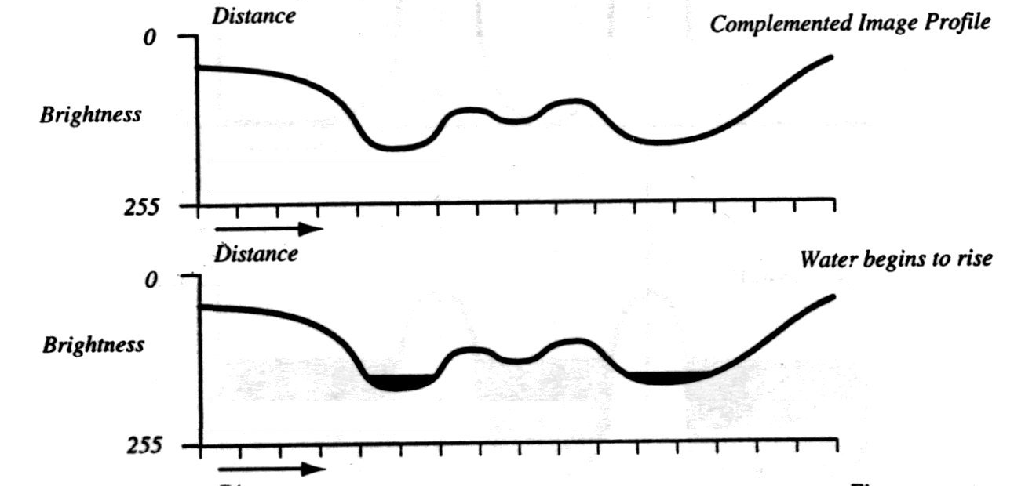
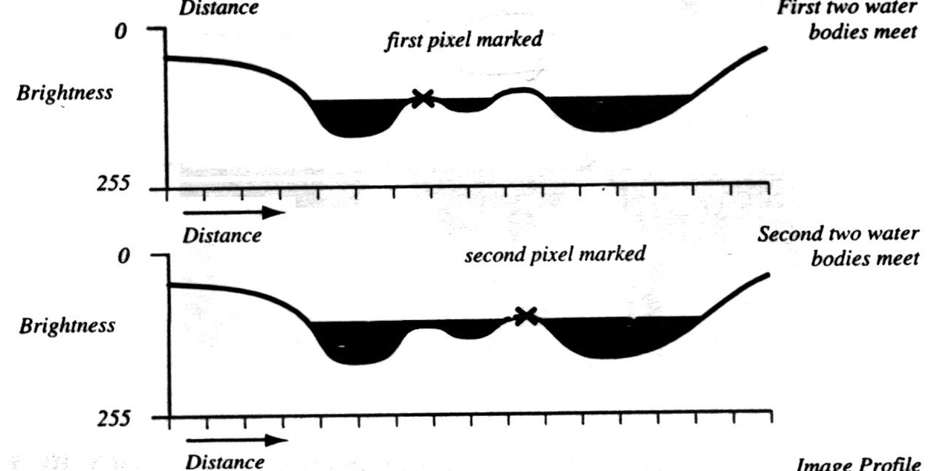
Watershed Segmentation
regions boundaries are the watersheds
to find the watersheds
fill the catchment basins with water starting from the local minima
if two catchment basins would merge by adding a little more water then build a dam between the two basins
the dams are the watersheds

Slide 11
Watershed Segmentation
http://cmm.ensmp.fr/~beucher/wtshed.html
http://www.mathworks.com/products/demos/image/watershed/ipexwatershed.html
Jean Cousty, Gilles Bertrand, Laurent Najman, and Michel Couprie. Watershed Cuts: Minimum Spanning Forests and the Drop of Water Principle. IEEE Transactions on Pattern Analysis and Machine Intelligence. 31 (8). August 2009. pp. 1362–1374.

Slide 12
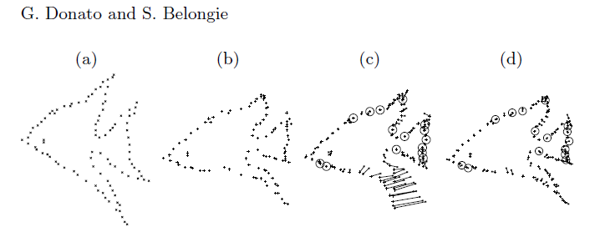
Segmentation via Non-rigid Registration
suppose that you have a contour (defined by a set of points) of a shape
can we transfer the contour onto an image by finding the corresponding set of points on the image?

Slide 13
given n corresponding control points find functions f and g such that

Slide 14
Polynomial Transformation
we might choose functions f and g to be polynomials in x and y
this is easy to solve in a least-squares way

Slide 15
Polynomial Transformation

Slide 16
Thin Plate Spline
Goshtasby, IEEE Transactions on Geoscience and Remote Sensing, 26(1), Jan 1988.
undeformed rubber sheet
deformed rubber sheet (pulled at edges)

Slide 17
Thin Plate Spline
using 20 control points
thin plate spline
polynomial (degree 2)

Slide 18
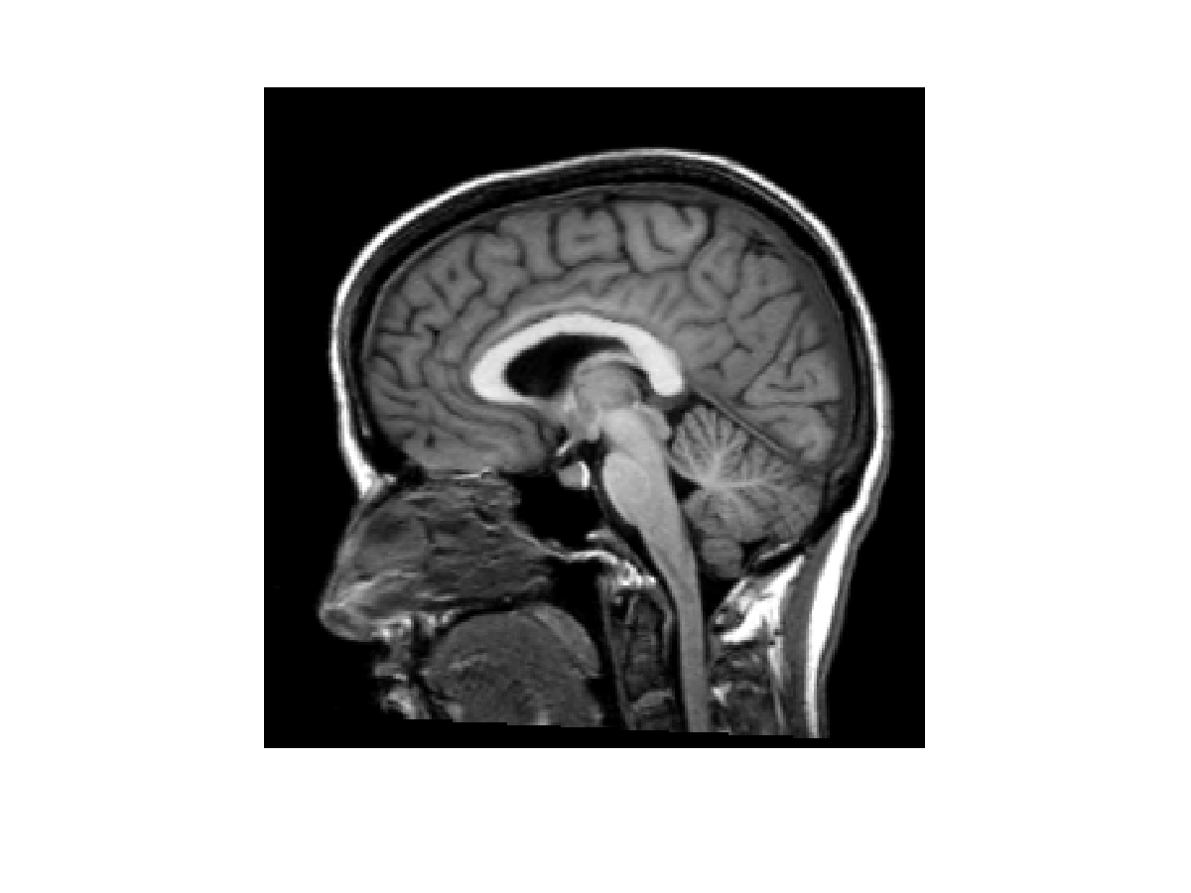
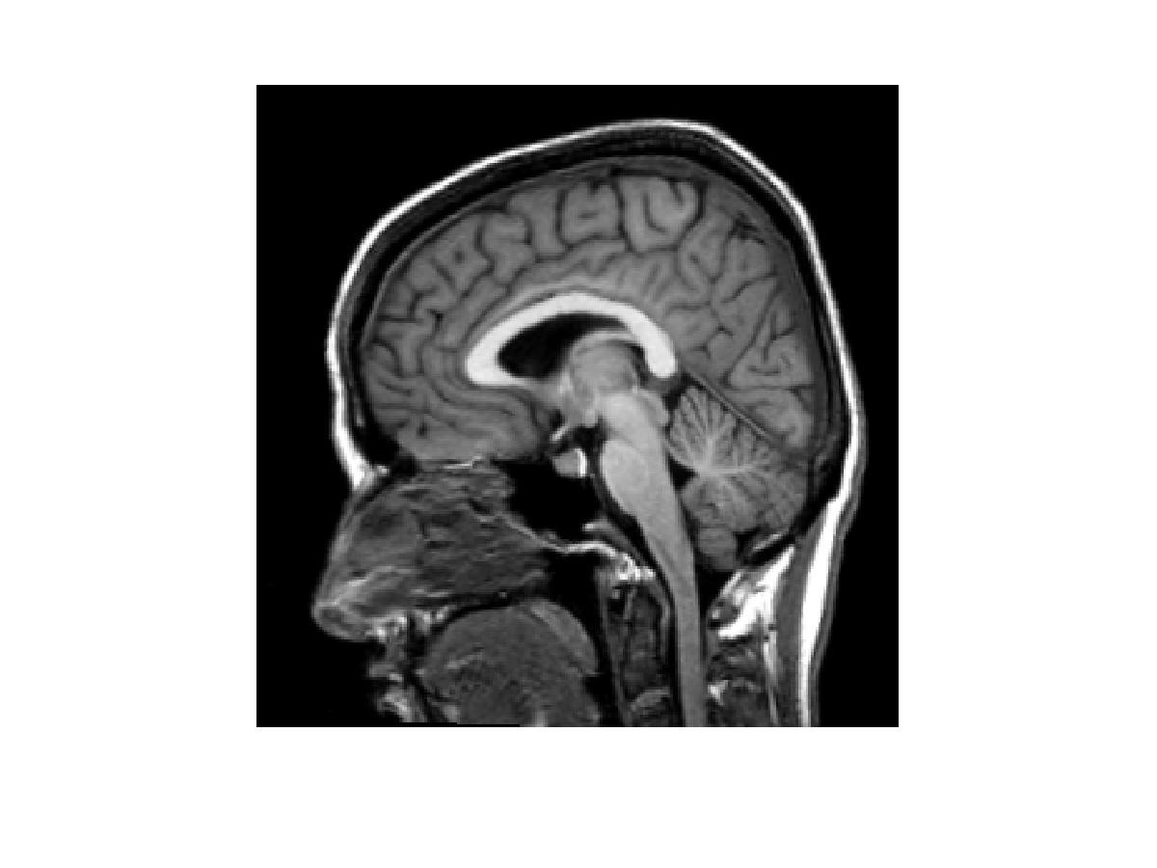
Thin Plate Splines
source image
target image

Slide 19
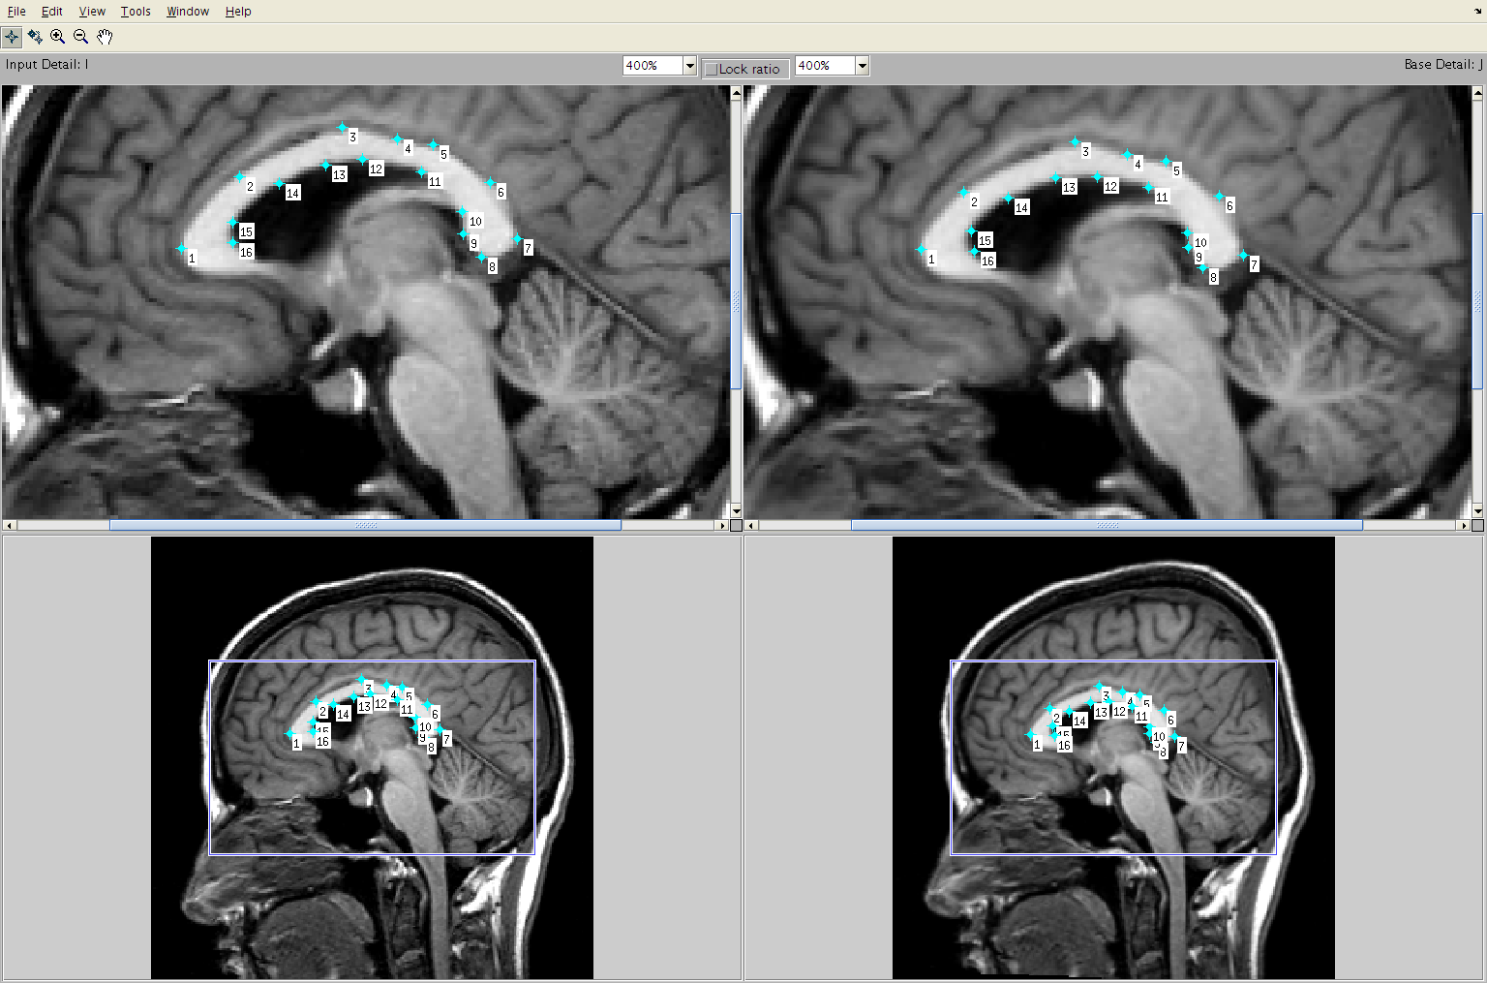
centrally located control points

Slide 20
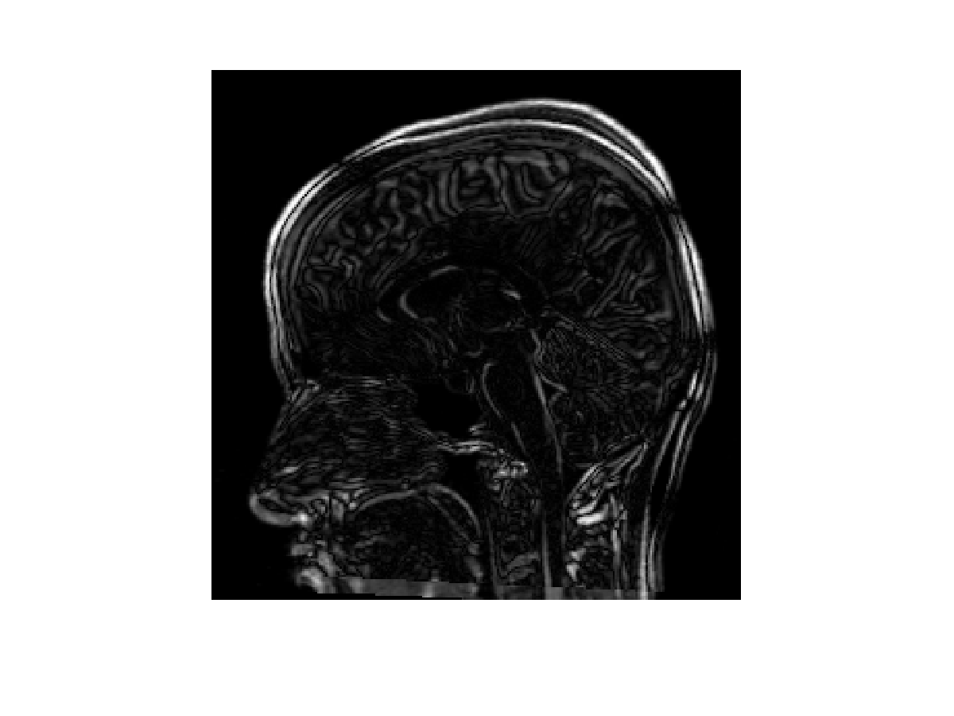
warped image
difference between warped
and target images

Slide 21
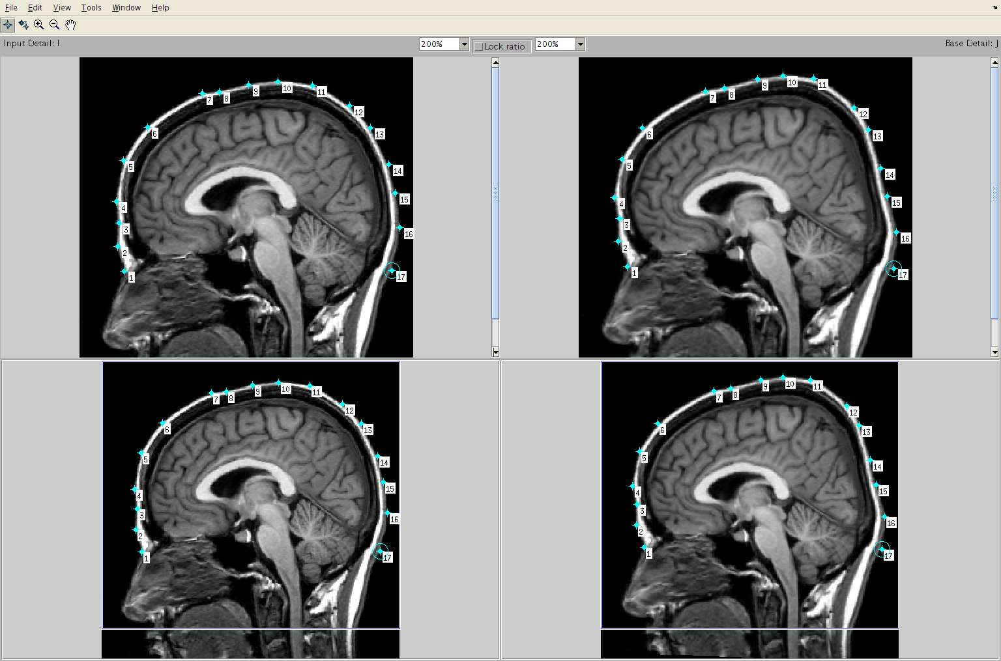
control points located at periphery

Slide 22
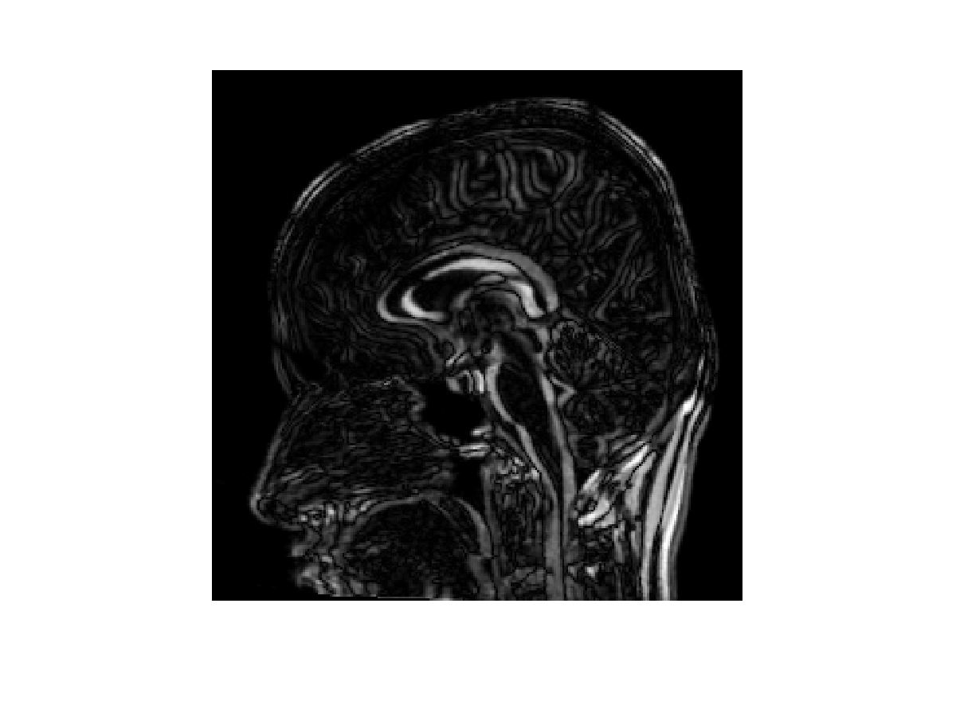
warped image
difference between warped
and target images

Slide 23
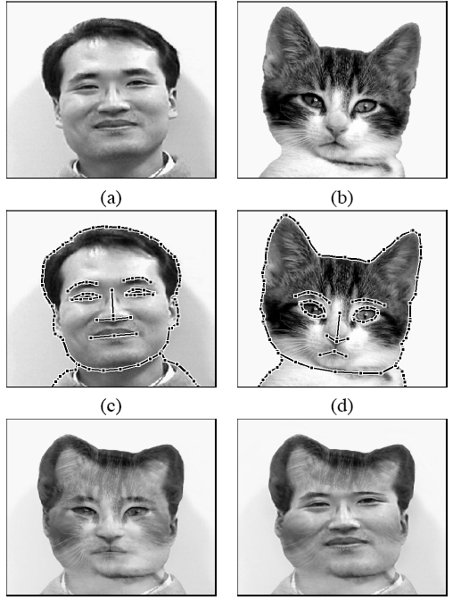

Slide 24
Thin Plate Spline
the surface of an infinite plate loaded with point loads is called a surface spline and is given by where and (x_{j}, y_{j}) is the position of the j^{th} point load

Slide 25
Thin Plate Spline
the coefficients F_{j} must meet certain constraints
the constraints are related to the original integral equation that the thin plate spline minimizes

Slide 26
Thin Plate Spline
by choosing
and imposing the constraints
we can solve a linear system of
equations to compute the
thin plate spline

