Slide 1
Canny Edge Detection
John F. Canny 1986
aims to meet several criteria
  low error rate
    edges should not be missed and detector should not respond to non-edges
  good localization
    detected edge locations should be as close as possible to actual edge locations
  minimal response
    one response per edge (no fat or double edges)

Slide 2
Canny Edge Detection
uses gradient magnitude for edge detection
  e.g., one of the first derivative kernels
  sensitive to image noise
input image is smoothed slightly to reduce image noise
smoothing can be accomplished using an appropriate filter
mean filter

Slide 3
Canny Edge Detection
Gaussian filter of size 5

Slide 4
Canny Edge Detector
after smoothing, the gradient magnitude and direction are found

Slide 5
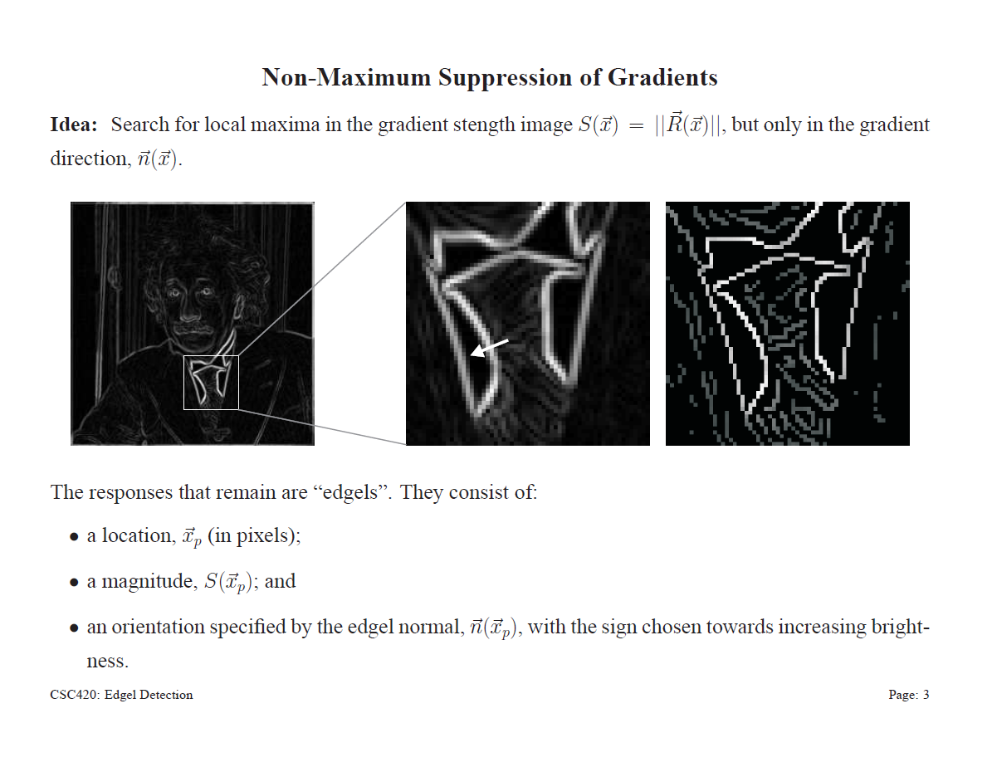

Canny Edge Detection
after computing the gradient, non-maximum suppression of the gradient is performed

Slide 6
Canny Edge Detection
finally, the gradient is thresholded using hysteresis thresholding
idea: edges should form continuous curves in the image
  a single threshold will tend to break an edge curve into pieces
  can recover the weaker sections by connecting them to stronger sections
use 2 thresholds
  high threshold T1: if the gradient magnitude is greater than T1 then an edge has been detected
  low threshold T2: if the gradient magnitude is less than T2 then no edge is detected
  where the gradient magnitude is between T1 and T2: considered candidate pixel

Slide 7
Canny Edge Detection
candidate pixel
  move along the edge (perpendicular to gradient direction) in both directions as long as the gradient > T2
  if the candidate pixel is connected to an edge then an edge is detected

Slide 8
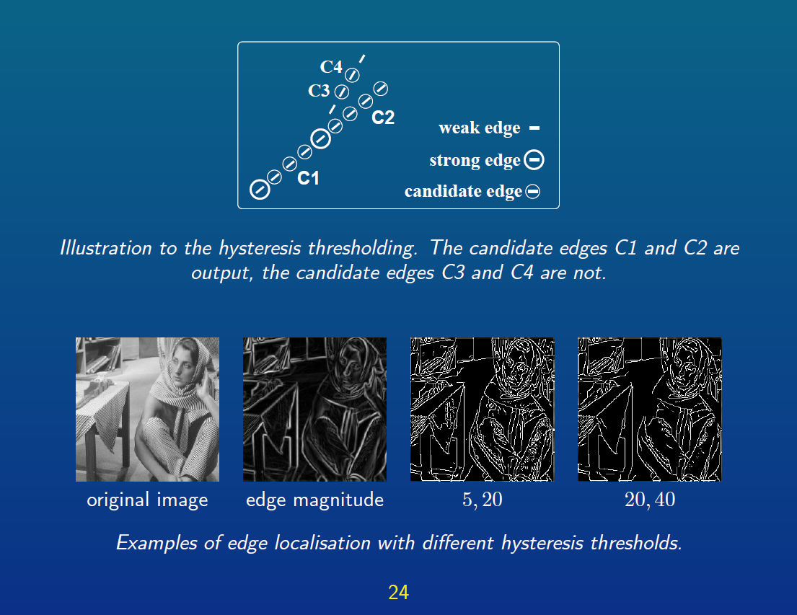


Canny Edge Detection

Slide 9
Hough Transforms
if an image contains objects with known shape and size then segmentation can be viewed as finding objects in the image
  lines
  circles
  ellipses
Hough transform can be used to find positions of known shapes in an image even when there is some occlusion or overlap
  bubble chamber image analysis (Hough, 1959)
  lines and curves (Duda and Hart, 1972)
  arbitrary shapes (Ballard, 1981)

Slide 10
Hough Transform
example: finding a square of known size
 |  |  |  |  |  |  | O
true location

Slide 11
Hough Transform
run an edge detector
 |  |  |  |  | X | X | X | X | X
 |  |  |  |  | X |  |  |  | X
 |  |  |  |  | X |  | O |  | X
 |  |  |  |  | X |  |  |  | X
 |  |  |  |  | X | X | X | X | X

Slide 12
Hough Transform
possible square center locations
 |  |  | O | O | O | O | O
 |  |  | O |  |  |  | O
 |  |  | O |  | X | X | O | X | X
 |  |  | O |  | X |  | O |  | X
 |  |  | O | O | O | O | O |  | X
 |  |  |  |  | X |  |  |  | X
 |  |  |  |  | X | X | X | X | X
1

Slide 13
Hough Transform
accumulate the possible center locations
accumulator
 |  |  | 1 | 1 | 1 | 1 | 1
 |  |  | 1 |  |  |  | 1
 |  |  | 1 |  |  |  | 1
 |  |  | 1 |  |  |  | 1
 |  |  | 1 | 1 | 1 | 1 | 1

Slide 14
Hough Transform
possible square center locations
 |  |  |  | O | O | O | O | O
 |  |  |  | O |  |  |  | O
 |  |  |  | O | X | X | X | O | X
 |  |  |  | O | X |  |  | O | X
 |  |  |  | O | O | O | O | O | X
 |  |  |  |  | X |  |  |  | X
 |  |  |  |  | X | X | X | X | X

Slide 15
Hough Transform
accumulate the possible center locations
accumulator
 |  |  | 1 | 2 | 2 | 2 | 2 | 1
 |  |  | 1 | 1 |  |  | 1 | 1
 |  |  | 1 | 1 |  |  | 1 | 1
 |  |  | 1 | 1 |  |  | 1 | 1
 |  |  | 1 | 2 | 2 | 2 | 2 | 1

Slide 16
Hough Transform
possible square center locations
 |  |  |  |  | O | O | O | O | O
 |  |  |  |  | O |  |  |  | O
 |  |  |  |  | O | X | X | X | O
 |  |  |  |  | O |  |  |  | O
 |  |  |  |  | O | O | O | O | O
 |  |  |  |  | X |  |  |  | X
 |  |  |  |  | X | X | X | X | X

Slide 17
Hough Transform
accumulate the possible center locations
accumulator
 |  |  | 1 | 2 | 3 | 3 | 3 | 2 | 1
 |  |  | 1 | 1 | 1 |  | 1 | 1 | 1
 |  |  | 1 | 1 | 1 |  | 1 | 1 | 1
 |  |  | 1 | 1 | 1 |  | 1 | 1 | 1
 |  |  | 1 | 2 | 3 | 3 | 3 | 2 | 1

Slide 18
Hough Transform
possible square center locations
 |  |  |  |  | X | X | X | X | X
 |  |  |  |  | X |  |  |  | X
 |  |  |  |  | X |  | O | O | O | O | O
 |  |  |  |  | X |  | O |  | X |  | O
 |  |  |  |  | X | X | O | X | X |  | O
 |  |  |  |  |  |  | O |  |  |  | O
 |  |  |  |  |  |  | O | O | O | O | O
1

Slide 19
Hough Transform
accumulate the possible center locations
accumulator
 |  |  | 1 | 2 | 3 | 4 | 5 | 4 | 3 | 2 | 1
 |  |  | 2 | 3 | 4 | 5 | 7 | 5 | 4 | 3 | 2
 |  |  | 3 | 4 | 5 | 6 | 9 | 6 | 5 | 4 | 3
 |  |  | 4 | 5 | 6 | 7 | 11 | 7 | 6 | 5 | 4
 |  |  | 5 | 7 | 9 | 11 | 16 | 11 | 9 | 7 | 5
 |  |  | 4 | 5 | 6 | 7 | 11 | 7 | 6 | 5 | 4
 |  |  | 3 | 4 | 5 | 6 | 9 | 6 | 5 | 4 | 3
 |  |  | 2 | 3 | 4 | 5 | 7 | 5 | 4 | 3 | 2
 |  |  | 1 | 2 | 3 | 4 | 5 | 4 | 3 | 2 | 1
maximum value
=
estimated location

Slide 20
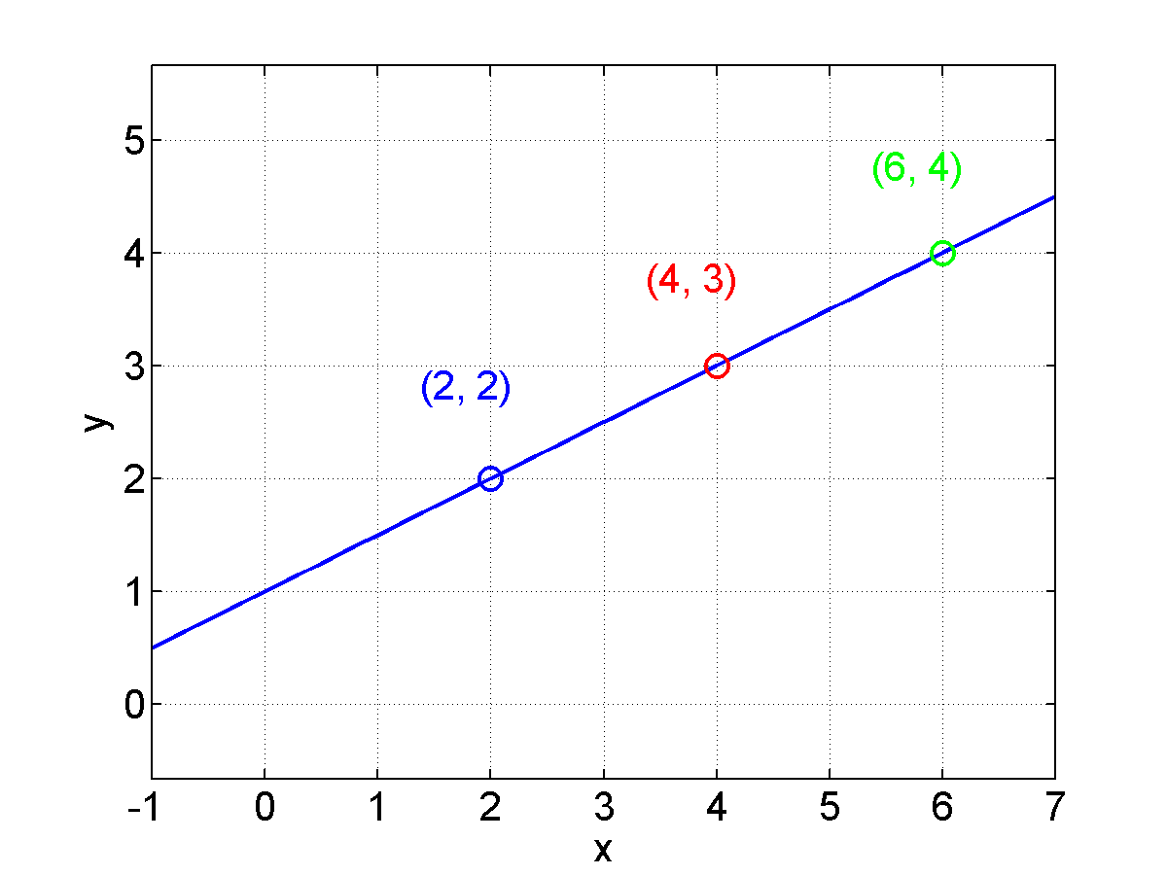
Hough Transform
for parametric shapes the accumulation is done in the parameter space
  consider a line given by y = kx + q
y = 0.5x + 1

Slide 21
Hough Transform
all lines passing through (2, 2) have the form
similarly, all lines passing through (4, 3) have the form
similarly, all lines passing through (6, 4) have the form
i.e., each point in image space xy is a line in the parameter space kq

Slide 22
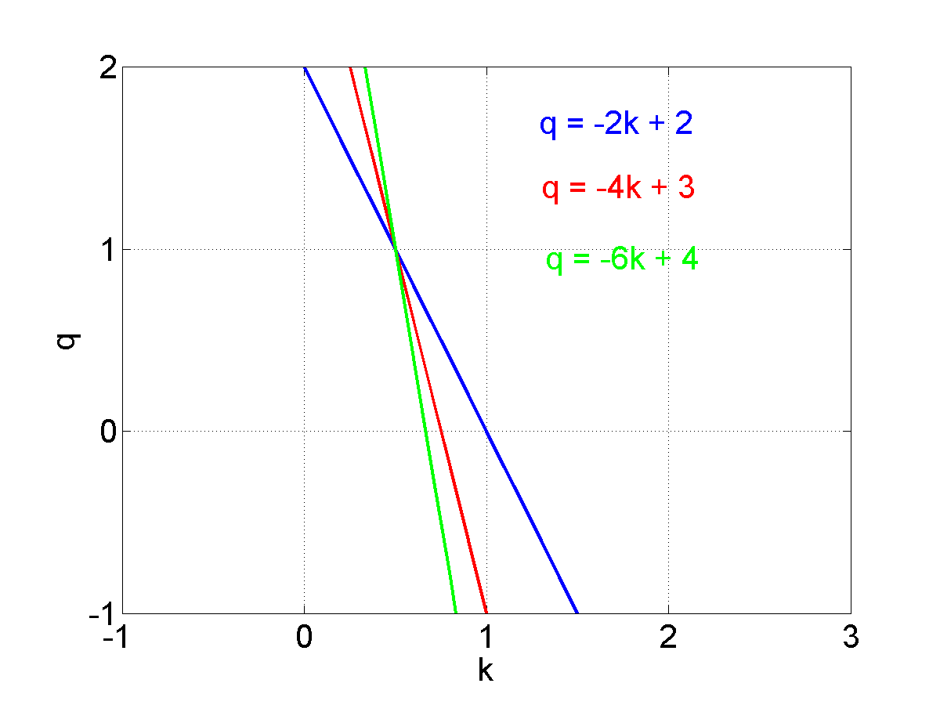
Hough Transform
the intersection point of the lines in the parameter space corresponds to the line in image space
(0.5, 1)

Slide 23
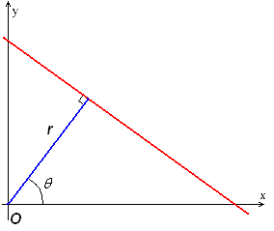
Hough Transform
to perform the accumulation we need to discretize the parameter space
  a careful choice of the parameterization is needed
our line example is a poor parameterization because the range of k is (-∞, ∞)
  instead use

