Slide 1
DICOM

Slide 2
DICOM
set of standards developed shortly after commercial CT machines started becoming available (early 1980s)
in part to allow access to image data by people other than the manufacturers
intent
promote communication of digital image information, regardless of device manufacturer
facilitate the development and expansion of picture archiving and communication systems (PACS) that can also interface with other systems of hospital information
allow the creation of diagnostic information data bases that can be interrogated by a wide variety of devices distributed geographically

Slide 3
DICOM
brochure
http://medical.nema.org/standard.html

Slide 4
DICOM in Matlab
functionality provided via the Image Processing toolbox
http://www.mathworks.com/help/images/index.html
http://www.mathworks.com/help/images/scientific-file-formats.html
there is a lot of confidential information embedded in a DICOM image
Supplement 55 Attribute Level Confidentiality (including De-identifiation)
dicomanon

Slide 5
Viewing Medical Images
for many types of medical images there is a mismatch between the range of the image data and the range of values that can be displayed
CT range = -1024 to 3072
8-bit grayscale = 256 gray levels
need to map the image data range to display range
“window” and “level” in medical imaging
http://blogs.mathworks.com/steve/2006/02/17/all-about-pixel-colors-window-level/

Slide 6
Viewing Medical Images
modern imaging workstations support volume rendering of 3D images
http://www.fovia.com/galleryhome.php
not a graphics course, but…
http://en.wikipedia.org/wiki/Volume_rendering
http://en.wikipedia.org/wiki/Volume_ray_casting
Real-Time Volume Graphics
Visualization in Medicine: Theory, Algorithms, and Applications

Slide 7
Segmentation

Slide 8
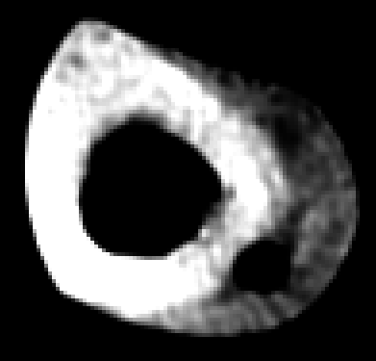

Slide 9
Segmentation
divide an image into parts that correspond to salient regions (e.g., objects or parts of objects)
complete segmentation
produces a set of S disjoint regions R_{i} corresponding uniquely with objects in the image
partial segmentation
regions do not correspond directly to objects in the image

Slide 10
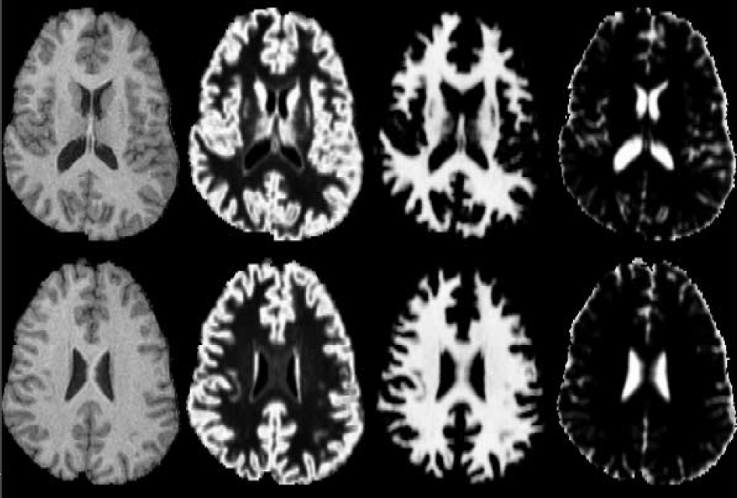
Segmentation
segmentation is task dependent
the whole organ?
all of the parts of the organ?
a specific part of the organ?
unusual regions?

Slide 11
Bottom-up versus Top-down
bottom-up segmentation
no prior knowledge of what objects are in the scene
segmentation into homogeneous regions
unlikely to produce a complete segmentation except in simple cases
top-down segmentation
objects in the image are recognized (using a detector) and then segmented
uses prior knowledge of object classes to guide segmentation

Slide 12
Approaches to Segmentation
thresholding
usually intensity-based
edges
edge detection followed by edge grouping to find boundaries separating regions
regions
individual regions are found directly by region growing, splitting, and merging

Slide 13
Thresholding
global intensity thresholding is the simplest segmentation process
input image f(i, j), output image g(i, j) for each pixel (i, j)
works only if the objects in the image are distinct from the background intensity

Slide 14
Thresholding
original
good threshold
threshold too low
threshold too high

Slide 15
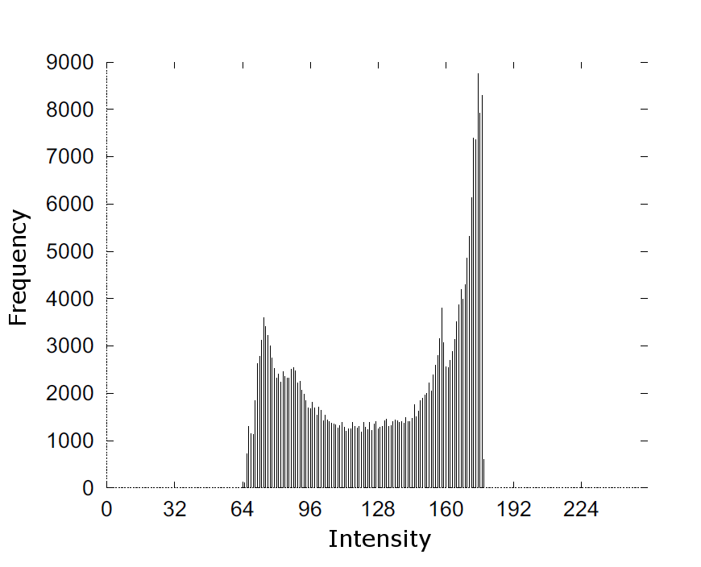
Threshold Detection
a histogram of intensity values can be helpful in selecting a threshold value

Slide 16
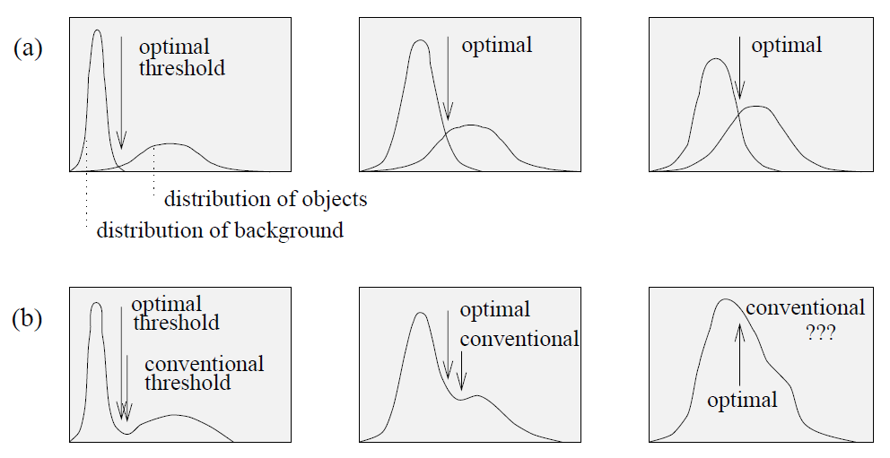
Optimal Thresholding
histogram is treated as the sum of two or more probability densities
choose threshold to minimize segmentation error

Slide 17
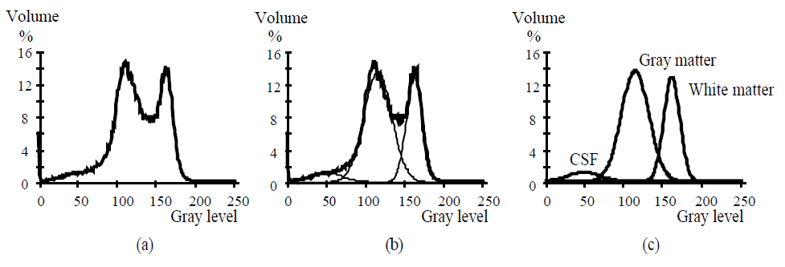
Optimal Thresholding

Slide 18
Edge-based Segmentation
edge-based segmentation tries to find the borders separating regions
edges are found using an edge detector
detected edges usually do not form closed borders
detectors can miss weak edges
detectors can find too many edges

Slide 19
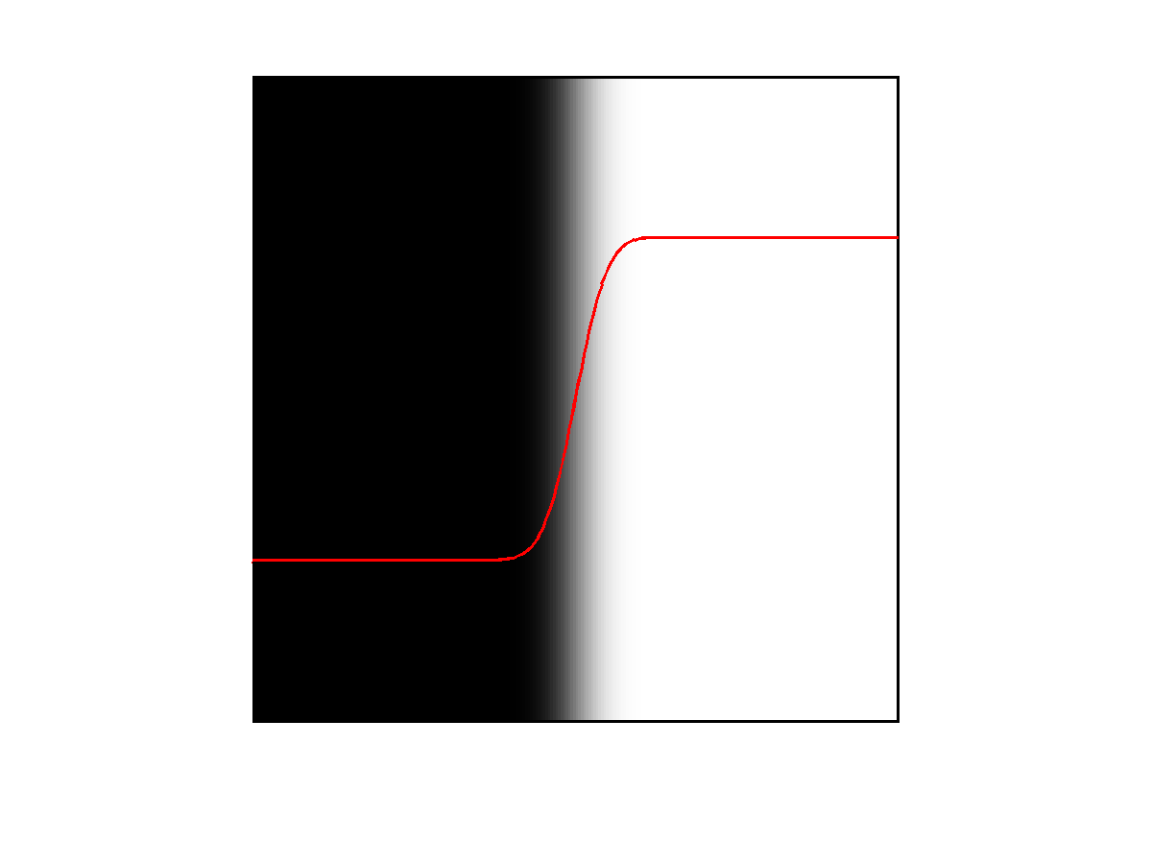
Edge
an edge is a discontinuity in image intensity along one direction
edges in real images are often blurry and noisy

Slide 20
Edge Detection Kernels
discrete approximations to first derivative
attempt to compute the image gradient magnitude
Roberts Cross
Prewitt
Sobel

