Slide 1
Day 05
Horn's Method

Slide 2
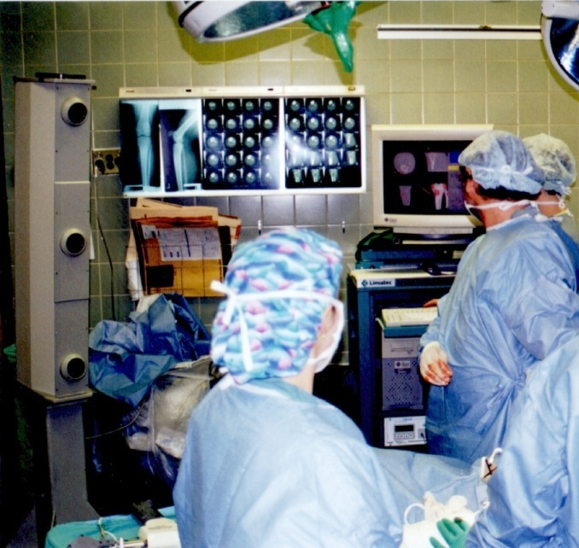
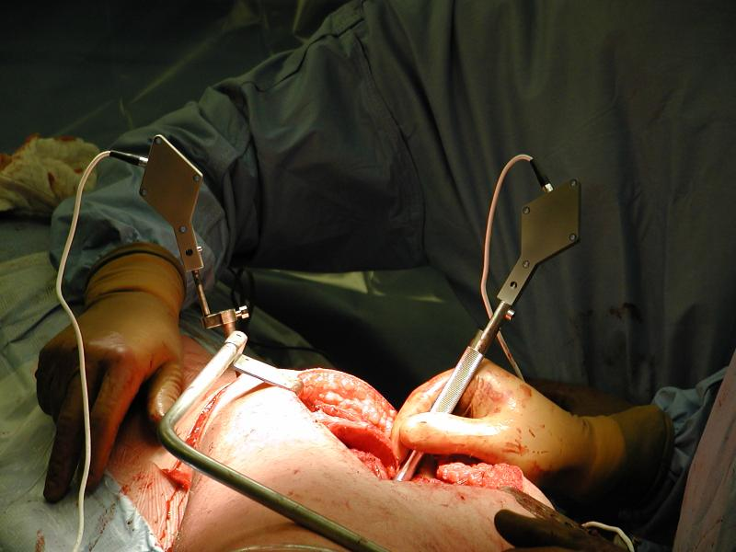
Frames in Computer-Aided Surgery
{P}
{T}
{C}

Slide 3
Frames in Computer-Aided Surgery
{P}
{M}
{T}

Slide 4
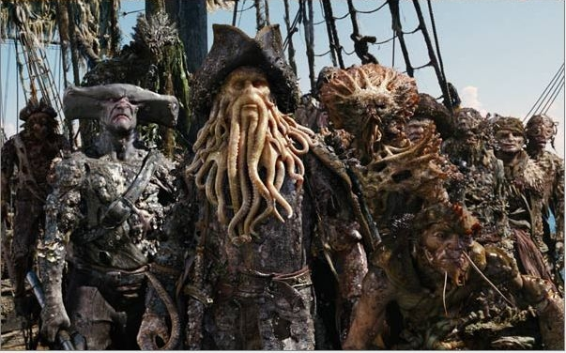
Frames in CGI

Slide 5
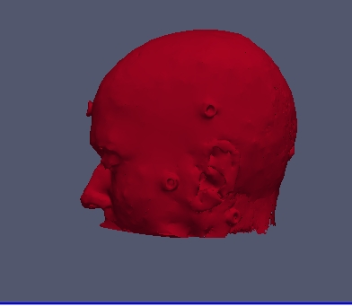
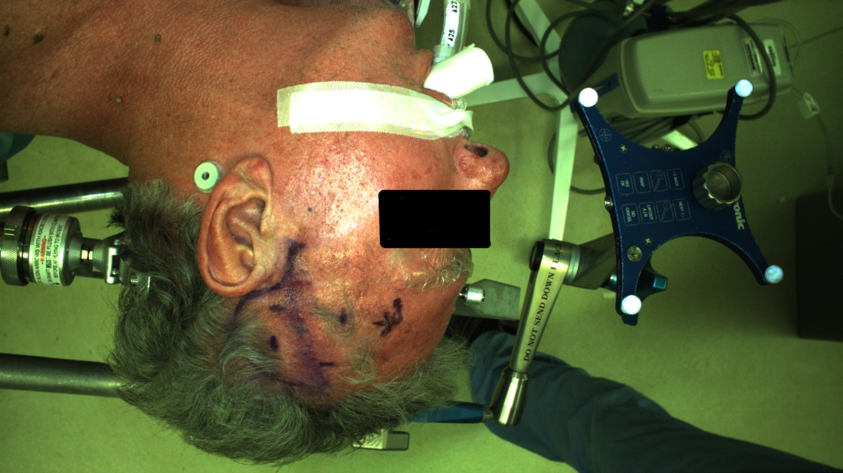
Frames in Computer-Aided Surgery
{P}
{CT }

Slide 6
Fiducial Registration
physical markers easily locatable in the medical imagery and on the patient are often used in neurosurgery to establish the spatial relationship between the patient and the images
same fundamental problem appears in many different fields and goes by many different names
fiducial registration
point-based registration
paired-point registration
registration with correspondances
absolute orientation
point fitting
...

Slide 7
Problem Statement
given n points measured in {L} and {R} estimate the transformation (or )
{L}
{R}

Slide 8
Problem Statement
given n points measured in {L} and {R}
find the transformation
residual errors
find the least-squares solution

Slide 9
1. Compute the Centroids
compute and subtract centroids from both sets of measurements

Slide 10
2. Compute the Matrix M
compute the sum of the component products for all pairs of corresponding points

Slide 11
3. Compute the Matrix N
use the elements of M to compute N
note that N is symmetric

Slide 12
4. Compute Eigenvectors and Eigenvalues
compute the eigenvectors and eigenvalues of N
in principle, the eigenvectors and eigenvalues can be found by finding the roots of a 4th order polynomial but numeric methods are easier
the fact that N is symmetric allows for efficient numeric eigenvalue/vector solvers
in Matlab
% D is a diagonal matrix of eigenvalues
% columns of V are the corresponding eigenvectors
[V, D] = eig(N);

Slide 13
5. Find the Quaternion
the quaternion representing the estimated rotation is the eigenvector corresponding to the largest positive eigenvalue
in Matlab
% y is the largest eigenvalue
% idx is the index of y in diag(D)
[y, idx] = max(diag(D));
Q = V(:, idx);

Slide 14
Quaternions
unit quaternions are another representation of rotations (and orientations)
the unit quaternion Q can be thought of as a scalar q_{w} and a vector [q_{x} q_{y} q_{z}]^{T}

Slide 15
6. Compute the Translation
use the centroids to compute the estimated translation
recall that
using the centroids

Slide 16
Issues
the use of the least-squares criteria assumes
identically distributed noise in each point
isotropic noise in each point
more accurate (although more complicated) algorithms are available if these criteria are not met
Matei and Meer, IEEE PAMI, 28(10), Oct 2006

Slide 17
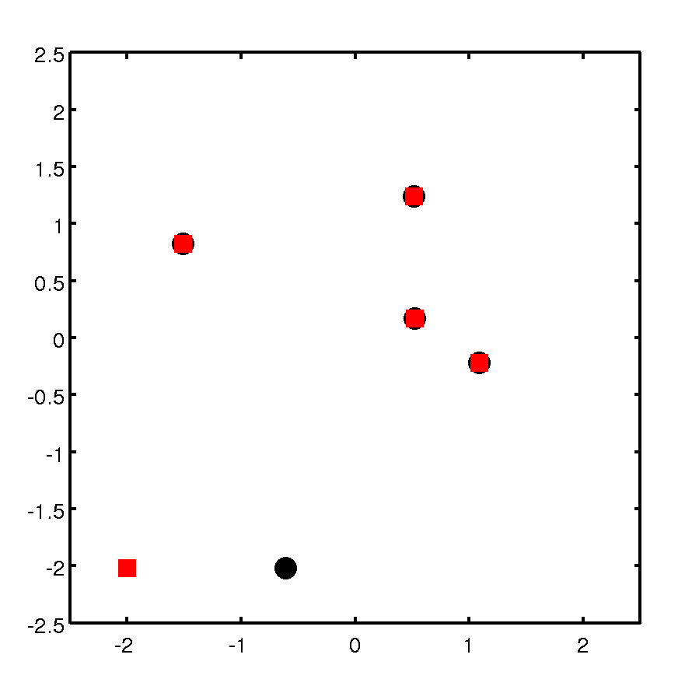
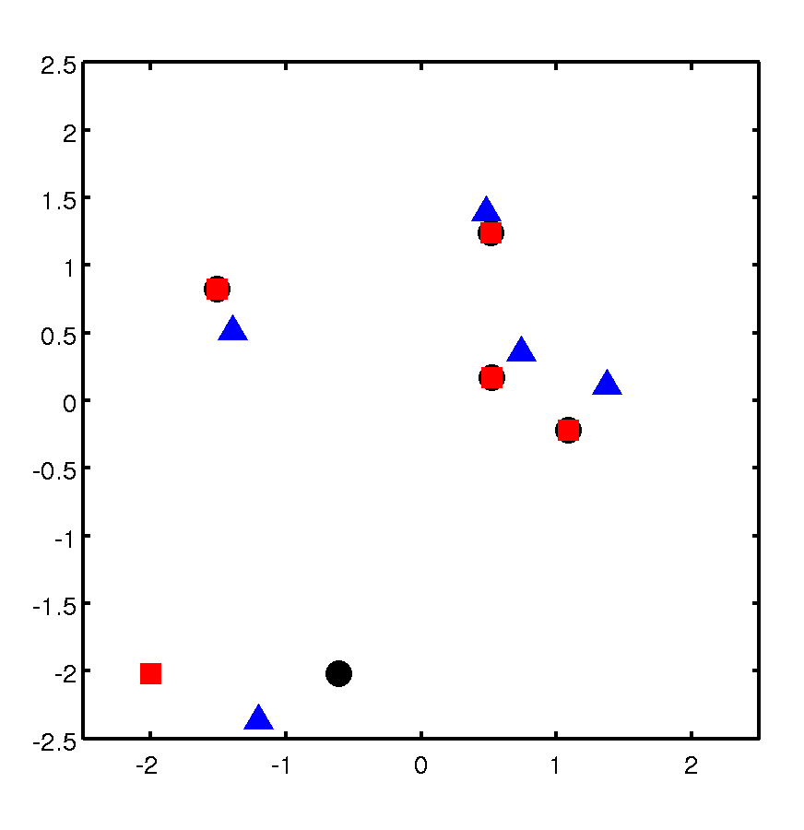
Issues
inaccurate measurements (statistical outliers) will lead to a poor estimate of the transformation
4 perfect measurements
1 inaccurate
measurement
measured
registered

