Slide 1
Checklists

Slide 2
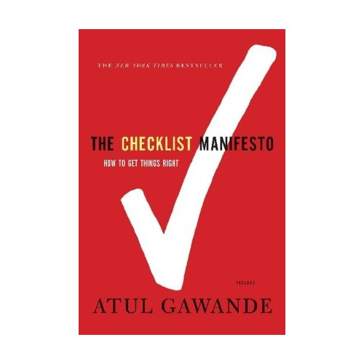
Atul Gawande, Brigham and Women’s Hospital

Slide 3
“Your mind doesn’t think of a bayonet in San Francisco,” John could only say.

Slide 4
equipment
failure?
blood clot?
asystole
massive
blood loss?
collapsed
lung?
lack of oxygen?

Slide 5
Causes of Failure
ignorance
lack of knowledge
ineptitude
knowledge exists but not applied correctly

Slide 6
Examples of Ineptitude
cardiac balloon therapy for heart attack should occur within 90 minutes of arrival at hospital
diagnosis, plan, inform patient, obtain consent, confirm no allergies or other medical problems, ready a lab and team, transport the patient, and get started
occurs in less than 50% of cases
at least 30% of stroke patients receive incomplete or inappropriate care
45% of asthma patients
60% of pneumonia patients
“Getting the steps right is proving brutally hard, even if you know them.”

Slide 7
“Here, then, is our situation at the start of the twenty-first century: We have accumulated stupendous know-how. We have put it in the hands of some of the most highly trained, highly skilled, and hardworking people in our society. And, with it, they have indeed accomplished extraordinary things. Nonetheless, that know-how is often unmanageable… And the reason is increasingly evident: the volume and complexity of what we know has exceeded our individual ability to deliver its benefits correctly, safely, or reliably. Knowledge has both saved and burdened us.”

Slide 8
Complexity in Medicine
World Health Organization international classification of diseases
more than 13,000 diseases, syndromes, injury
6,000 different drugs
4,000 medical and surgical procedures
in 1 year of office practice physicians evaluated an average of
250 different primary diseases and conditions
more than 900 other active medical problems
prescribed 300 medications
ordered more than 100 different types of laboratory tests
performed 40 different kinds of office procedures

Slide 9
Dealing with Complexity
superspecialization
“Then of course there are the surgeons. Surgeons are so absurdly ultraspecialized that when we joke about right ear surgeons and left ear surgeons, we have to check to be sure that they don’t exist.”

Slide 10
Checklists
checklists have a long history in other professions
aviation
construction
nursing
cooking
Van Halen

Slide 11
“When I would walk backstage, if I saw a brown M&M in that bowl, well, we’d line-check the entire production. Guaranteed you’re going to arrive at a technical error… Guaranteed you’d run into a problem.”

Slide 12
Peter Pronovost, Johns Hopkins Hospital, 2001
checklist for preventing central line infections
wash hands with soap
clean the patient’s skin with antiseptic
drape the patient
wear mask, hat, sterile gown, and gloves
put a sterile dressing over the insertion site after the line is in
observe doctors for a month (without using the checklist)
in more than 1/3 of patients doctors missed at least one step

Slide 13
Pronovost managed to convince administration to authorize the nurses to intervene if they observed a doctor skipping steps on the checklist
10-day infection rate dropped from 11% to 0%
estimated prevention of 43 infections and 8 deaths with a savings of $2,000,000
led to the Keystone Initiative in Michigan
New England Journal of Medicine, Dec 2006
within 3 months, infection rates fell by 66%
most ICUs cut infection rates to 0%
after 18 months, estimated savings of 1,500 lives and $175,000,000

Slide 14
The List is not Enough
success in complex non-routine problems often relies on
dispersing power
communication
when this fails to happen you end up with situations like the response to hurricane Katrina

Slide 15
Wal-Mart’s Response to Katrina
Lee Scott, CEO
“A lot of you are going to have to make decisions above your level. Make the best decision that you can with the information that’s available to you at the time, and, above all, do the right thing.”
within 2 days, employees figured out how to get tractor trailers with food, water, and emergency equipment into the city
“If the American government had responded like Wal-Mart has responded, we wouldn’t be in this crisis,” Jefferson Parish’s top official, Aaron Broussard, said in a network television interview at the time.

Slide 16
Communication
communication among a surgical team is typically poor
one survey of 300 staff members exiting the operating room
1 in 8 did not where the incision would be until the operation started
another survey of more than 1000 staff members in five countries
64% of surgeons rated their operations as having high levels of teamwork
39% of anesthesiologists
28% of nurses
10% of anesthesia residents
25% of surgeons believed that junior team members should not question the decision of senior members
another survey
half the time the staff did not know each others names

Slide 17
Communication
“activation phenomenon”
giving people a chance to say something at the start of the procedure activates their sense of participation and responsibility and their willingness to speak up
many surgical checklists include a step where all staff members introduce themselves
Kaiser Hospital in Southern California
3,500 operations
average teamwork rating increased from good to outstanding
employee satisfaction rose 19%
OR nurse turnover dropped from 23% to 7%

Slide 18
Communication

Slide 19
WHO Checklist
tested in 8 hospitals around the world
University of Washington Medical Center, Seattle
Toronto General Hospital
St. Mary’s Hospital, London
Auckland City Hospital, New Zealand
Philippines General Hospital, Manila
Prince Hamza Hospital, Amman, Jordan
St. Stephen’s Hospital, New Delhi, India
St. Francis Designated District Hospital, Ifakara, Tanzania

Slide 21
3 months pre-checklist
4,000 surgical patients
more than 400 major complications
about half involved infections
about a quarter technical failures
56 deaths
overall complication rates ranged from 6–21%
looked at 6 specific safety steps
best hospital missed at least one step 6% of the time
on average, the hospitals missed one step 2/3 of the time

Slide 22
results
rate of major complications fell 36%
rate of mortality fell 47%
80% of users reported that the checklist was easy to use
78% of users observed that the checklist prevented an error
“If you were having an operation would you want the checklist to be used?”
93% said yes

Slide 23
“To my own chagrin, however, I have yet to get through a week in surgery without the checklist’s leading us to catch something we would have missed.”

