Slide 1
Calibration

Slide 2
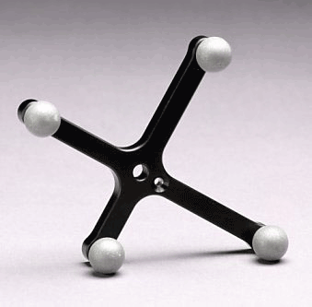
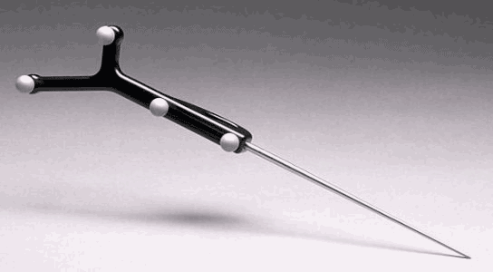
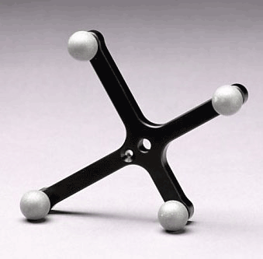
Tracked Pointers
http://www.ndigital.com/medical/polarisfamily-accessories.php

Slide 4
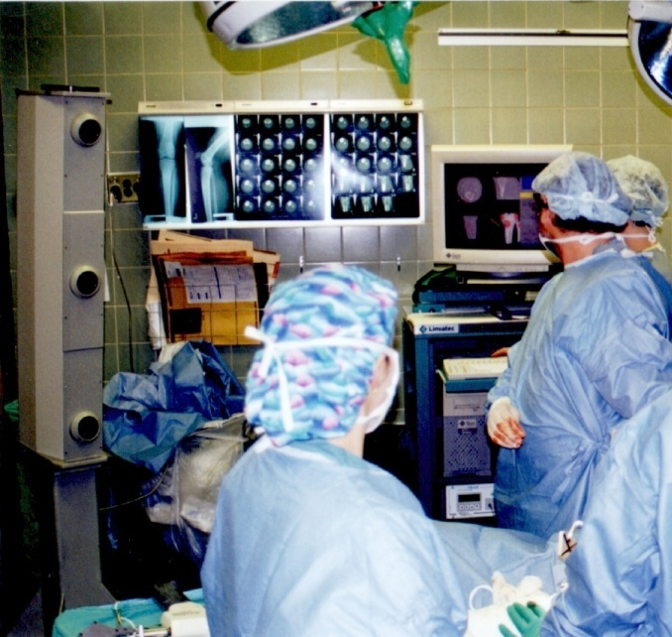
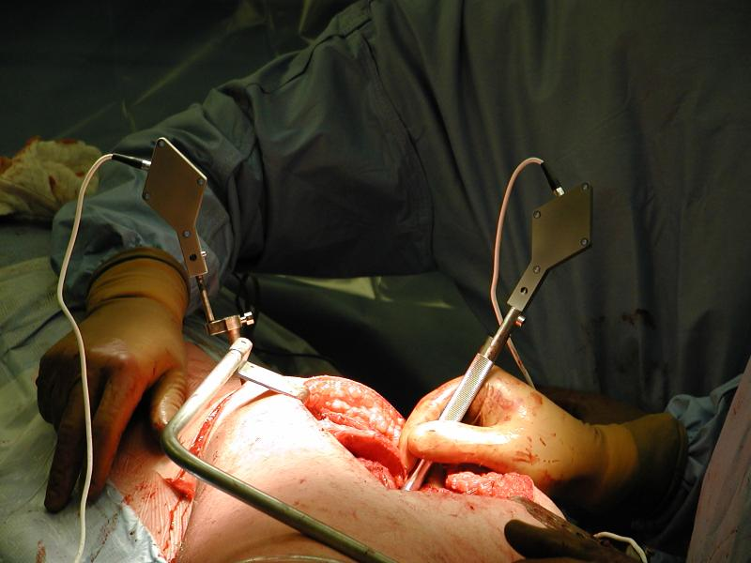
Frames in Computer-Aided Surgery
{P}
{T}
{C}

Slide 5
Calibrating a Tracked Pointer
{P}
{T}
{M}
_{M}
t_{p} ?

Slide 6
Pivot Calibration
constraint: pivot about a fixed point
p^{c}

Slide 7
Pivot Calibration
p^{c}

Slide 8
Pivot Calibration

Slide 9
Calibration By Sphere Fitting
when pivoting about a fixed point the path of each marker lies on the surface of a sphere
p^{c}

Slide 10
Circle Fitting: Algebraic Fitting
for circle fitting we wish to find the location of the center of the circle (a, b) and the circle radius R
the “obvious” approach is to minimize
the standard approach is to differentiate F with respect to a, b, and R, set the partial derivatives to zero, and then solve the resulting system of equations
unfortunately, the partial derivatives are non-linear

Slide 11
Circle Fitting: Algebraic Fitting
instead use a change of variables to obtain
it is easy to show that the partial derivatives are linear in B, C, and D
this approach is known as the Kåsa fit

Slide 12
Circle Fitting: Algebraic Fitting
unfortunately the Kåsa fit is poor when the measured points come from a small arc of the circle

Slide 13
Circle Fitting: Geometric Fitting
notice that the objective function minimized in the algebraic fit is not the true distance between each data point and the circle
(x_{i}, y_{i})
R
(a,b)

Slide 14
Circle Fitting: Geometric Fitting
the geometric fitting algorithms attempt to minimize the sum of orthogonal distances to the circle
there appears to be no non-iterative solution to this problem so standard numerical minimization techniques are used
steepest descent
Gauss-Newton
Levenberg-Marquardt

