Slide 1
Advanced Ray Tracing
Smoke and Fog

Slide 2
What is Ray Tracing?
Recall from Day 1: Computer Graphics is the inverse of Computer Vision, Kajiya Equation
Given 3D data, figure out the 2D image with cameras and lighting
Ray tracing is an alternative solution to the fixed-function/GLSL pipeline (mostly)
For each pixel in output image, shoot a ray (line segment) through the screen (viewport) into the scene to calculate intersections with geometry

Slide 3
Sound Complex?
Recall from Day 4: Human Eye, Optics
Human eye sees range of visible light emitted from light sources and bouncing/interacting with matter
First Idea: Try to compute light coming to the camera by tracing path of photons emitted from light source
- Very difficult, complex physics, slow
Second Idea: Trace path of light from screen to objects in scene then shade (approximate radiance)
Third Idea (Photon Mapping): Trace light from both light sources and screen, terminate after some quantitative criterion, compute radiance

Slide 4
Examples of Ray Traced Images (1)
IBM: Interactive Ray Tracer (iRT): Note the natural looking shadows and reflections

Slide 5
Examples of Ray Traced Images (2)
Ray tracing refractions are superior compared to GPU refraction, simply recursively ray trace at the refracted angle

Slide 6
Examples of Ray Traced Images (3)
Ray tracing also makes it easier to add camera effects such as depth of field

Slide 7
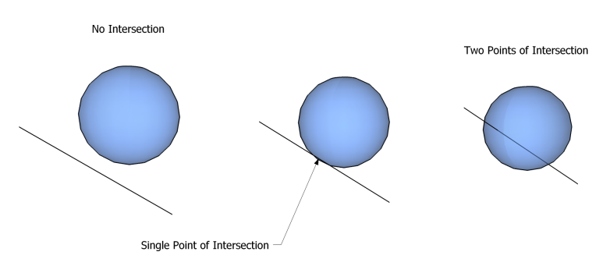
Do we need primitive geometry?
Depending on your implementation, we might not need vertices, quads & triangles for certain geometric primitives
Sphere: |x – c|² = r² , Line: x = dl
Solve for d:
|dl – c|² = r²
Expand and Simplify:
d²l² = 2d(l ∙ c) + c² –r² = 0
Quadratic Equation:
d = (l ∙c) ± sqrt((l ∙c)² – c² + r² )

Slide 8
Hardware Discussion
All of this is easily done without a graphics card!
Need to manually manage transformation matrices for the entire scene (not as hard as it sounds) in your application
No card compatibility problems in graphics applications (#version)
faster processor → instantly faster application (Exact same code running on Core 2 Duo vs. i7)
Embarrassingly parallel, Can use as many cores as you give it, imagine one core per pixel!

Slide 9
Advanced Topics
Real-time ray tracing
Aliasing/Anti-aliasing
Smoke and fog

Slide 10
Real Time Ray Tracing
Previously very limited
The trick is usually high parallelization
Clever optimizations at a low level make a big difference
Recently there have been some interesting developments
Quake Ray Traced
http://en.wikipedia.org/wiki/Quake_Wars:_Ray_Traced
IBM iRT
http://www.youtube.com/watch?v=oLte5f34ya8
NVIDIA announced OptiX, a ray tracing hardware pipeline in 2009 available on CUDA (parallel computing architecture) chips
http://www.youtube.com/watch?v=87PmVhERz6A

Slide 11
Anti-aliasing (1)
Aliasing: Distortion caused by sampling multiple signals, reconstructed (discrete) signal is not the same as the continuous one
In ray tracing we see aliasing on the edges of objects, very sharp lines and jagged edges
At one pixel the ray misses the object, at the next pixel it hits the target, there is no transition

Slide 12
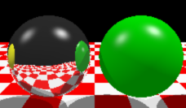
Anti-aliasing (2)
Anti-aliased image, super-sampling averages neighborhood of pixels, slight blurring
Original aliased image, note rough edges

Slide 13
Anti-aliasing (3)
Also some distributed techniques, better than blurring
Original criticisms of ray tracing argued that things look too clean / artificial
Distributed ray tracing uses noisy perturbations of rays shot through scene
2001 SIGGRAPH paper talks about using Perlin Noise in anti-aliasing
Monte Carlo integration

Slide 14
Fog and Smoke Modelling (1)
Will briefly talk about how to actually model smoke physically
Physics behind fluid dynamics is very tough
Fluid dynamics laws: Navier-Stokes equations
Figuring out when Navier-Stokes equations have solutions is one of the Clay Mathematics Millennium Prize Problems (1M dollar prize)
Probably as hard as P = NP problem
Usually a good hack is enough (human eye does not detect these things very well anyways)

Slide 15
Fog and Smoke Modelling (2)
Rough basics of particle systems (different lecture topic)
Particles as vectors that store measured quantities e.g. Position, velocity, force, mass, heat, energy, colour etc...
Have system of differential equations for a particle system, compute forces (based on physics laws)
Force and mass tells us acceleration, integration of acceleration gives velocity, integration of velocity gives position
Explicit integration methods cause instability, force slow time steps in simulation

Slide 16
Fog and Smoke Modelling (3)
Physics of fluid dynamics assumes viscous flow of incompressible fluids
Navier-Stokes system of equations, pressure gradient
Local pressure
gravity
Kinematic viscosity

Slide 17
Fog and Smoke Modelling (4)
Navier-Stokes: All possible momentum difference possibilities
Gives us a way to calculate buoyancy forces...more physics
The previous slide shows a continuous model
To do this on a computer, needs to be discretized
Usually bound by a volume cube, compute pressure in voxels, need to mark which part of volume is surface of fluid, empty cells and internal cells (non surface volume, cells with particles in them)
Leads into volume rendering, volumetric ray tracing (I think this is also another lecture topic)
Simulation: http://www.youtube.com/watch?v=vOFcHqImXJ8

Slide 18
Back to Ray Tracing
To ray trace fog and smoke, do not need to look too heavily at simulation, integration techniques
Lets not think too much about smoke geometry & simulation here
From an optics point of view fog and smoke are light scattering phenomenon
Radiance is no longer constant along a ray (between surfaces)

Slide 19
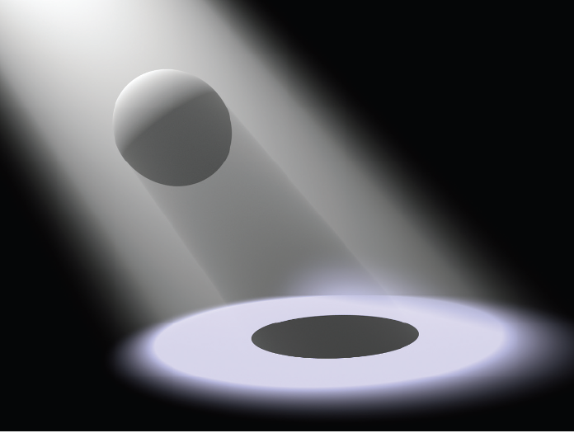
Volume Scattering (1)
Three phenomenon to consider:
Emission
Absorption
Scattering
Taken from Physically Based Rendering, Matt Pharr and Greg Humphreys. 2004. Chapter 11: Volume Scattering

Slide 20
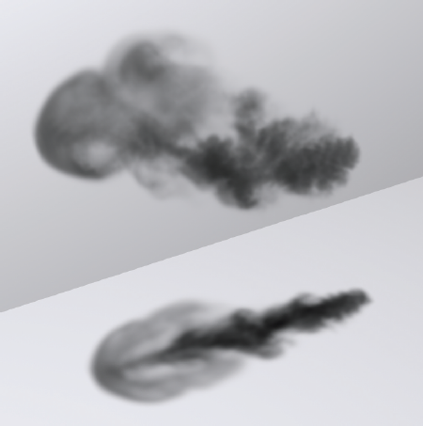
Volume Scattering - Absorption (2)
Absorption of radiance as ray passes through medium

Slide 21
Volume Scattering - Absorption (3)
L₀(p, ω) - L_{i}(p, -ω) = dL₀(p, ω) = -σ_{a}(p, ω)L_{i}(p, -ω)dt
Derivative linear combination of itself:

Slide 22
Volume Scattering – Emission (4)
Emission of radiance as ray passes through medium

Slide 23
Volume Scattering – Emission (5)
L_{ve}(p, ω) is another distribution function
Differential Equation:
dL₀(p, ω) = L_{ve}(p, ω) dt

Slide 24
Volume Scattering (6)
In-scattering, Out-scattering and extinction
Beams of light deflected out of path of ray
Beams of light deflected into path of ray
Caused by collisions with particles in the medium
Out-Scattering coefficient, again chosen in a distribution function
σ_{s}(p, ω)

Slide 25
Volume Scattering (7)
Differential equation that defines out-scattering
dL₀(p, ω) = -σ_{s}(p, ω)L_{i}(p, -ω) dt
Combine out-scattering and absorption, we get extinction
σ_{t}(p, ω) = σ_{a}(p, ω) + σ_{s}(p, ω)
Differential equation:
dL₀(p, ω)/dt =−σ_{t}(p, ω) L_{i}(p, −ω)
Solution of this system is called the transmittance

Slide 26
Volume Scattering (8)
Accounting for extinction, if radiance of point p point is L₀(p, ω), incident radiance at point p’ is:
T_{r}(p→p’)L₀(p, ω)

Slide 27
Volume Scattering (9)

Slide 28
Volume Scattering (10)
Particles are roughly spaced out by a few multiples of their radii
Use a phase function, this is the volumetric version of BDRF
Angular distribution of scattered radiance
Phase functions are probability density functions
In-scattering:

Slide 29
Volume Scattering (11)

Slide 30
Bibliography
Pharr, Matt. Humphreys, Greg. (2004). Physically Based Rendering. MA. Elsevier, Inc. [1]
Foster, N. Metaxas, D. (1996). Realistic Animation of Liquids. Graphical Models and Image Processing. Volume 58 (5), 24. [2]
Fedkiw, R. Stam, J. Jensen, H.W. (2001). Visual Simulation of Smoke. SIGGRAPH ‘01, 8. [3]
Zhou, K. Ren, Z. Lin, S. Bao, H. Guo, B. Shum, H. 2008. ACM Transactions of Graphics. Volume 27 (3), 12. [4]
Langer, M. (2008, November, 13). Volume Rendering [PDF], Retrieved From: www.cim.mcgill.ca/~langer/557/lecture20.pdf
Links:
http://en.wikipedia.org/wiki/Ray_tracing_%28graphics%29
http://en.wikipedia.org/wiki/Aliasing

