Slide 1
Non-photorealistic Rendering

Slide 2
Non-photorealistic Rendering
a longtime goal of graphics research has been to render a scene that is indistinguishable from a photograph of the scene
non-photorealistic rendering, or stylized depiction, is inspired by artistic styles
painting
drawing
etching
technical illustration
cartoons

Slide 3
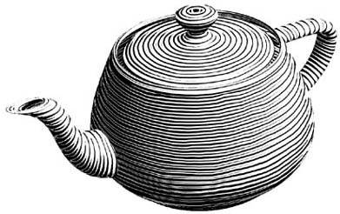
Hatching
attempts to render an object so that it looks hand drawn with strokes drawn with pen and ink
strokes lead to perception of shape and lighting
stroke width and placement are important

Slide 4
Hatching
vertex shader outputs per-vertex diffuse lighting
no ambient or specular component
intensity only
vertex shader outputs model coordinates of each vertex
model coordinates are used to access a noise texture
vertex shader outputs one component of the incoming texture coordinate
strokes are rendered along the other texture coordinate direction

Slide 5
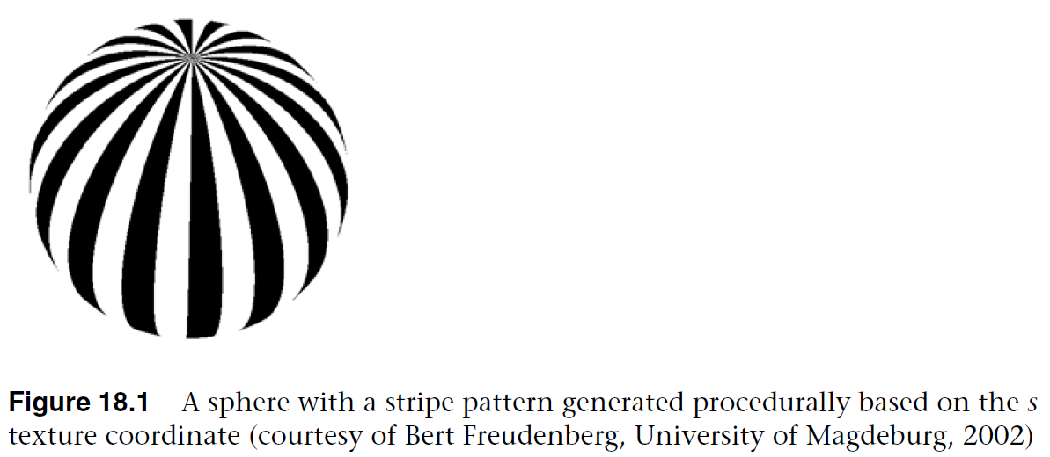
Hatching
vertex shader outputs one component of the incoming texture coordinate
strokes are rendered along the other texture coordinate direction
OpenGL Shading Language, 3rd Edition

Slide 6
Hatching
fragment shader procedurally generates strokes
relies on generating a regular striped pattern
float sawtooth = fract(V * 16.);
float triangle = abs(2. * sawtooth – 1.);
float square = step(0.5, triangle);

Slide 7
Hatching
want stripes of uniform width
how do we calculate how wide a stripe is at a given location on the surface?
look at how quickly the texture coordinate changes
float dp = length(vec2(dFdx(V), dFdy(V)));
skinny here
fat here

Slide 8
Hatching
each time dp doubles, the number of strokes doubles
strokes become too thin and too densely placed
suppose that we want N strokes for some value of dp = G
dp | Number of strokes
G | N
2G | N / 2
4G | N / 4
8G | N / 8
float logdp = -log2(dp);
float ilogdp = floor(logdp);
float freq = exp2(ilogdp);
float sawtooth = fract(V * freq * stripes);

Slide 9
Hatching
OpenGL Shading Language, 3rd Edition

Slide 10
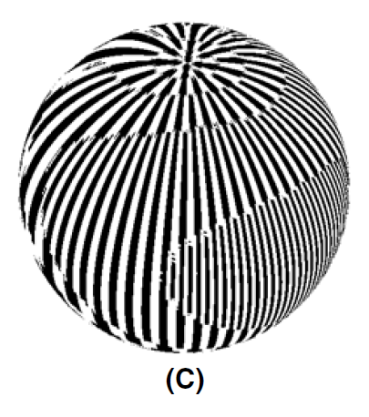
Hatching
notice that suddenly reducing the number of strokes leads to strong visual artifacts
OpenGL Shading Language, 3rd Edition

Slide 11
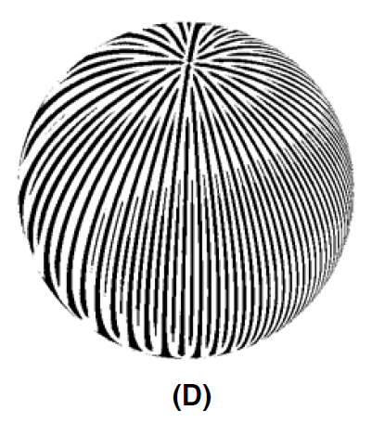
Hatching
the trick is to use the fraction part of logdp to do a smooth blend of the two frequencies
float transition = logdp – ilogdp;
triangle = abs((1. + transition) * triangle – transition);
OpenGL Shading Language, 3rd Edition

Slide 12
Hatching
width of stripes is used to simulate lighting effects
dark stripes should be wider where light intensity is low and narrower where light intensity is high
float sawtooth = fract(V * 16.);
float triangle = abs(2. * sawtooth – 1.);
float square = step(0.5, triangle);
this value affects the width of the stripe
OpenGL Shading Language, 3rd Edition

Slide 13
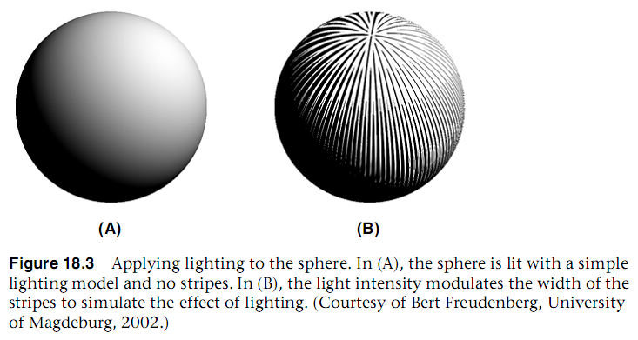
Hatching
use the computed light intensity to modulate the stripe width
float edge0 = clamp(LightIntensity - edgew, 0., 1.);
float edge1 = clamp(LightIntensity, 0., 1.);
float square = 1. - smoothstep(edge0, edge1, triangle);
OpenGL Shading Language, 3rd Edition

Slide 14
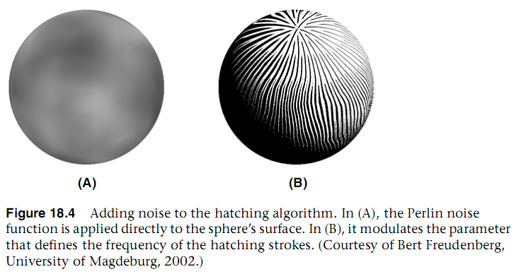
Hatching
finally, adding noise to the stripe generating function will create a “hand drawn” effect
float noise = texture(Noise3, ObjPos).r;
float sawtooth = fract((V + noise * 0.0) * frequency * stripes);
OpenGL Shading Language, 3rd Edition

Slide 15
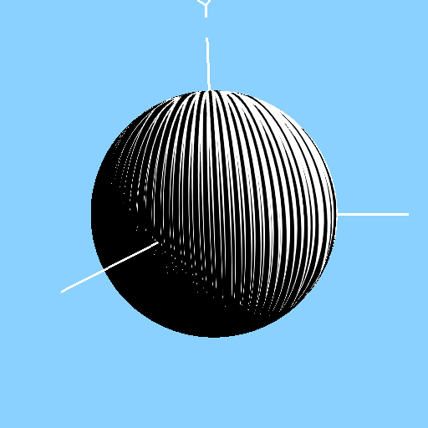
Hatching

Slide 16
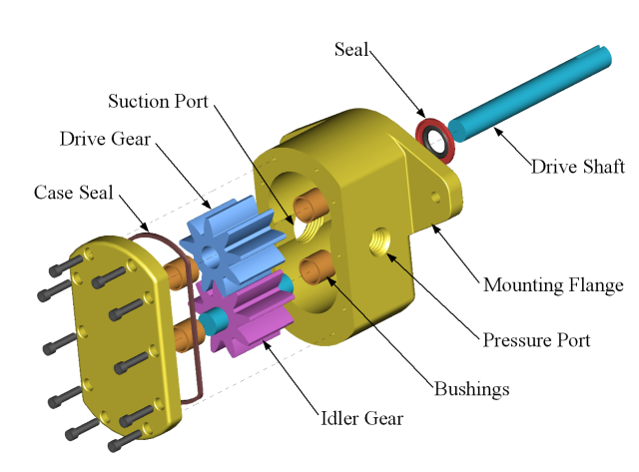
Technical Illustration Shading
illustrations in technical books (manuals, textbooks, CAD drawings) are typically stylized illustrations that tend to emphasize important details and de-emphasize other details (e.g., no shadows, no reflections, etc.)
http://en.wikipedia.org/wiki/File:Gear_pump_exploded.png

Slide 17
Technical Illustration Shading
Gooch, Gooch, Shirley, Cohen proposed a list of common characteristics for airbrush and pen drawings
surface boundaries, silhouette edges, and surface discontinuities are drawn with black curves
single light source, white highlights, positioned above the object
effects that add realism (shadows, reflections, multiple light sources) are omitted
matte objects are shaded with intensities far from white or black so as to be distinct from edges and highlights
warmth or coolness of color indicates curvature of surface

Slide 18
Gooch Shading
“low dynamic range artistic tone algorithm”
requires edge information
specular highlights computed using Phong model and shaded white
limited range of luminance used to indicate curvature
diffuse term only
add a warm-to-cool color gradient to convey more information about surface curvature
warm colors tend to advance towards the viewer and cool colors tend to recede from the viewer

Slide 19
Gooch Shading
A Non-Photorealistic Lighting Model For Automatic Technical Illustration

Slide 20
Gooch Shading
A Non-Photorealistic Lighting Model For Automatic Technical Illustration

Slide 21
Gooch Shading
A Non-Photorealistic Lighting Model For Automatic Technical Illustration

Slide 22
Gooch Shading
A Non-Photorealistic Lighting Model For Automatic Technical Illustration

Slide 23
Gooch Shading
A Non-Photorealistic Lighting Model For Automatic Technical Illustration

Slide 24
Gooch Shading
A Non-Photorealistic Lighting Model For Automatic Technical Illustration

Slide 25
Gooch Shading
edge information can be obtained in several ways
edge detection
silhouette only
best way is to identify important edges in modelling process

Slide 26
Gooch Shading
warm and cool colors
pick a cool color for surfaces angled away from the light source
pick a warm color for surfaces facing the light source
add in the diffuse illumination and mix based on the value of

Slide 27
Gooch Shading
vertex shader
performs the usual transformation of vertices and normals
computes at each vertex (for the fragment shader)
computes the view and reflection vectors at each vertex (for the fragment shader)

Slide 28
Gooch Shading
#version 330 compatibility
in vec4 aVertex;
in vec4 aNormal;
uniform mat4 uModelViewProjectionMatrix;
uniform mat4 uModelViewMatrix;
uniform mat4 uNormalMatrix;
out float vNdotL;
out vec3 vReflectDir;
out vec3 vViewDir;
// light position in eye coordinates
const vec3 myLightPosition = vec3(5., 5, 1.);

Slide 29
Gooch Shading
void main(void)
{
vec3 ecPos = vec3(uModelViewMatrix * aVertex);
vec3 norm = normalize(vec3(uNormalMatrix * aNormal));
vec3 lightDir = normalize(myLightPosition - ecPos);
vReflectDir = normalize(reflect(-lightDir, norm));
vViewDir = normalize(-ecPos);
vNdotL = dot(lightDir, norm) * 0.5 + 0.5;
gl_Position = uModelViewProjectionMatrix * aVertex;
}

Slide 30
Gooch Shading
geometry shader computes silhouette edges and passes per-vertex information from vertex shader to fragment shader
geometry shader needs adjacency information
fragment shader computes Phong specular term and blends the warm and cool colors

Slide 31
Gooch Shading
#version 330 compatibility
uniform vec4 uSurfaceColor;
uniform vec4 uWarmColor;
uniform vec4 uCoolColor;
uniform float uDiffuseWarm;
uniform float uDiffuseCool;
in float gNdotL;
in vec3 gReflectDir;
in vec3 gViewDir;
flat in int gIsEdge;
out vec4 fFragColor;

Slide 32
Gooch Shading
void main()
{
if (gIsEdge == 0)
{
vec3 kcool = min(uCoolColor.rgb + uDiffuseCool * uSurfaceColor.rgb, 1.);
vec3 kwarm = min(uWarmColor.rgb + uDiffuseWarm * uSurfaceColor.rgb, 1.);
vec3 kfinal = mix(kcool, kwarm, gNdotL);
vec3 nreflect = normalize(gReflectDir);
vec3 nview = normalize(gViewDir);
float spec = max(dot(nreflect, nview), 0.);
spec = pow(spec, 32.);
fFragColor = vec4(min(kfinal + spec, 1.), 1.);
}
else
{
fFragColor = vec4(0., 0., 0., 1.);
}
}

Slide 33
Gooch Shading

Slide 34
Gooch Shading
A Non-Photorealistic Lighting Model For Automatic Technical Illustration

