Slide 1
Image Processing

Slide 2
Image Processing
a typical image is simply a 2D array of color or gray values
i.e., a texture
image processing takes as input an image and outputs
characteristics about the image
a new image
modifies the input image
many image processing algorithms are “embarrassingly parallel”
computation at each pixel is completely independent of the computations done at all other pixels

Slide 3
Image Processing on the GPU
input image = 2D image texture
per-pixel computation = fragment shader
use texture coordinates to access pixels
visualize results
use fragment shader to render to a texture mapped quadrilateral
store results
use fragment shader to render to texture memory

Slide 4
Image Processing with glman
sample glib file for a single image
##OpenGL GLIB
Ortho -1. 1. -1. 1.
Texture 5 sample1.bmp
Vertex sample.vert
Fragment sample.frag
Program Sample uImageUnit 5
QuadXY .2 5

Slide 5
Image Processing with glman
vertex shader
#version 330 compatibility
out vec2 vST;
void main( )
{
vST = aTexCoord0.st;
gl_Position = uModelViewProjectionMatrix * aVertex;
}

Slide 6
Luminance
luminence is the physical measure of brightness
has a specific definition to a physicist
a black and white (or grayscale) image is typically (approximately) a luminence image
human perception of brightness depends strongly on the viewing environment
see http://www.w3.org/Graphics/Color/sRGB

Slide 7
Luminance
an image encoded in sRGB color space can easily be converted to a luminance image
notice that the formula reflects the fact that the average human viewer is most sensitive to green light and least sensitive to blue light

Slide 8
Luminance
fragment shader
#version 330 compatibility
uniform sampler2D uImageUnit;
in vec2 vST;
out vec4 fFragColor;
void main( )
{
vec3 irgb = texture2D( uImageUnit, vST ).rgb;
fFragColor = dot( irgb, vec3(0.2125,0.7154,0.0721) );
}

Slide 9
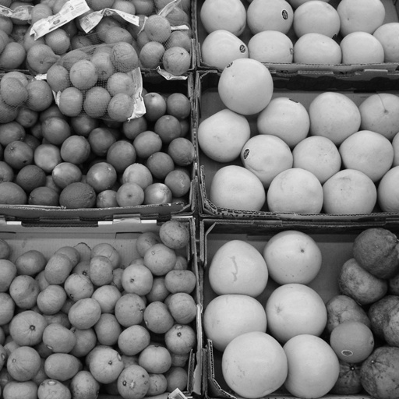
Luminance

Slide 10
Image Rotation
rotation in 2D about the origin by an angle θ can be performed using the matrix
typically you want to rotate about the center of the image, which has texture coordinates (0.5, 0.5)

Slide 11
Image Rotation
shift incoming texture coordinates by (-0.5, -0.5)
rotate the shifted coordinates by -θ
shift the rotated coordinates by (0.5, 0.5)
after transforming the incoming texture coordinates, you will need to check to make sure that they are in the range [0, 1]

Slide 12
Image Rotation
fragment shader
#version 330 compatibility
uniform float uRotation;
uniform sampler2D uImageUnit;
in vec2 vST;
out vec4 fFragColor;

Slide 13
Image Rotation
void main( )
{
// shift s and t to range [-0.5, 0.5]
vec2 uv = vST - vec2(0.5, 0.5);
// rotate uv by -uRotation
float rad = -uRotation * 3.141592653589793 / 180.;
float c = cos(rad);
float s = sin(rad);
float u = dot(vec2(c, -s), uv);
float v = dot(vec2(s, c), uv);
// shift back to range [0, 1]
u += 0.5;
v += 0.5;
// in range [0, 1]?
if (u >= 0. && u <= 1. && v >= 0. && v <= 1.)
fFragColor = texture(uImageUnit, vec2(u, v));
else
fFragColor = vec4(0., 0., 0., 1.);
}

Slide 14
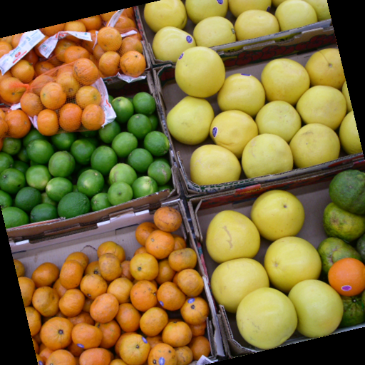
Image Rotation
rotation of +15 degrees

Slide 15
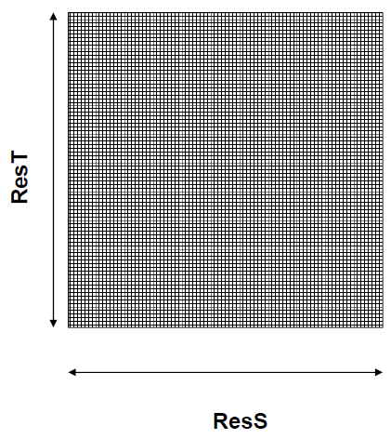
Image Dimensions
image dimensions can be retrieved using
the distance between neighboring texels is
ivec2 ires = textureSize(uImageUnit, 0);
int ResS = ires.s;
int ResT = ires.t;
float dS = 1. / ResS;
float dT = 1. / ResT;

Slide 16
Spatial Filtering
spatial filtering, or convolution, is a common image processing tool
basic idea
input: image + convolution kernel (or mask)
mask is often small (e.g., 3x3 or 5x5)
each pixel at location (i, j) in the output image is obtained by centering the mask on the input image at location (i, j) and multiplying the mask and image element by element and summing the values*

Slide 17
Spatial Filtering
-1
-2
-1
0
0
0
(s-dS,
t+dt)
(s,
t+dT)
(s+dS,
t+dT)
1
2
1
t
(s-dS,
t)
(s,
t)
(s+dS,
t)
(s-dS,
t-dT)
(s,
t-dT)
(s+dS,
t-dT)
mask
s

Slide 18
Spatial Filtering
edges occur at locations in an image that correspond to object boundaries
edges are pixels where image brightness changes rapidly
the Sobel filters are common simple edge detectors
horizontal edge detector
vertical edge detector

Slide 19
Generic 3x3 Spatial Filter Shader
converts color image to luminance image and filters the luminance image
fragment shader
#version 330 compatibility
uniform sampler2D uImageUnit;
in vec2 vST;
out vec4 fFragColor;
float luminance(in vec2 st)
{
vec3 irgb = texture2D(uImageUnit, st).rgb;
float lum = dot( irgb, vec3(0.2125,0.7154,0.0721) );
return lum;
}

Slide 20
Generic 3x3 Spatial Filter Shader
void main( )
{
// get image dimensions
ivec2 ires = textureSize(uImageUnit, 0);
int ResS = ires.s;
int ResT = ires.t;
float dS = 1. / ResS;
float dT = 1. / ResT;
vec2 left = vec2(-dS, 0);
vec2 right = vec2(dS, 0);
vec2 up = vec2(0, dT);
vec2 down = vec2(0, -dT);

Slide 21
Generic 3x3 Spatial Filter Shader
// sobel horizontal edge detector
mat3 kernel = mat3(-1., 0., 1., -2., 0., 2., -1., 0., 1.);
mat3 subimg = mat3(luminance(vST + left + up),
luminance(vST + left),
luminance(vST + left + down),
luminance(vST + up),
luminance(vST),
luminance(vST + down),
luminance(vST + right + up),
luminance(vST + right),
luminance(vST + right + down));

Slide 22
Generic 3x3 Spatial Filter Shader
float result = dot(kernel1[0], subimg[0]) +
dot(kernel1[1], subimg[1]) +
dot(kernel1[2], subimg[2]);
fFragColor = vec4(result, result, result, 1.);
}

Slide 23
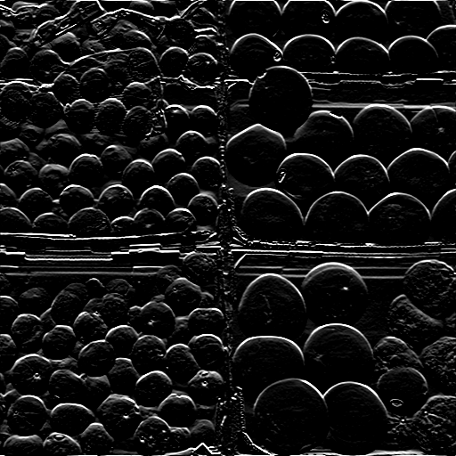
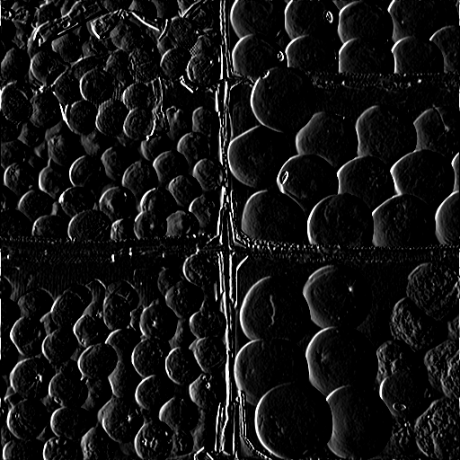
Sobel Filtering
horizontal edge detector
g_{x}
vertical edge detector
g_{y}
gradient magnitude

Slide 24
Gaussian Blur
blurring an image is a task commonly done as a preprocessing step for subsequent image processing
the Gaussian kernel is a truncated discrete approximation to the Gaussian function

Slide 25
Gaussian Blur

Slide 26
Gaussian Blur
the Gaussian kernel has a nice property called separability
separability means that convolution with the 2D kernel is equivalent to convolution with two 1D kernels applied serially to the image

Slide 27
Gaussian Blur
we need to store the intermediate result of blurring with the first 1D kernel
try rendering the intermediate result to a texture

Slide 28
Gaussian Blur
##OpenGL GLIB
GSTAP
Ortho -5. 5. -5. 5.
LookAt 0 0 1 0 0 0 0 1 0
Texture2D 5 fruit.bmp
Texture2D 6 512 512
RenderToTexture 6
Clear
Vertex filt1.vert
Fragment filt1h.frag
Program Filt uImageUnit 5
QuadXY .2 5.
RenderToTexture
Ortho -5. 5. -5. 5.
LookAt 0 0 1 0 0 0 0 1 0
Clear
Vertex filt1.vert
Fragment filt1v.frag
Program Filt uImageUnit 6
QuadXY .2 5.

Slide 29
Gaussian Blur

Slide 30
Gaussian Blur
qualitatively the results look identical
numerically there is a difference because the rendered quadrilateral from the first pass is not an exact substitute for an image
if you need to do high quality image processing then you might be better off investigating alternative methods

