Slide 1
Tesselation Shaders

Slide 2
Tesselation
dictionary definition of tesselate is the forming of a mosaic

Slide 3
Tesselation
in computer graphics tesselation refers to the subdivision of a surface (not necessarily made up of polygons) into smaller polygons
there should be no seams between polygons
there should be no overlap of the polygons
typically used to convert a coarse model to a model with fine detail

Slide 4
Tesselation
coarse model
smooth tesselated
model
tesselated
model
+
displacement
mapping
http://www.nvidia.com/object/tessellation.html

Slide 5
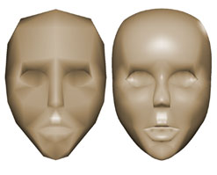
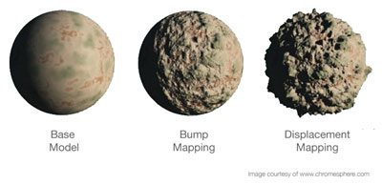
Tesselation
the effects of tesselation are often most apparent around the silhouette of objects
http://www.nvidia.com/object/tessellation.html

Slide 6
Tesselation Shaders
TCS
TPG
TES
http://web.engr.oregonstate.edu/~mjb/cs519/Handouts/tessellation.1pp.pdf

Slide 7
Tesselation Shaders
patch
quads
(which are
converted
to triangles)
isolines
triangles

Slide 8
Patch
when a tesselation shader is active the only primitive that can be used is a patch
the GL_PATCHES type is what you would use in your OpenGL program; e.g.,
glBegin(GL_PATCHES);
glVertex... glVertex... // and so on glEnd();
the patch is just a chunk of geometry (vertices) that is defined by the programmer

Slide 9
Tesselation Primitive Generator
patches are never directly rendered
tesselation primitive generator (TPG) generates the primitives that are eventually passed down the remainder of the pipeline
TPG is a fixed function stage that runs once per patch
but configurable to produce primitives based on a set of standard tesselation algorithms
TCS sets up the TPG and instructs the TPG how many primitives to generate
TES determines the vertex positions of the primitives generated by the TPG
TPG generates primitives with vertices defined in a parametric space (u, v, w) where 0 ≤ u, v, w ≤ 1

Slide 10
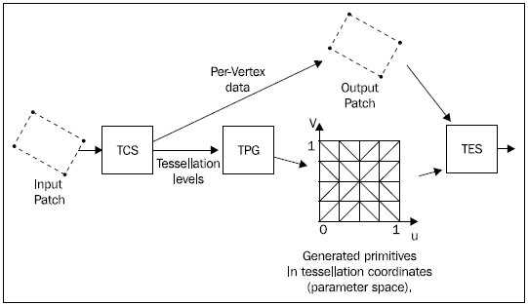
Tesselation Control Shader
TCS runs for each vertex in a patch
can compute additional information about the patch and vertices and pass them to the TES
tells TPG how many primitives to produce
OpenGL 4 Shading Language Cookbook

Slide 11
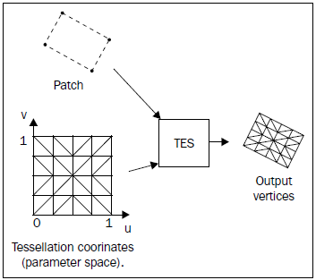
Tesselation Evaluation Shader
TES specifies which algorithm the TPG uses
seemingly strange because the TES runs after the TPG; the GLSL compiler resolves this inconsistency
runs once per output vertex generated by the TPG
TES uses the parametric coordinates provided by the TPG and the patch vertices to determine the final positions of the output primitive vertices
OpenGL 4 Shading Language Cookbook

Slide 12
Outer and Inner Division Levels
TCS tells the TPG how many primitive to produce by specifying the outer and inner division levels via a pair of output arrays
patch out float gl_TessLevelOuter[4]
patch out float gl_TessLevelInner[2]
 | quad | triangle | isoline
gl_TessLevelOuter[0] | ✓ | ✓ | ✓
gl_TessLevelOuter[1] | ✓ | ✓ | ✓
gl_TessLevelOuter[2] | ✓ | ✓ | ✗
gl_TessLevelOuter[3] | ✓ | ✗ | ✗
gl_TessLevelInner[0] | ✓ | ✓ | ✗
gl_TessLevelInner[1] | ✓ | ✗ | ✗

Slide 13
Outer and Inner Division Levels
quad tesselation
first subdivide the original rectangle into a regular mesh of rectangles where the number of subdivisions is given by the inner tesselation level
v
u
gl_TessLevelInner[0] = 5
gl_TessLevelInner[1] = 4

Slide 14
Outer and Inner Division Levels
quad tesselation
all rectangles except those adjacent to one of the outer rectangle edges are decomposed into triangle pairs
spec says “algorithm used to subdivide the rectangular domain in (u, v) space into individual triangles is implementation-dependent”

Slide 15
Outer and Inner Division Levels
quad tesselation
outermost rectangle edges are subdivided independently
gl_TessLevelOuter[0] = 1
gl_TessLevelOuter[1] = 2
gl_TessLevelOuter[2] = 4
gl_TessLevelOuter[3] = 5

Slide 16
Outer and Inner Division Levels
quad tesselation
area between inner rectangles and outer edges are filled by triangles produced by joining the vertices on the subdivided outer edges to the vertices on the edge of the inner mesh

Slide 17
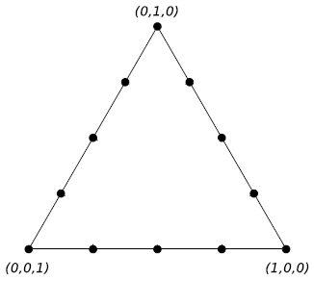
Outer and Inner Division Levels
triangle tesselation
first temporarily subdivide each edge of an equilateral triangle using the inner tesselation level n
gl_TessLevelInner[0] = 4

Slide 18
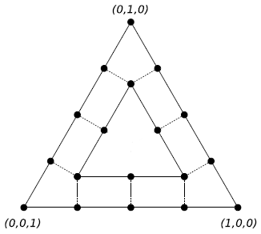
Outer and Inner Division Levels
triangle tesselation
generate a nested inner triangle with edges subdivided in n-2 segments

Slide 19
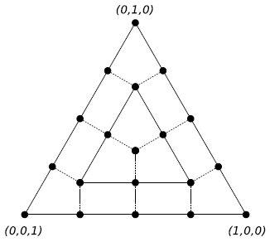
Outer and Inner Division Levels
triangle tesselation
continue generating nested inner triangles until a triangle with edge subdivision equal to 0 or 1 is reached

Slide 20
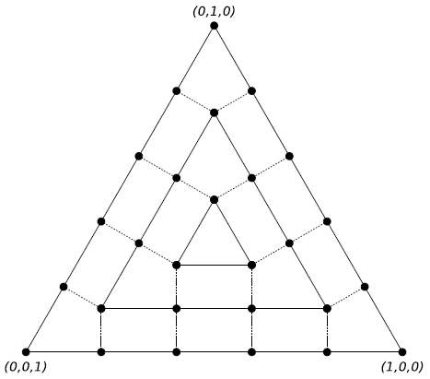
Outer and Inner Division Levels
triangle tesselation
continue generating nested inner triangles until a triangle with edge subdivision equal to 0 or 1 is reached
gl_TessLevelInner[0] = 5

Slide 21
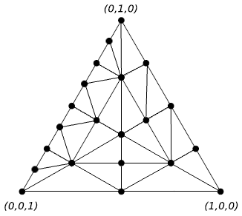
Outer and Inner Division Levels
triangle tesselation
the temporary subdivision of the outer triangle is discarded and the first, second, and third outer tesselation levels are used
gl_TessLevelInner[0] = 8
gl_TessLevelInner[1] = 2
gl_TessLevelInner[2] = 4

Slide 22
Outer and Inner Division Levels
isoline tesselation
n parallel line segments each subdivided into m segments are created where m and n are the first two outer tesselation levels
v
v
u
u
gl_TessLevelInner[0] = 3
gl_TessLevelInner[1] = 1
gl_TessLevelInner[0] = 6
gl_TessLevelInner[1] = 4

Slide 23
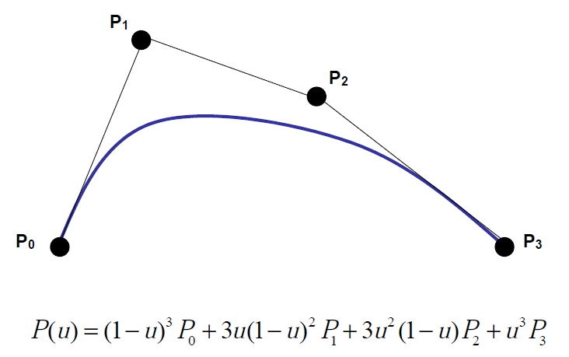
Bezier Curve Example
see textbook p324-327

Slide 24
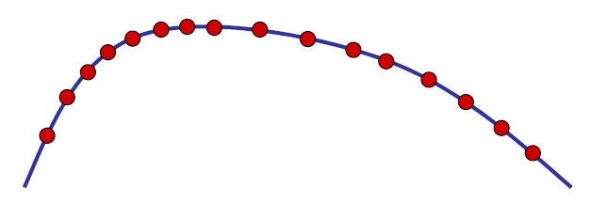
Bezier Curve Example
use the tesselation shader to subdivide the curve into line segments that can be rendered
possible to control the number of vertices based on curvature, screen area, etc.

Slide 25
Bezier Curve Example

Slide 26
Bezier Curve Example
tesselation control shader
#version 400
#extension GL_ARB_tessellation_shader: enable
uniform float uOuter1;
layout(vertices = 4) out; // number of vertices in output patch
void main()
{
gl_out[gl_InvocationID].gl_Position =
gl_in[gl_InvocationID].gl_Position;
gl_TessLevelOuter[0] = 1.;
gl_TessLevelOuter[1] = uOuter1;
}
runs once for each input patch vertex
index of the vertex being processed
by this invocation of the shader
output patch
vertex position
= input patch
vertex position

Slide 27
Bezier Curve Example
tesselation evaluation shader
#version 400
#extension GL_ARB_tessellation_shader: enable
layout(isolines, equal_spacing) in;
void main()
{
vec4 p0 = gl_in[0].gl_Position;
vec4 p1 = gl_in[1].gl_Position;
vec4 p2 = gl_in[2].gl_Position;
vec4 p3 = gl_in[3].gl_Position;
runs once for each output patch vertex
generated by the TPG
assign incoming vertex
positions to separate
variables for readability
number of vertices in the input patch is stored in
gl_PatchVerticesIn

Slide 28
Bezier Curve Example
tesselation evaluation shader (cont)
float u = gl_TessCoord.x;
float b0 = (1. – u) * (1. – u) * (1. – u);
float b1 = 3. * u * (1. – u) * (1. – u);
float b2 = 3. * u * u * (1. – u);
float b3 = u * u * u;
gl_Position = b0 * p0 + b1 * p1 + b2 * p2 + b3 * p3;
}
3-component floating-point vector holding
the (u, v, w) coordinate of the vertex being
processed by the TES

