Slide 1
Geometry Shaders

Slide 2
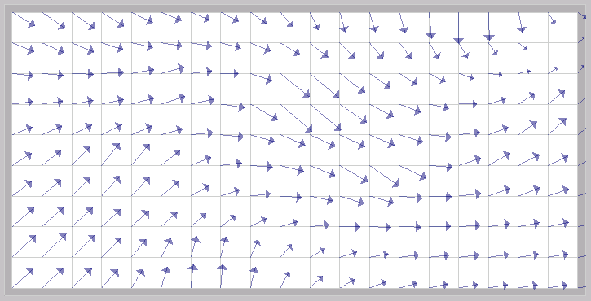
Visualizing Normal Vectors
textbook calls this a “hedgehog plot” but (I think) that this is a misuse of the term
a hedgehog plot is used to visualize vector fields
http://classes.soe.ucsc.edu/cmps161/Winter08/projects/asopenap/index.html

Slide 3
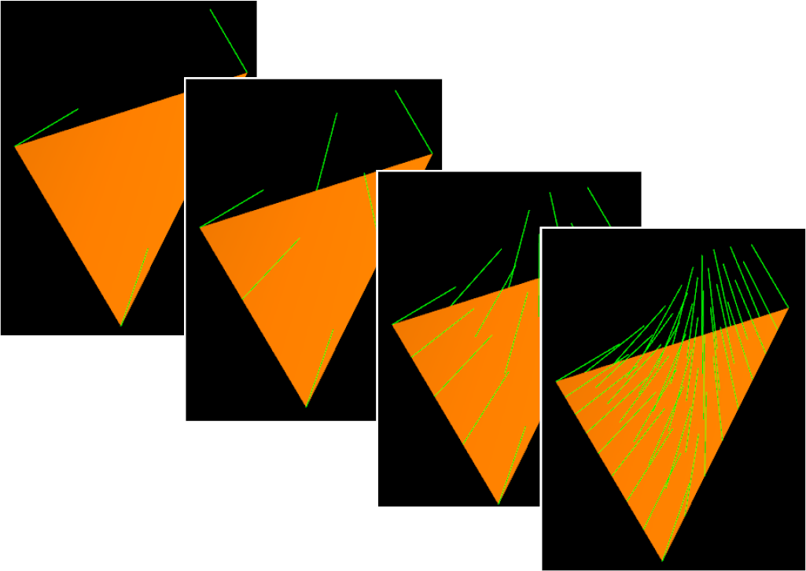
Visualizing Normal Vectors
idea is to render a line in the direction of the normal vector at each vertex
at locations other than a vertex the normals are interpolated
details on p417-420
http://web.engr.oregonstate.edu/~mjb/cs519/Handouts/geometry_shaders.1pp.pdf

Slide 4
Visualizing Normal Vectors
one way to achieve this effect
geometry shader takes as input triangles and outputs lines
object must be rendered twice
once for the triangles (does not require the geometry shader)
once for the lines (requires the geometry shader)
another way
geometry shader takes as input triangles and outputs triangles
lines are drawn as tubes made up of triangles
the input triangle can be passed through as is
object is rendered once

Slide 5
Visualizing Normal Vectors
look at a slightly simpler version of the problem
draw one normal vector per vertex and one normal vector at the centroid of the triangle
vertex shader is strictly passthrough
#version 330
in vec4 aVertex;
in vec3 aNormal;
out vec3 vNormal;
void main(void)
{
gl_Position = aVertex;
vNormal = aNormal;
}

Slide 6
Visualizing Normal Vectors
geometry shader accepts as input a triangle and outputs 4 line strips
also needs to apply the modelview projection transformation

Slide 7
Visualizing Normal Vectors
geometry shader
#version 330
#extension GL_EXT_geometry_shader4 : enable
layout (triangles) in;
layout (line_strip, max_vertices = 8) out;
in vec3 vNormal[3];
uniform uModelViewProjectionMatrix;
uniform float uNormalLength; // length of generated lines

Slide 8
Visualizing Normal Vectors
geometry shader (cont)
void main()
{
// compute the lines for the vertex normals
for (int i = 0; i < gl_VerticesIn; i++)
{
gl_Position = uModelViewProjectionMatrix * gl_PositionIn[i];
EmitVertex();
gl_Position = uModelViewProjectionMatrix *
vec4(gl_PositionIn[i].xyz + vNormal[i] * uNormalLength, 1.0);
EmitVertex();
EndPrimitive();
}

Slide 9
Visualizing Normal Vectors
geometry shader (cont)
// compute centroid
vec4 cen = (gl_PositionIn[0] + gl_PositionIn[1] + gl_PositionIn[2]) / 3;
// compute normal vector to the triangle
vec3 v01 = gl_PositionIn[1].xyz - gl_PositionIn[0].xyz;
vec3 v02 = gl_PositionIn[2].xyz - gl_PositionIn[0].xyz;
vec3 n = normalize(cross(v01, v02));
// compute line for the triangle normal
gl_Position = uModelViewProjectionMatrix * cen;
EmitVertex();
gl_Position = uModelViewProjectionMatrix *
vec4(cen.xyz + n * uNormalLength, 1.0);
EmitVertex();
EndPrimitive();
}

Slide 10
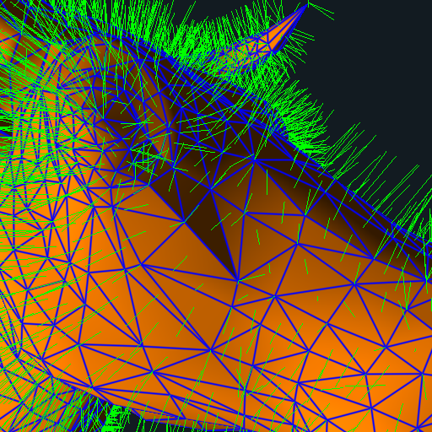
Visualizing Normal Vectors

Slide 11
Visualizing Normal Vectors
textbook version is more sophisticated
generates more normal vectors per triangle using vertex normal interpolation
each normal vector is represented as a line strip of uLength segments
there is a uDroop scalar that controls how much the line strip bends downwards

Slide 12
Visualizing Normal Vectors
vertex shader performs per vertex lighting
vertices are transformed into eye space (no perspective projection to make interpolation easier)
geometry shader computes line strips representing the normal vectors
performs perspective projection
passes through the per vertex lighting
fragment shader passes through the lighting from geometry shader

Slide 13
Visualizing Normal Vectors
geometry shader
#version 330 compatibility
#extension GL_EXT_geometry_shader4: enable
layout( triangles ) in;
layout( line_strip, max_vertices=128 ) out;
uniform mat4 uProjectionMatrix;
uniform int uDetail;
uniform float uDroop;
uniform int uLength;
uniform float uStep;
in vec3 vNormal[3];
in vec4 vColor[3];
out vec4 gColor;

Slide 14
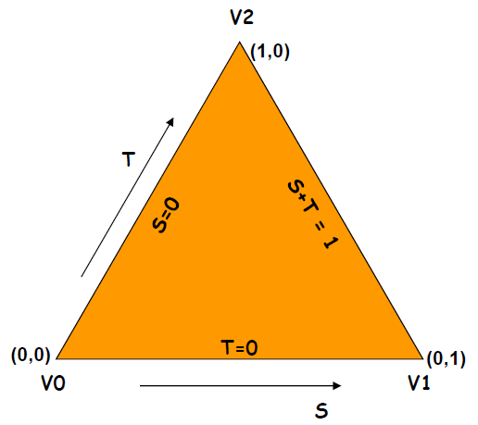
Visualizing Normal Vectors
int ILength;
vec3 Norm[3];
vec3 N0, N01, N02;
vec4 V0, V01, V02;
void ProduceVertices( float s, float t )
{
vec4 v = V0 + s*V01 + t*V02;
vec3 n = normalize( N0 + s*N01 + t*N02 );
for( int i = 0; i <= uLength; i++ )
{
gl_Position = uProjectionMatrix * v;
gColor = vColor[0];
EmitVertex( );
v.xyz += uStep * n;
v.y -= uDroop * float(i*i);
}
EndPrimitive();
}

Slide 15
Visualizing Normal Vectors
void main( )
{
V0 = gl_PositionIn[0];
V01 = ( gl_PositionIn[1] - gl_PositionIn[0] );
V02 = ( gl_PositionIn[2] - gl_PositionIn[0] );
Norm[0] = vNormal[0];
Norm[1] = vNormal[1];
Norm[2] = vNormal[2];
if( dot( Norm[0], Norm[1] ) < 0. )
Norm[1] = -Norm[1];
if( dot( Norm[0], Norm[2] ) < 0. )
Norm[2] = -Norm[2];
N0 = normalize( Norm[0] );
N01 = normalize( Norm[1] - Norm[0] );
N02 = normalize( Norm[2] - Norm[0] );

Slide 16
Visualizing Normal Vectors
int numLayers = 1 << uDetail;
float dt = 1. / float( numLayers );
float t = 1.;
for( int it = 0; it <= numLayers; it++ )
{
float smax = 1. - t;
int nums = it + 1;
float ds = smax / float( nums - 1 );
float s = 0.;
for( int is = 0; is < nums; is++ )
{
ProduceVertices( s, t );
s += ds;
}
t -= dt;
}
}

Slide 17
Visualizing Normal Vectors

Slide 18
Visualizing Normal Vectors
uDetail = 0

Slide 19
Visualizing Normal Vectors
uDetail = 1

Slide 20
Visualizing Normal Vectors
uDetail = 2

Slide 21
Visualizing Normal Vectors
uDetail = 3

Slide 22
Visualizing Normal Vectors
uDetail = 4
number of vertices exceeds
max_vertices causing primitives
to be not output

Slide 23
Visualizing Normal Vectors
uDetail = 1
uDroop = 0.02
uLength = 6
uStep = 0.1

Slide 24
Explosion
http://web.engr.oregonstate.edu/~mjb/cs519/Handouts/geometry_shaders.1pp.pdf

Slide 25
Explosion
vertex shader simply passes vertices through to geometry shader
does not perform perspective projection because point physics are defined in object or world coordinates
geometry shader computes points, applies physics model, and computes lighting intensity
fragment shader computes fragment color

Slide 26
Explosion
geometry shader
#version 150
#extension GL_EXT_geometry_shader4: enable
#extension GL_EXT_gpu_shader4: enable
layout( triangles ) in;
layout( points, max_vertices=200 ) out;
uniform mat4 uProjectionMatrix;
uniform int uLevel;
uniform float uGravity;
uniform float uTime;
uniform float uVelScale;
out float gLightIntensity;

Slide 27
Explosion
const vec3 LIGHTPOS = vec3( 0., 0., 10. );
vec3 V0, V01, V02;
vec3 CG;
vec3 Normal;
void ProduceVertex( float s, float t )
{
vec3 v = V0 + s*V01 + t*V02;
gLightIntensity = abs( dot( normalize(LIGHTPOS - v), Normal ) );
vec3 vel = uVelScale * ( v - CG );
v = v + vel * uTime + 0.5 * vec3(0.,uGravity,0.) * uTime * uTime;
gl_Position = uProjectionMatrix * vec4( v, 1. );
EmitVertex( );
}

Slide 28
Explosion
int numLayers = 1 << uLevel;
float dt = 1. / float( numLayers );
float t = 1.;
for( int it = 0; it <= numLayers; it++ )
{
float smax = 1. - t;
int nums = it + 1;
float ds = smax / float( nums - 1 );
float s = 0.;
for( int is = 0; is < nums; is++ )
{
ProduceVertex( s, t );
s += ds;
}
t -= dt;
}
}

Slide 29
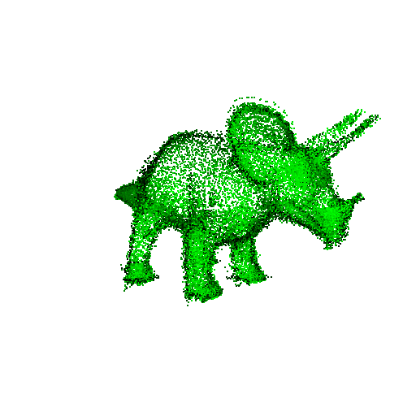
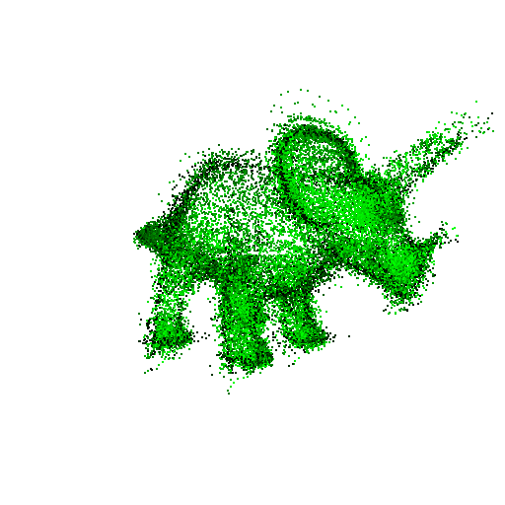
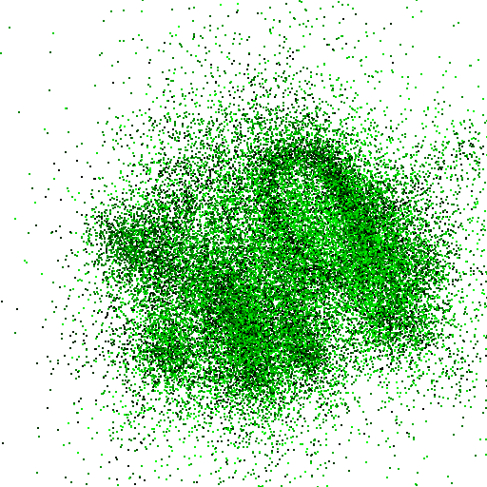
Explosions

Slide 30
Silhouettes
http://web.engr.oregonstate.edu/~mjb/cs519/Handouts/geometry_shaders.1pp.pdf

Slide 31
http://web.engr.oregonstate.edu/~mjb/cs519/Handouts/geometry_shaders.1pp.pdf

Slide 32
http://web.engr.oregonstate.edu/~mjb/cs519/Handouts/geometry_shaders.1pp.pdf

Slide 33
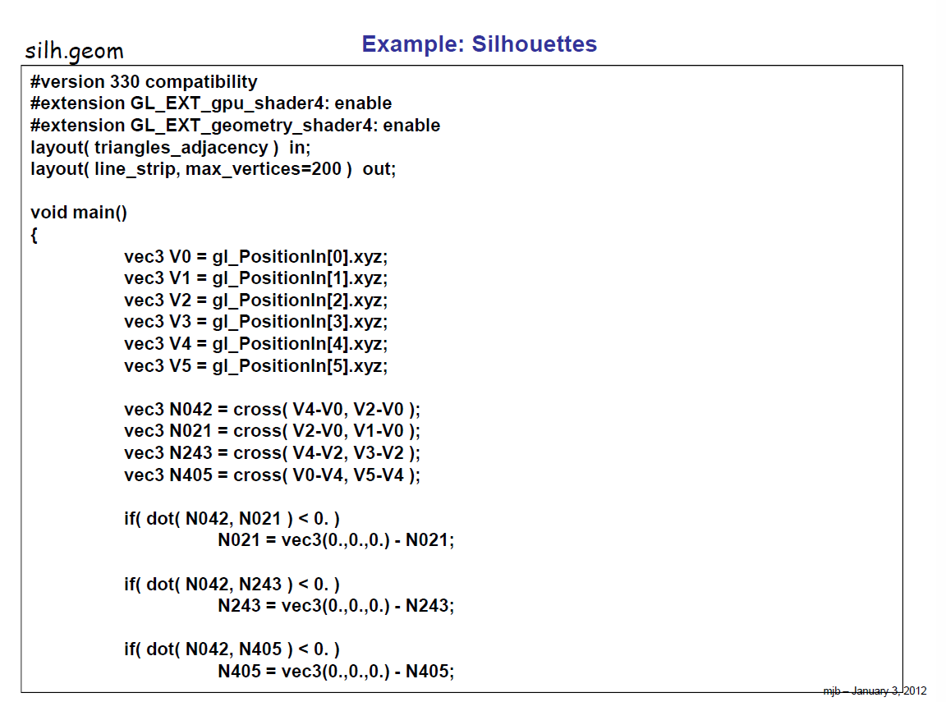
http://web.engr.oregonstate.edu/~mjb/cs519/Handouts/geometry_shaders.1pp.pdf

Slide 34
http://web.engr.oregonstate.edu/~mjb/cs519/Handouts/geometry_shaders.1pp.pdf

Slide 35
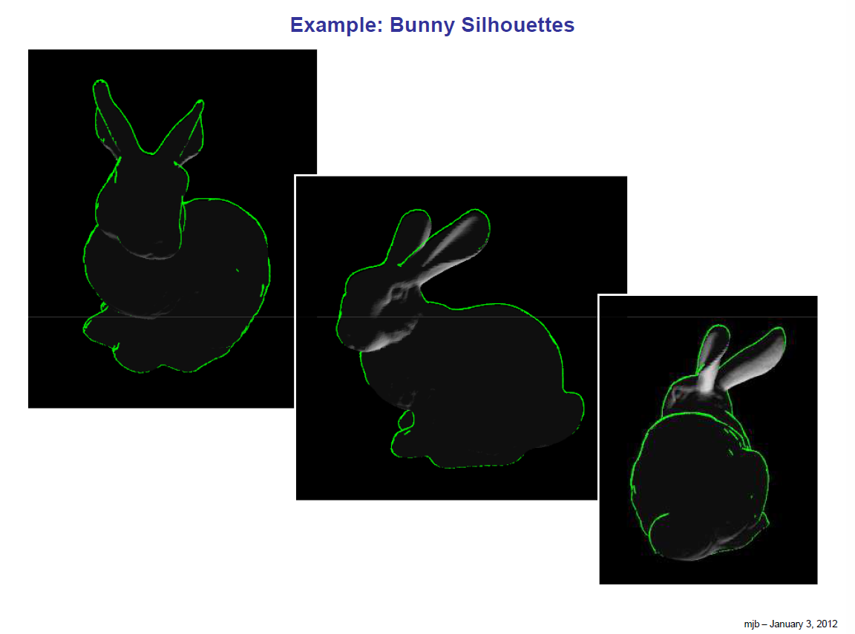
http://web.engr.oregonstate.edu/~mjb/cs519/Handouts/geometry_shaders.1pp.pdf

