Slide 1
Geometry Shaders

Slide 2
Graphics Pipeline
per-vertex attributes
out / in variables
uniform
variables
out / in variables
out / in variables
out / in variables

Slide 3
Geometry Shader
executes once per primitive
cannot take as input more than one primitive type
has access to all vertices of the primitive
has access to values output by the previous stage (tesselation evaluation shader, or vertex shader if no tesselation shader used) for each vertex of the primitive
input variables are typically arrays
can output zero, one, or more primitives
not necessarily the same kind of primitive as was input
cannot output more than one primitive type
not designed for large amplification of geometry

Slide 4
Geometry Shader

Slide 5
New Adjacency Primitives

Slide 6
New Adjacency Primitives
lines with adjacency
4N vertices are given (where N is the number of segments to draw)
for each set of four vertices a line segment is drawn between vertices 1 and 2

Slide 7
New Adjacency Primitives
line strip with adjacency
N+3 vertices are given (where N is the number of segments to draw)
a line segment is drawn between vertices 1 and 2, 2 and 3, and so on, to N+1 and N+2

Slide 8
New Adjacency Primitives
triangle with adjacency
6N vertices are given (where N is the number of triangles to draw)
for each triangle, vertices 0, 2, and 4 define the triangle

Slide 9
New Adjacency Primitives
triangle strip with adjacency
4+2N vertices are given (where N is the number of triangles to draw)
even numbered vertices define the triangle

Slide 10
layout Qualifier
shader takes as input a particular primitive type
shader produces a particular primitive type
OpenGL implementations restrict the maximum number of vertices in the output
the input primitive type, output primitive type, and maximum number of vertices output must be specified using a layout qualifier

Slide 11
layout Qualifier
for the input primitive type you use a statement of the form layout( topology ) in;
where topology must be one of points lines lines_adjacency triangles triangles_adjacency
you can only change the text in red

Slide 12
layout Qualifier
for the output primitive type you use a statement of the form layout( topology, max_vertices=num) out;
where topology must be one of points line_strip triangle_strip
you can only change the text in red

Slide 13
Number of Vertices
the type of input topology tells you the number of vertices input to the geometry shader
number of vertices is also available to you in the built-in variable gl_VerticesIn
Input Topology Type | Number of Vertices
points | 1
lines | 2
lines_adjacency | 4
triangles | 3
triangles_adjacency | 6

Slide 14
Built-in Functions
there are two important GLSL functions for geometry shaders
EmitVertex()
emit the current values of output variables to the current output primitive
EndPrimitive()
completes the current output primitive and starts a new one
there is no BeginPrimitive() because a new primitive is deemed to begin at the start of the geometry shader (and every time EndPrimitive() is invoked)

Slide 15
Pass-through Shader
a simple geometry shader that does nothing but pass information from the vertex shader through to the fragment shader
vertex shader performs per vertex lighting
#version 330
#extension GL_EXT_geometry_shader4: enable
layout (triangles) in;
layout (triangle_strip, max_vertices = 3) out;
in vec4 vColor[3];
out vec4 gColor;

Slide 16
Pass-through Shader
#version 330
#extension GL_EXT_geometry_shader4: enable
layout (triangles) in;
layout (triangle_strip, max_vertices = 3) out;
in vec4 vColor[3];
out vec4 gColor;
you need to enable this extension to use some of the built-in variables
input primitives are triangles → 3 per vertex colors as input
output one color per vertex

Slide 17
Pass-through Shader
void main(void)
{
for (int i = 0; i < gl_VerticesIn; i++)
{
gl_Position = gl_PositionIn[i];
gColor = vColor[i];
EmitVertex();
}
EndPrimitive();
}
for each vertex in the primitive
set the position and color of the
vertex and emit the vertex

Slide 18
Bezier Curve Shader
textbook p301-303
a Bezier curve is a smooth curve defined using n points
the Bezier curve defined using 4 points has the parametric form
the curve starts at P₀ heading towards the direction of P₁ and finishes at P₃ coming from the direction of P₂
the curve usually does not pass through P₁ and P₂
Bernstein polynomials

Slide 19
Bezier Curve Shader

Slide 20
Bezier Curve Shader
the shader takes as input
4 vertices as a line adjacency primitive
a uniform variable that defines the number of line segments used to represent the Bezier curve
it outputs the curve as a line strip with n line segments
parametric form makes this very easy to do

Slide 21
Bezier Curve Shader
n = 8
n = 4

Slide 22
Bezier Curve Shader
#version 330
#extension GL_EXT_geometry_shader4: enable
uniform int uNum;
layout (lines_adjacency) in;
layout (line_strip, max_vertices = 1024) out;

Slide 23
Bezier Curve Shader
void main( )
{
float dt = 1. / float(uNum);
float t = 0.;
for( int i = 0; i <= uNum; i++ )
{
float omt = 1. - t;
float omt2 = omt * omt;
float omt3 = omt * omt2;
float t2 = t * t;
float t3 = t * t2;
vec4 xyzw = omt3 * gl_PositionIn[0].xyzw +
3. * t * omt2 * gl_PositionIn[1].xyzw +
3. * t2 * omt * gl_PositionIn[2].xyzw +
t3 * gl_PositionIn[3].xyzw;
gl_Position = xyzw;
EmitVertex( );
t += dt;
}
}

Slide 24
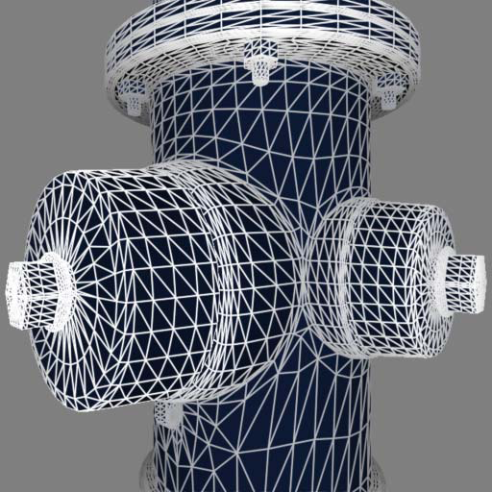
Solid Wireframe
the standard method of rendering an object as a solid wireframe is described in Chapter 6 of the “OpenGL Programming Guide” (red book)
render the object twice, first as a solid using a small polygon offset then as an unlit wireframe
polygon offset needed to avoid “z fighting”
“Solid Wireframe”, NVIDIA Whitepaper, Feb 2007

Slide 25
Solid Wireframe
a one-pass algorithm is possible using the geometry shader
this geometry shader works in screen coordinates
computes the distance between a vertex and its opposite edge on a triangle
outputs the three distances as a vector called the edge-distance vector
the rasterizer interpolates the edge-distance vectors to generate the correct distances (in pixels) between a fragment and each edge

Slide 26
Solid Wireframe

Slide 27
Solid Wireframe
edge-distance vector for A is (ha, 0, 0)

Slide 28
Solid Wireframe
the fragment shader takes as input an edge-distance vector
finds the minimum of the edge distances
if the distance is less than the line width the shader mixes the fragment color with the line color
done with a smoothstep to reduce aliasing
fragment shader also computes lighting (but this could also be done in the vertex shader)

Slide 29
Solid Wireframe
vertex shader just performs the usual transformations
#version 330
in vec4 aVertex;
in vec4 aNormal;
out vec4 vPosition; // in eye coordinates
out vec4 vNormal; // in eye coordinates
uniform mat4 uModelViewProjectionMatrix;
uniform mat4 uModelViewMatrix;
uniform mat4 uNormalMatrix;
void main(void)
{
vPosition = uModelViewMatrix * aVertex;
vNormal = normalize(uNormalMatrix * aNormal);
gl_Position = uModelViewProjectionMatrix * aVertex;
}

Slide 30
Solid Wireframe
geometry shader computes edge-distance vector
#version 330
#extension GL_EXT_geometry_shader4: enable
layout( triangles ) in;
layout( triangle_strip, max_vertices = 3 ) out;
out vec4 gNormal; // in eye coordinates
out vec4 gPosition; // in eye coordinates
noperspective out vec3 gEdgeDistance;
in vec4 vNormal[];
in vec4 vPosition[];
// viewport dimensions; should be uniforms supplied by application
const int viewWidth = 512;
const int viewHeight = 512;
noperspective instructs the rasterizer
to perform bilinear interpolation without
accounting for perspective projection

Slide 31
Solid Wireframe
void main()
{
// we need the window coordinates of the incoming vertex
float sx = viewWidth / 2.;
float sy = viewHeight / 2.;
mat3 viewportMatrix = mat3(sx, 0., 0., 0., sy, 0., sx, sy, 1.);
// transform each vertex into viewport space
vec2 p0 = vec2(viewportMatrix *
vec3(gl_PositionIn[0].xy / gl_PositionIn[0].w, 1.));
vec2 p1 = vec2(viewportMatrix *
vec3(gl_PositionIn[1].xy / gl_PositionIn[1].w, 1.));
vec2 p2 = vec2(viewportMatrix *
vec3(gl_PositionIn[2].xy / gl_PositionIn[2].w, 1.));

Slide 32
Solid Wireframe
// find the altitudes (ha, hb and hc)
float a = length(p1 - p2);
float b = length(p2 - p0);
float c = length(p1 - p0);
float alpha = acos( (b*b + c*c - a*a) / (2.0*b*c) );
float beta = acos( (a*a + c*c - b*b) / (2.0*a*c) );
float ha = abs( c * sin( beta ) );
float hb = abs( c * sin( alpha ) );
float hc = abs( b * sin( alpha ) );

Slide 33
Solid Wireframe
// send the triangle along with the edge distances
gEdgeDistance = vec3( ha, 0, 0 );
gNormal = vNormal[0];
gPosition = vPosition[0];
gl_Position = gl_PositionIn[0];
EmitVertex();
gEdgeDistance = vec3( 0, hb, 0 );
gNormal = vNormal[1];
gPosition = vPosition[1];
gl_Position = gl_PositionIn[1];
EmitVertex();

Slide 34
Solid Wireframe
gEdgeDistance = vec3( 0, 0, hc );
gNormal = vNormal[2];
gPosition = vPosition[2];
gl_Position = gl_PositionIn[2];
EmitVertex();
EndPrimitive();
}

Slide 35
Solid Wireframe
fragment shader uses the interpolated depth vector to determine if the fragment should be shaded as a line
#version 330
in vec4 gNormal;
in vec4 gPosition;
noperspective in vec3 gEdgeDistance;
out vec4 fFragColor;
// constants; would normally be uniforms
const float lineWidth = 1;
const vec3 lineColor = vec3(0., 0., 1.);

Slide 36
Solid Wireframe
vec3 ADSLightModel(in vec3 myNormal, in vec3 myPosition) { // not shown }
void main(void)
{
vec3 color = ADSLightModel(normalize(gNormal.xyz), gPosition.xyz);
// distance to nearest edge
float d = min(gEdgeDistance.x, gEdgeDistance.y);
d = min(d, gEdgeDistance.z);
// mix line color and lighting color
float f = smoothstep(lineWidth - 1, lineWidth + 1, d);
fFragColor.rgb = mix(lineColor, color, f);
fFragColor.a = 1.;
}

Slide 37
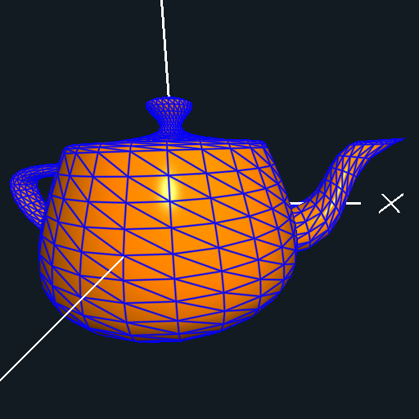
Solid Wireframe

Slide 38
Solid Wireframe
there is a potential problem when a triangle is visible and one or two of its vertices are behind the eye
situation is uncommon but might occur in some applications
solution is to have the geometry shader provide the edge directions to the fragment shader and allow the fragment shader to compute the edge distances
see link below for details
http://developer.download.nvidia.com/whitepapers/2007/SDK10/SolidWireframe.pdf

