Slide 1
Global Illumination (cont)

Slide 2
Shadow Mapping
shadow mapping suffers from self-shadow aliasing or “surface acne”
polygon is incorrectly considered to shadow itself
occurs because of
limited precision in the z-buffer
depth values from two different perspective projections are being compared

Slide 3
Shadow Mapping

Slide 4
Shadow Mapping
self-shadow aliasing can be reduced by subtracting a small amount from the computed depth distance for a fragment
see Section 9.1.4 of Real-Time Rendering, 3rd Edition

Slide 5
Shadow Mapping
unfortunately, biasing the depth values can cause the “Peter Panning” problem
object that should be sitting on a surface appear to float slightly above the surface

Slide 6
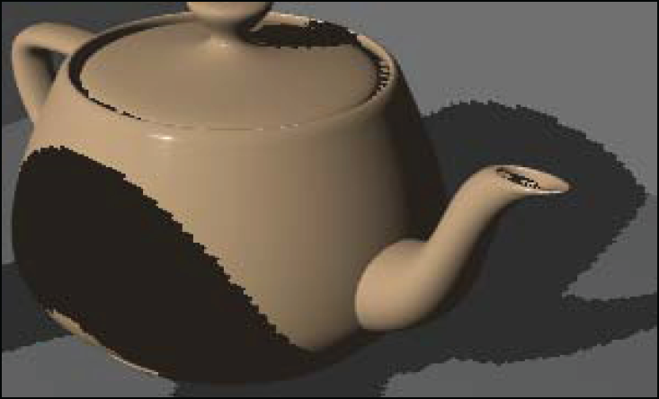
Shadow Mapping
the edges of shadow mapped shadows often have severe aliasing because of the finite size of the shadow map

Slide 7
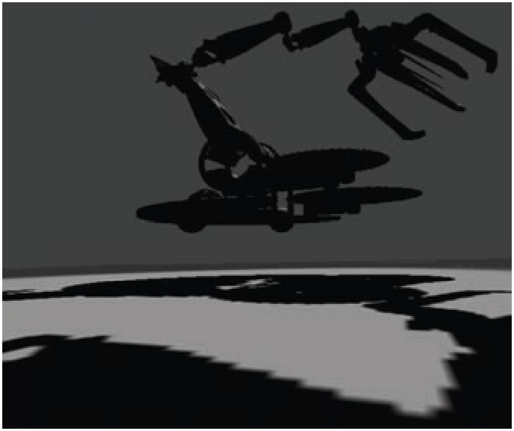
Shadow Mapping
shadow mapping also suffers from perspective aliasing where the shadow looks blocky on points close to the eye but far from the light

Slide 8
Shadow Mapping
percentage-closer filtering (PCF) is a common technique for softening the edges of shadow mapped shadows
tries to compute the percentage of the surface that is closer to the light (hence, not in shadow)
instead of comparing the fragment depth value to one texel in the shadow map, the four nearest texels are used
the results are bi-linearly interpolated to determine how much light is visible to the fragment
has hardware support in OpenGL
in general, the number of texels sampled should vary with the distance between the occluder and the receiver

Slide 9
Shadow Mapping

Slide 10
Shadow Mapping

Slide 11
Shadow Mapping
the Wikipedia page for shadow mapping is quite good
http://en.wikipedia.org/wiki/Shadow_mapping

Slide 12
Refraction

Slide 13
Refraction
we have already talked briefly about refraction
Day 07: Fresnel equations
Day 10: Cube mapping

Slide 14
Fresnel Reflectance and Refraction
ideal reflection
direction
light direction
ideal refraction
direction
from Real-Time Rendering, 3rd Edition

Slide 15
Fresnel Reflectance and Refraction
indices of
refraction
index of refraction = (speed of light in vacuum) / (speed of light in material)
from Real-Time Rendering, 3rd Edition

Slide 16
Fresnel Reflectance and Refraction
Fresnel reflectance (a function of the angle of incidence θ_{i})
from Real-Time Rendering, 3rd Edition

Slide 17
Fresnel Reflectance and Refraction
recall that the Fresnel reflectance is somewhat complicated to compute
the Schlick approximation is easier to compute
depends only on R_{F} (0°)
where n is the index of refraction of the object material

Slide 18
Refraction
the refraction direction can be computed using the glsl function refract
only the first refraction can be easily calculated

Slide 19
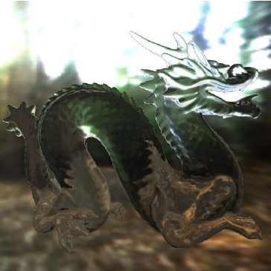
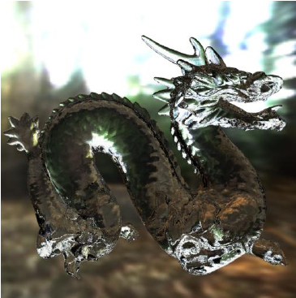
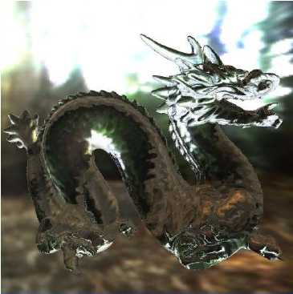
Refraction
recently, a technique for modeling refraction into and out of a transparent object has been described
http://www.inf.ufrgs.br/~oliveira/pubs_files/Oliveira_Brauwers_I3D_2007_w_copyright_notice.pdf
single interface refraction
ray tracing
two interface refraction

Slide 20
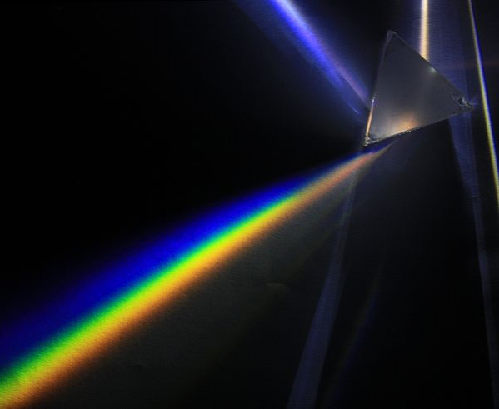
Chromatic Dispersion
the index of refraction for most materials is dependent on the wavelength of the incident light
D-Kuru/Wikimedia Commons

Slide 21
Chromatic Dispersion
leads to chromatic aberration in camera lenses

Slide 22
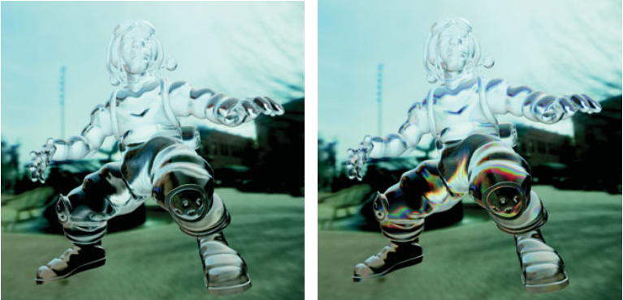
Chromatic Dispersion
chromatic dispersion can be simulated by using slightly different indices of refraction for the R, G, and B color components

Slide 23
Diffraction

Slide 24
Diffraction
in computer graphics it is usually assumed that small-scale surface detail is unimportant
thus the fact that light behaves like a wave can be ignored
some surfaces have regular small-scale detail with spacing on the order of the wavelengths of visible light
such surfaces can reflect light in such a way that the light splits into its separate wavelength components

Slide 25
Diffraction
GPU Gems, Chapter 11, Figure 8.2

Slide 26
Diffraction

Slide 27
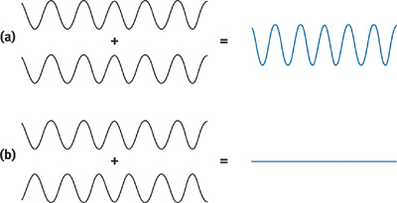
Diffraction
adding waves leads to constructive and destructive interference
depends on wavelength and phase of waves
GPU Gems, Chapter 11, Figure 8.3

Slide 28
Diffraction
we are interested in the case where waves interfere constructively
waves from adjacent bands will interfere constructively when the difference in distance from the source to the eye is equal to an integer number of wavelengths

Slide 29
Diffraction
GPU Gems, Chapter 11, Figure 8.4

Slide 30
Diffraction
by looping from 1 to n we can compute the n wavelengths that interfere constructively at a point
converting the wavelengths into RGB values and summing them produces the diffraction color
see the lambda2rgb function in the handout

Slide 31
Diffraction
GPU Gems, Chapter 11, Figure 8.6

Slide 32
Diffraction
GPU Gems, Chapter 11, Figure 8.7

